Slide 1
Gokhale Education Society’s,
B. Y. K. College [Sinnar] of Commerce, Nashik
Department of Marathi
Welcomes
NAAC Peer TEAM
CHAIRPERSON: DR. DHARMINDER KUMAR
MEMBER CO-ORDINATOR: Dr. ramu nagarajapillai
Member: Dr. R kittappa vaithiyanathan

Slide 2
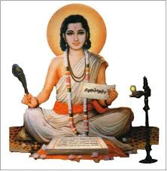
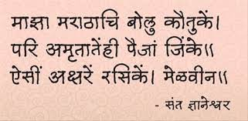

Slide 3
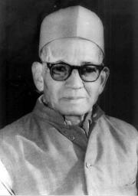
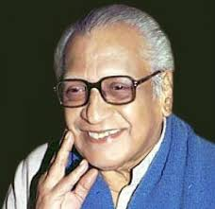
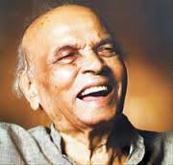
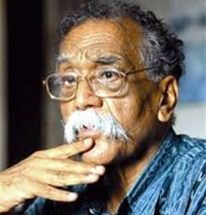
विष्णू सखाराम खांडेकर वि. वा. शिरवाडकर गोविंद विनायक करंदीकर भालचंद्र वनाजी नेमाडे
Awardees of Dnyanpeeth

Slide 4
OBJECTIVES
To develop language skill and capabilities among the student
To imbibe Significance of Marathi language in Personality Development and Professional Development
To develop abilities to think creatively and communicate effectively among the students
To create an interest in Marathi Literature

Slide 5
FACULTY
Mrs. Anuradha Manohar More
Assistant Professor
Qualification : M.A. B. Ed, M. Phil, SET
Experience : 16 years

Slide 6
Departmental Workload
Sr. No. | Class | Division | Workload
1 | F.Y.B. Com | B | 04
2 | F.Y.B. Com | C | 04
3 | F.Y.B. Com | D | 04
4 | F.Y.B. Com | E | 04
5 | F.Y.B. Com | F | 04
 |  |  | Total – 20

Slide 7
SUBJECTS TAUGHT
F.Y.B.Com
Semester I :Bhasha, Sahitya Ani Kaushalya Vikas
Semester II : Bhasha Ani Kaushalya Vikas
Student Strength : 400

Slide 8
TEACHING METHODS
1.Lectures 2.Group Discussion 3.Interactive
4. Guest Lecture

Slide 9
Evaluation
Examination as per Savitribai Phule Pune University Rules.
Assignment and Internal Test Examination.

Slide 10
Orientation & Faculty Development Programme
Orientation Programme: UGC-HRDC Sant Gadge Baba Amravati University (16/07/2019 to 05/08/2019)
Faculty Development Programme :
One week FDP (Online) on ‘Open Source Tools for Research’ at Ramanujan College, University of Delhi.
Ten days FDP (Online) on ‘Effective Ways To Develop E- Content For Teaching- Learning’ at MVP’s K.T.H.M. College and UGC-HRDC Pune University.
Three Days FDP (Online) on ‘Awareness of E-Content Development’ at Gokhale Education Society, Nashik.
Completed Seven days Short Term Course in Marathi at Goa university during the 22 Feb 2024 to 28 Feb 2024.

Slide 11
ACHIVEMENTS OF FACULTY
Published 6 research Papers in UGC care listed and Peer Reived research journal.
Attended International, National and State Level Conferences and Seminars.
(International – 02, National – 04 & State - 03)
Recipient Prizes for script writing for Skits, One Act Play & Street Play.

Slide 12
Other cotribution in the College
Working as a Cultural Officer of the college
In-charge of Vidyarthini Manch
Member of editorial board of college Magazine ‘Vyavahar’
Member of editorial board of Special issue ‘Guruvandana’
Extension activities done by Staff
Life Member of Sarvajanik Vachanalay, Nashik

Slide 13
SWOC Analysis
Strength | Weakness | Opportunities | Challenges
Experienced and qualified Staff. Positive response for students enrolment. Positive response of students achievement. | Restricted to F.Y.B.Com therefore students from higher classes(S.Y, T.Y) can not opt for it | To orient Non –Marathi students to learn Marathi language | To orient the students to develop language skills. To develop interdisciplinary approach between Commerce education and language Skills.

Slide 14
VISITORS TO THE DEPARTMENT
Name | Organisation
Mr. Swanand Bedarkar | Editor – Shbdamallhar Publication, Anchor, Orator
Mr. Ravindra Malunjkar | Poet, Anchor
Mrs. Alaka Kulkarni | Poetess
Mrs. Tanvi Amit | Poetess, Anchor
Dr. Pratibha Bishwas | Associate Professor and Poetess
Dr. Veena Mali | Radio Jokey & Writer
Mr. Sachin Chandratre | Language Trainer
Mrs. Bhavana Kulkarni | Poetess, Anchor
Mr. Sachin Jadhav | Anchor, Theatre Artist, Youtuber

Slide 15
Result Analysis for the year 2018 to 2023
Sr.No. | Year | 0-39 | 40-49 | 50-59 | 60-69- | 70& Above | Total | Result | Percentage
1. | 2018-2019 | 76 | 187 | 94 | 56 | 27 | 440 | 364 | 83.72 %
2. | 2019-2020 | 58 | 62 | 126 | 124 | 71 | 441 | 383 | 86.84 %
3. | 2020-2021 | 8 | 46 | 31 | 76 | 145 | 306 | 298 | 97.38 %
4. | 2021-2022 | 20 | 51 | 40 | 97 | 135 | 343 | 323 | 94.16 %
5. | 2022-2023 | 40 | 111 | 82 | 87 | 85 | 405 | 365 | 90.12 %

Slide 16
Result Analysis for the year 2018 to 2023

Slide 17
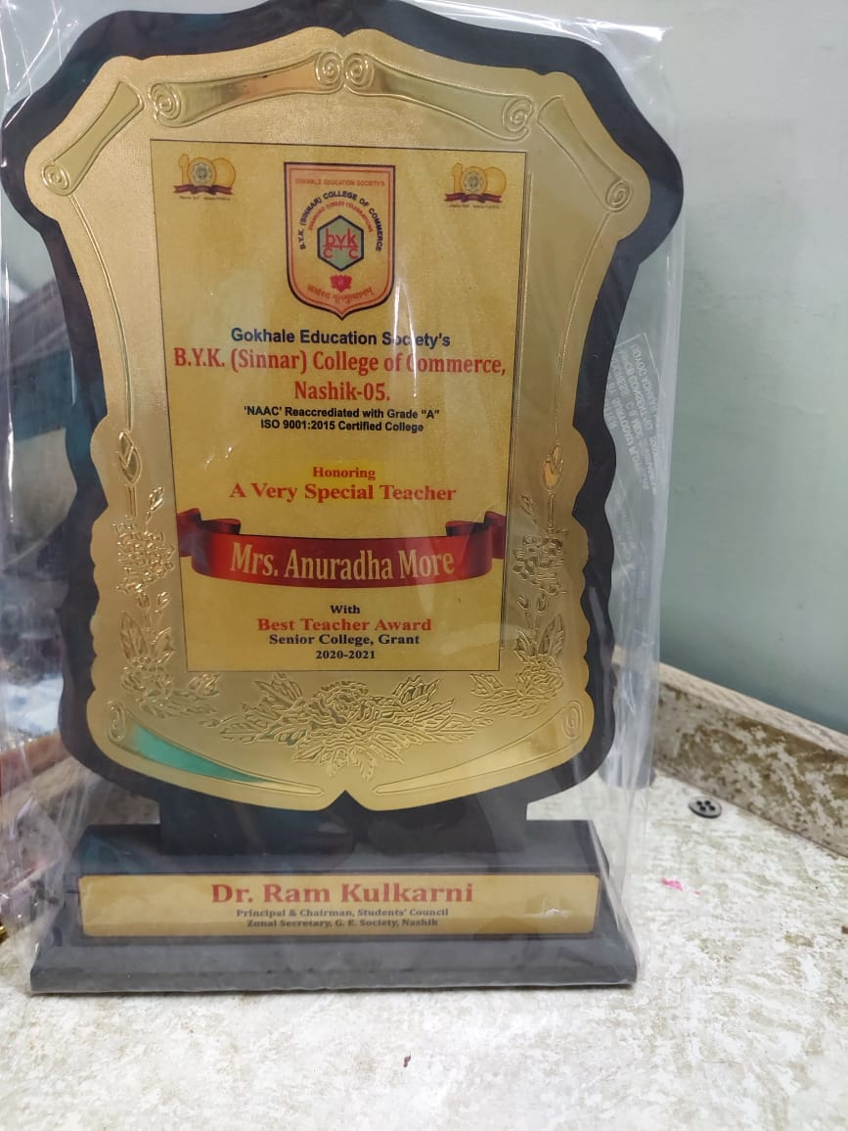
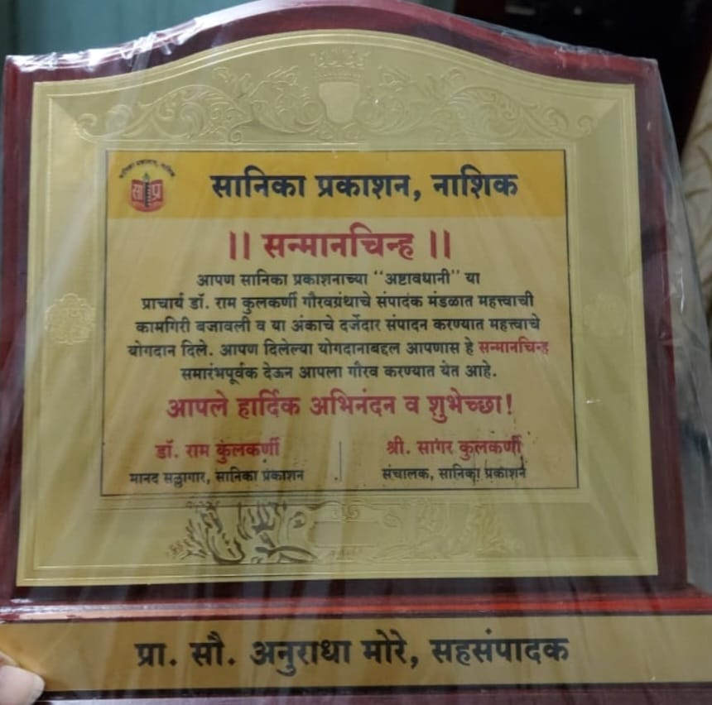
ACHIVEMENTS OF FACULTY
Mrs. Anuradha Manohar More Awarded ‘Best Teacher Award’ by B. Y. K. College of Commerce, Nashik.

Slide 18
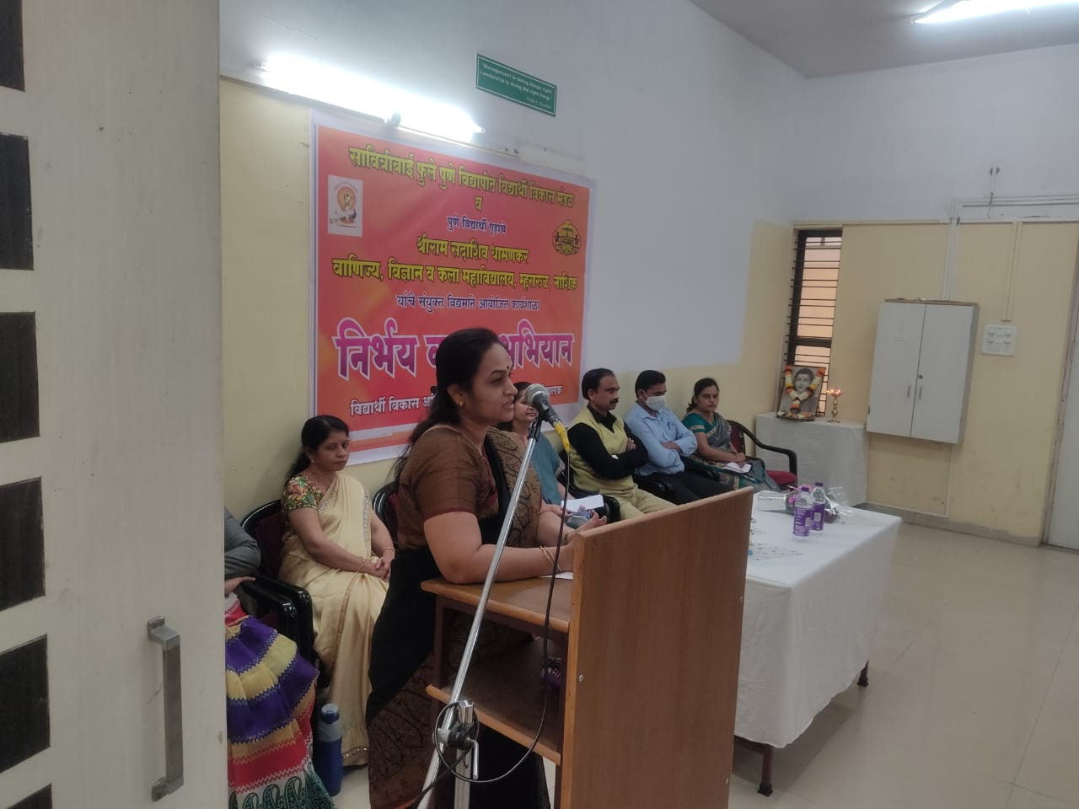
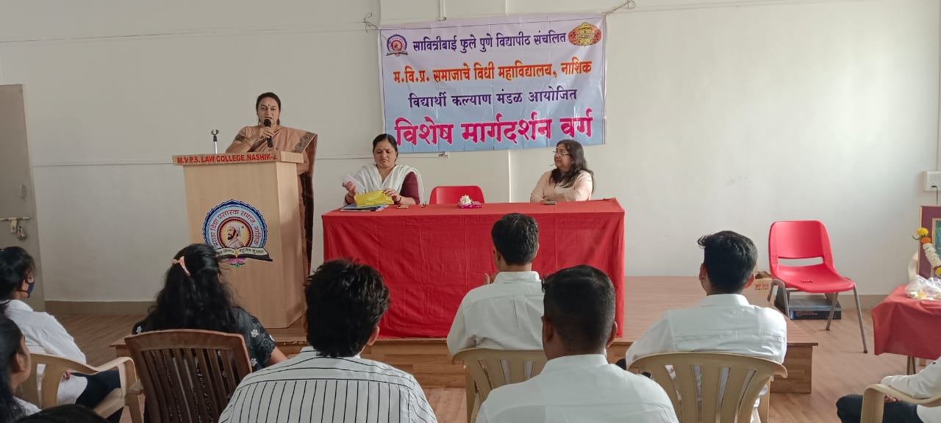
Guided as a resource person at Shriram Sadashiv Dhamankar
Commerce, Science and Arts College, Nashik
on the topic of ‘Women Empowerment’.
Guided as a resource person at MVP’s Law College, Nashik
on the topic of ‘Writing Skill’.

Slide 19
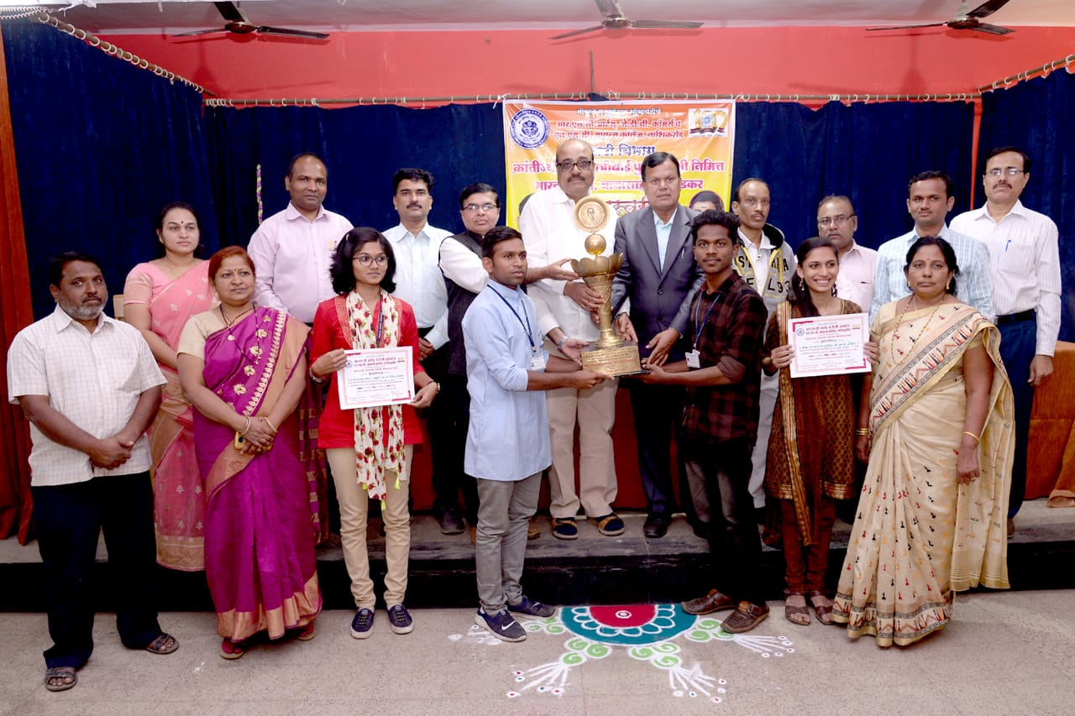
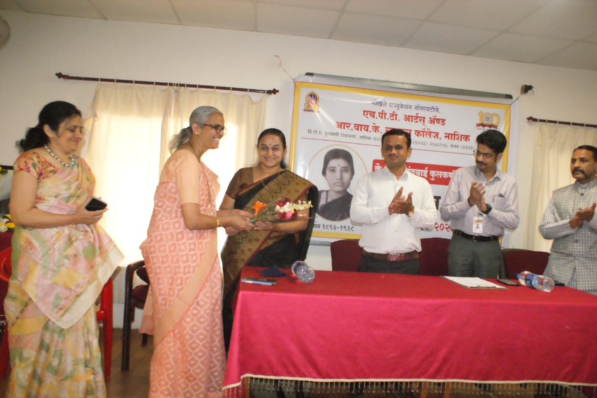
Worked as a Judge of Poetry Reading Competition at R. N. C. Arts, J. D. B. Commerce and N.S.C. Science College, Nashikroad.
Worked as a Judge of Elocution Competition at H.P.T. Arts and R.Y.K. Science College, Nashikroad.

Slide 20
ACTIVITIES OF THE DEPARTMENT
‘Marathi Bhasha Sanwardhan Pandhaerwada’ Programme.(Every year Jan 1st to Jan 14th )
‘Marathi Raj Bhasha Din’ (every year 27th February)
‘Sarjanshil Lekhan Karyashala’ (Creative Writing Workshop)
‘Bhashantar Karyashala’ (Transletion Workshop)
Visit to Language Laboratory
Visit to Press / Media

Slide 21
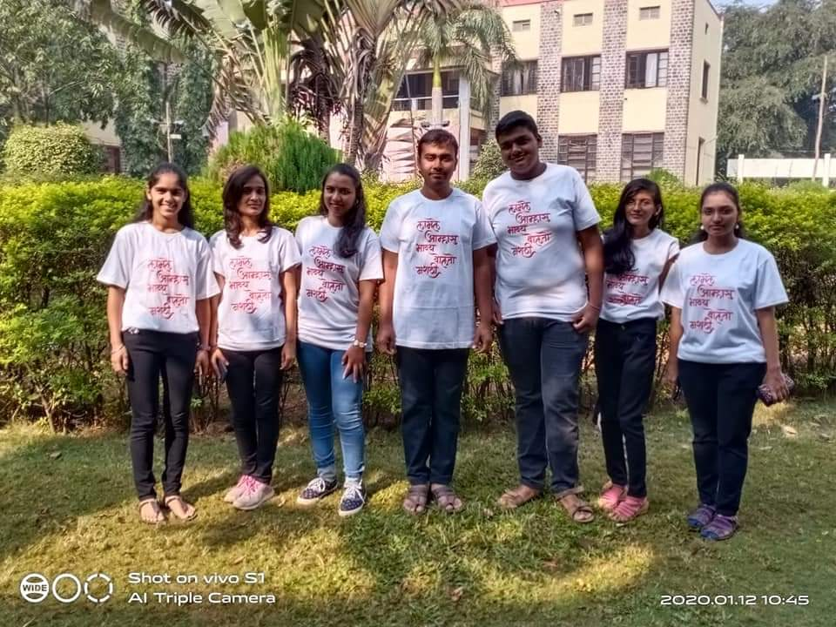
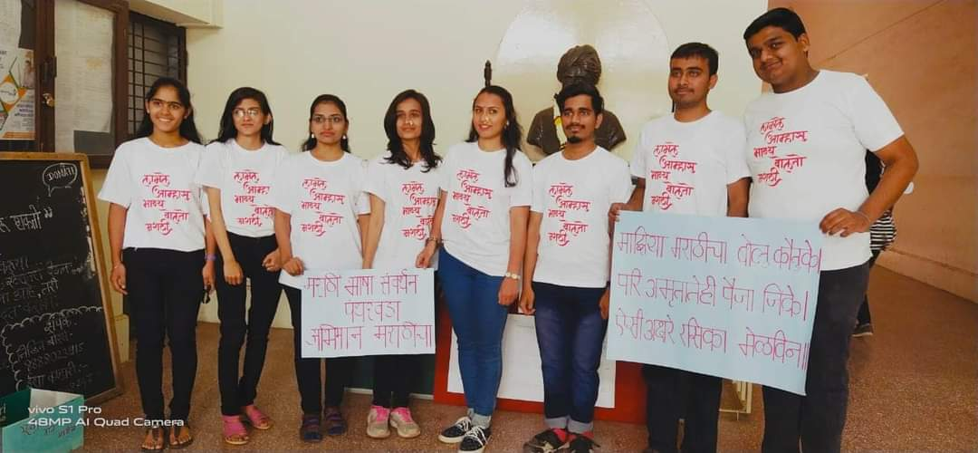
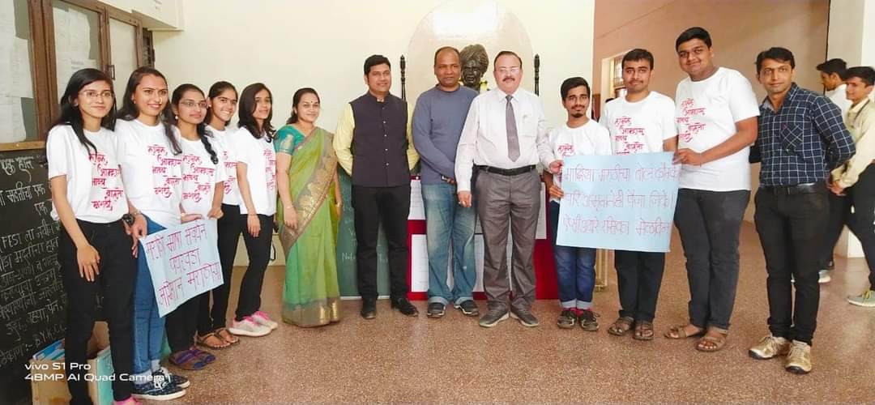
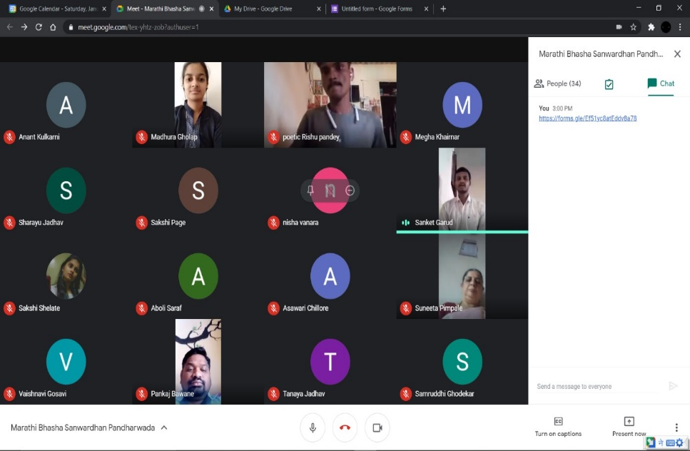
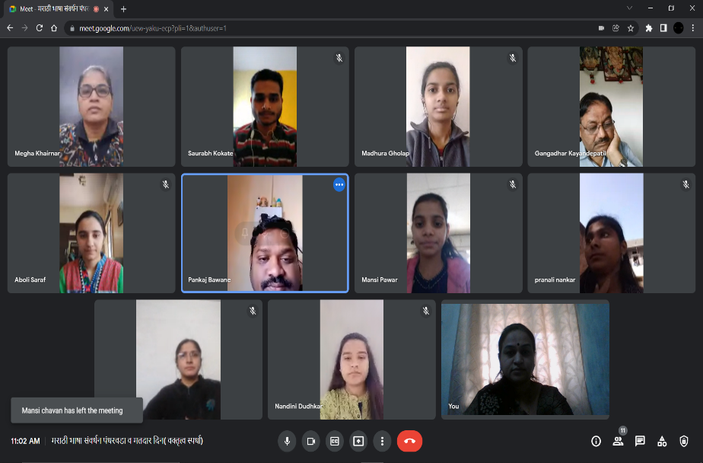
Departmental Activities
Marathi Bhasha Sanwardhan Pandharwada:

Slide 22
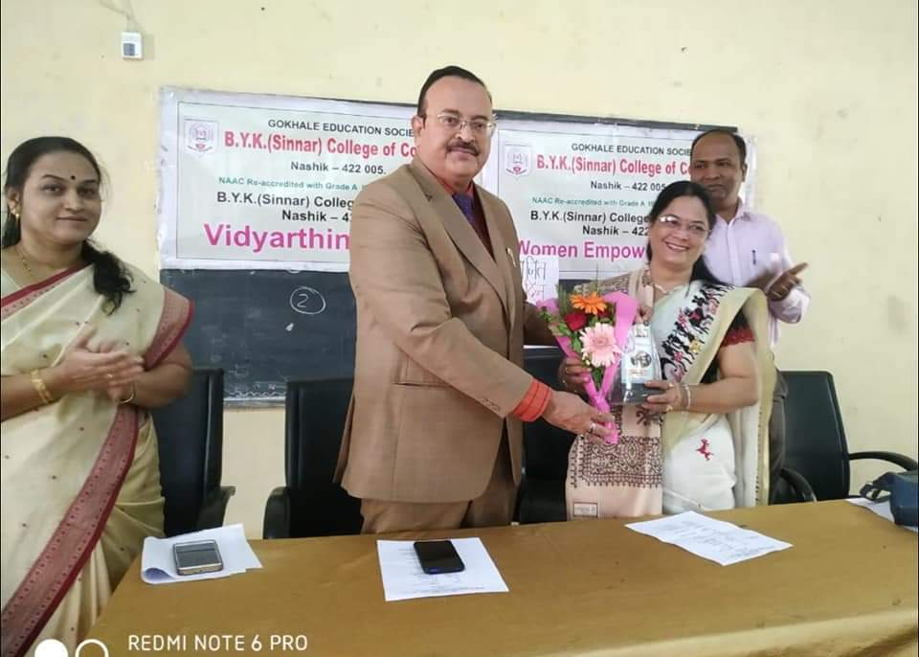
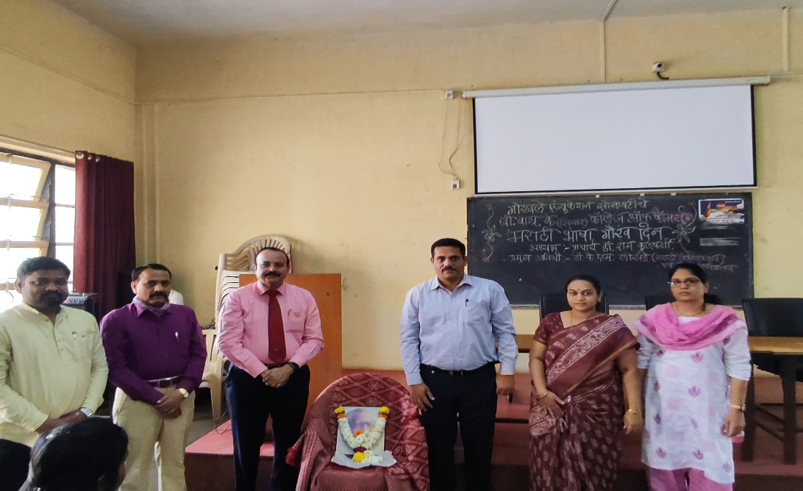
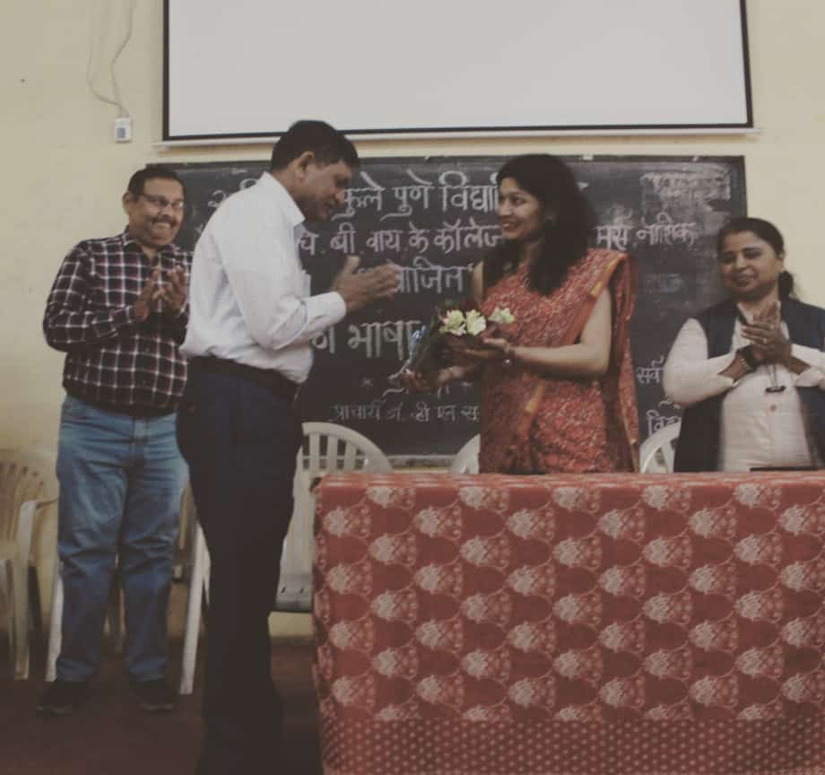
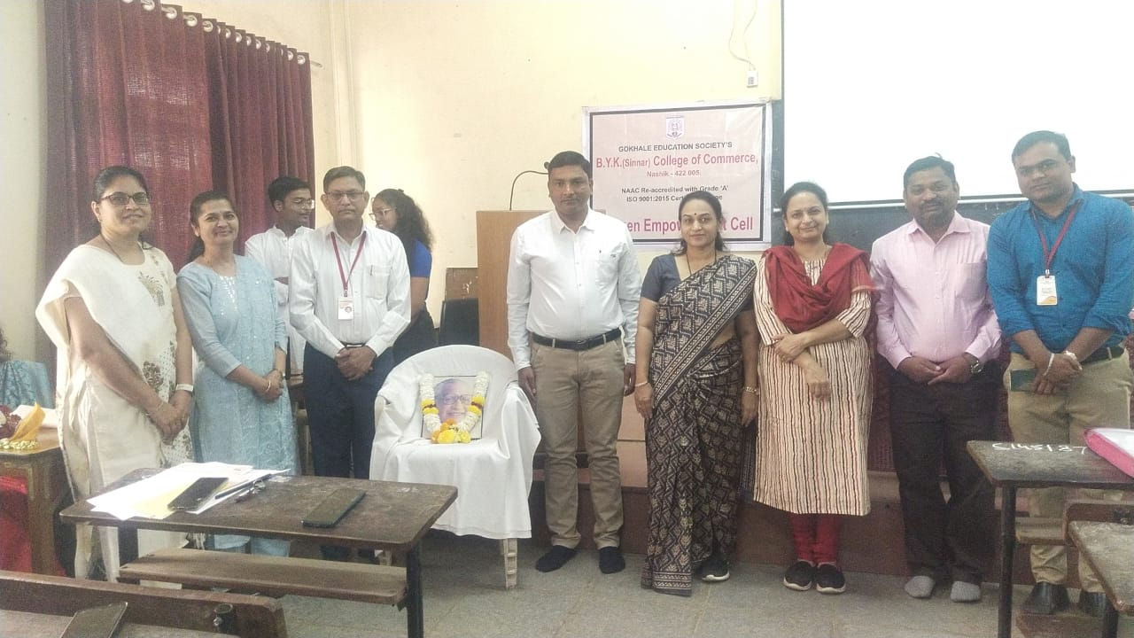
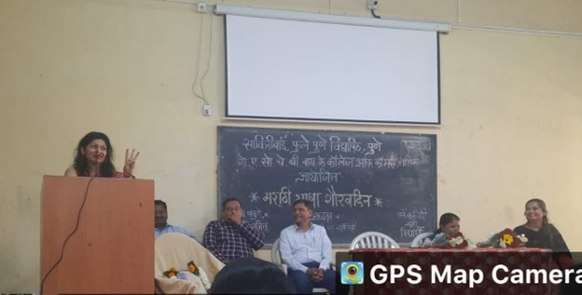
ACTIVITIES OF DEPARTMENT
Marathi Raj Bhasha Din

Slide 23
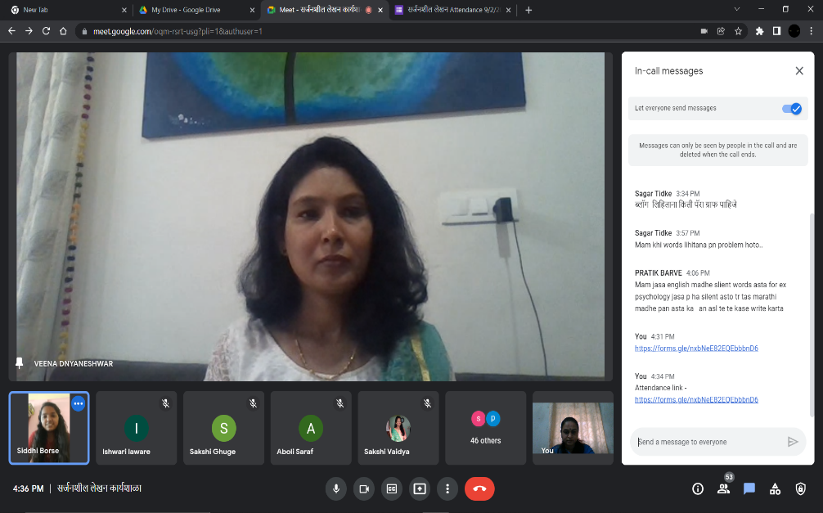
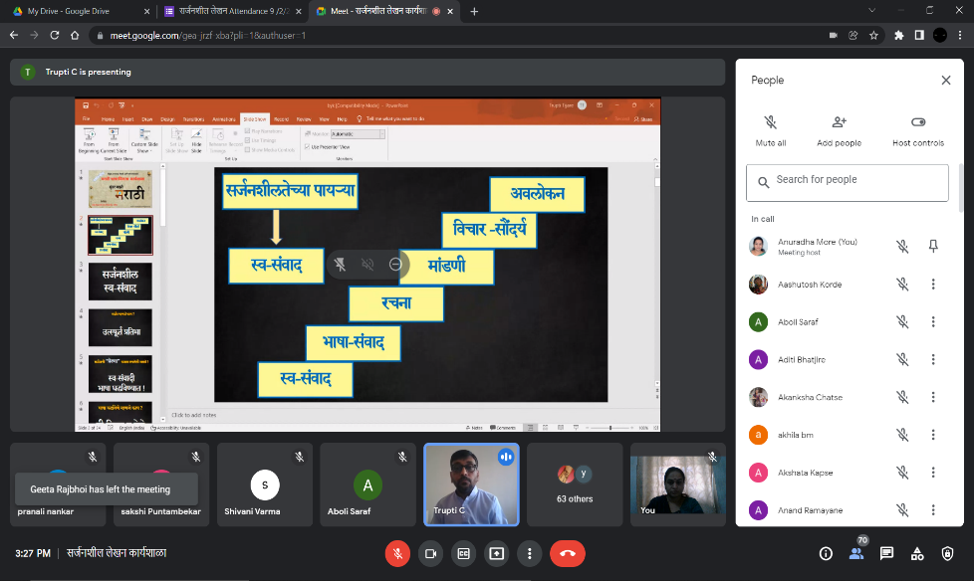
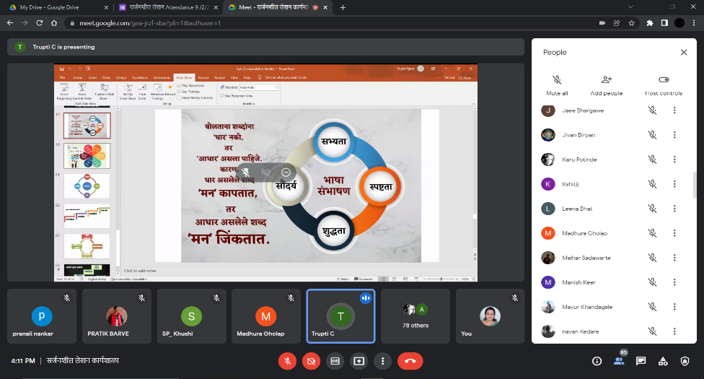
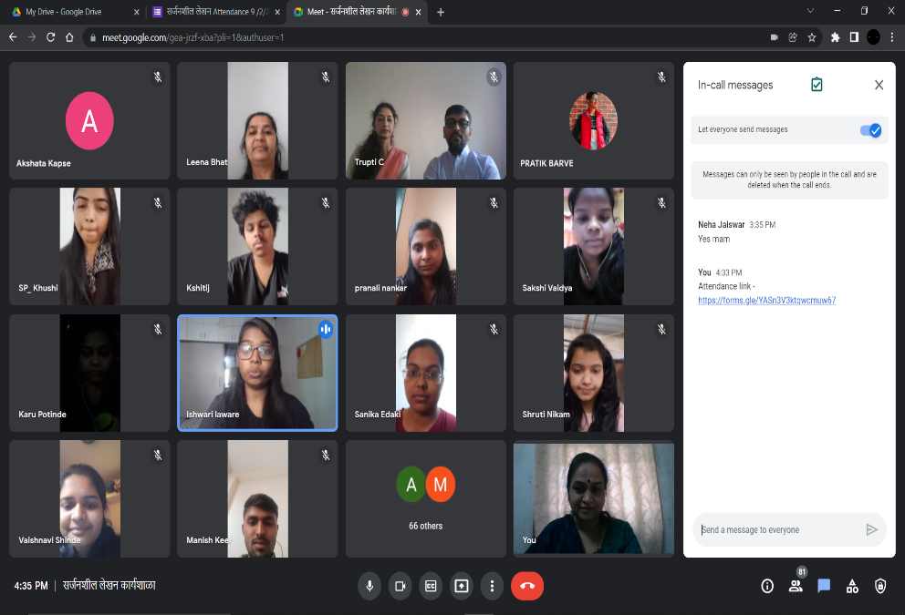
Three Days Sarjanshil Lekhan Karyashala’ (Creative Writing Workshop)
Resource person Dr.Veena Mali
Assistant Professor, Devgiri College,
Sambhajinagar
Resource person –
Mr. Sachin Chandratre
Founder, Mind Rhythm Academy &
International Language Trainer
Mrs. Trupti Tijare
Member, Mind Rhydm Academy

Slide 24
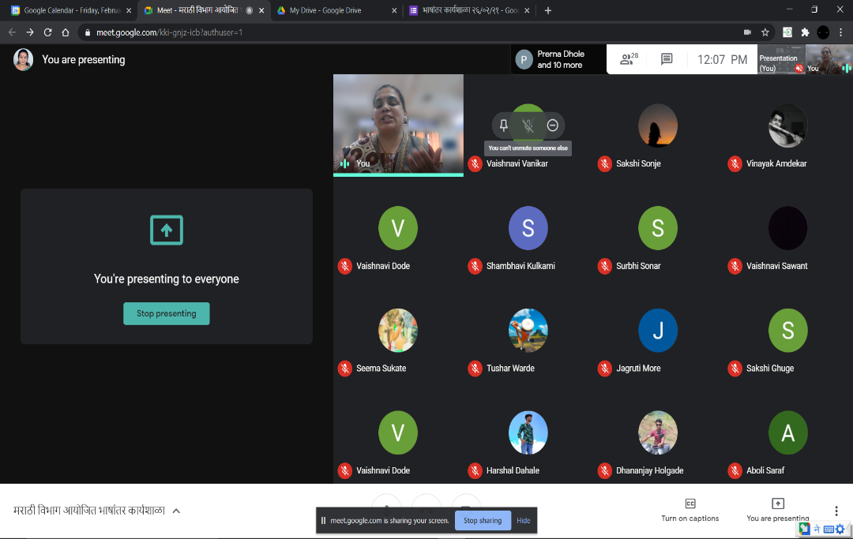
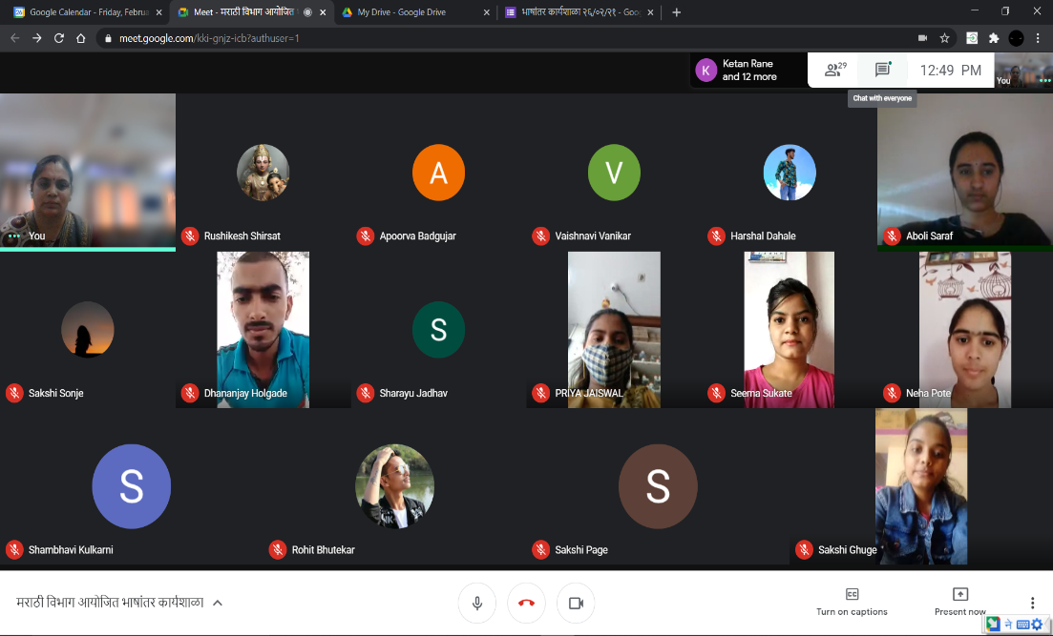
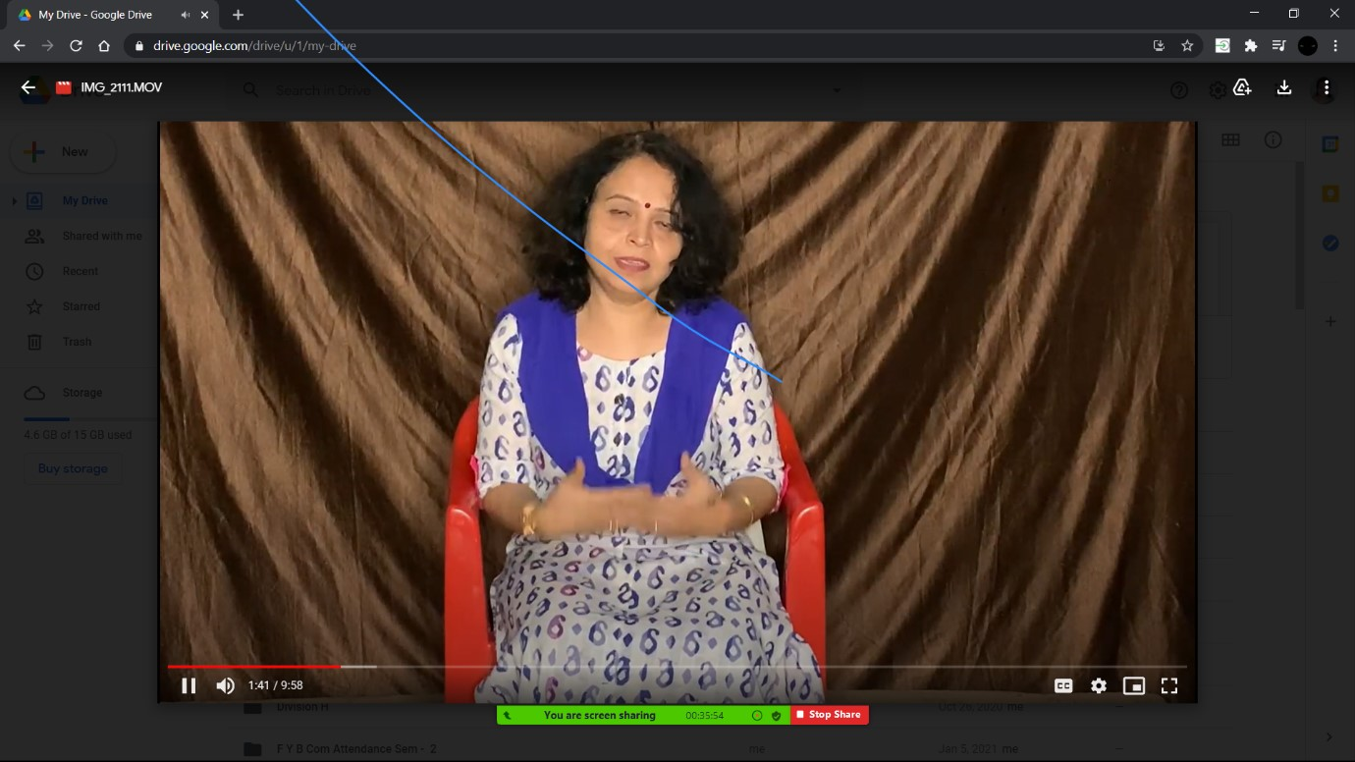
Two Days Bhashantar Karyashala (Translation Workshop)
Resource Person –
Dr. Jaswanti Mojad
Assistant Professor,
HPT Arts College, Nashik
Resource Person –
Dr. Pratibha Biswas
HOD & Associate Professor
Kirti College, Mumbai

Slide 25
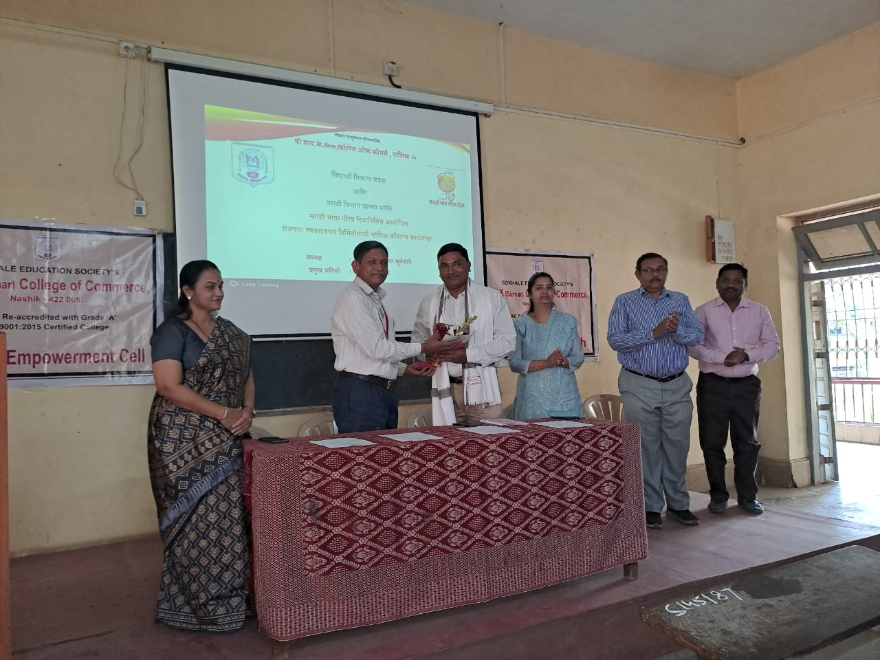
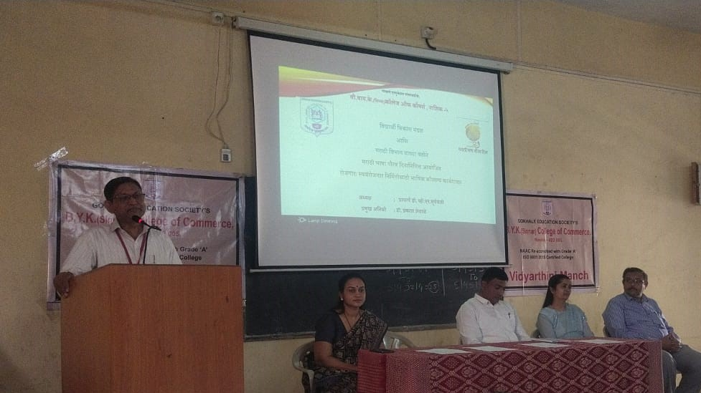
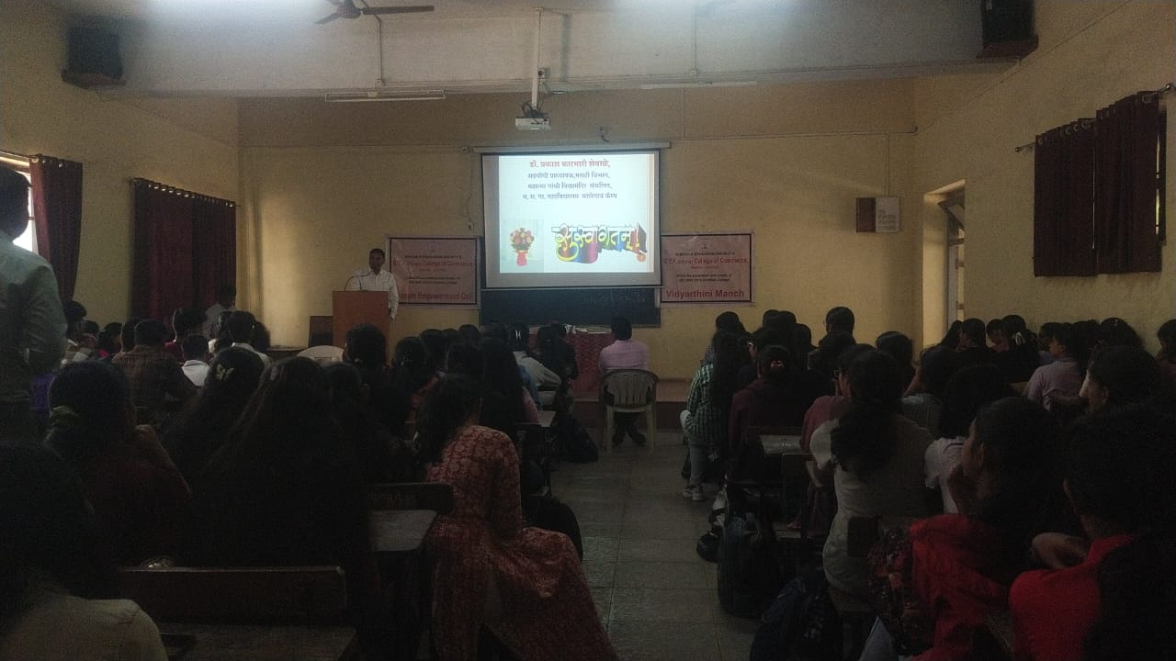
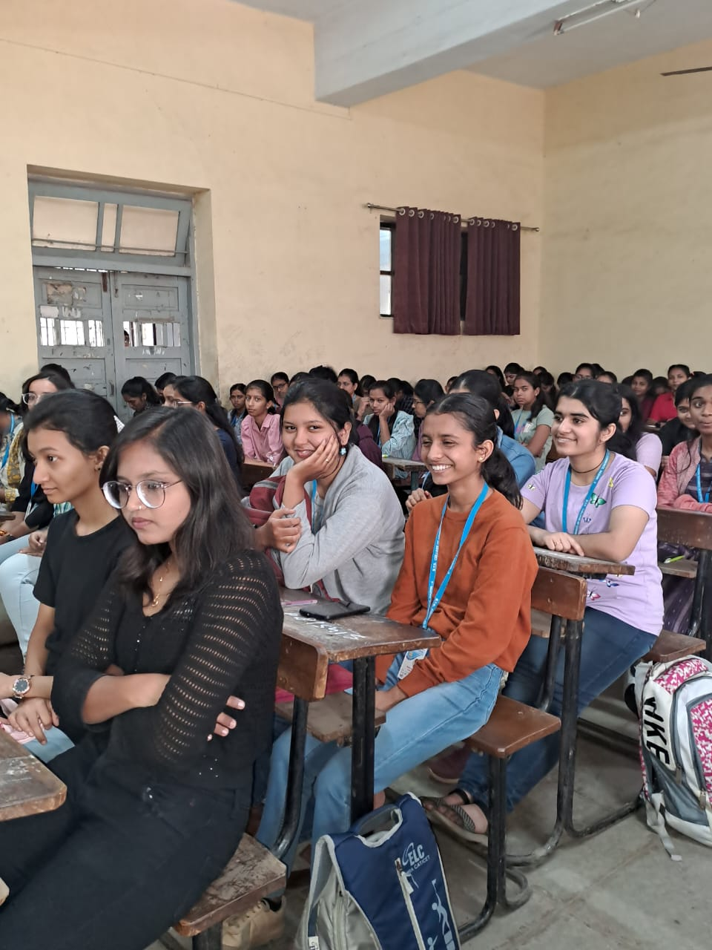
रोजगार /स्वयंरोजगार निर्मितीसाठी भाषिक कौशल्ये कार्यशाळा
Recourse person :
Dr. Prakash Shevale
Associate Professor, Panchavati College, Nashik

Slide 26
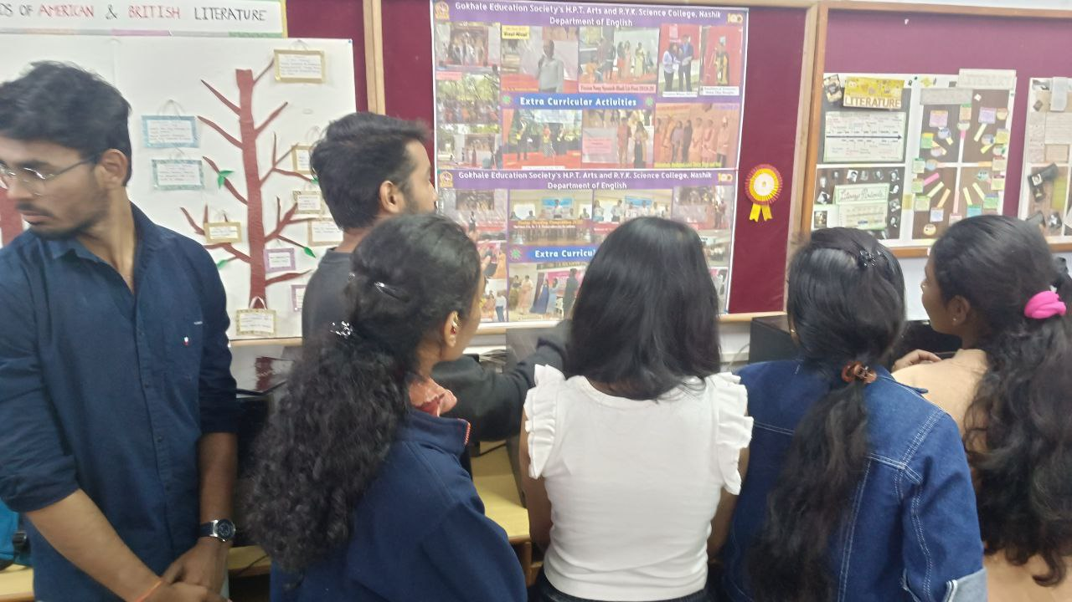
Visit to Language Laboratory

Slide 27
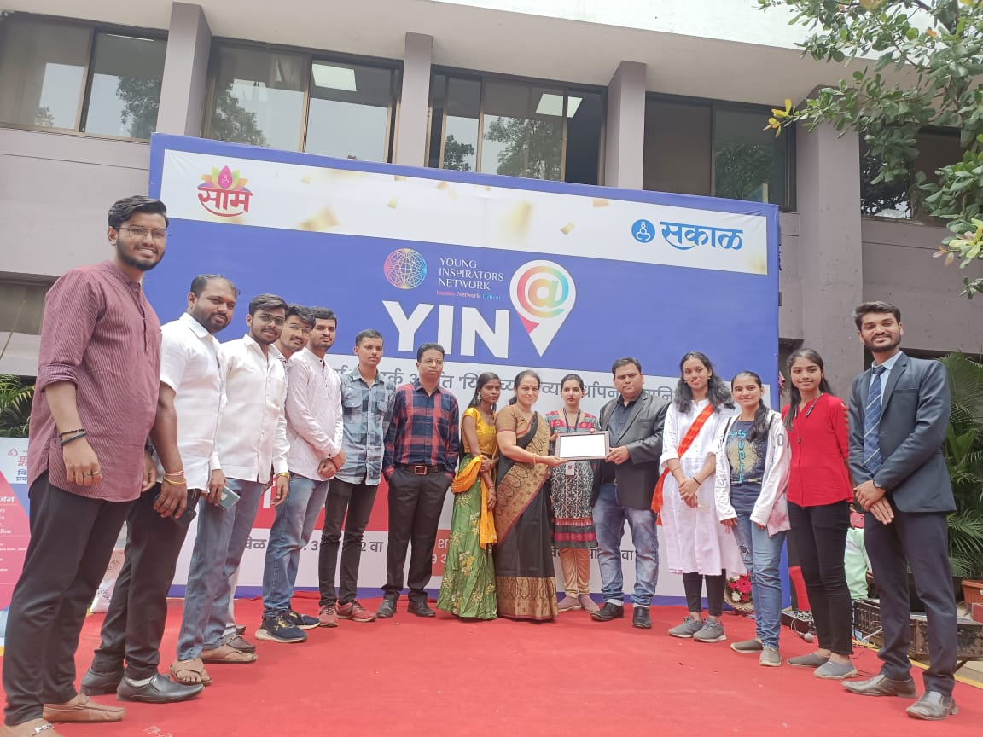
Visit to Sakal Printing Press

Slide 28
Competitions
Poetry Reading Competition
Story Narrating Competition
Play Reading Competition
Elocution Competition (‘Mukt chintan’)
Essay Writing Competition
Marathi Signature Competition
Quiz Competition
Letter Writing Competition

Slide 29
ACHIVEMENTS BY STUDENTS
International Level Elocution Competition:
1.Ms. Madhura Gholap – 1st prize in Elocution, Debate, write an Articles in Daily Newspapers. (participated continuously 5 years in International level elocution competition)
2. Ms. Shweta Dongare – Elocution, Debate
Both are participated and won International, National, State & University level Elocution and Debate Competitions.
National Level Competition:
1. Master Rishu Pandey – Elocution, Poetry, Essay Writing
2. Ms.Madhura Gholap – Elocution

Slide 30
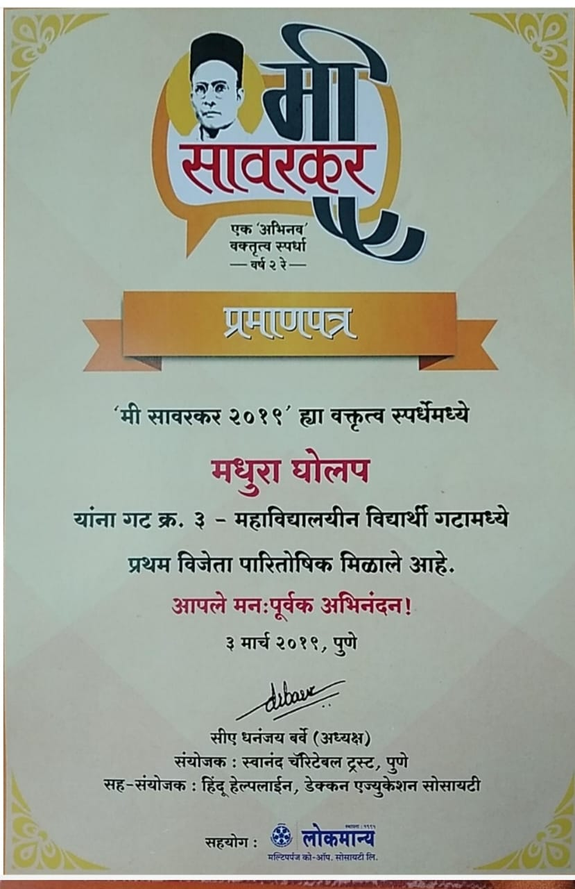
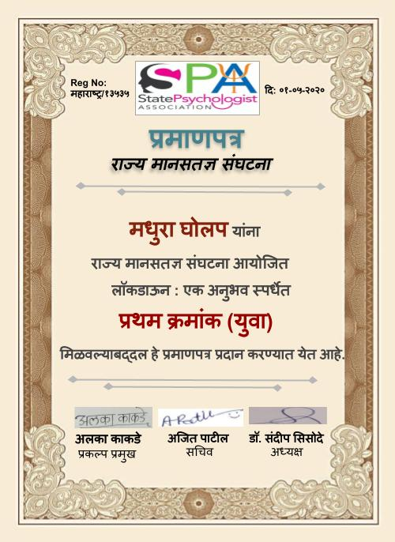
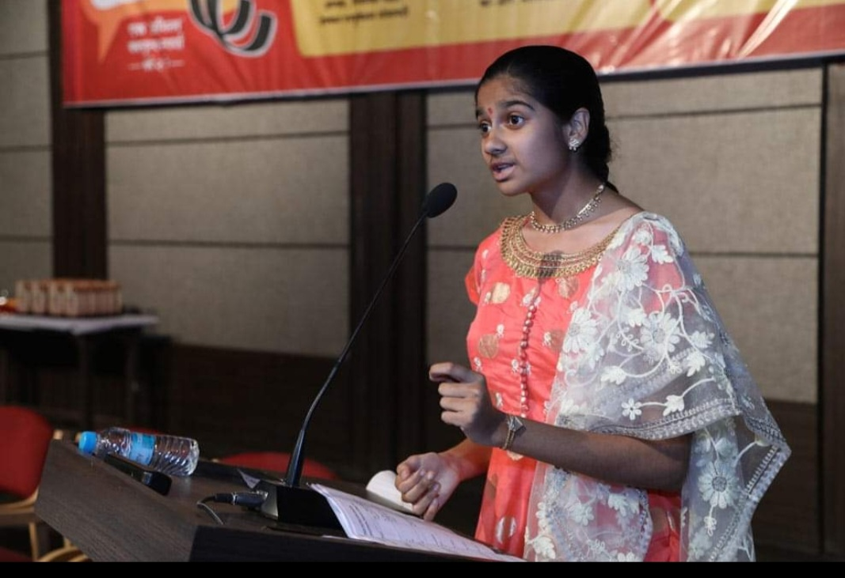
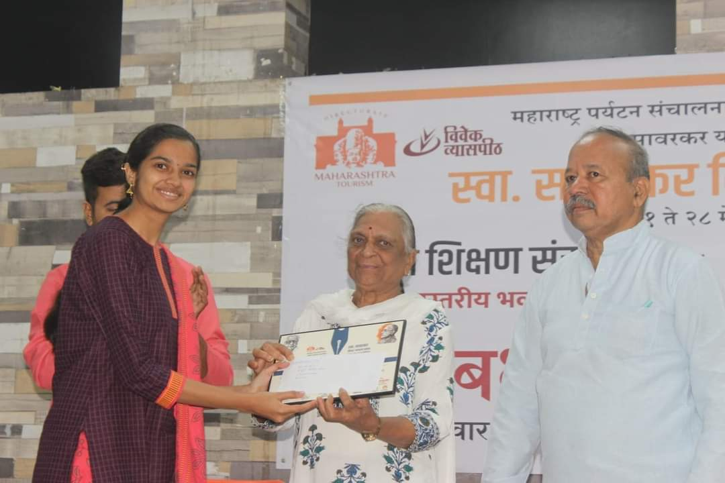
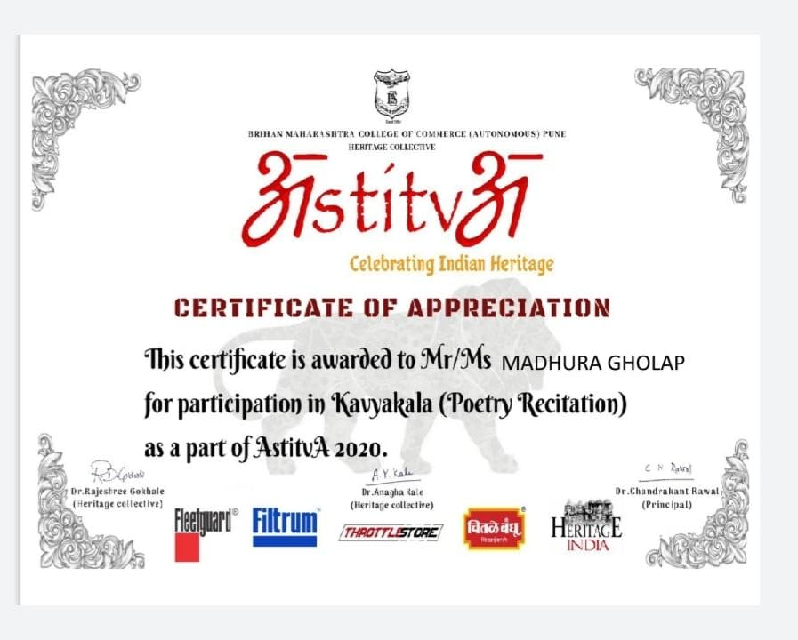
Ms. Madhura Gholap –
Participated continuous 5 years at International level ‘Mi Savarkar’ Elocution Competition & received 1st, 2nd & Consolation Prize.
2^{nd prize} in Natyavachan – International level
Participated in National level Elocution Competitions.
Script Writer & Director (Skits)
Students Achievements

Slide 31
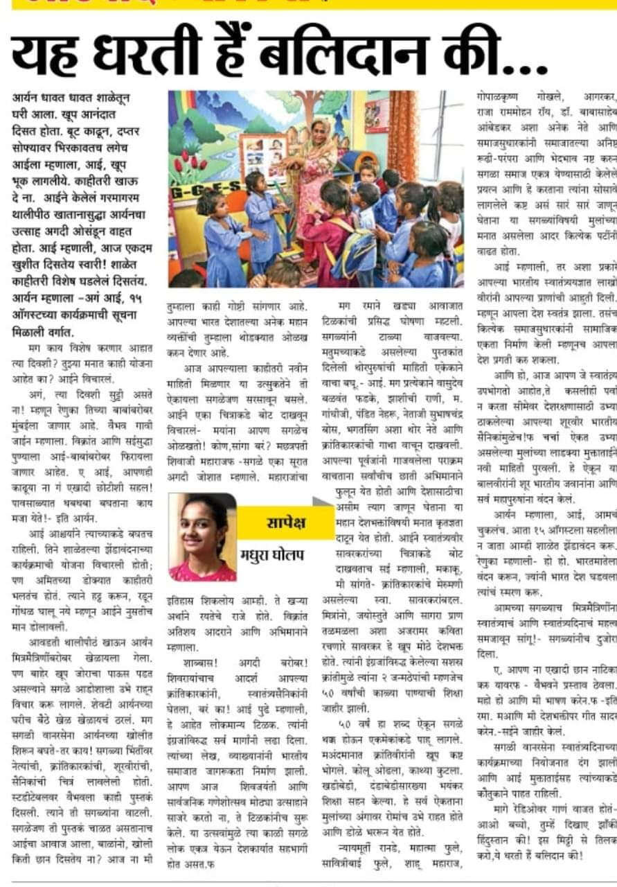
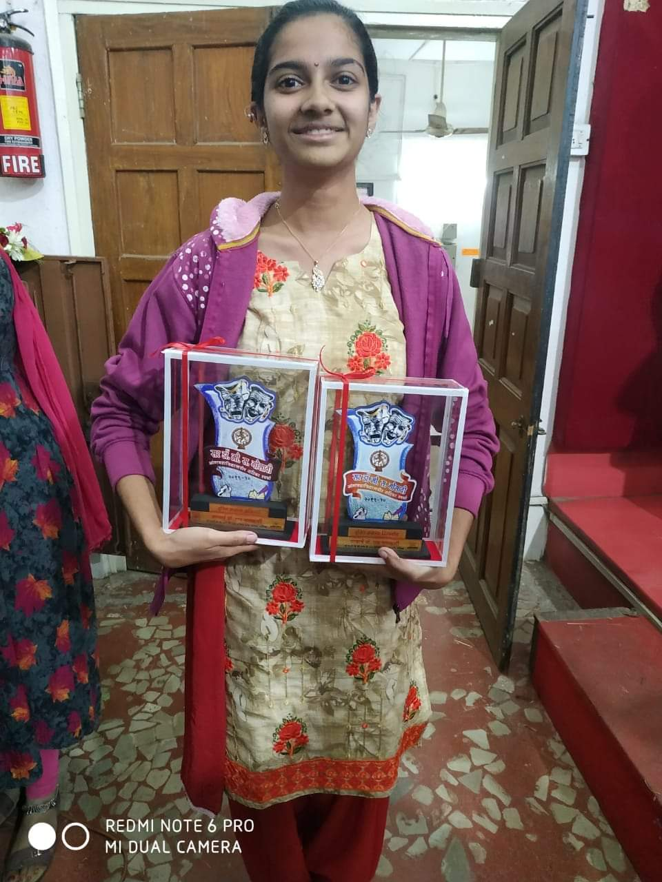
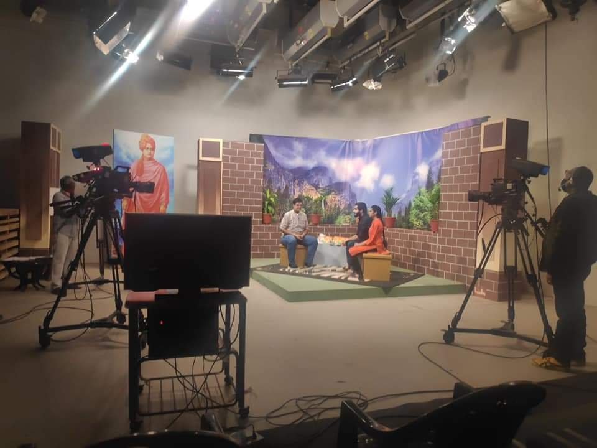
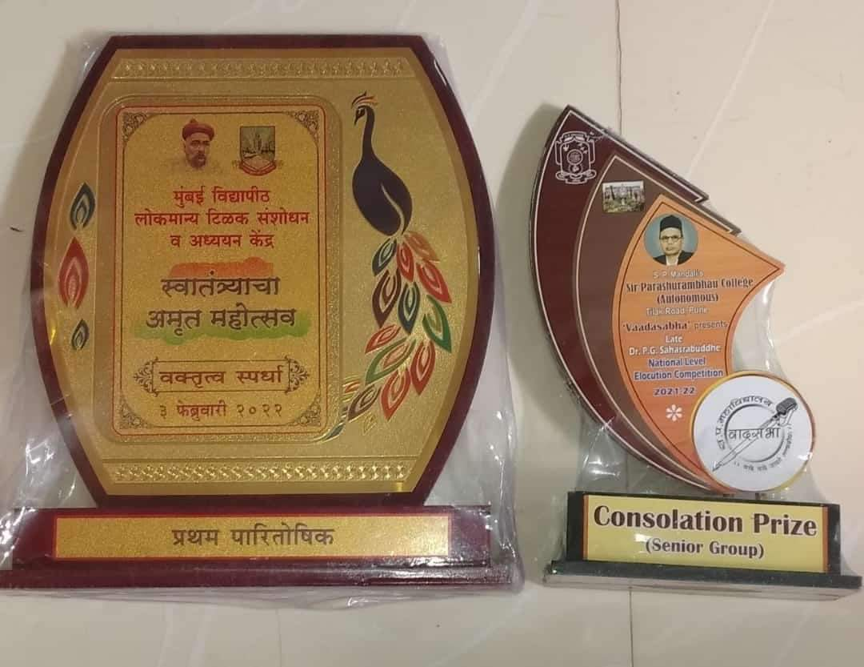
Recipient of of various prestigious awards
Participation as a Speaker in ‘Yuvakanand’
Programme telecasted by Sahyadri Chanel.
Received 1st prize at National level Elocution Competition
Received 2nd prize in Inter –college skit Competition
( Script Writing – Mrs. Anuradha More,
Director – Madhura Gholap)

Slide 32
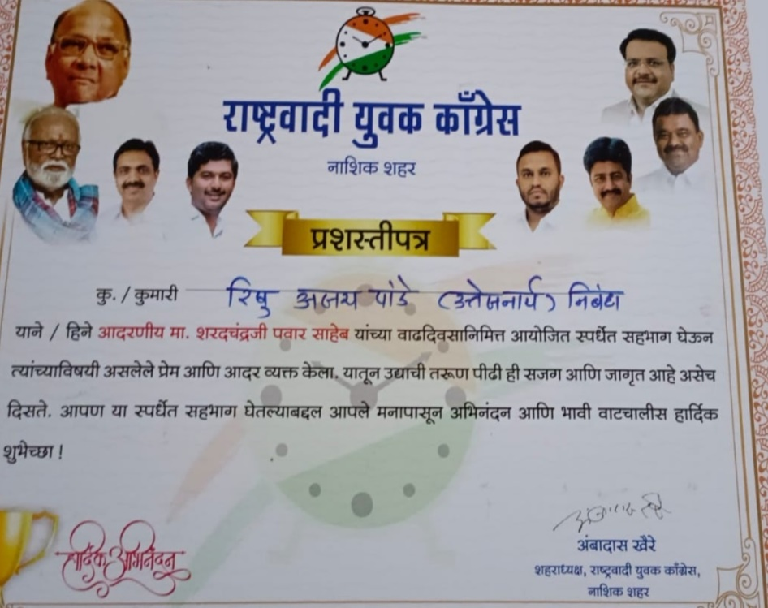
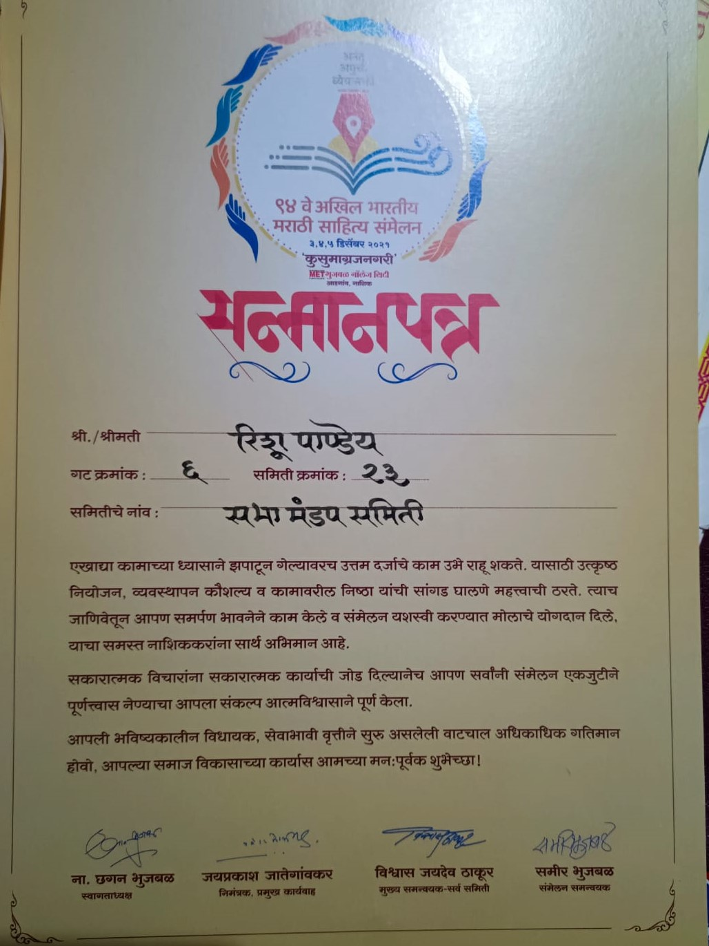
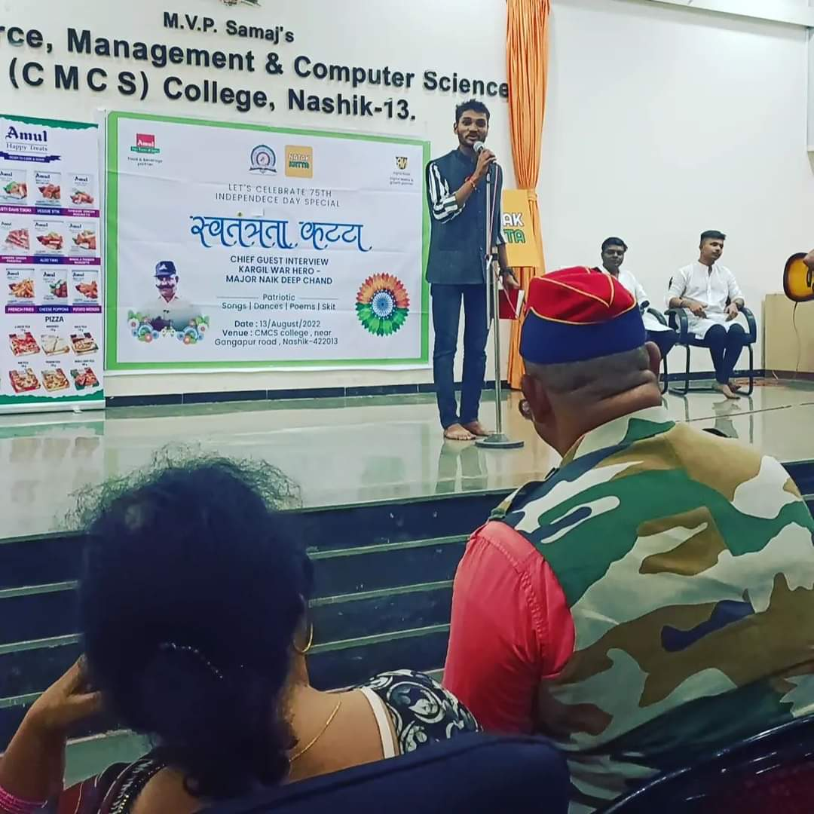
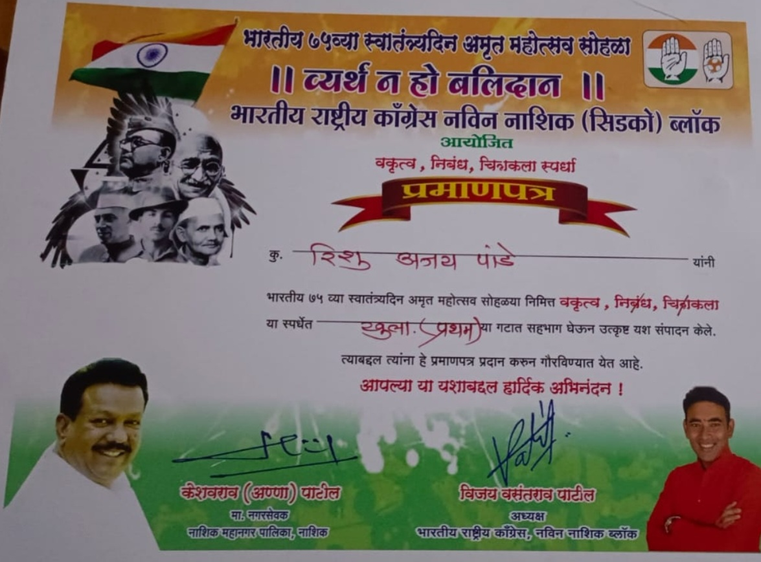
Master Rishu Pandey-
Participated in various National, State & District level Poetry reading, Essay Writing & Elocution Competitions.
Recipient ‘Kalam Yodhha Award’, ‘Vruksha Sakha Award’

Slide 33
State Level Competitions:
Ms. Riddhi Bhavsar – Poetry, One Act Play & Skit
Ms. Priya Jain - Poetry, Elocution, One Act Play & Skit
Ms. Siddhi Borse - Poetry, Elocution, One Act Play & Skit, Acting in Television Shows.
Ms. Mrunal Patil – Essay Writing, Social Work, write an Articles in Daily Newspapers.
Master Yogesh Rakhunde – Poetry
Master Varad Sonawane – Poetry, Debate & Elocution
Ms. Uma Khardikar – Poetry, Skit, Script Writing
Master Sarvesh Sable – Poetry
Ms. Tejashree Sambre – Poetry
Ms. Ketaki Kulkarni - Elocution
Ms. Renuka Deshpande – Elocution
.

Slide 34
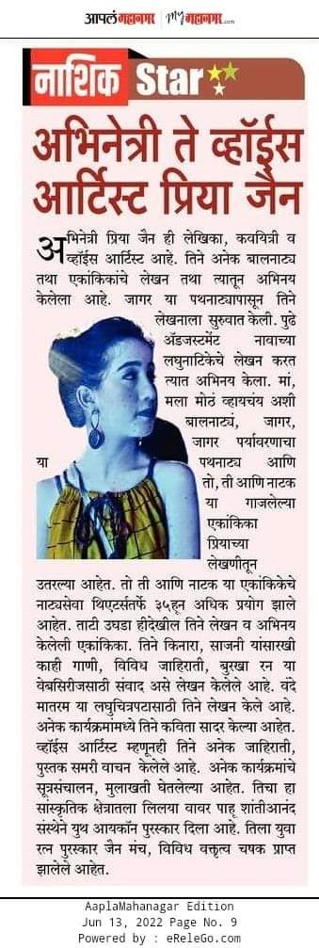
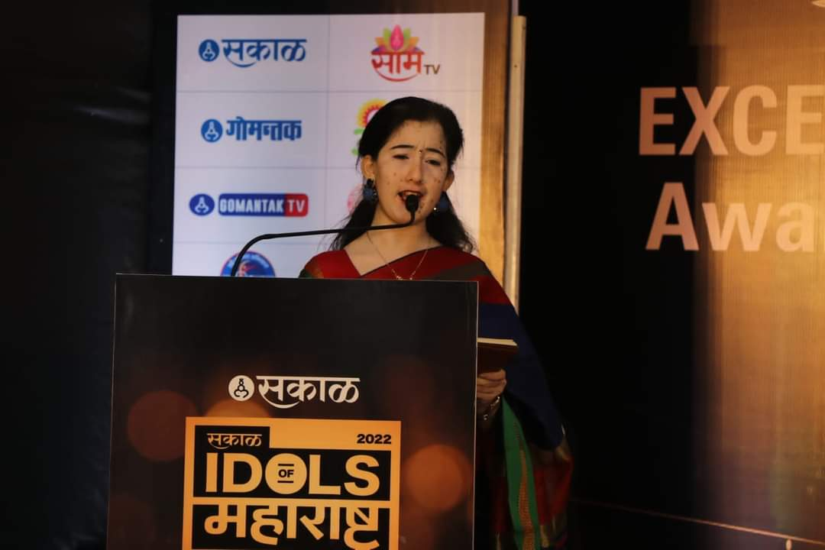
Priya Jain:
Radio Jockey, Story & Script Writer, Poetess, Anchor, Youtuber
Participated in Various Elocution, Debate Competitions.
Working as a Radio Jockey at Radio Vishwas 90.8
Participated in One Act Play Competition as a Script Writing, Director &
Actress

Slide 36
Miss Mrunal Patil:
Social Worker, Reporter and Column Writer
Participated in various Essay Writing Competitions.
Recipient of various awards:
Bharat Ratna Mother Teressa Gold Medal Award
Yuva Sangharsh Award
Rashtriya Samaj Gaurav Gold Medal Award
Mahila Sanman Puraskar
National Yashawant Ratna Award
Rajmata Aausaheb Jijau Gaurav Puraskar
National Ahilyaratn Award
Sarvesh Sable – 2nd Prize instate Level Poetry Reading Competition

Slide 37
Ms. Siddhi Borse –
Acting at various One Act Play & Skits Competitions.
3rd Prize in State Level One Act Play.
Played a leading role in the Marathi serial ‘Yog Yogeshwar Jay Shankar’ and ‘Sundara Manamadhe Bharali’.

Slide 38
Ms.Bageshree Parnerkar:
Radio Jockey, Press Reporter & Anchor
Miss Shweta Dongre :
Received 3rd prize at International level Poetry Reading Competion
Ms. Ketaki Kulkarni : Actor, lead role in Marathi serial

Slide 39
Ms. Renuka Deshpande:
Anchor, News Reporter for local news channel & Actor
Participated in Various Elocution Competition.
Playing a Lead Roll In Marathi Serial ‘Tuch Maza Sapan’
Recipient various awards like ‘Samajratn’, Maharashtrachi Kanya Sanman’,and Hirakani Ratn’

Slide 40
Received 2nd Prize in ‘Rangavaikhari’ State level One Act
Play Competition.
(Script Writing- Priya Jain & Director – Mrs. Anuradha More)

Slide 41
Received 2nd Prize for Street Play Competition at District level
(Script Writing by Mrs. Anuradha More)
MS.Uma Khardikar –
1st Prize in District level Script Writing Competition
3rd Prize in State level Poetry Reading Competition
Received 3rd Prize for Street Play Competition at District Level
(Script Writing by Mrs. Anuradha More)

Slide 42
One Act Play ‘Vithabaicha Kawala’ performed at SPPU
Swar-Rang Youth Festival (3rd prize at Nashik Zonal level)
One Act Play‘Aakda’performed in G.H.Raysoni
State level Competition.

Slide 43
Received 3rd prize at Nashik zonal level ‘Loksatta Lokankika’
Script writer & Director – Vandan Welde

Slide 44
Master Varad Sonawane –
Participated in various Poetry reading & Elocution Competitions.
1st in State Level Poetry reading Competition and received ‘Kavyakarandak’ trophy.
3rd Prize in State level Elocution Competition
Master Sarvesh Sable –
Participated in various Poetry reading Competitions.
Received 1st Prize in State level Poetry Competition

Slide 45
Thank You !

