Slide 1
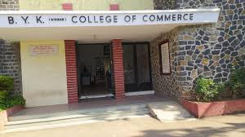
Gokhale Education Society’s BYK College of Commerce Nasik – 422005 Affiliated to Savitribai Phule Pune University Pune
Department of English (Estt 1957)
Welcomes
The NAAC Peer Team
Professor Dr Dharminder Kumar – Chairperson
Professor Dr Ramu Nagarajapillai – Member Coordinator
Professor Dr R Kittappa Vaithiyanathan Member

Slide 2
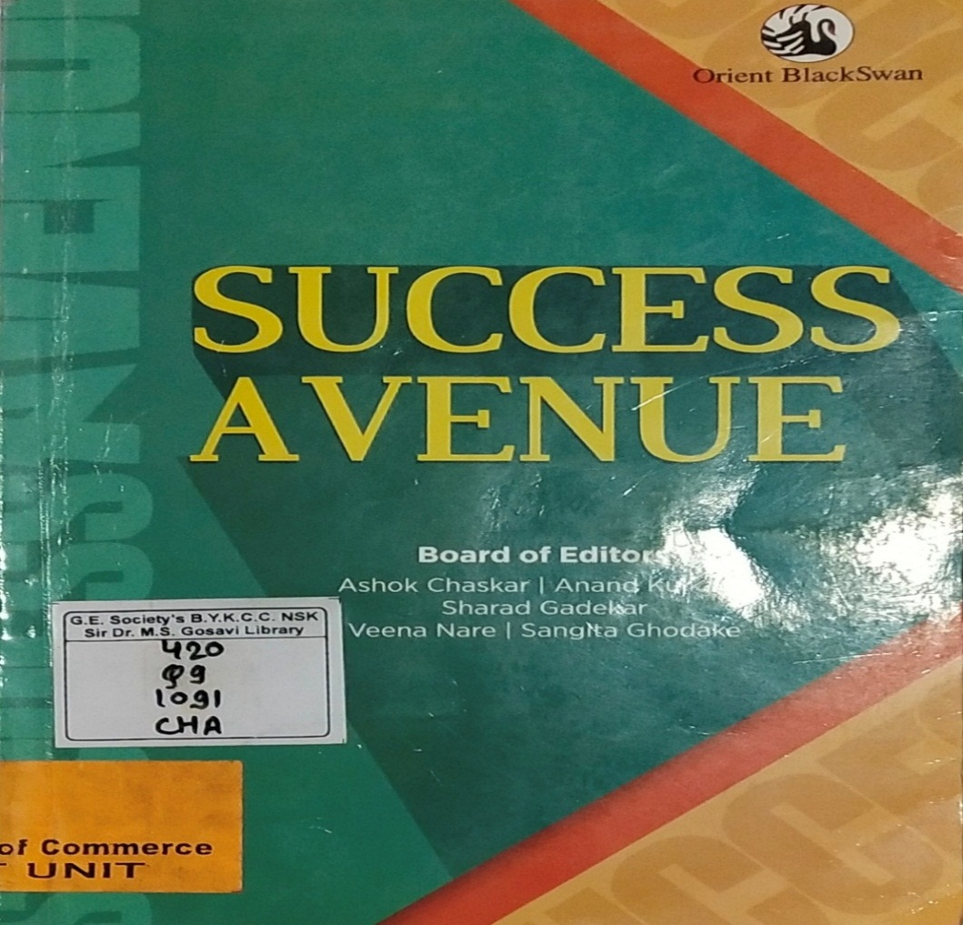
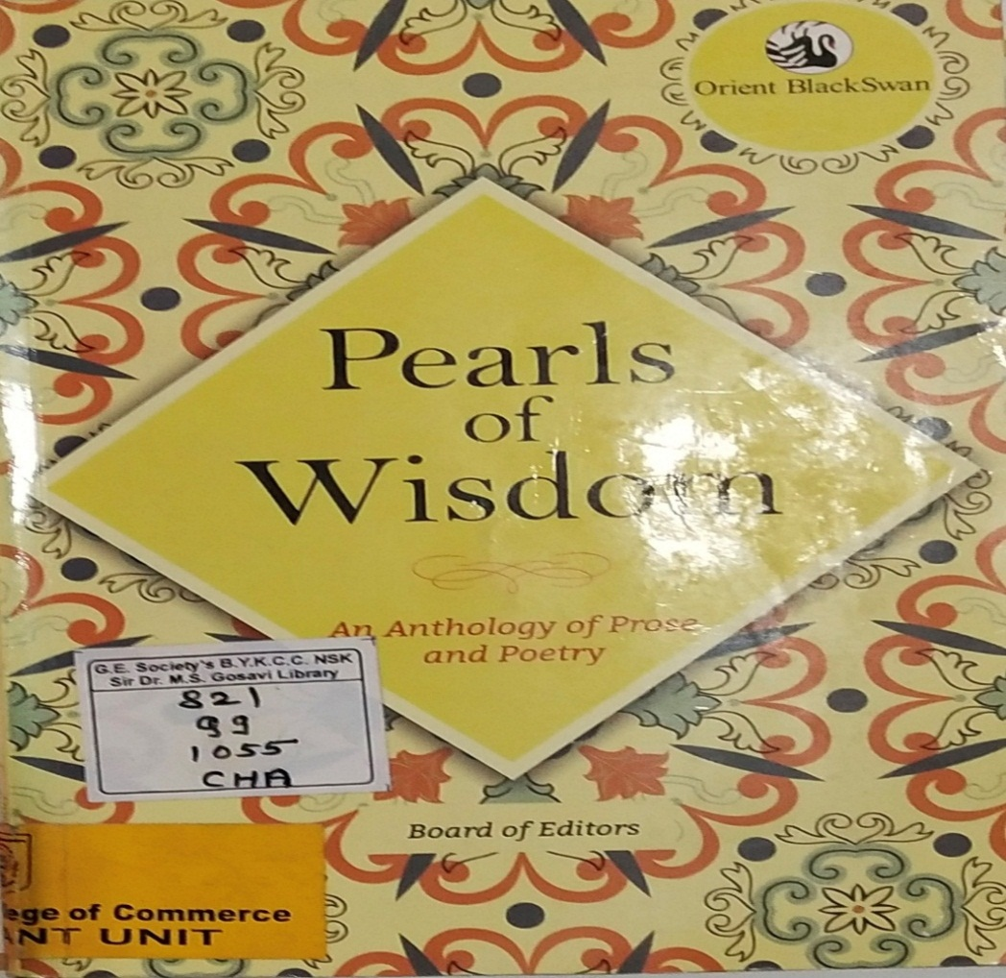
Courses Offered
Compulsory English Additional English
Both the courses are offered at the First Year level only.

Slide 3
Objectives
To offer relevant and practically helpful pieces of prose and poetry to the students so that they not only get to know the beauty and communicative power but also its practical application To expose students to a variety of topics of the contemporary socio-economic and cultural life creating literary sensibilities To develop oral and written communication skills to enhance students' employability To expose the students to the literary extracts with the themes of entertainment, enlightenment and information

Slide 4
Outcomes
Enlightenment, information and enlightenment
Refining literary sensibilities
Beauty and communicative power along with its practical application
Oral and written communication skills enhancing students' employability and entrepreneurship talent

Slide 5
SWOC Analysis
Strengths | Weakness
Access to all First Year students as the subject is compulsory Strong Communication platform for the upcoming entrepreneurs English as lingua franca opening up global markets Literary texts with social and cultural sensibilities Access to quality language and literature learning resources | Subject prescribed only at the First Year level so no access to the Second and Third Year students Language barrier for non-native speakers in terms of commerce related interactions vis-à-vis large number of students in classrooms
Opportunities | Challenges
Language enhancement programmes and workshops to improve the students’ proficiency so as to bridge the gap Online learning platforms with resources to supplement the traditional classroom Transforming students into better citizens and entrepreneurs | Students’ diverse language background might prove challenge catering to language learning and support The subject is most likely to be overshadowed by the core commerce subjects

Slide 6
Students’ Enrolment
Additional English is an optional subject to choose from two languages, nearly 600 students enrol for this subject.
Year | Compulsory English | Additional English
2023-2024 | 950 | 533
2022-2023 | 889 | 528
2021-2022 | 958 | 626
2020-2021 | 950 | 604
2019-2020 | 959 | 591
2018-2019 | 953 | 507

Slide 7
Name of Faculty | Academics | Interest Areas | Experience
Uttam B Sonkamble Head and Associate Professor | MA MPhil PhD | Literature of Margin Genre Fiction | 26 Years
Ananya Chaudhary Assistant Professor | MA SET | Soft Skills | 20 Years
Ms Sonali Mharsale Assistant Professor | MA MEd SET NET | Language, Translation | 11 Years
Dr Vaishali Patil Assistant Professor | MA BEd MPhil PhD SET | American Absurd Drama | 13 Years

Slide 8
Teaching Workload
 | Name | No of lectures
1 | Uttam B Sonkamble | 20
2 | Ms Ananya Chaudhary | 20
3 | Ms Sonali Mharsale | 10
4 | Dr Vaishali Patil | 10

Slide 9
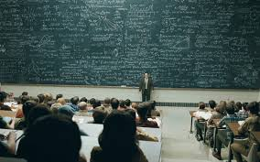
Teaching Learning Methods
Lecture
Participative Learning E-content https://bykcollege.com/e-content-notes-videos/

Slide 10
Library Support
Textbooks – 1. Success Avenue – Compulsory English
2. Pearls of Wisdom – Additional English
Literature – All genres
Total Collection of Books: 4800

Slide 11
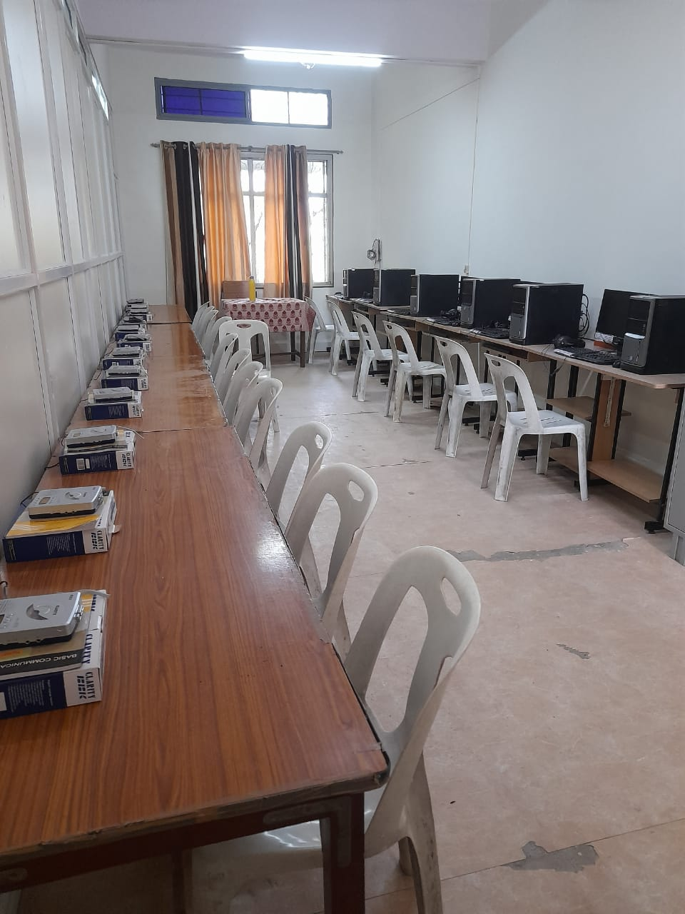
Language Laboratory

Slide 12
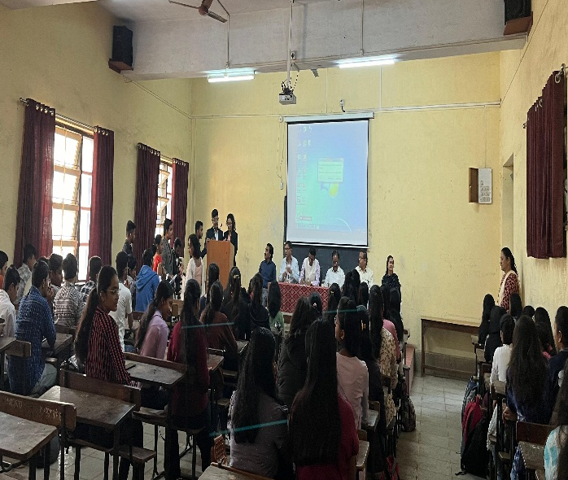
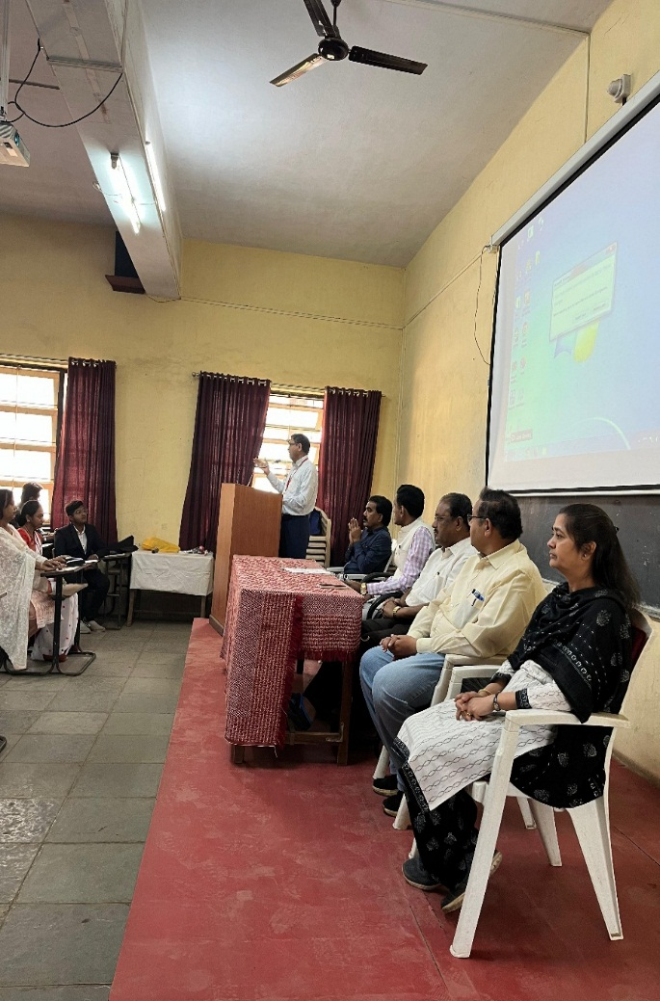
Six Day Certificate Course in Language Skills 12th February 2024 to 17th February 2024 170 Students Actively Attended the Course.
Sharvari and Bhavik – Student Anchors Principal’s Inaugural Address
On the stage, Dr Premji Parmar, Vice Principals Professor GV Kayande Patil, Dr Prasad Kulkarni and Dr Leena Bhat

Slide 13
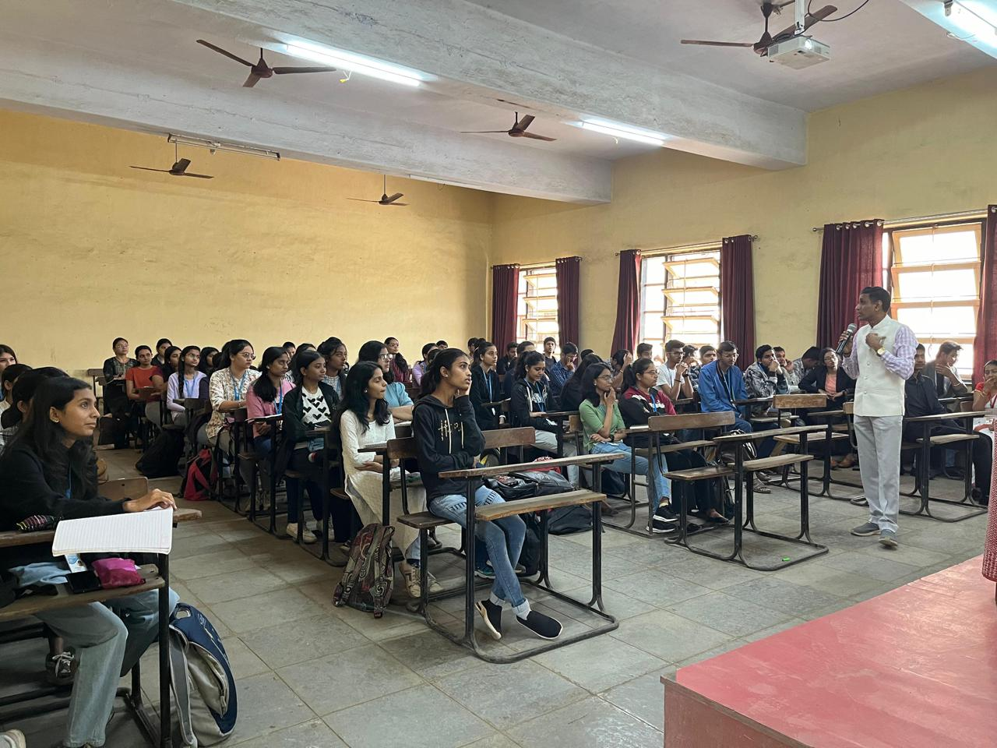
Dr Premji Parmar’s GUEST LECTURE on You Attitude Day 1
Six Day Certificate Course in Language Skills

Slide 14
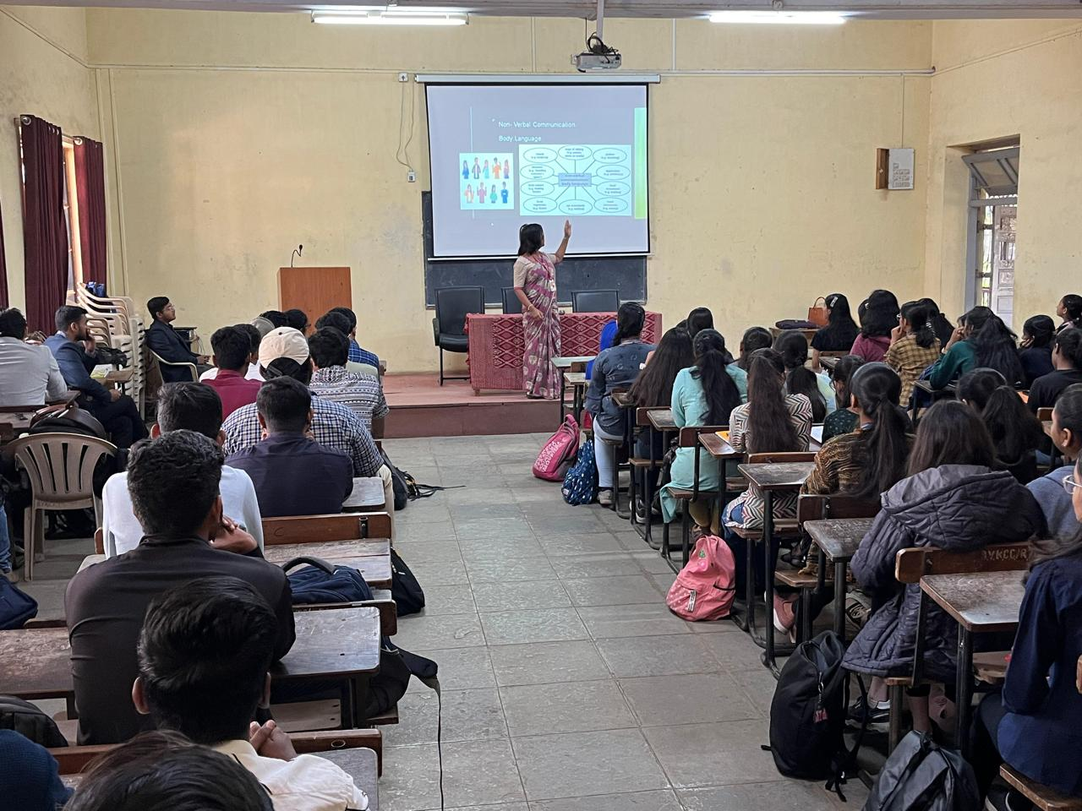
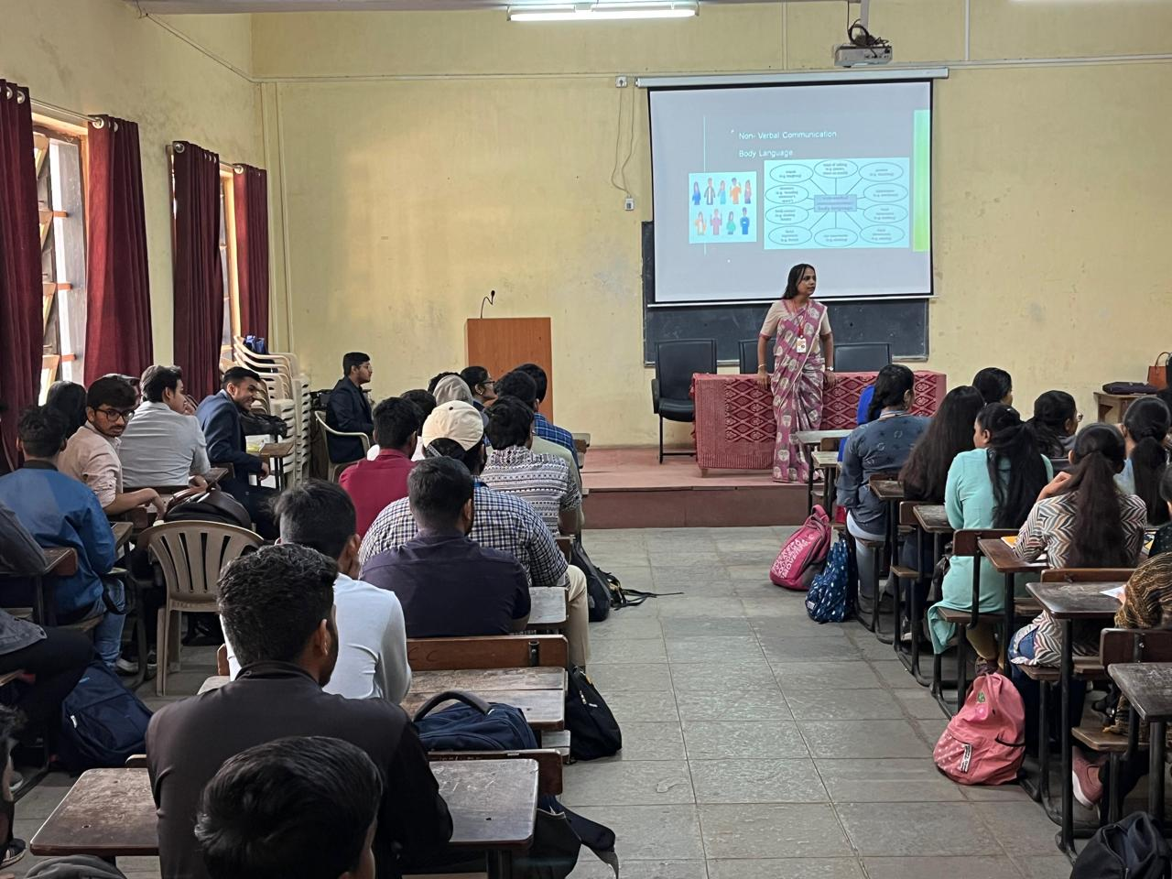
Ms Ananya Chaudhary on Non Verbal Communication Day 2
Six Day Certificate Course in Language Skills

Slide 15
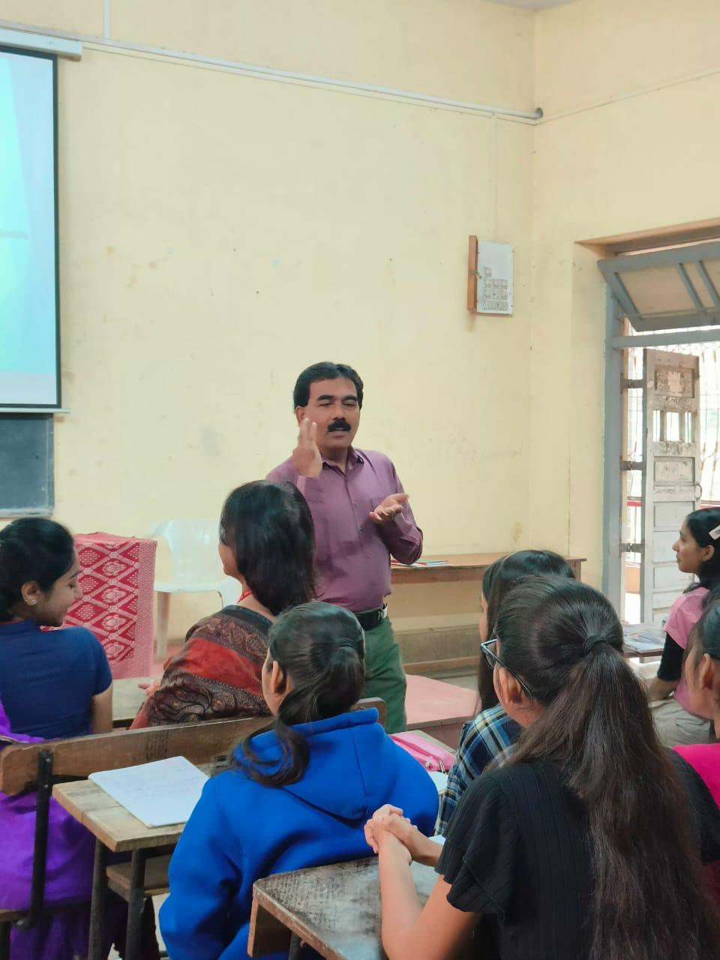
Uttam Sonkamble on Verb – Nucleus Day 3
Six Day Certificate Course in Language Skills

Slide 16
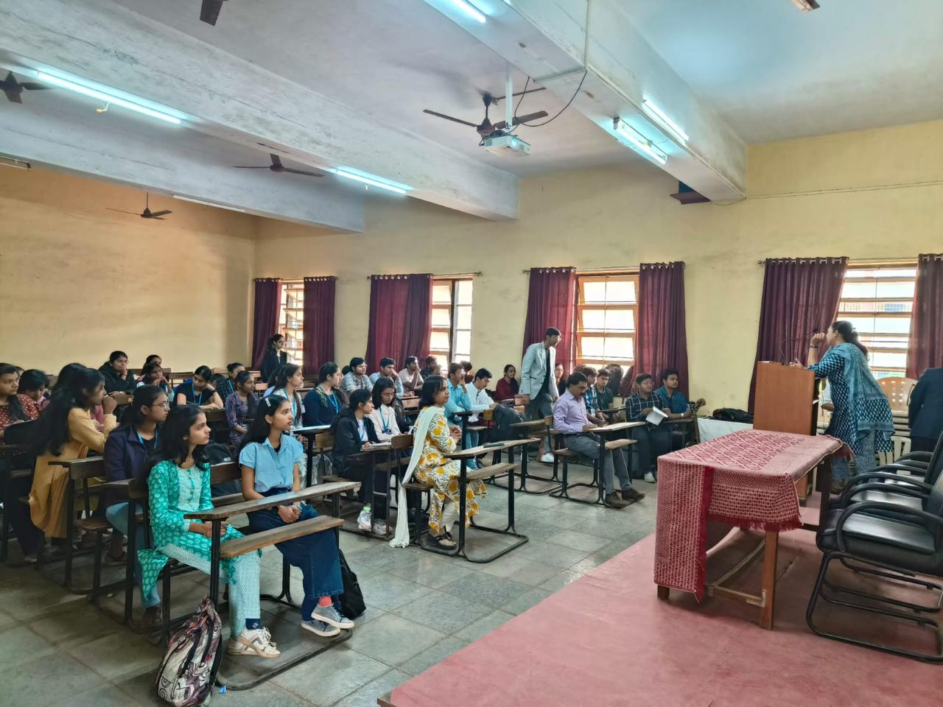
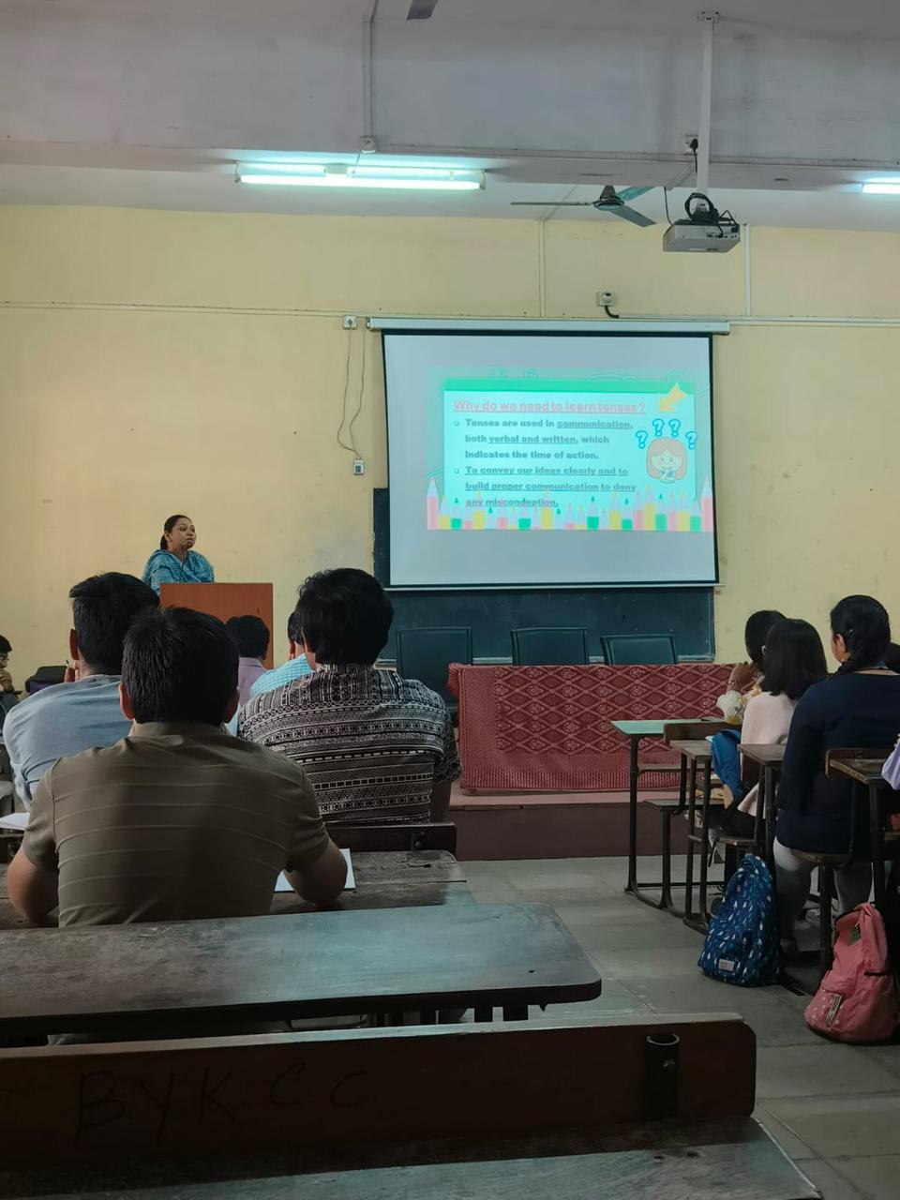
Dr Vaishali Patil on Tenses Day 4
Six Day Certificate Course in Language Skills

Slide 17
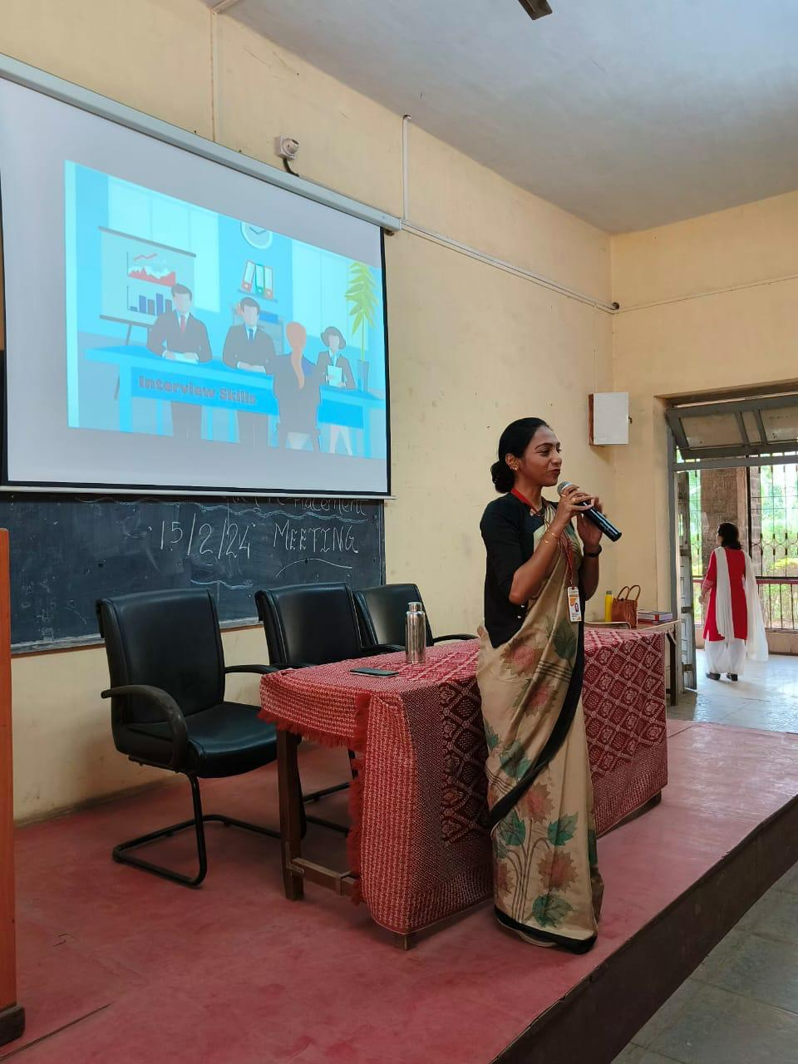
Ms Sonali Mharsale on Interview Skills Day 5
Six Day Certificate Course in Language Skills

Slide 18
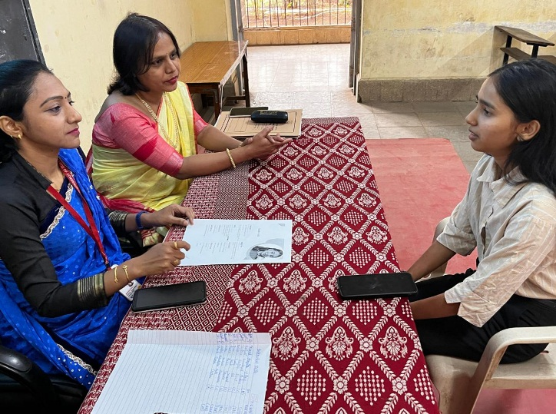
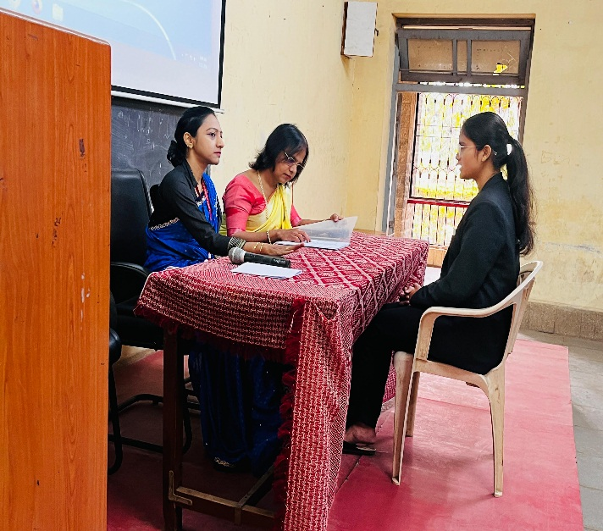
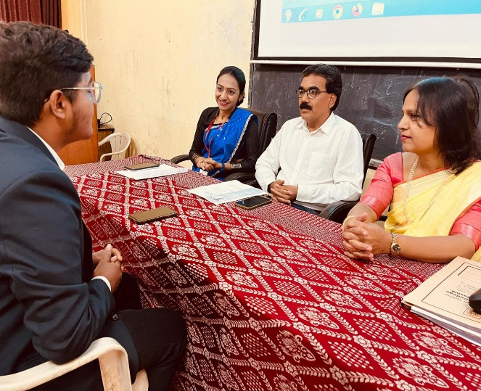
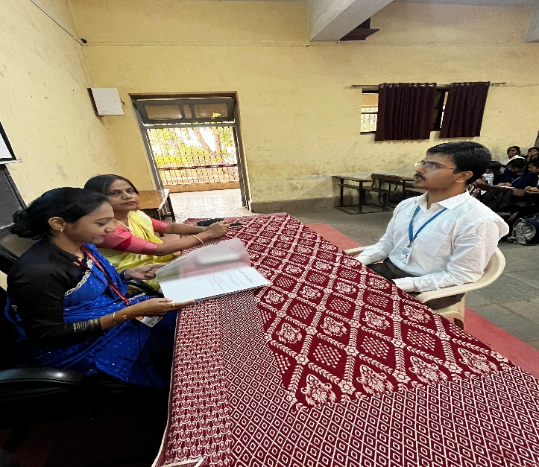
Mock Interviews of Students Day 6
Six Day Certificate Course in Language Skills

Slide 19
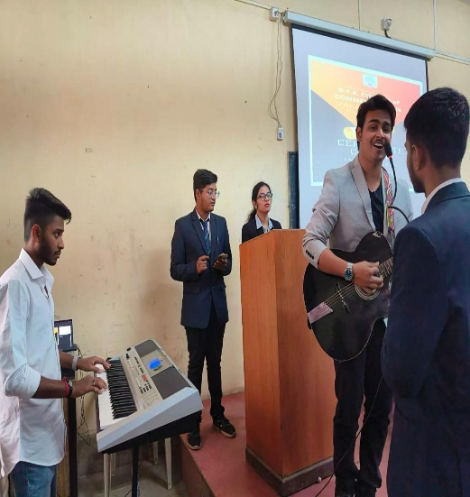
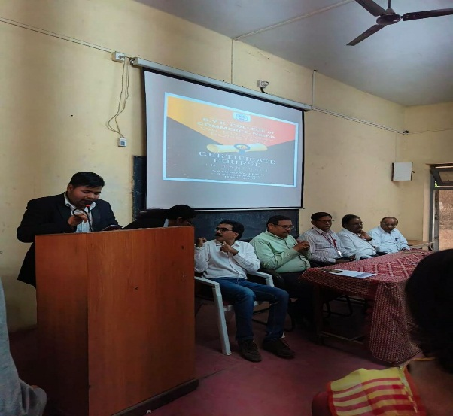
Six Day Certificate Course Valedictory Session
Valedictory Program of Six Day Certificate Course in Language Skills
Sharvari and Bhavik student anchors | Aayan and Prithwish English Welcome song | Harsh – presenting his feedback

Slide 20
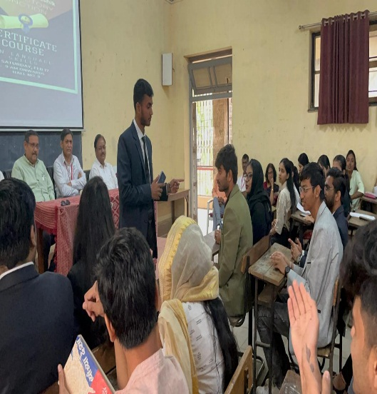
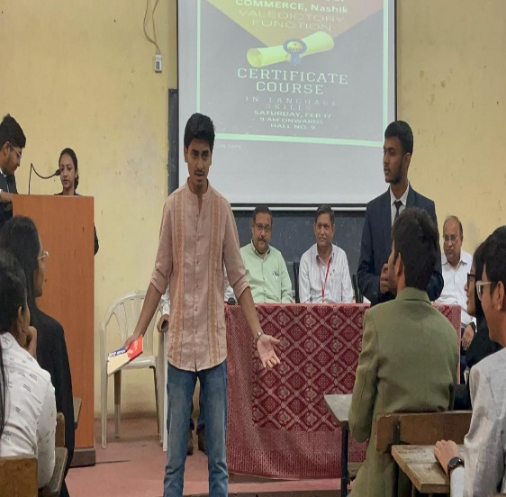
Aditya as Professor Utkarsh as Student
Six Day Certificate Course Valedictory Session – Skit Performance
Valedictory Program of Six Day Certificate Course in Language Skills
Valedictory Program of Six Day Certificate Course in Language Skills

Slide 21
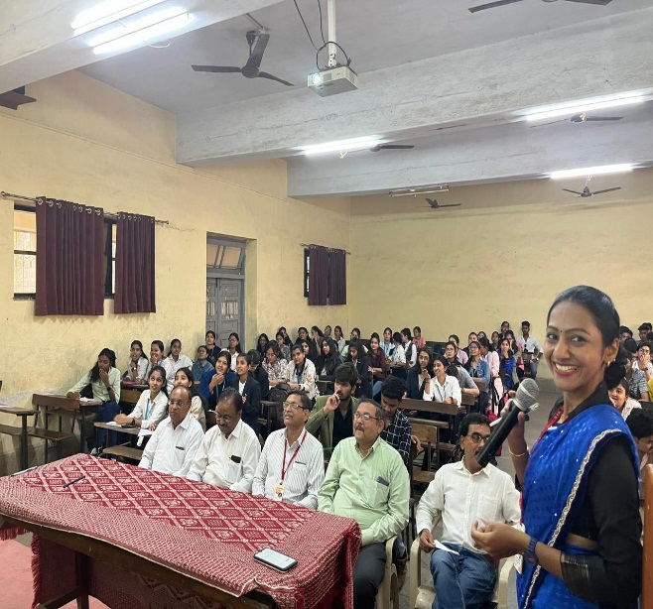
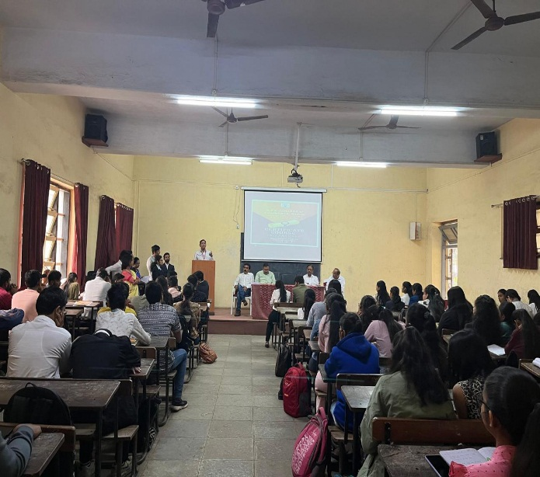
Valedictory Program - Six Day Certificate Course in Language Skills
Language activity for all: Principal Sir, Vice Principals and all the students | Uttam Sonkamble - Deptt of English, Report Reading of the Certificate Course

Slide 22
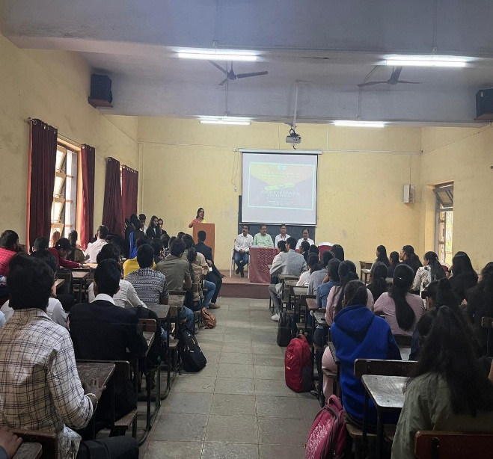
Principal Dr V N Suryawanshi Sir’s Address Ananya Chaudhary – Thanks giving
Valedictory Session - Six Day Certificate Course in Language Skills

Slide 23
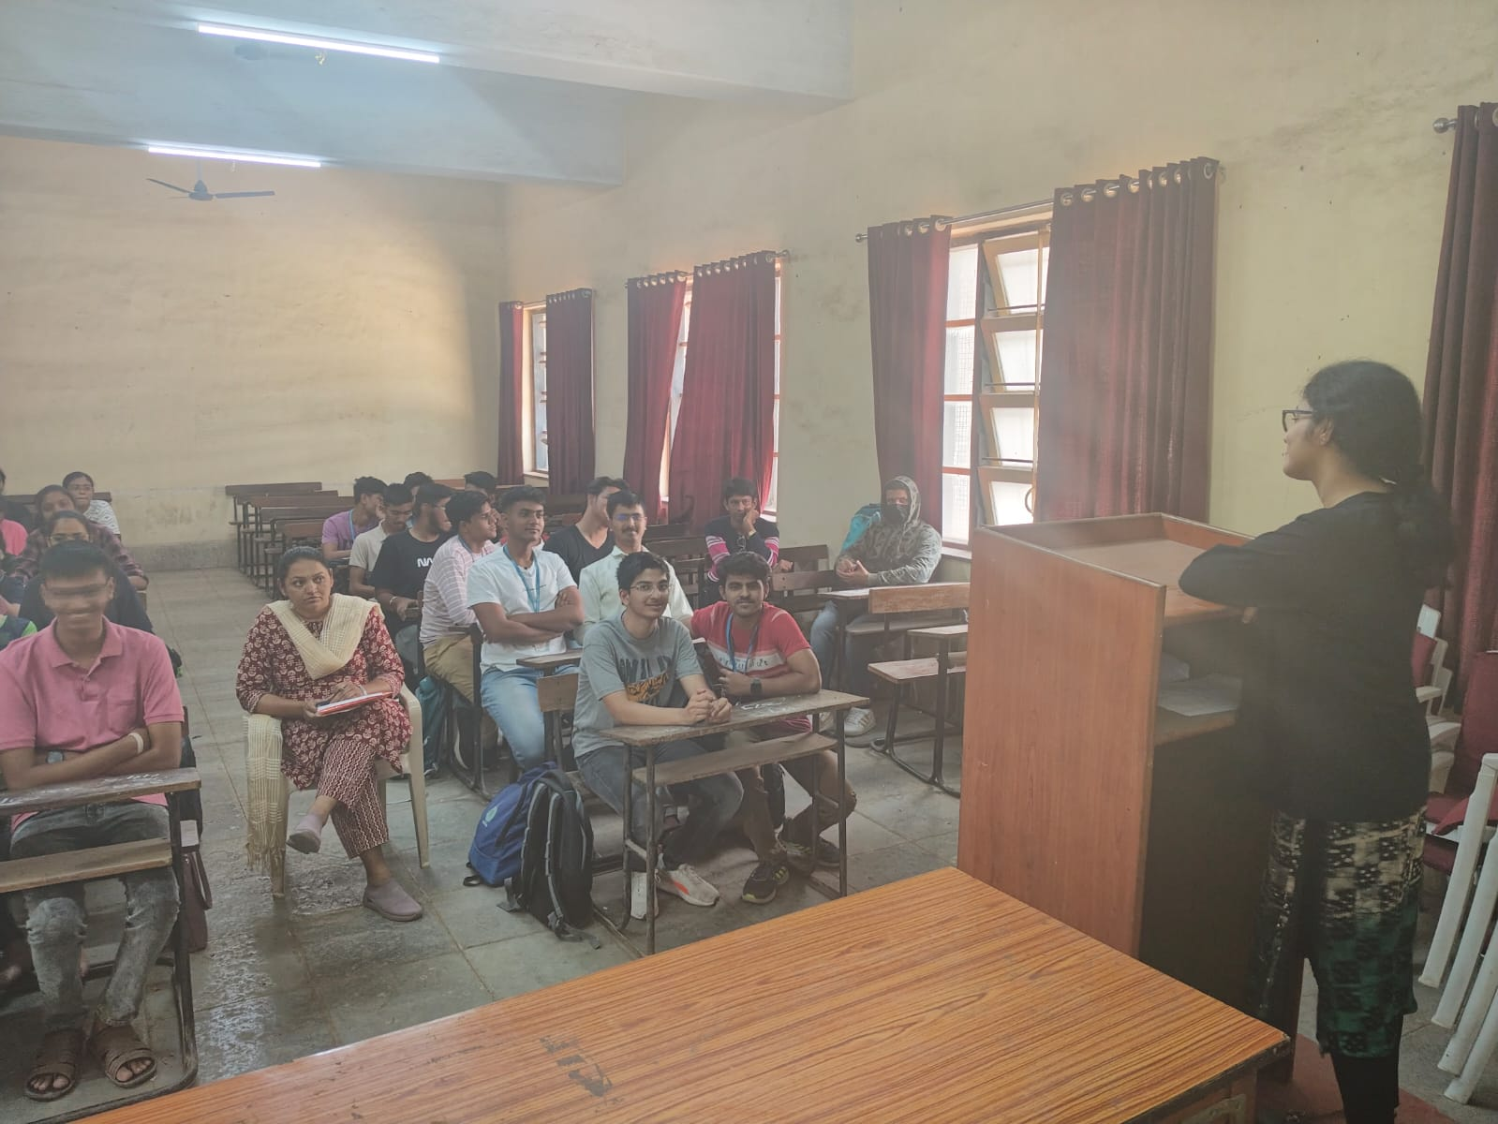
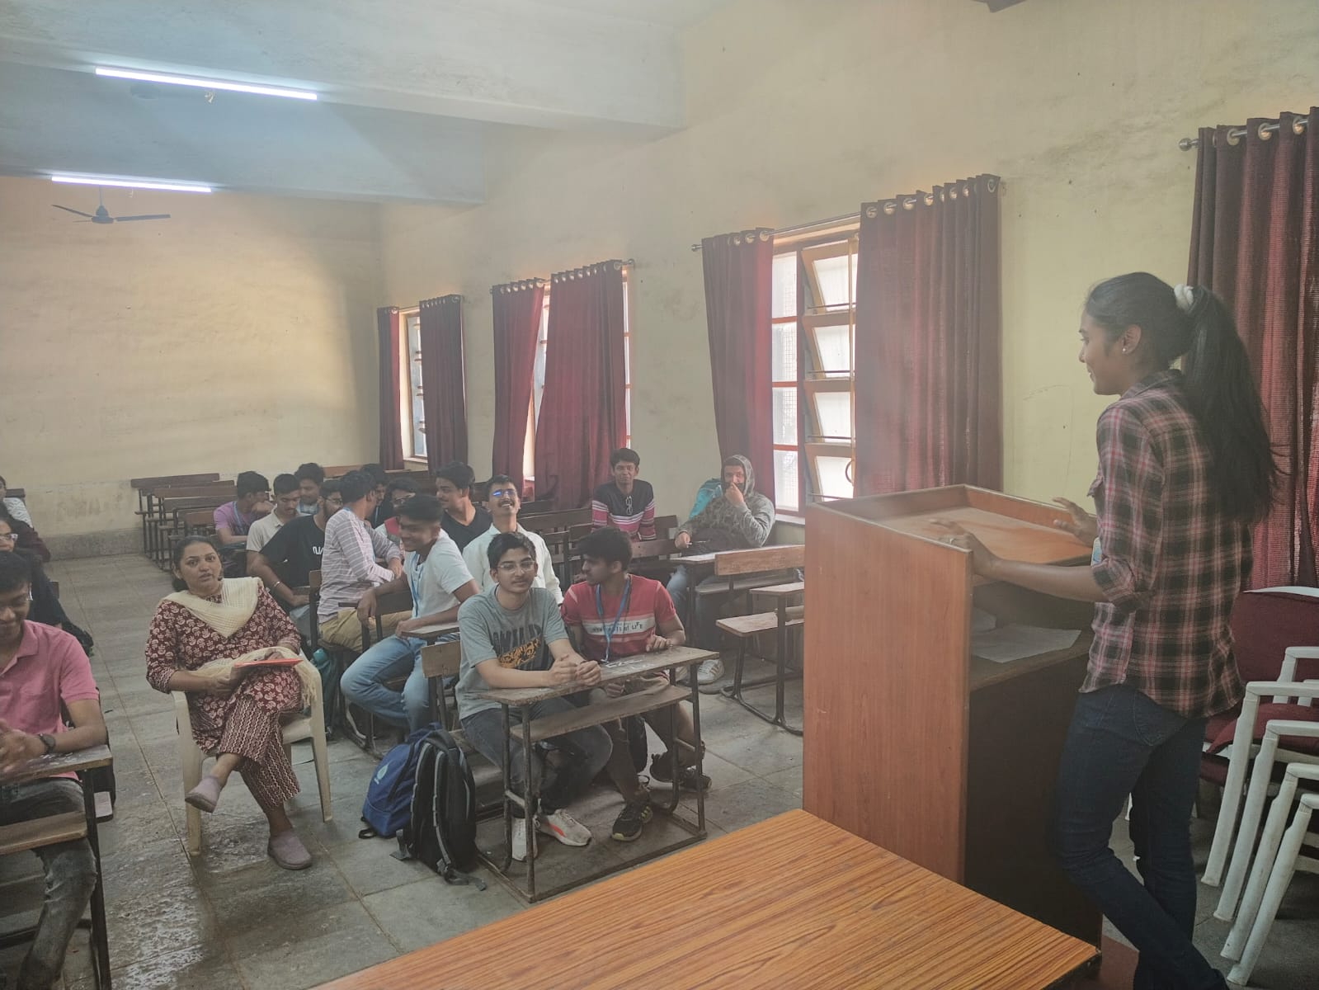
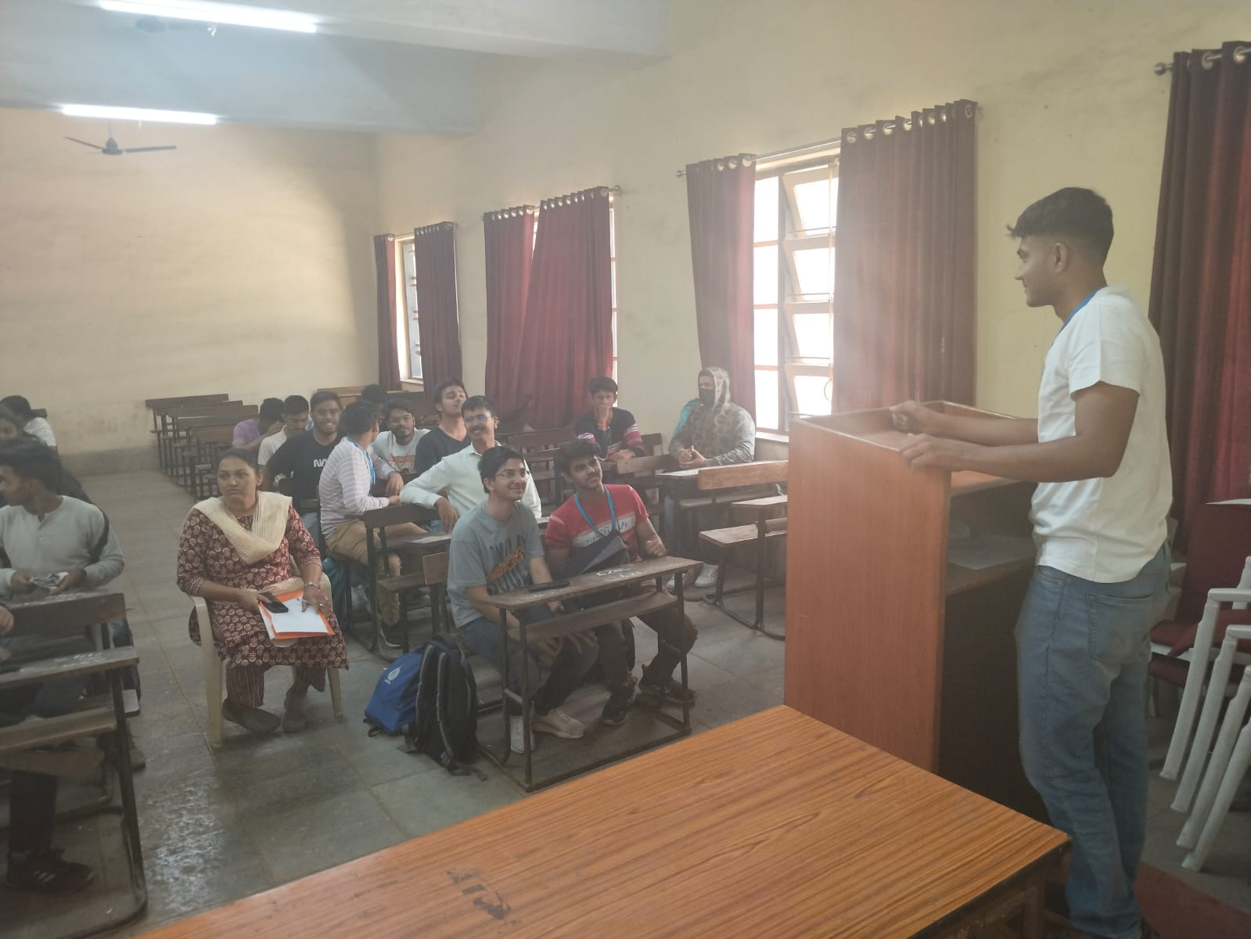
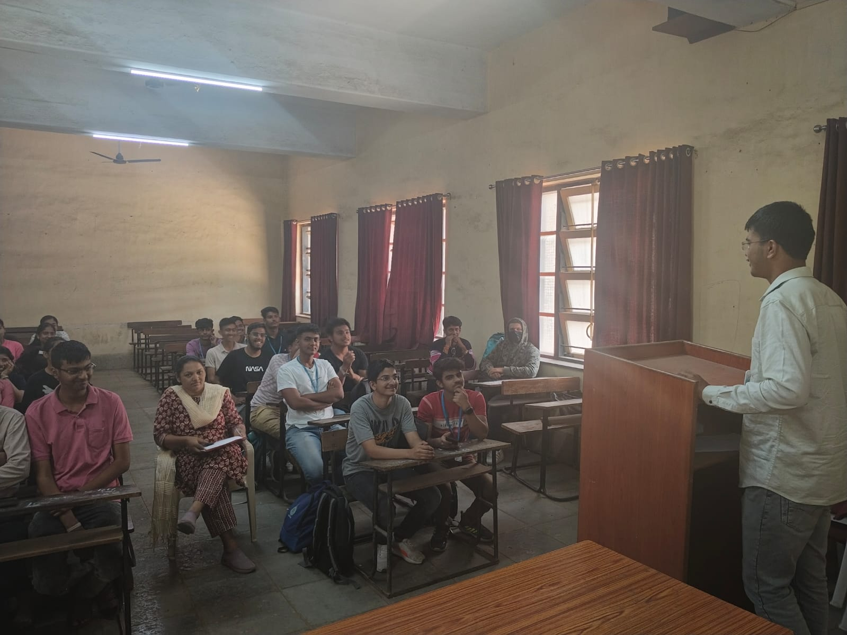
Best Practices of the Department
Presentations 2023-2024

Slide 24
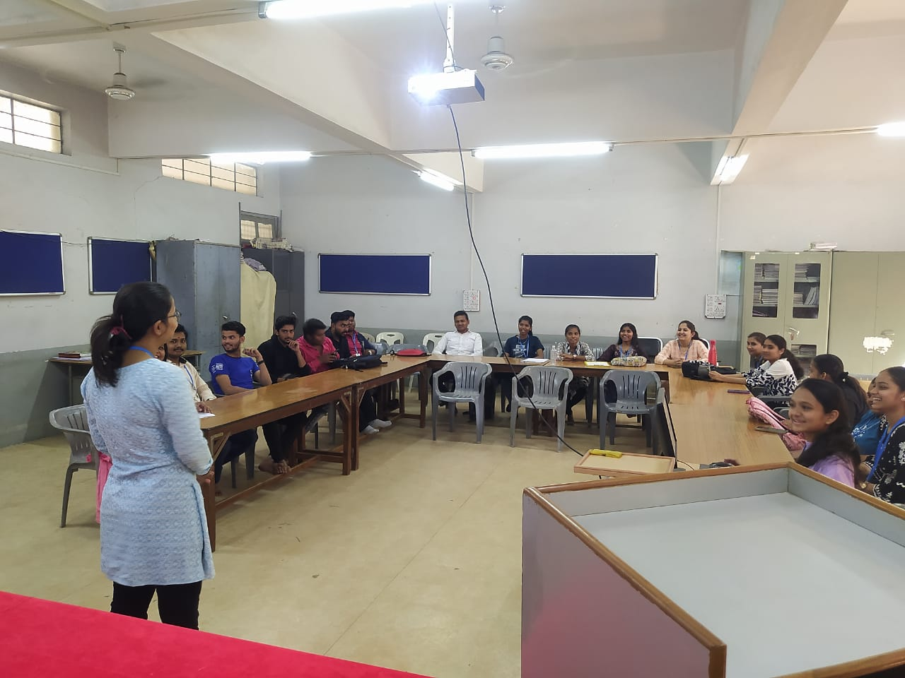
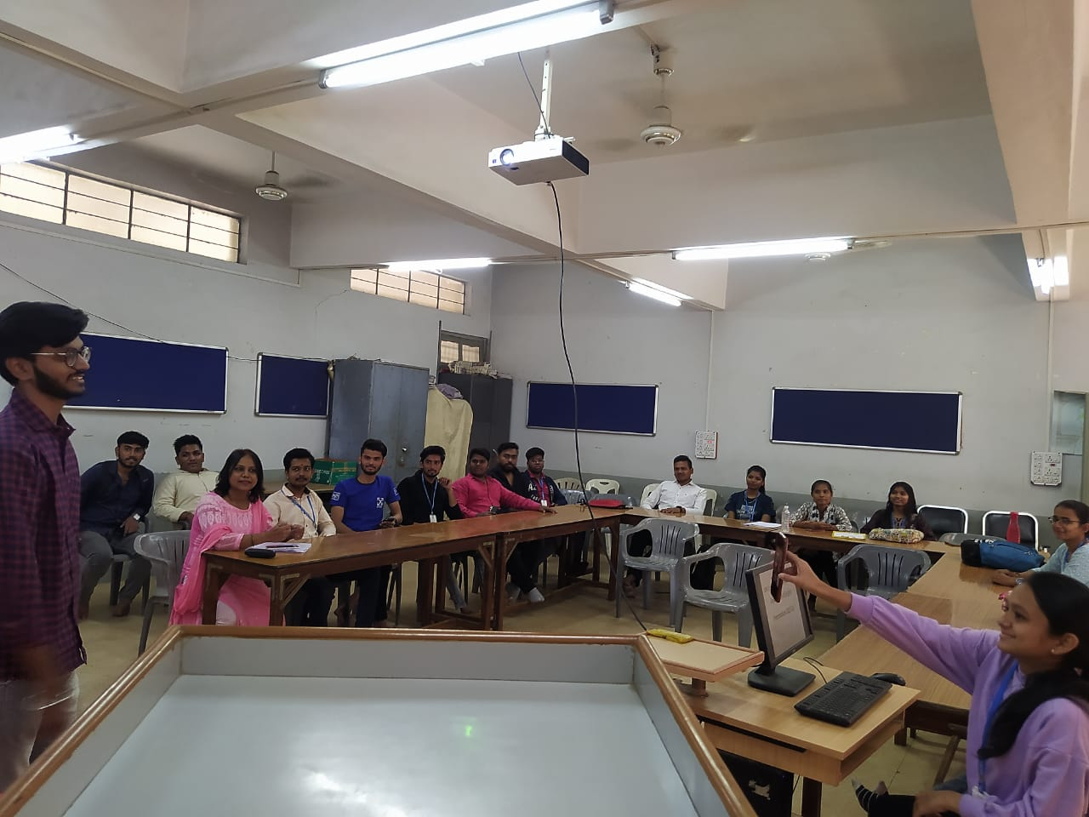
Best Practices
Presentations 2022-2023

Slide 25
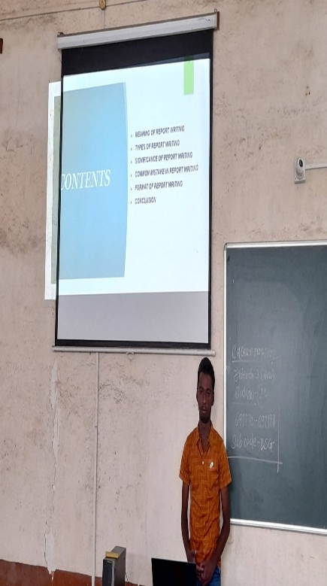
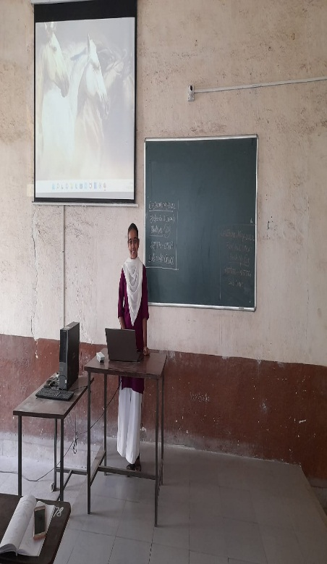
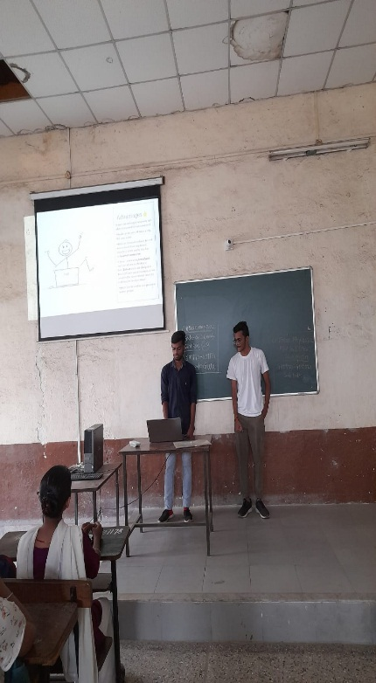
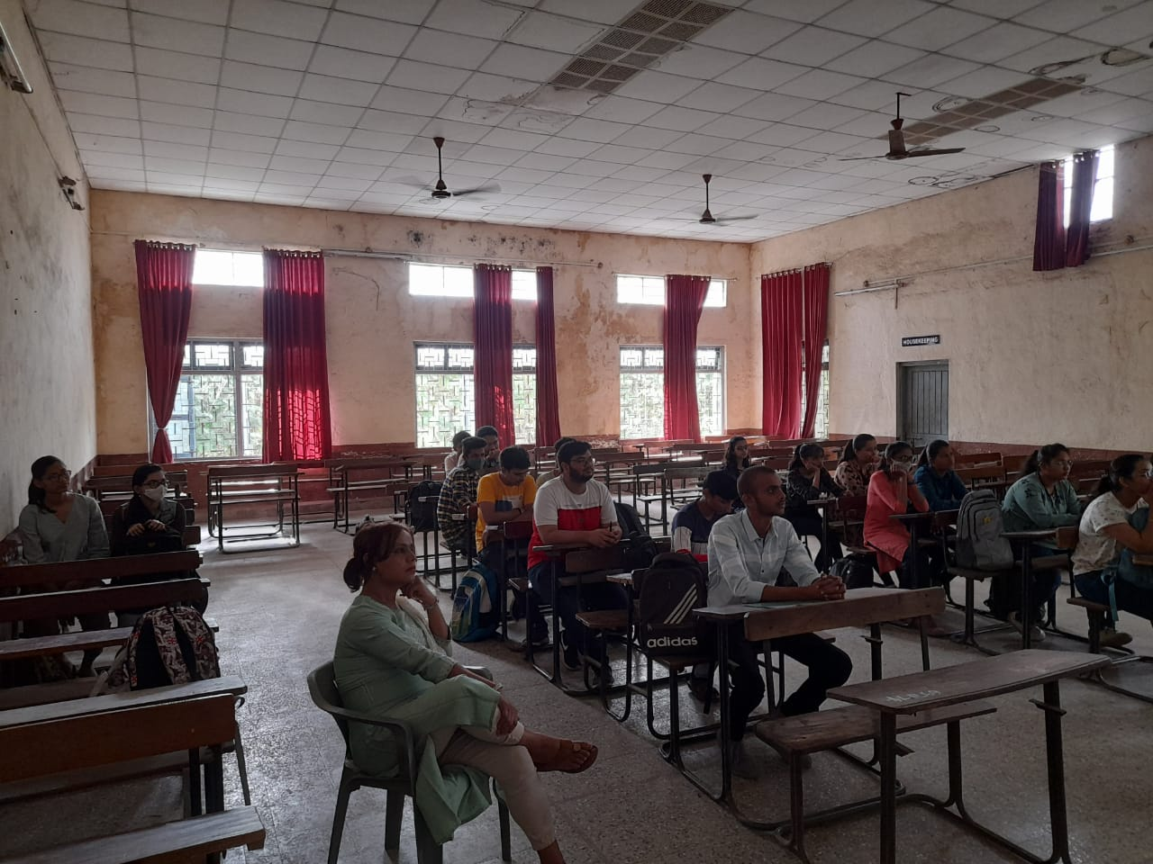
Best Practices
Presentations
Presentations 2021-2022

Slide 26
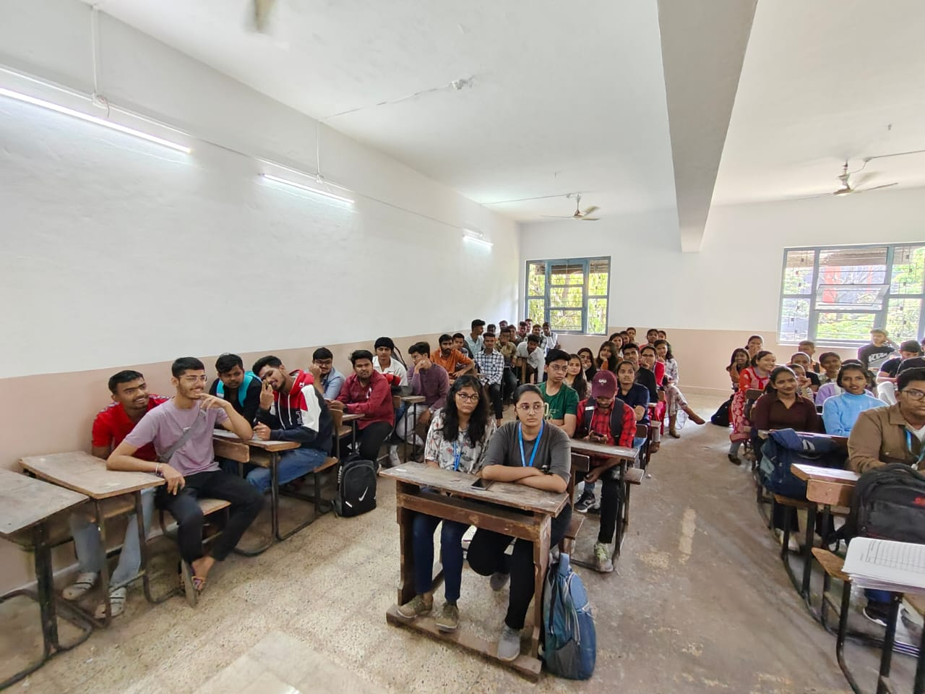
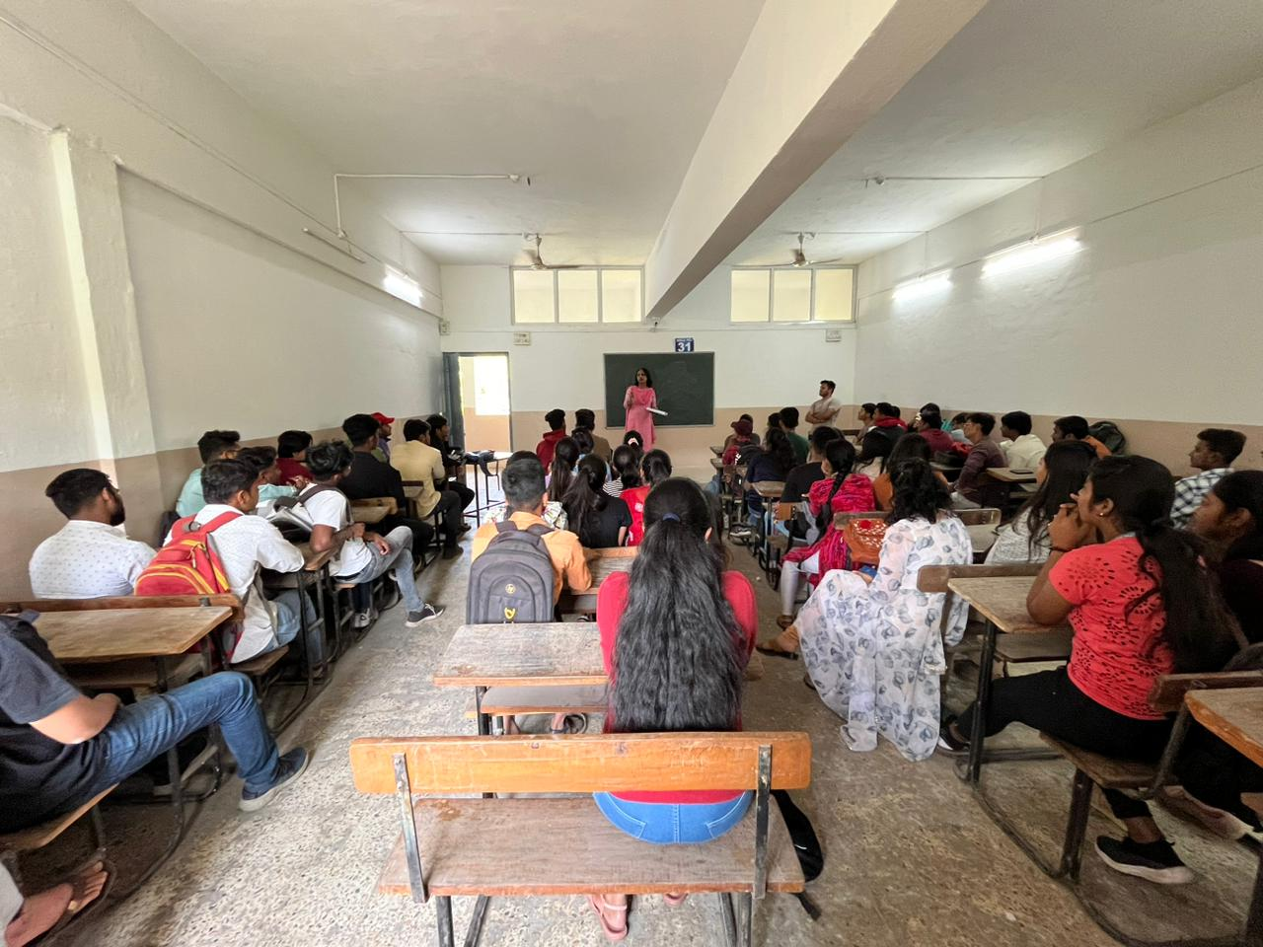
Best Practices
Remedial Course 2023-2024

Slide 27
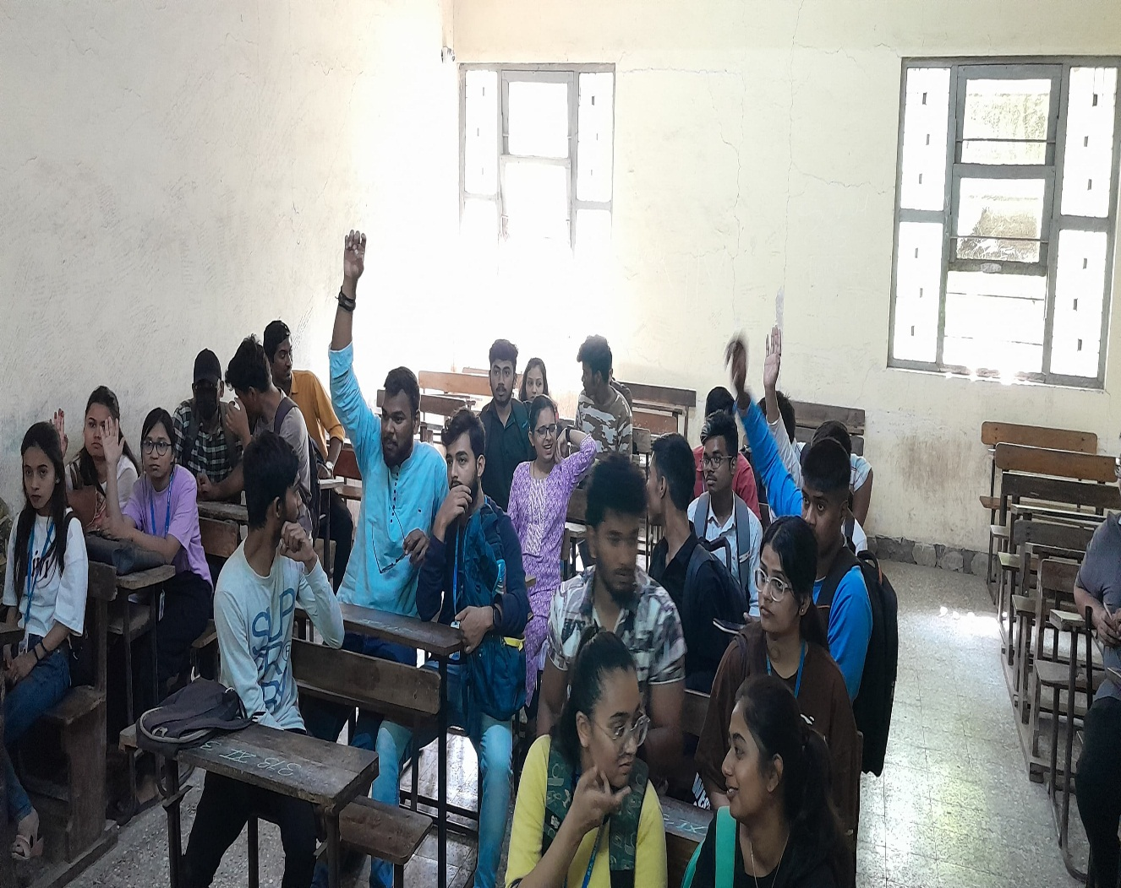
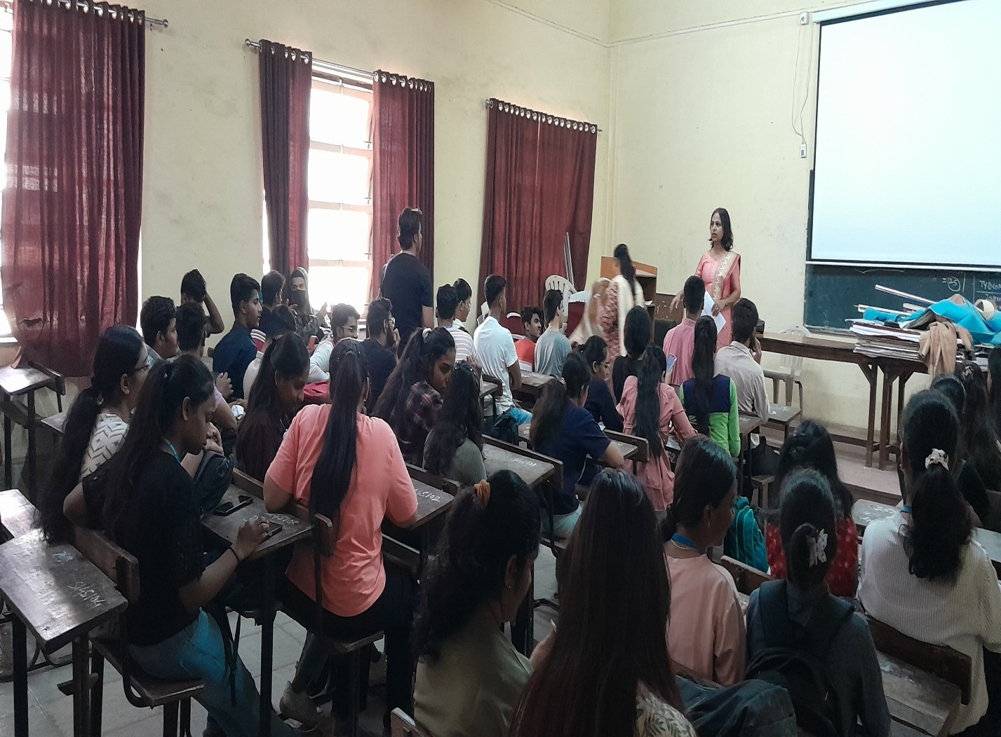
Best Practices
Remedial Course 2022-2023

Slide 28
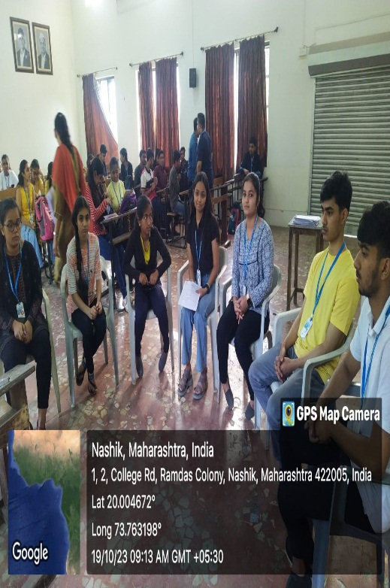
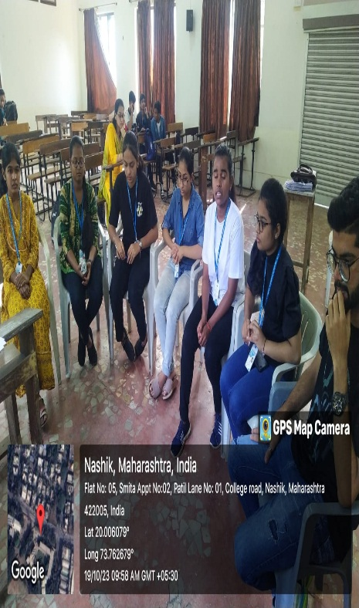
Group Discussion 2023
Best Practices

Slide 29
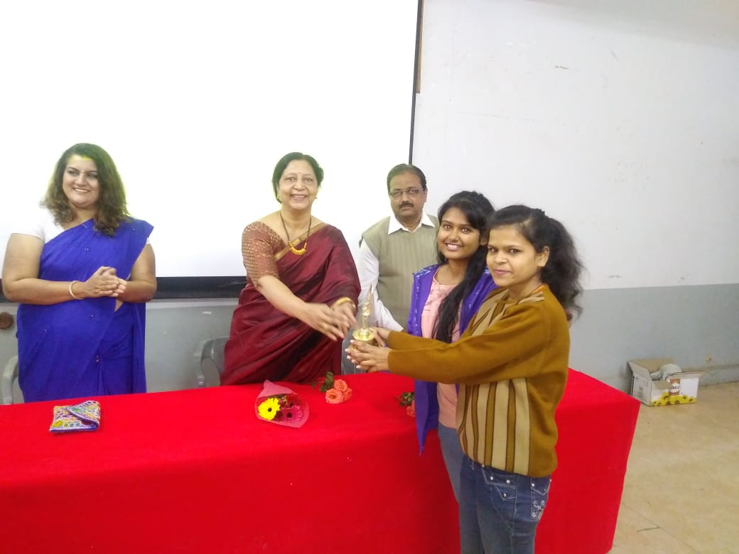
Activities Late Shri Satish Chandra Rotating Trophy Elocution Competition - 07.01.2019 Winner – HPT College Nasik Second Prize – KNM College Satana

Slide 30
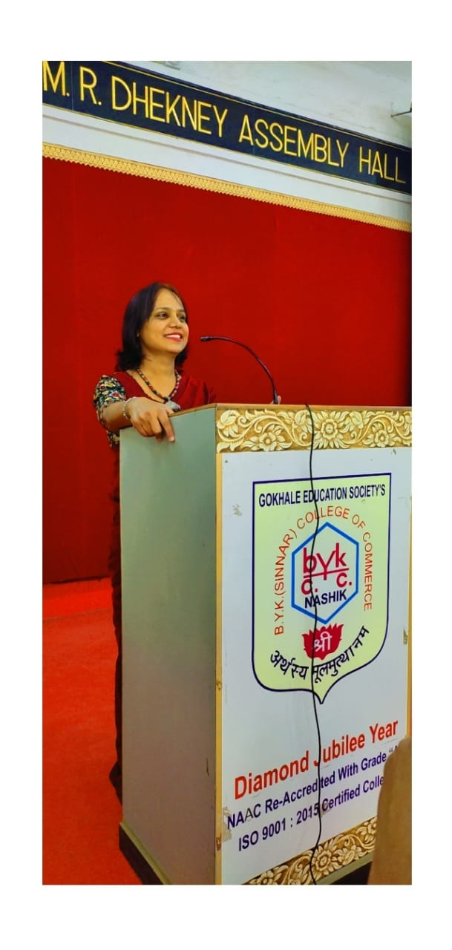
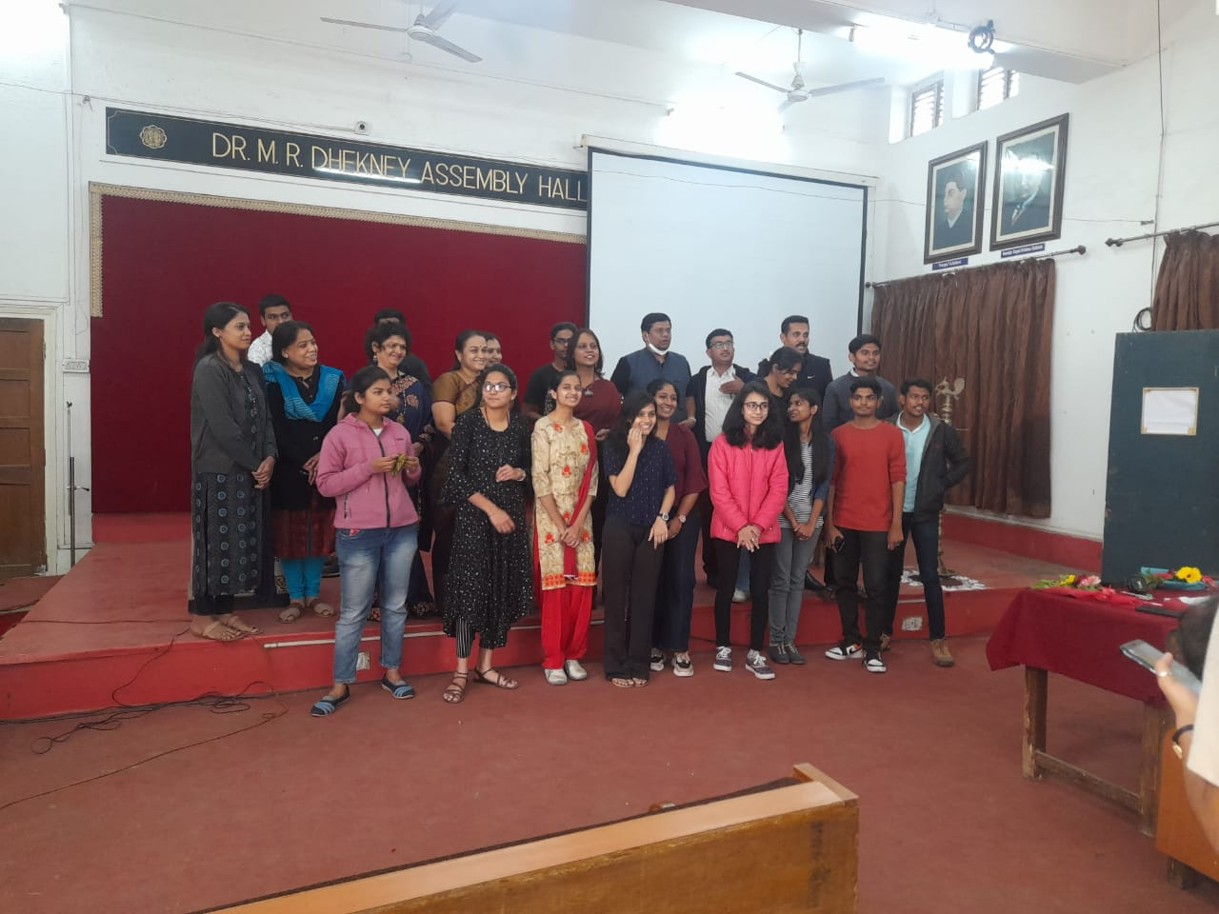
Essay Writing Competition – Bank of Maharashtra 04.11.2022
Activities

Slide 31
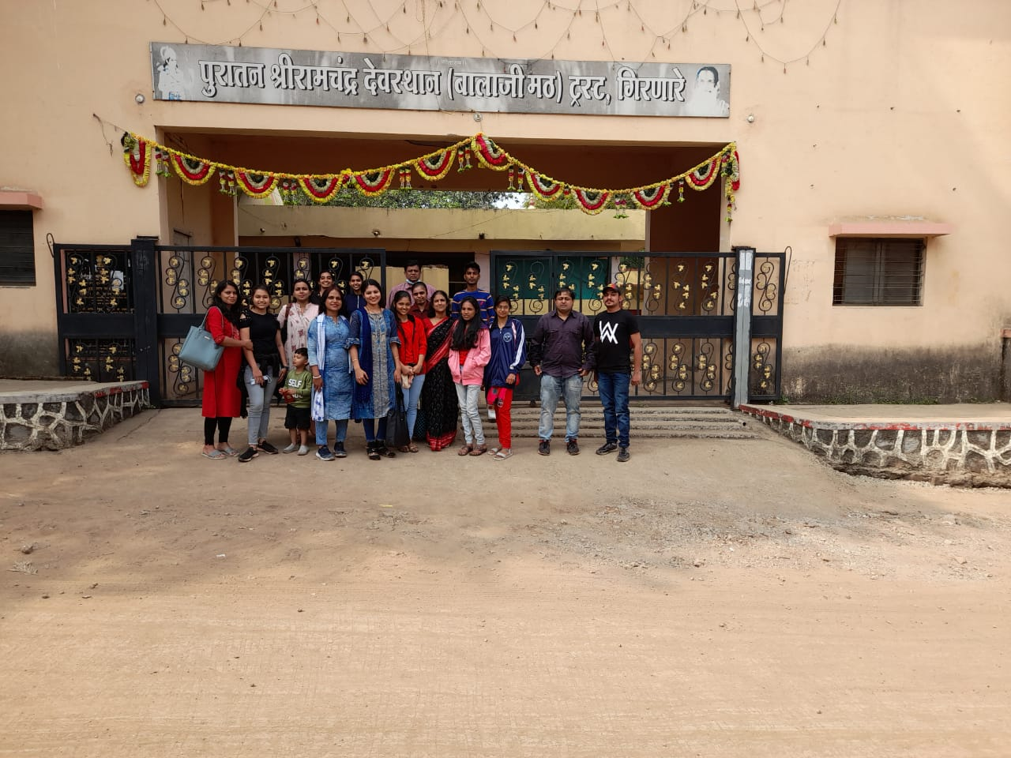
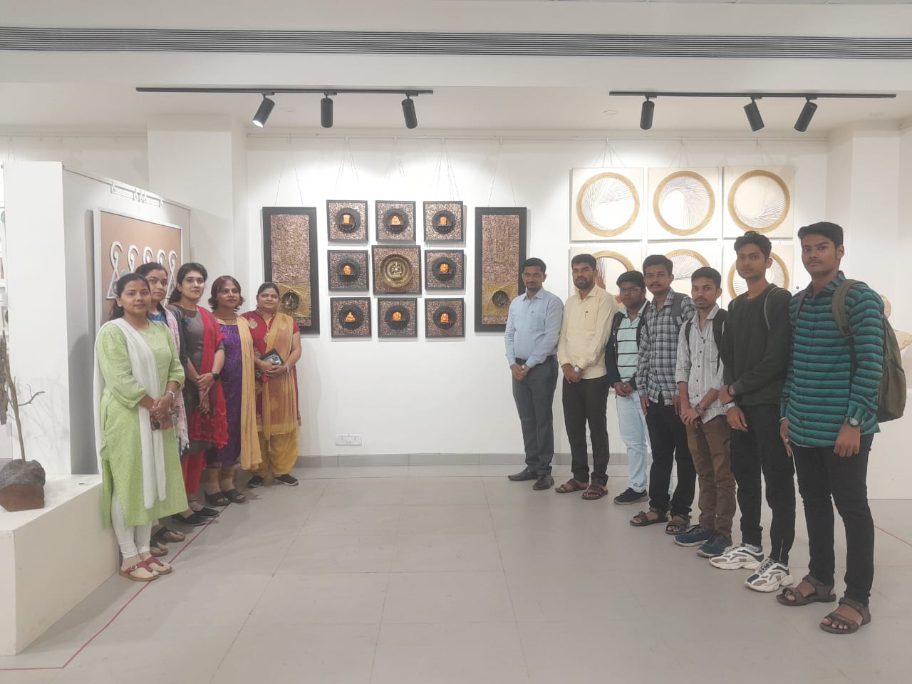
Activities
Visit to NSS Camp 14.12.2021 Visit to Art Exhibition 23.08.2023

Slide 32
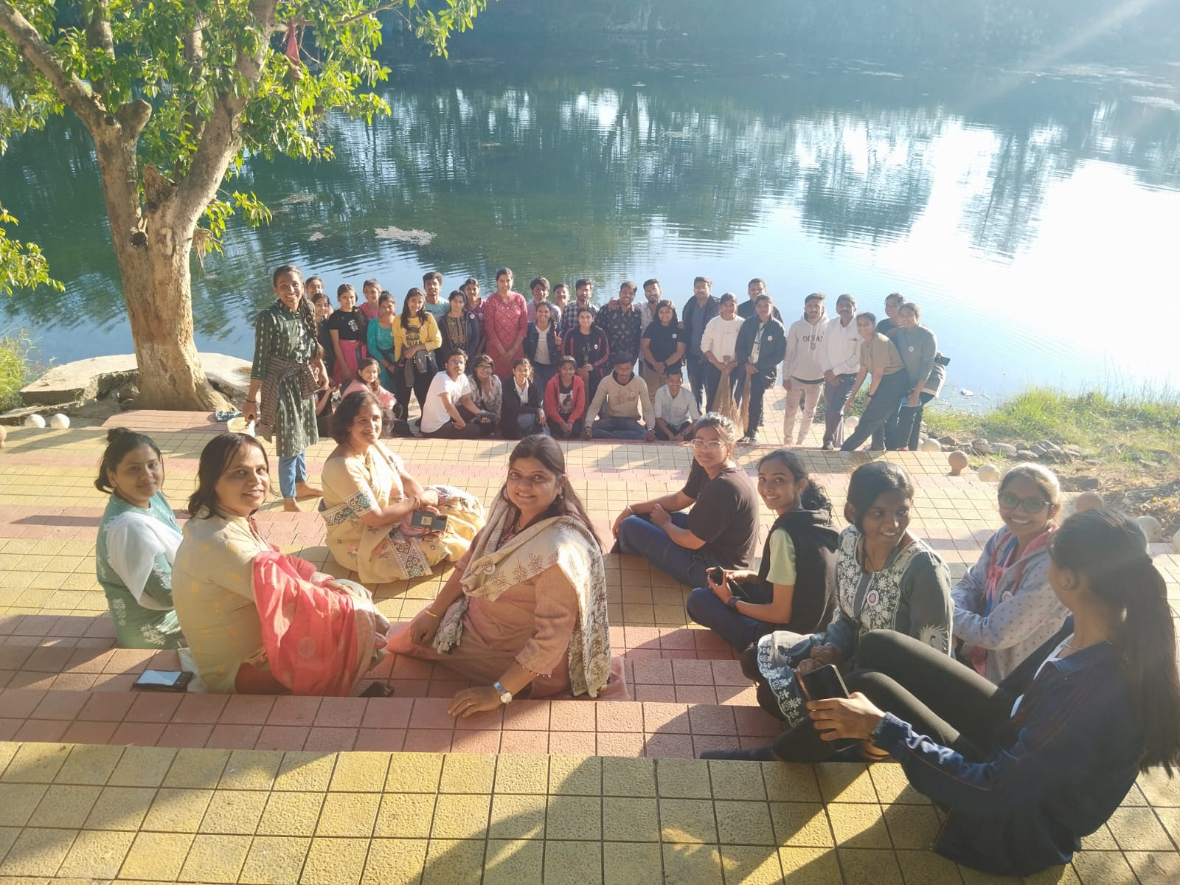
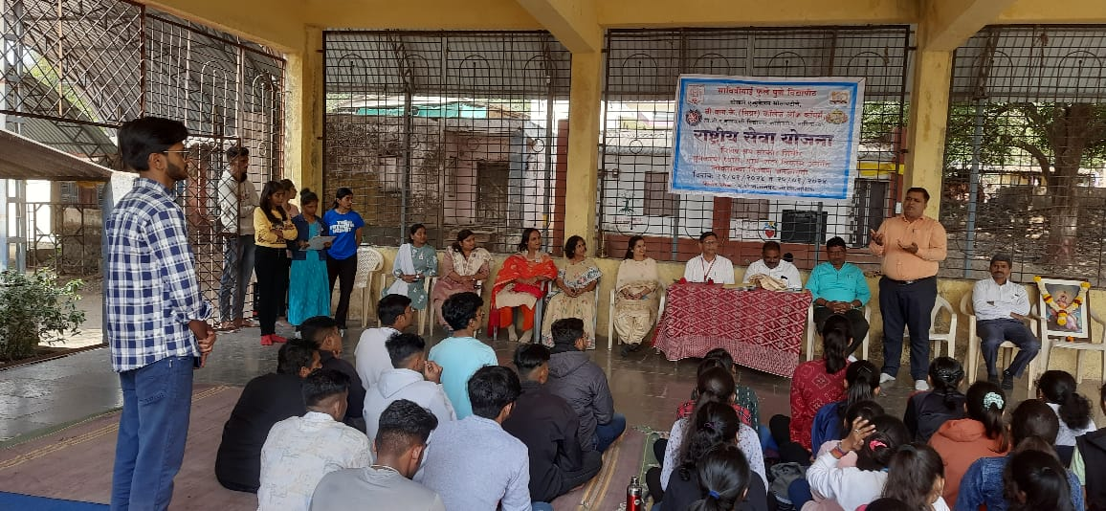
Activities
NSS Camp Visit 2022-2023

Slide 33
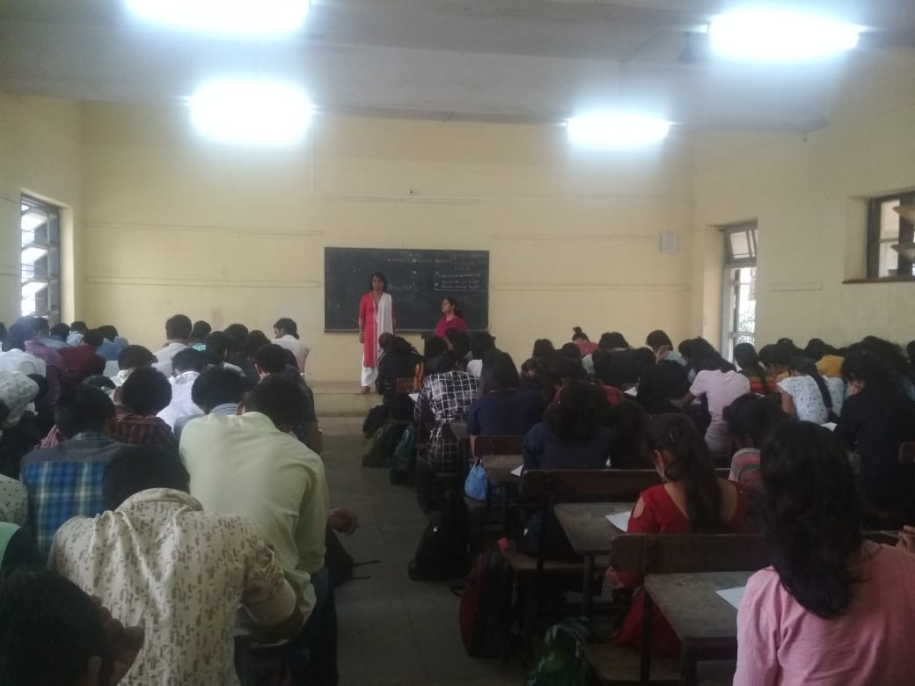
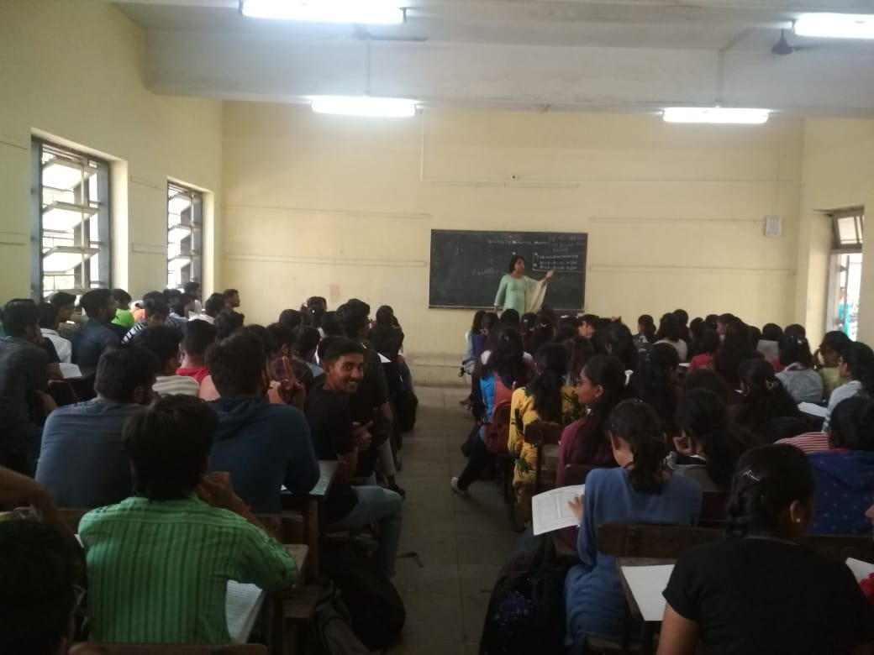
1. Sem I - Employability Skill Enhancement Programme – VA 2 2. Sem II – Value Education – VE 5
Add on Course - Value Added Course

Slide 34
Internal Test
Assessment

Slide 35
Publication in ISSN Journals
Year | Name of Faculty | UGC List/CARE | Refereed
2022-2023 | Sachin Bagul | 01 | -
 | Sonali Mharsale | 01 | -
2021-2022 | Vaishali Patil | - | 02
2019-2020 | Uttam Sonkamble | 01 | 03
2018-2019 | Uttam Sonkamble | 01 | -
 | Vaishali Patil | 02 | -

Slide 36
Paper Presentation in Seminars and Conferences
Year | Name of Faculty | National | International
2022-2023 | Sachin Bagul | 01 | 01
 | Sonali Mharsale | 01 | -
2019-2020 | Uttam Sonkamble | 01 | -
 | Dr Vaishali Patil | 02 | -
2018-2019 | Uttam Sonkamble | 01 | 01
 | Ananya Chaudhary | 01 | -
 | Sonali Mharsale | 01 | -

Slide 37
Articles/Books Publication
Year | Name of Faculty | Books with ISBN | Articles in edited book with ISBN
2022-2023 | Vaishali Patil | 01 | -
 | Sachin Bagul | - | 01
2019-2020 | Uttam Sonkamble | 01 | -
 | Sachin Bagul | - | 01

Slide 38
Invited as Guest Speaker
Year | Name of Faculty | No of Guest Lectures/Talks
2023-2024 | Sonali Mharsale | 01
2022-2023 |  | 03
2021-2022 | Sachin Bagul | 04
 | Sonali Mharsale | 02
2020-2021 | Sachin Bagul | 04
 | Sonali Mharsale | 01
2019-2020 | Vaishali Patil | 02
2018-2019 | Sachin Bagul | 02
 | Ananya Chaudhary | 01

Slide 39
PhD Guidance
 | Name of Faculty | Awarded | Registered | University
2022 | Uttam Sonkamble | - | 04 | Savitribai Phule Pune University Pune
 |  | 01 | - | Bahinabai Chaudhari North Maharashtra University Jalgaon
2022
 |  | 01 | - | Bahinabai Chaudhari North Maharashtra University Jalgaon
2021

Slide 40
Workshops/Seminars/Conferences Attended
 |  | State | National | International
 | Uttam Sonkamble | - | 01 | 01
 | Ananya Chaudhary | 04 | 01 | 01
 | Sonali Mharsale | - | 03 | -
 | Dr Vaishali Patil | 01 | 02 | -

Slide 41
Faculty Development Course
Year | Name | Organisers | Duration | Place
2020-2021 | Uttam Sonkamble | HRDC SPPU Pune | 10 Days | YCMOU Nasik
2018-2019 | Ananya Chaudhary | MSGF Mumbai | 01 Day | Nasik

Slide 42
Ms Ananya Chaudhary Best Teacher Award 2021-2022 Dr Vaishali Patil – Best Research Paper Award 2023
Faculty Achievement
Six Day Certificate Course in Language Skills

Slide 43
Result Analysis
Compulsory English: above 85%

Slide 44
Result Analysis
Additional English: above 95%

Slide 45
Future Plans
Guest lectures
Workshops: Soft Skills
Visits to (with an aim to acquaint with language and communication practiced):
Deptt of Communication and Journalism HPT College
Language Academy
Commercial Bank
Corporate Office

Slide 46
THANK YOU

