Slide 1


Department of Computer, Mathematics and Statistics
Gokhale Education Society’s
B.Y.K. College of Commerce, Nashik-422005
Dr. Leena M. Bhat
Vice Principal and HOD
GES’s BYKCC, Nashik

Slide 2


Slide 3

Contents
Objectives
Staff List
Courses Undertaken by the Department
Workload
Research and Development
Staff Contribution in Revision of Syllabi
Staff Achievements
Activities Conducted by the Department
Best Practices
Result Analysis
Toppers
Student Achievements
Good Practices
SWOC Analysis
Future Plans

Slide 4
Objectives
1
To impart knowledge and skills in computing
2
To develop proficiency in computer programming and Software project development
3
To create awareness about data handling and analysis
4
To promote mathematical skills and knowledge among students
5
To create competent manpower for IT industries and businesses with commerce expertise

Slide 5
Staff List
Sr. No | Name of the Faculty | Qualification | Experience
1 | Dr. Mrs. Leena M. Bhat (Vice Principal & HOD) | P.h.D., M. Phil (Comp. Sci.) & M.Phil (IT) | 24
2 | Mrs. Suwarna Y . Mulay (Co-ordinator, BBA(CA) | M.C.M., M.C.A. | 16
3 | Mrs. Pradnya D. Bapat (Co-ordinator, B.Com Voc) | M.C.M., M.C.A. | 16
4 | Mrs. Sharda R. Purkar | M.Sc.(Computer Science) | 13
5 | Ms. Yogita A Deore | M.C.A. | 10
6 | Ms. Prajakta S. Salunke | M.Sc(Statistics), MBA(Fin.) | 5
7 | Ms. Ruchita J. Zankar | M.Sc(Statistics) | 3
8 | Mrs. Trupti V. Katare | M.C.A. | 1

Slide 6
Courses undertaken by the department
B. Com
Restructuring
F. Y. B. Com- ‘D’ Component
S. Y. B. Com & T. Y. B. Com- ‘C’ Component
Computer Appreciation
Business Mathematics
Statistical Techniques
Computer Applications and Systems Management (CASM)
Applied Statistics (APST)
B. Com Vocational - Computer Applications
Bachelor of Business Administration (Computer Applications)
F. Y. B. Com
S. Y. B. Com
T. Y. B. Com
F. Y. BBA (CA)
S. Y. BBA (CA)
T. Y. BBA (CA)
F. Y. B. Com
E-Commerce

Slide 7
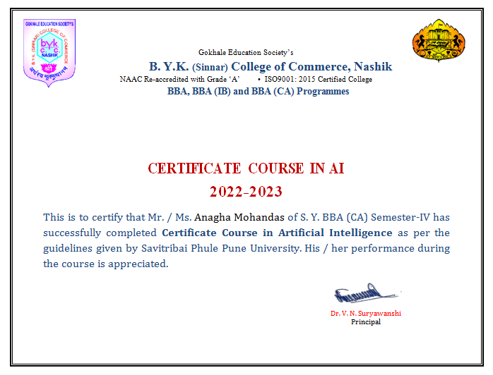
Certificate Course in Artificial Intelligence
Course Objectives
To introduce the concepts of Artificial intelligence and methods
To provide the knowledge representation and Learning techniques to problem solving strategy
To design and understand real world problems using AI approaches
To implement AI techniques in different fields.
Enrollment Year | No. of students
2022-23 | 84
2023-24 | 84

Slide 8
Workload
Restructuring Course B. Com.(CASM & APST)
B. Com. Vocational (Computer Applications)
36
B. B. A. (Computer Applications)
78
64

Slide 9
Teaching & Evaluation Methods
Lectures
Guest Lectures
Practical
Project Work
Seminars
Presentations
Workshops
Online Teaching
Tutorial
Internal Exam
Home Assignments
Viva- Voce
Journals
Presentation of Projects
Semester Exam
Online Evaluation

Slide 10
Research and Development
Patent in Artificial Intelligence
01
International Level Seminar
04
National Level Seminar
05
State Level Seminar
27
Research Papers Published
10
Publication of Book
02

Slide 11
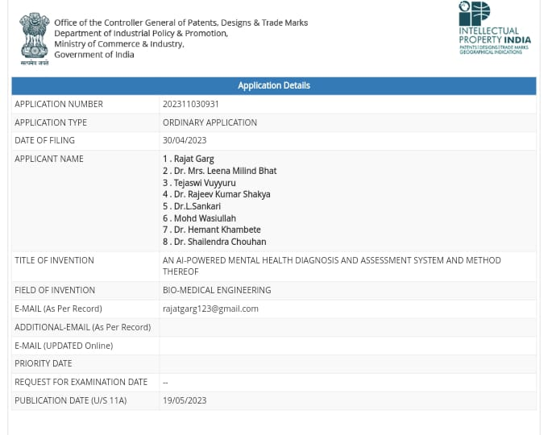
Patent in Artificial Intelligence

Slide 12
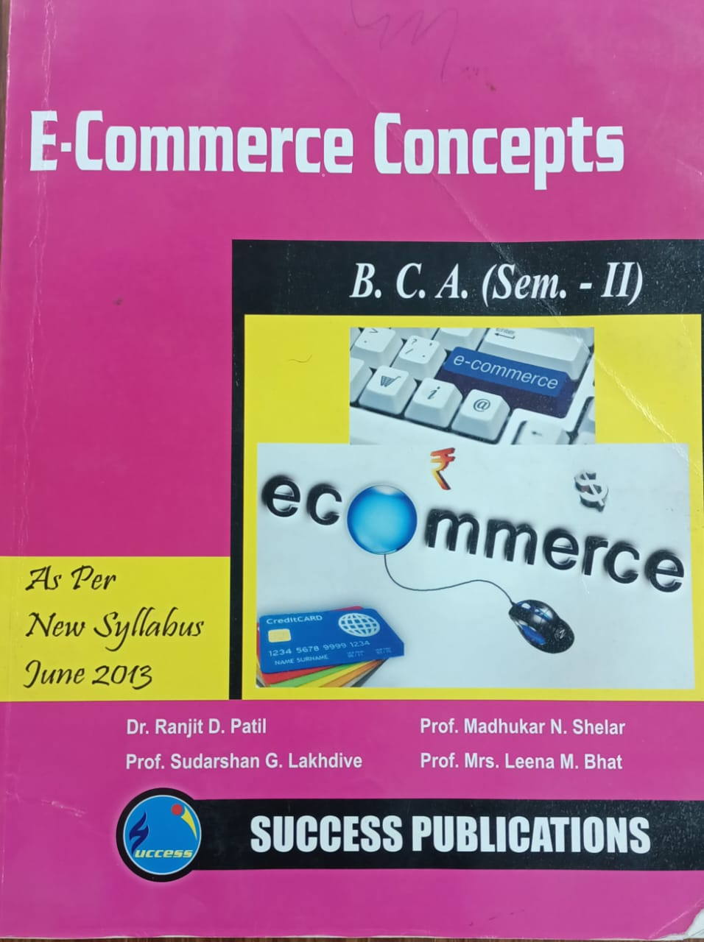
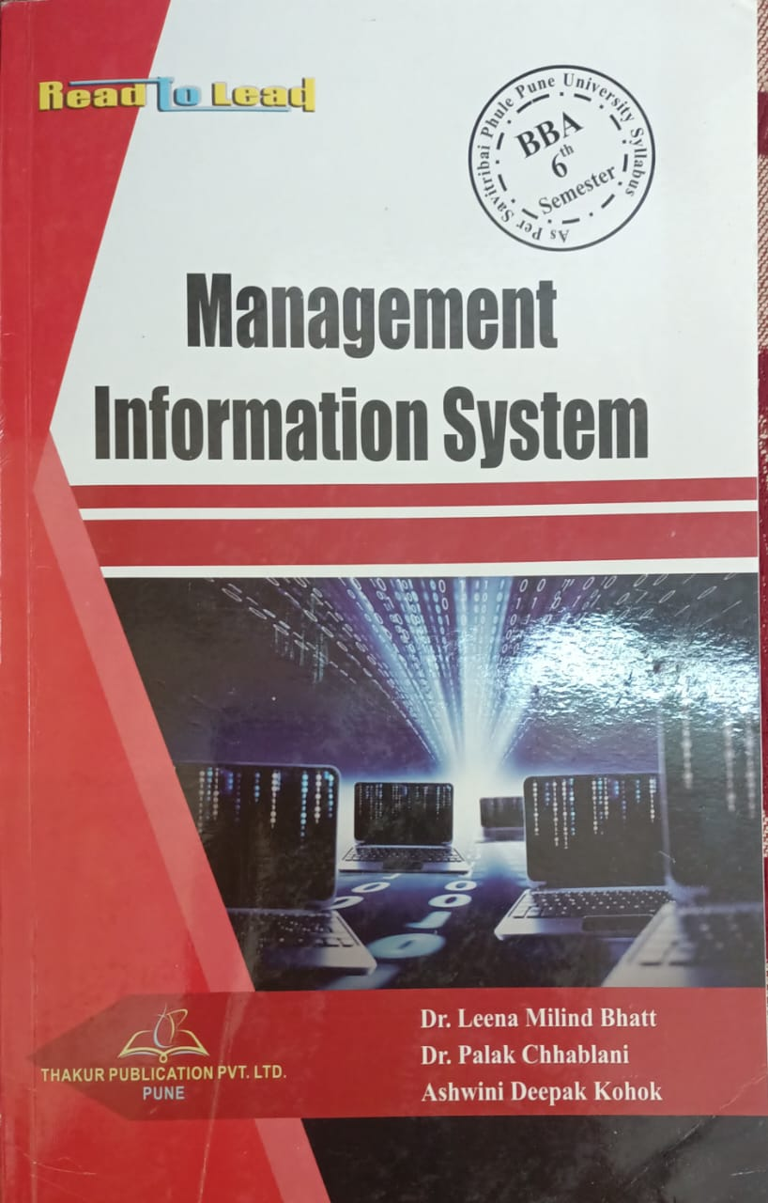
Books Published

Slide 13
Staff contribution in Revision of Syllabi of SPPU, Pune
D’ Component Subject: Computer Appreciation at FYBcom | 03
C’ Component Subject: CASM at SYBcom | 03
C’ Component Subject: CASM at TYBCom | 03
BBA(CA) Syllabus | 03
Preparation of Lab book | 01
Preparation of Practical Slips | 02

Slide 14
Staff Achievements
Dr. Mrs. Leena M. Bhat
Board of Studies
  Steering Committee member of B.Com Restructuring Committee
  Board of Studies member of BBA(CA) Course, SPPU, Pune
  Board of Studies member of B.Com (Vocational) Course
  B.Com Computer and Statistics Board, SPPU, Pune
  Appointed as Ph.D. Guide of SPPU
  MMS Computer Management Board, North Maharashtra University Jalgaon
Membership
  Life member of Gokhale Education Society
  Life member of MCEAM(Maharashtra Council of Educational Administration and Management)
  Life member of IIPA(Indian Institution of Public Administration)
  Life member of ISTD (Indian Society for Training & Development)
  Member of Sarvajanik Vachanalay, Nashik

Slide 15
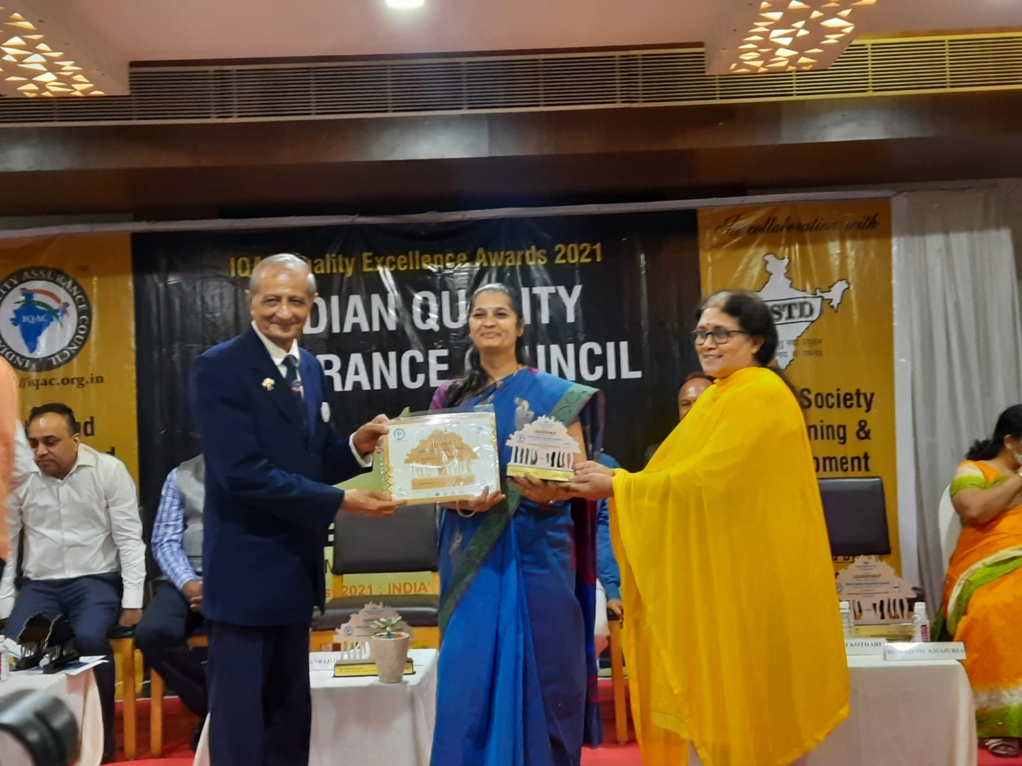
Awards
  IQAC Excellence Award in Individual Category by Indian Society for Training and Development, Delhi on 15th August 2021.
  Mahila Gaurav award in Education category by Supreme foundation and Indian Red cross Society, in March 2019
  Accountability prize by B.Y.K. College of Commerce, Nashik in 2019.
  Best Teacher award by Gokhale Education Society, in September 2018.
Receiving IQAC Excellence Award

Slide 16
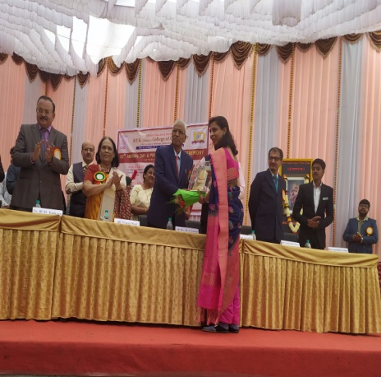
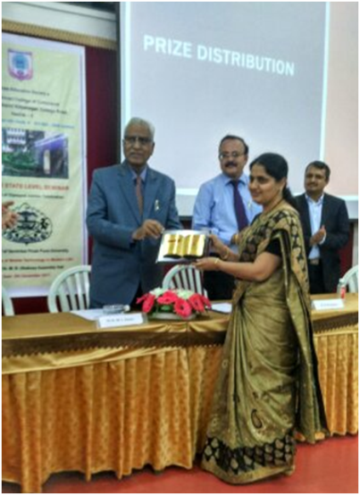
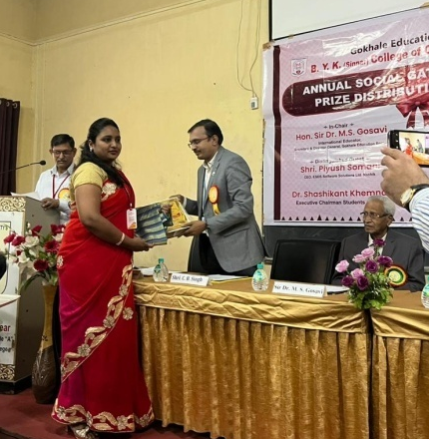
Mrs. Suwarna Mulay
  BOS Member of BBA(CA) course, SPPU, Pune
  Best Teacher award by B.Y.K. College of Commerce, Nashik in 2020.
  Accountability prize by B.Y.K. College of Commerce, Nashik in 2019
Mrs. Pradnya Bapat
  BOS Member of BBA(IB) course, SPPU, Pune
  Best Teacher award by B.Y.K. College of Commerce, Nashik in 2018.
  Accountability prize by B.Y.K. College of Commerce, Nashik in 2021
  Member of Sarvajanik Vachanalay, Nashik
Mrs. Shital Patil
  Best Teacher award by B.Y.K. College of Commerce, Nashik in 2022.

Slide 17
Activities Conducted by the Department
Induction Programme for the Staff
Induction Programme for Student
Seminar
Guest Lectures
Sir Dr. M. S. Gosavi Technomohotsav
  Intercollegiate Software Development Competition
  Web Designing Competition
  Scribble Competition
  Scratch Competition
  Black Coding competition
Software Exhibition
Celebration of National Mathematics Day

Slide 18
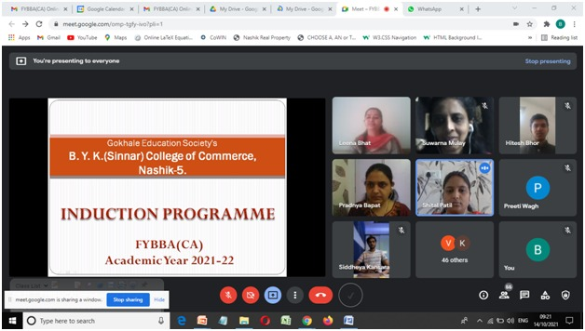
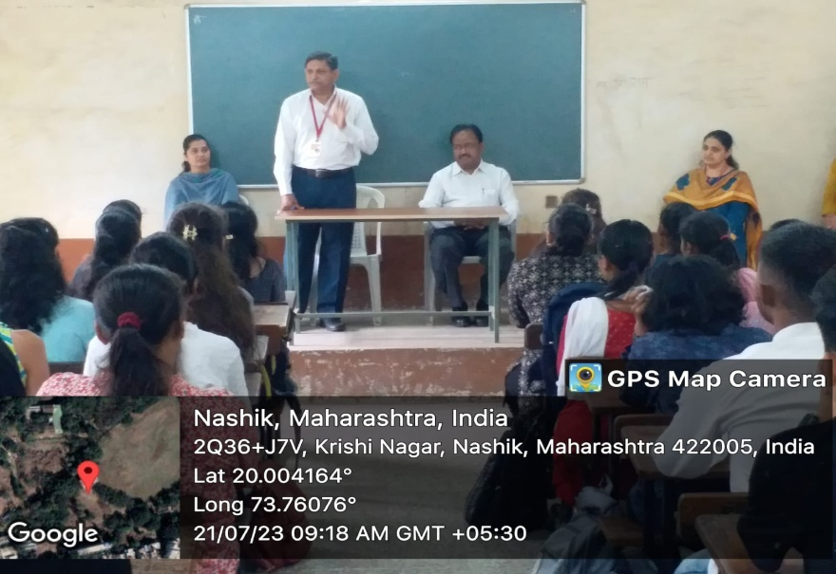
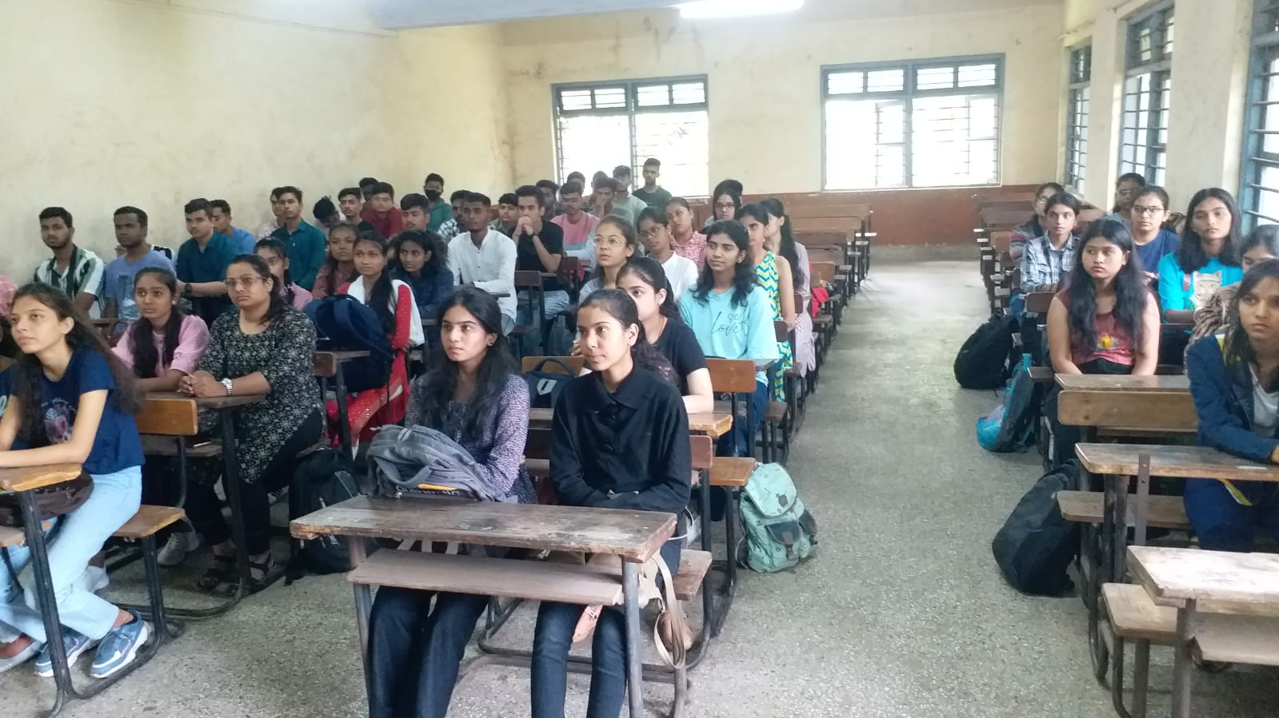
Induction Programme
Every year Induction Programme was conducted at the starting of new academic year for newly appointed staff and students.

Slide 19
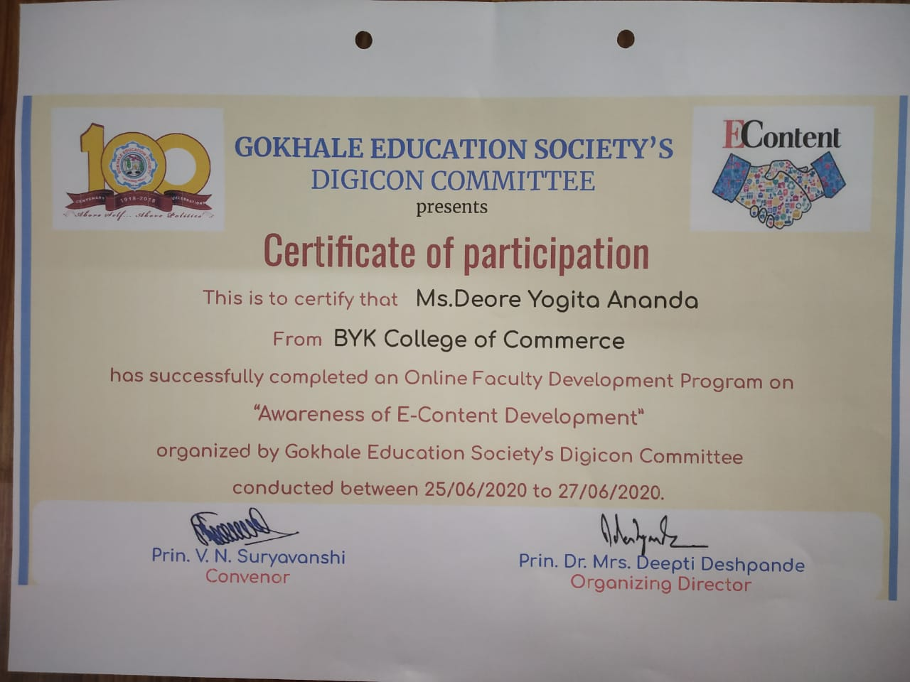
Faculty Development Programme
Computer Department in collaboration with Gokhale Education Society has taken initiative for training the staff for Online teaching-learning tools such as Zoom, Google Meet and E-Content Development from 25th June to 27th June 2020.

Slide 20
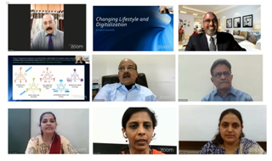
National Webinar on Digitalization
Webinar on Changing life style and digitalization was organized on 18th July 2020 for faculty members.
Mr. Sanjay Kulkarni from North Carolina as the Resource Person for the Webinar.
The Webinar was organized by IQAC and Computer department.

Slide 21
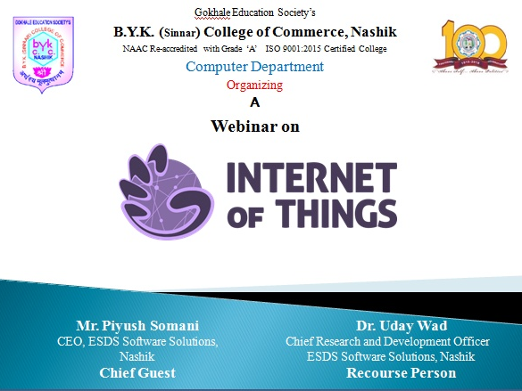
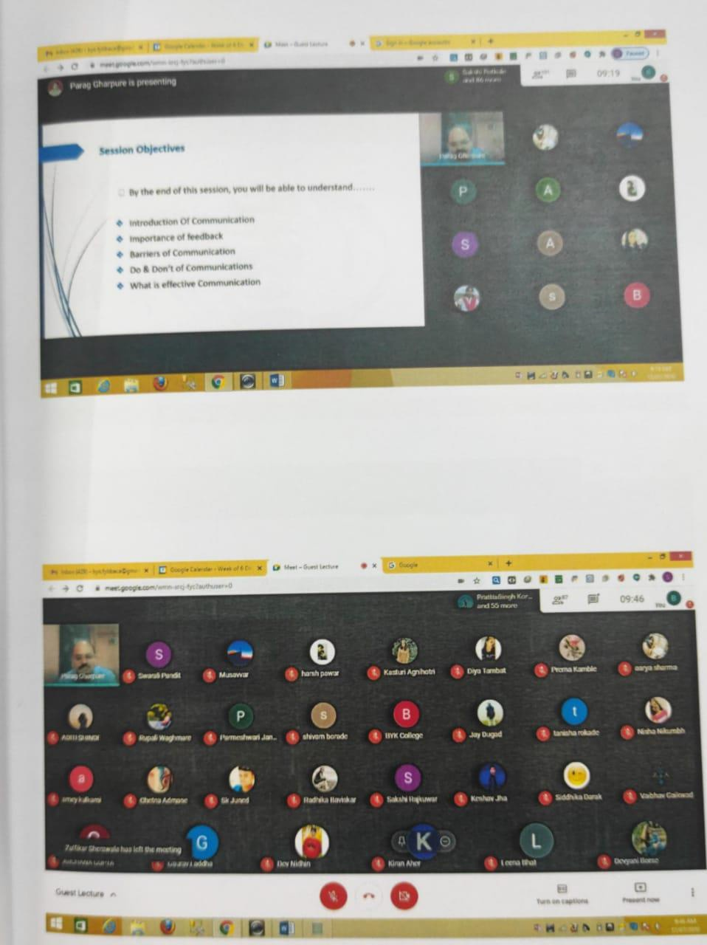
Webinar on IoT
Webinar on IoT was organized on 3rd December 2022 for the students of BBA (CA).
Mr. Piyush Somani CEO of ESDS software Ltd. was the chief guest for the Webinar and Mr. Uday Wad was the Resource Person.

Slide 22
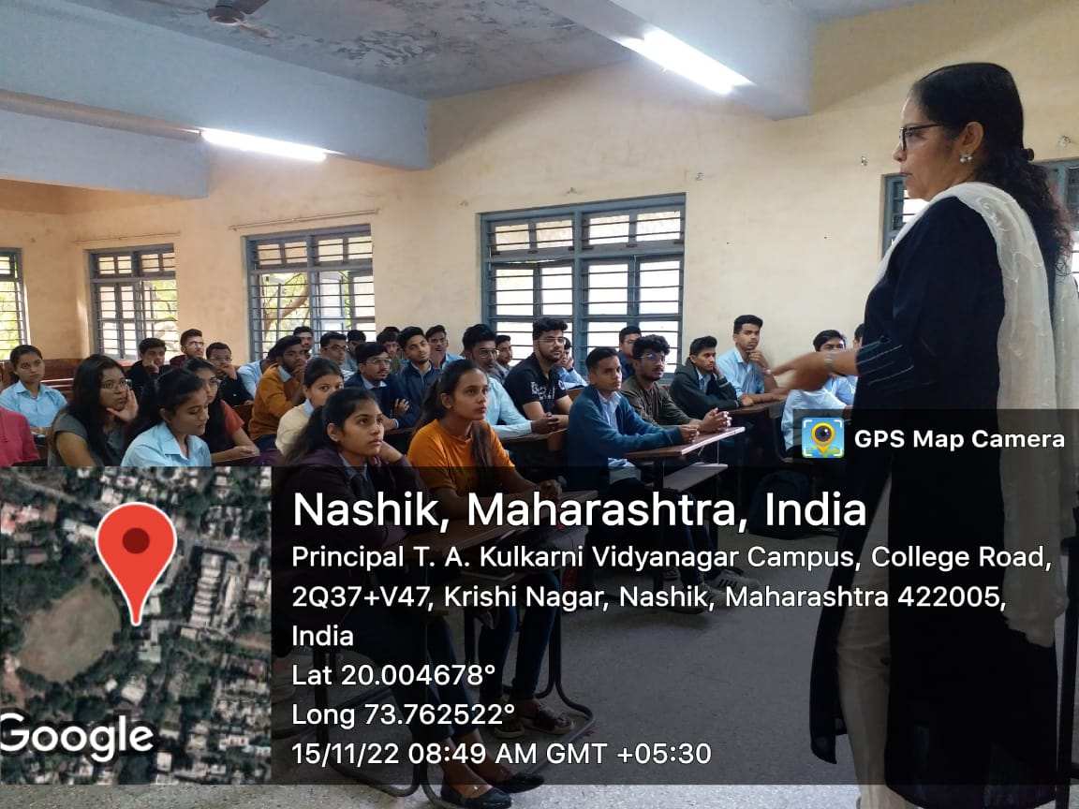
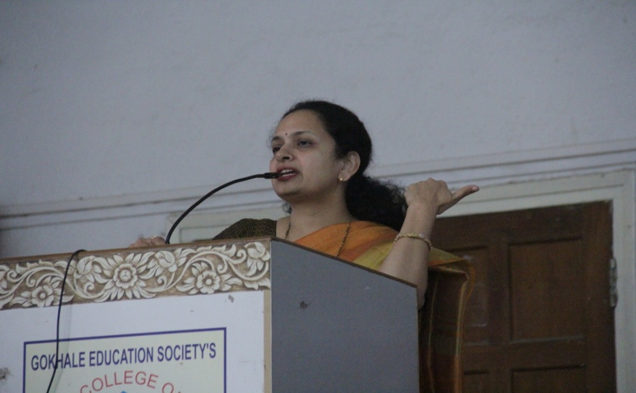
Guest Lectures
Guest Lecture was organized for the students of FYBBA(CA) for the subject “Principles of Management” on 15th November 2022 by Dr. Mrs. Pallavi Joshi.
Guest Lecture was organized for the students of FYBBA(CA) for the subject “Business Communication Skills” on 28th & 29th December 2022 by Dr. Mrs. Sonali Chindhade.

Slide 23
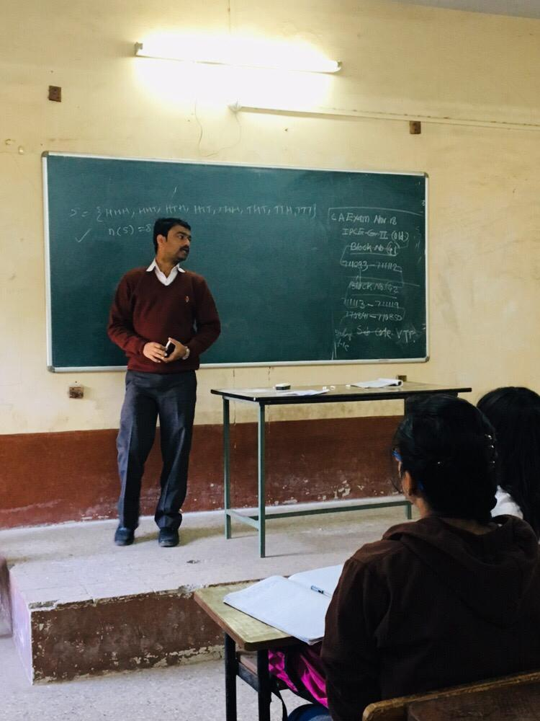
Guest Lectures
Guest Lecture was organized for the students of FYBBA(CA) and S. Y. B.Com Applied Statistics students for the subject “Business Statistics” on 7th to 9th November 2022 by Prof. V. V. Mhaske.
Guest Lecture was organized for the students of F.Y.BBA (CA), F.Y. B.Com , S.Y. B.Com and T.Y.B.Com Statistics students for the subject “Business Statistics” by Dr. Smita Kachole

Slide 24
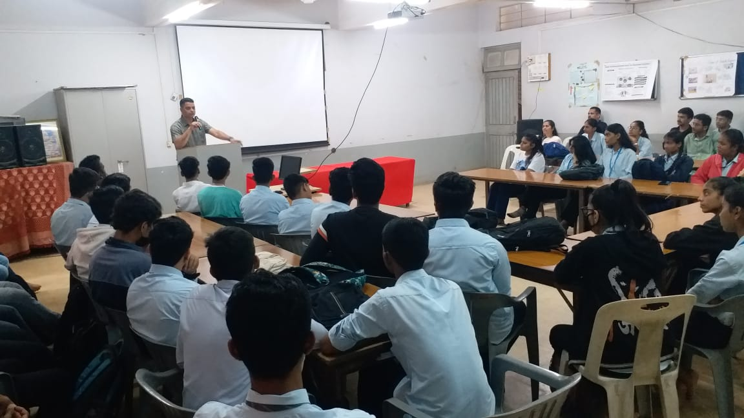
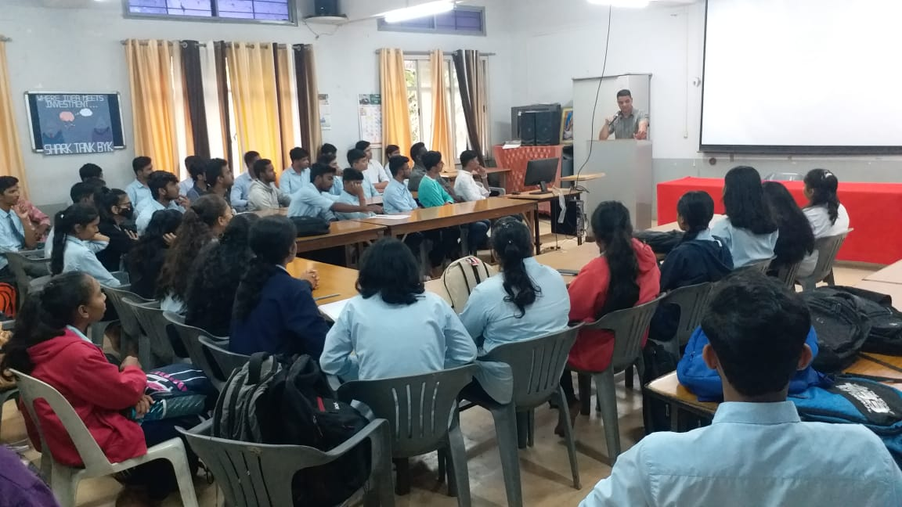

Guest Lectures
Guest Lecture was organized for the students of FYBBA(CA) for the subject “Health Awareness” on by Dr. Sunil More on 25th August 2023.

Slide 25
Guest Lectures
A Guest Lecture on “Interview Techniques” was conducted on 8th December 2020 by Mr. Parag Gharpure for T.Y. BBA (CA) and T. Y. B. Com students.

Slide 26
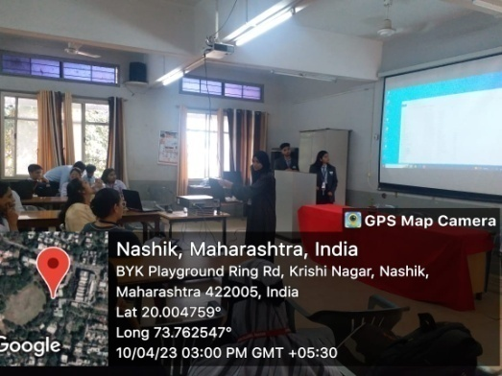
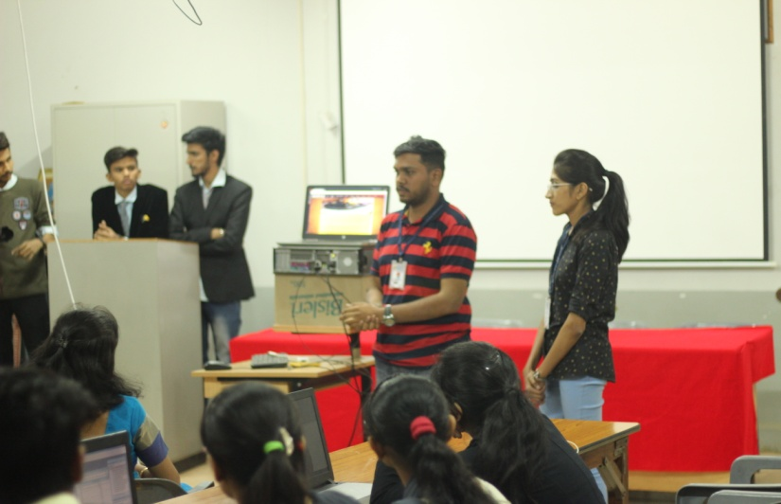
Sir Dr. M. S. Gosavi Technomohotsav
Intercollegiate Software Development Competition
Intercollegiate Software Development competition is conducted under Sir Dr. M. S. Gosavi Technomohotsav every year.
Students from various colleges in and around Nashik of undergraduate courses participate in the competition.

Slide 27
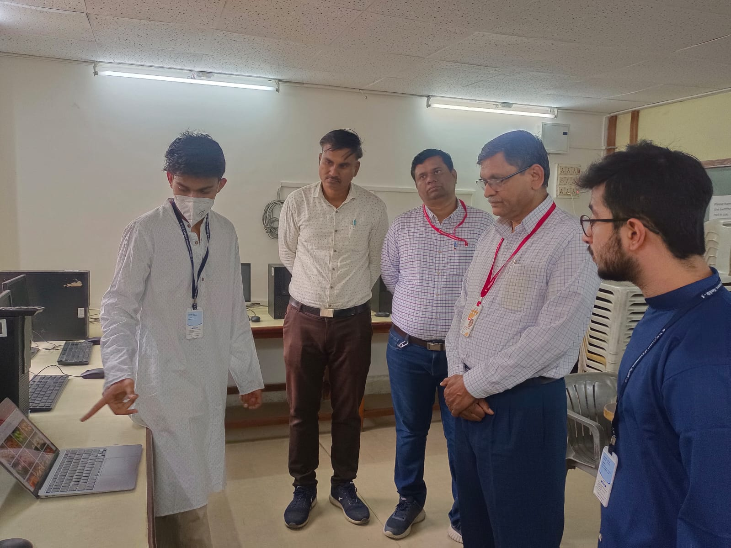
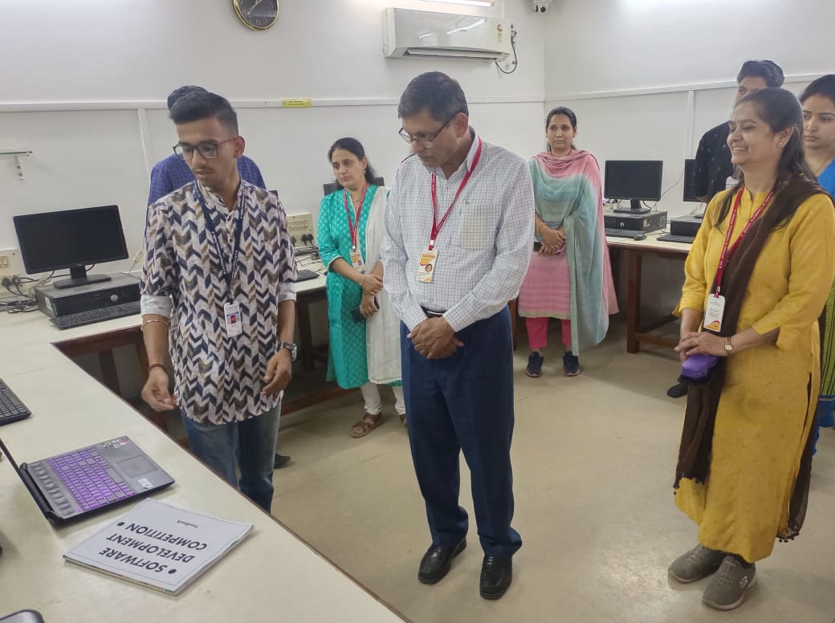

Sir Dr. M. S. Gosavi Technomohotsav
Web Designing Competition
Web Designing competition was conducted for the students of FYBBA(CA) and TYBBA(CA).
Students had developed Web applications using recent technologies.

Slide 28
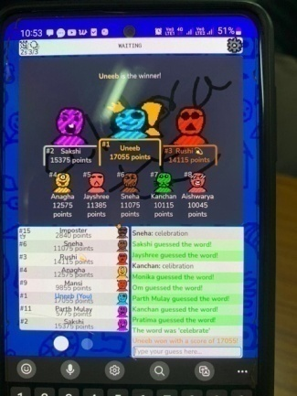
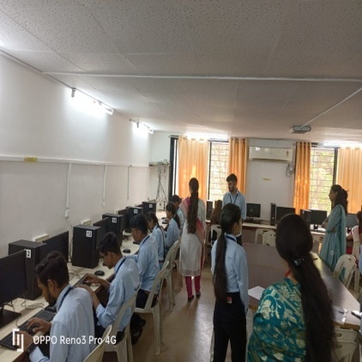
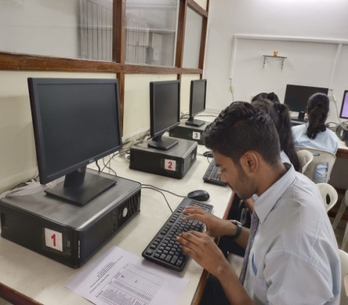
Sir Dr. M. S. Gosavi Technomohotsav
Scribble and Black Coding Competitions
Scribble competition and Black Coding competition were conducted as a part of Sir Dr. M. S. Gosavi Technomahotsav.

Slide 29
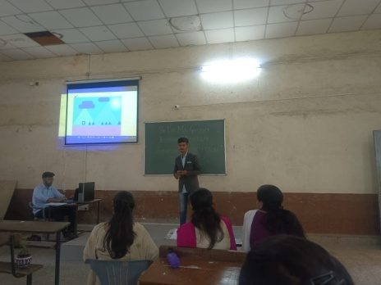
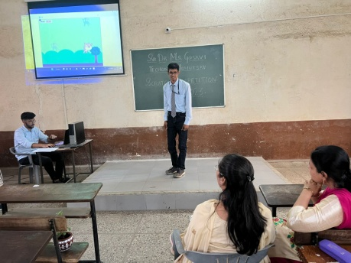
Sir Dr. M. S. Gosavi Technomohotsav
Scratch Competition
Scratch competition was organized under Sir Dr. M. S. Gosavi Technomohotsav. It was conducted to enhance coding skills of students.

Slide 30
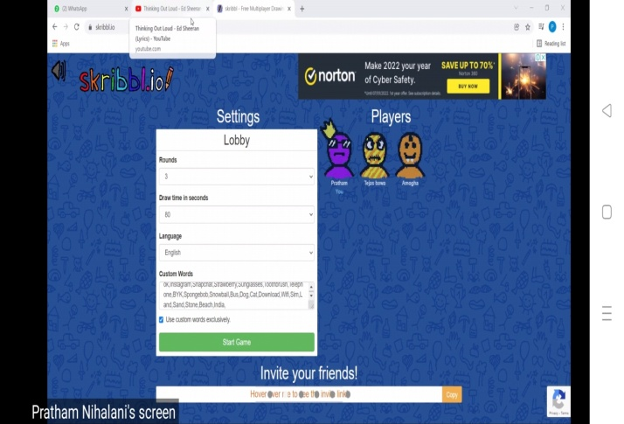
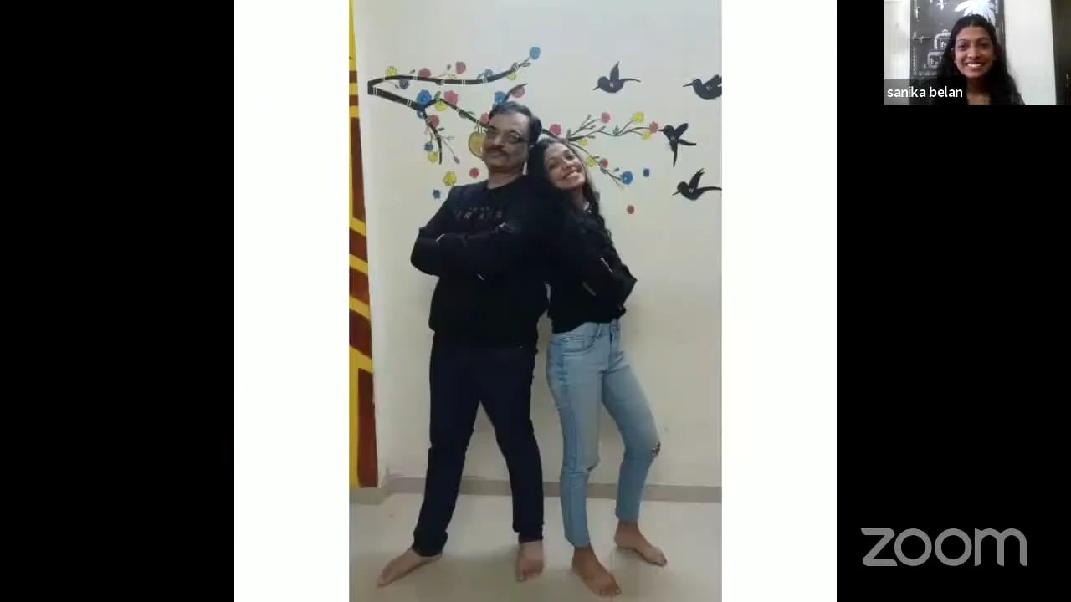
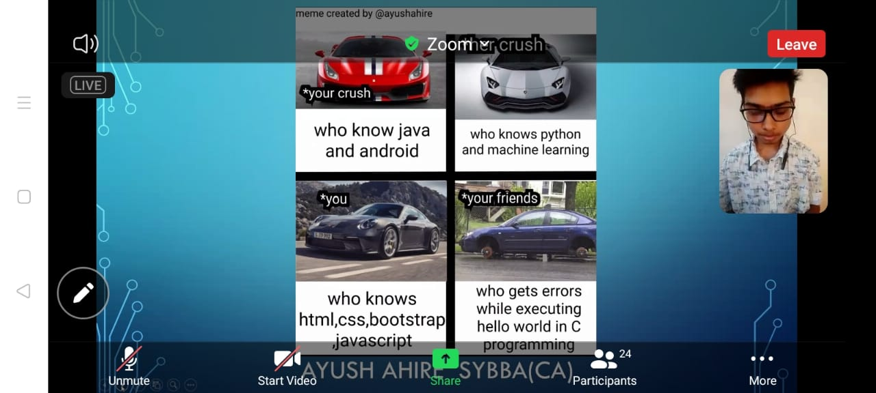
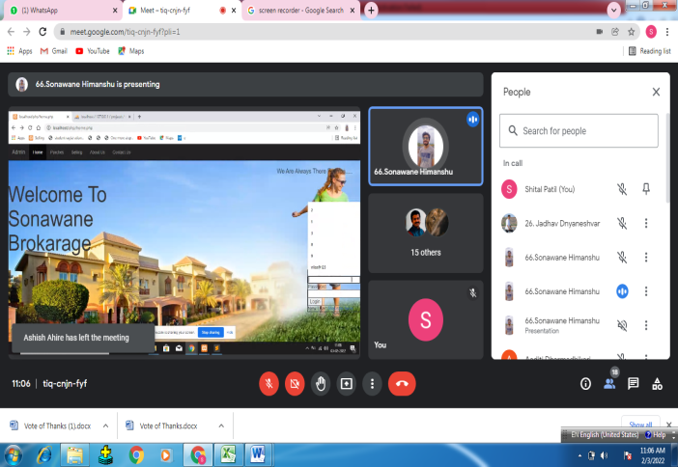
Sir Dr. M. S. Gosavi Technomohotsav
Online Eureka And Technomahostsav
Scribble Competition
Performance with father
Coder Meme
Intercollegiate Software Development Competition

Slide 31
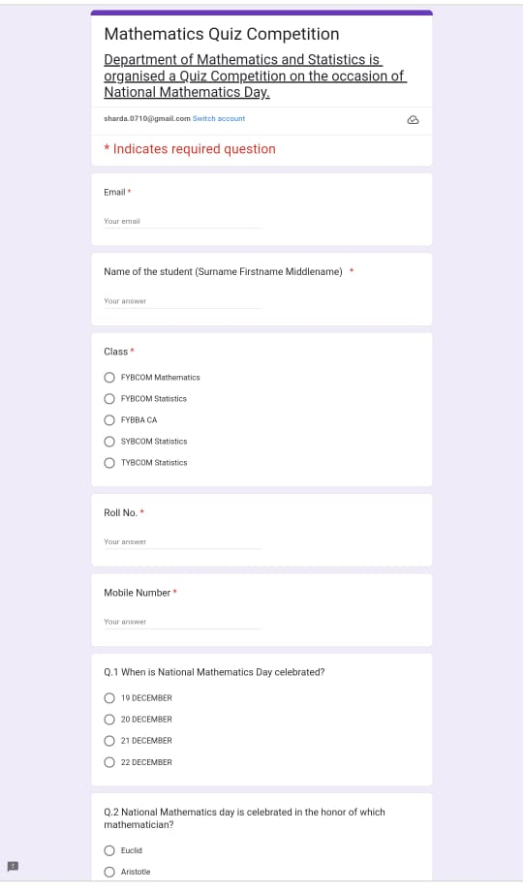
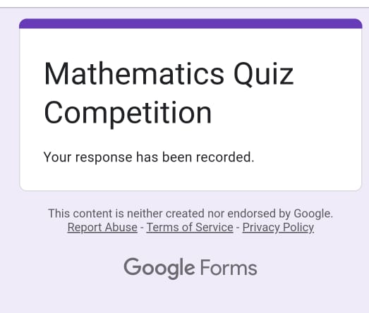
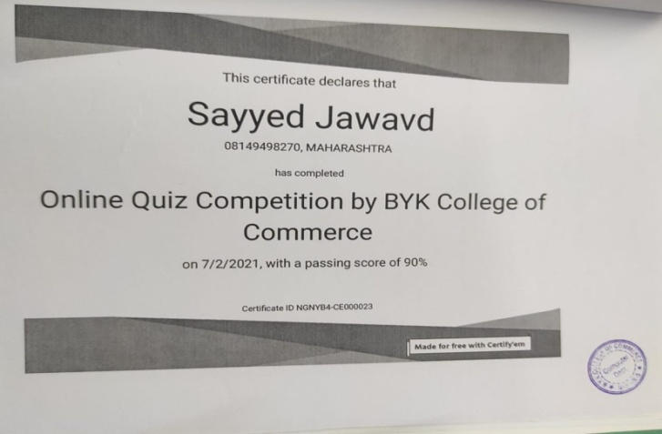
Celebration of National Mathematics Day
Celebrating National Mathematics Day on 22nd December by organizing Quiz Competition.

Slide 32
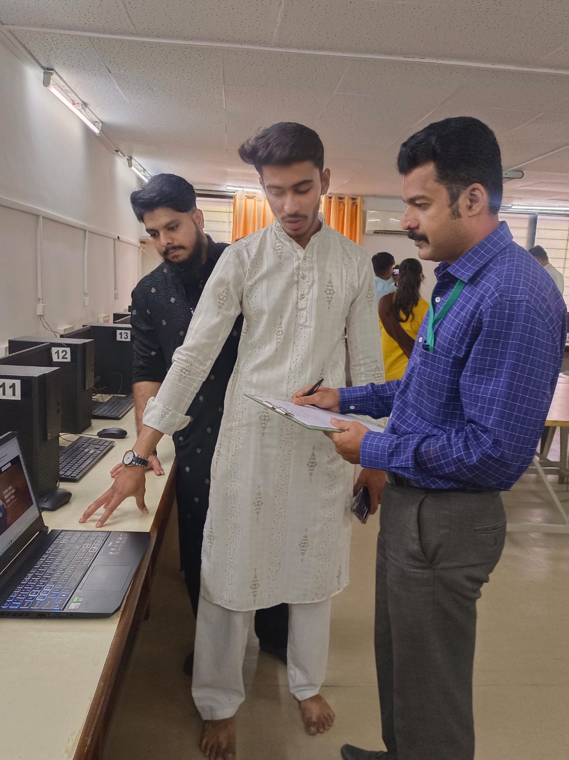
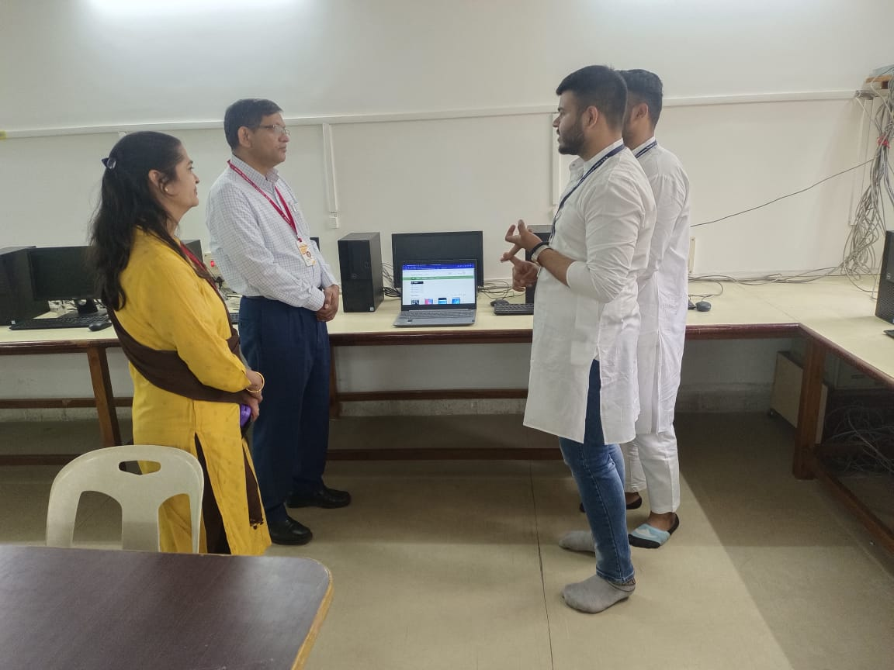
Best Practices
Software Exhibition
Software Exhibition was organized as a part of Annual Social Functions. The students of T. Y. B. Com and TYBBA(CA) were participated in it.

Slide 33
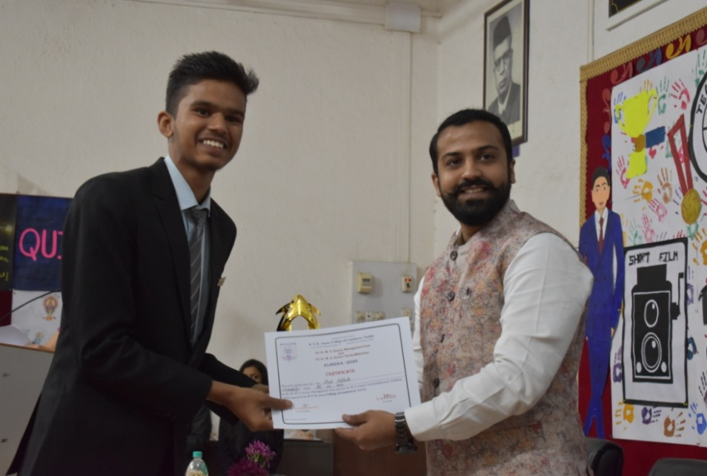
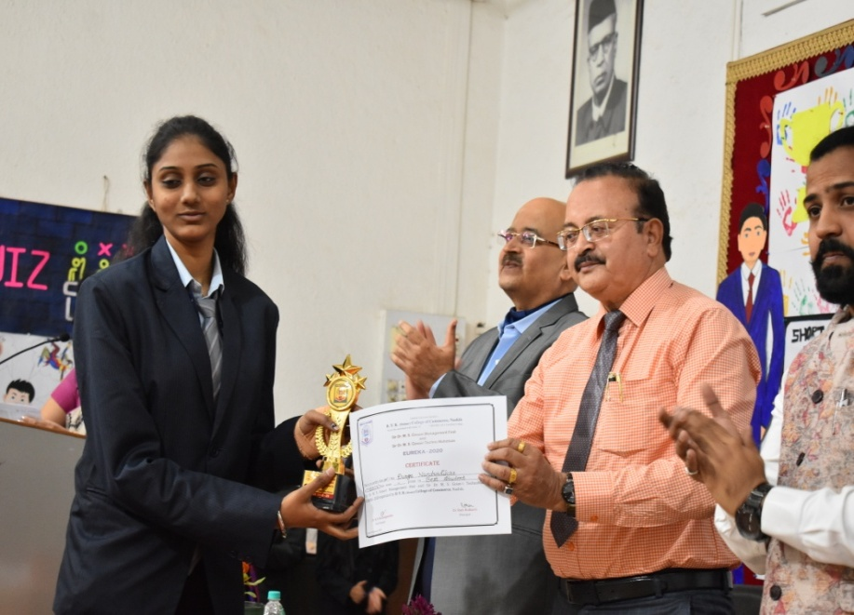
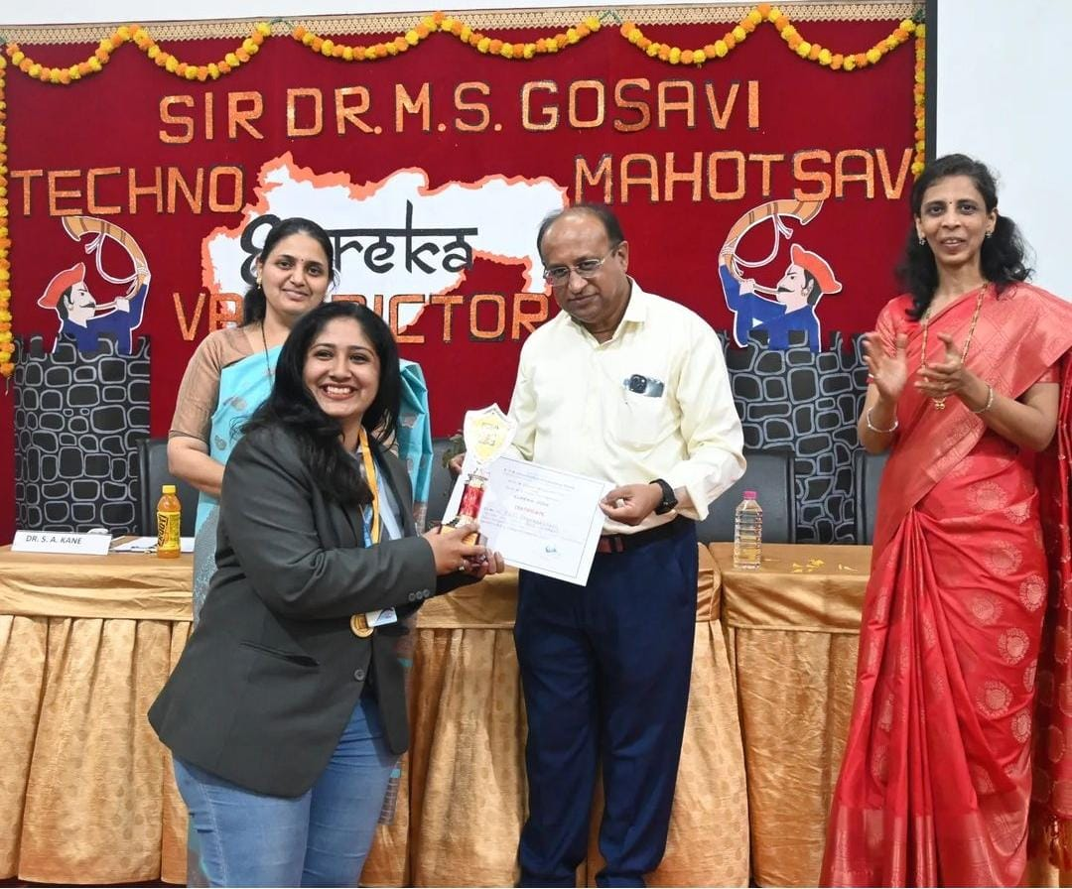
Best Practices
Best Student Award
Every Year student of T. Y. BBA (CA) is awarded with Best Student Award
Meet Nakhate
Durga Nandurdikar
Aaditi Dharmadhikari

Slide 34
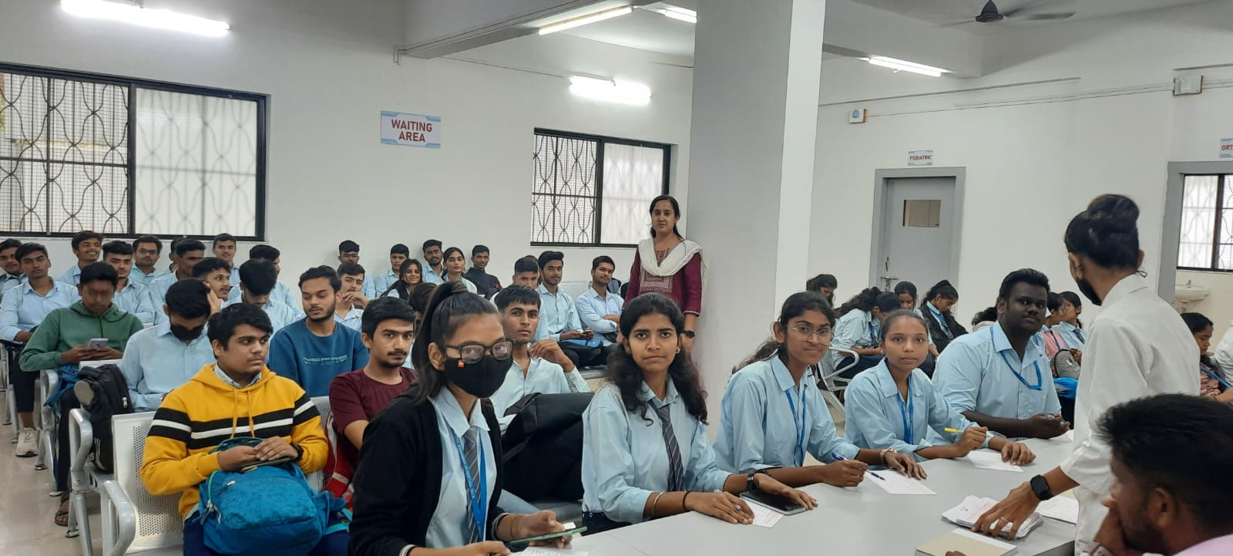
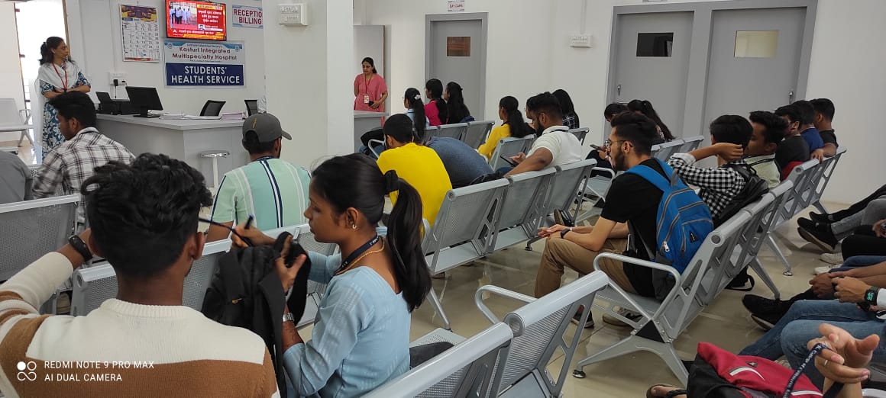
Best Practices
Medical Checkup
Medical Checkup for BBA(CA) students was conducted on 23th March 2023.

Slide 35
Result Analysis
C’ Component CASM

Slide 36
Result Analysis
C’ Component APST

Slide 37
Result Analysis
BBA (CA)

Slide 38
Toppers
Class | Academic Year | Name of the Topper
B.Com (CASM) Late Shri. S. G. Puranik Prize | 2018-19 | Patwardhan Sampada Suresh
 | 2019-20 | Daragode Shiva Daulat
 | 2020-21 | Mahajan Samkit Rajendra
 | 2021-22 | Kulkarni Varad Milind
 | 2022-23 | Saraf Aboli
B. Com (APST) Prof. S. Parthasarathi Prize | 2018-19 | Sharma Sneha Gopalchand
 | 2019-20 | Nitturkar Bhargavi Jayant
 | 2020-21 | Bhide Sahil Mahesh
 | 2021-22 | Gajare Ishwari Sanjay
 | 2022-23 | Tajane Jayesh
BBA(CA) | 2018-19 | Picha Mayuri mahavir
 | 2019-20 | Walzade Purva Anant
 | 2020-21 | Chandak Amita Purushottam
 | 2021-22 | Bansode Samiksha Mukund
 | 2022-23 | Gadekar Sakshi Sanjay

Slide 39
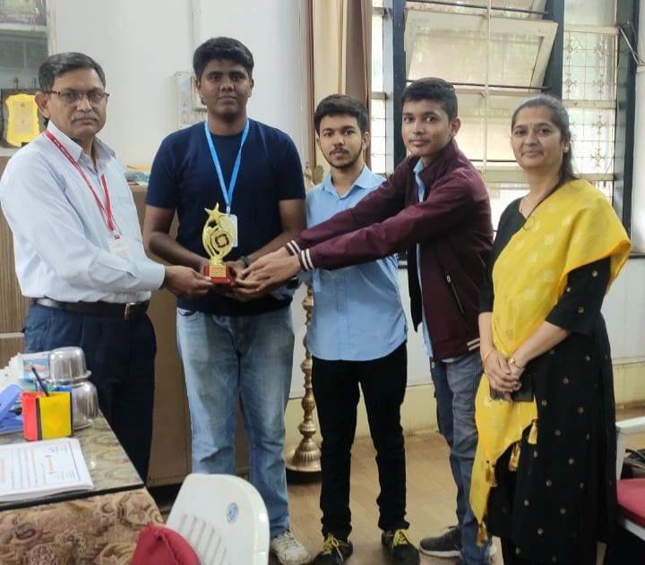
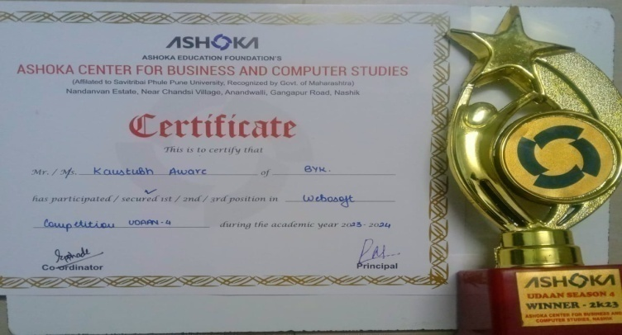
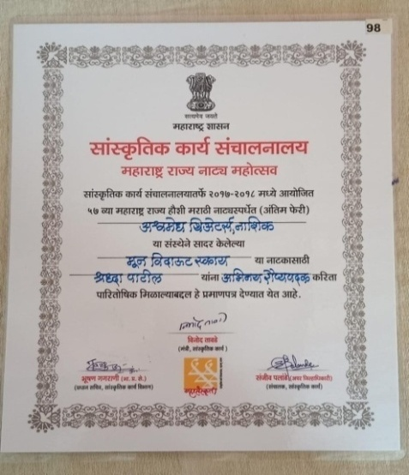
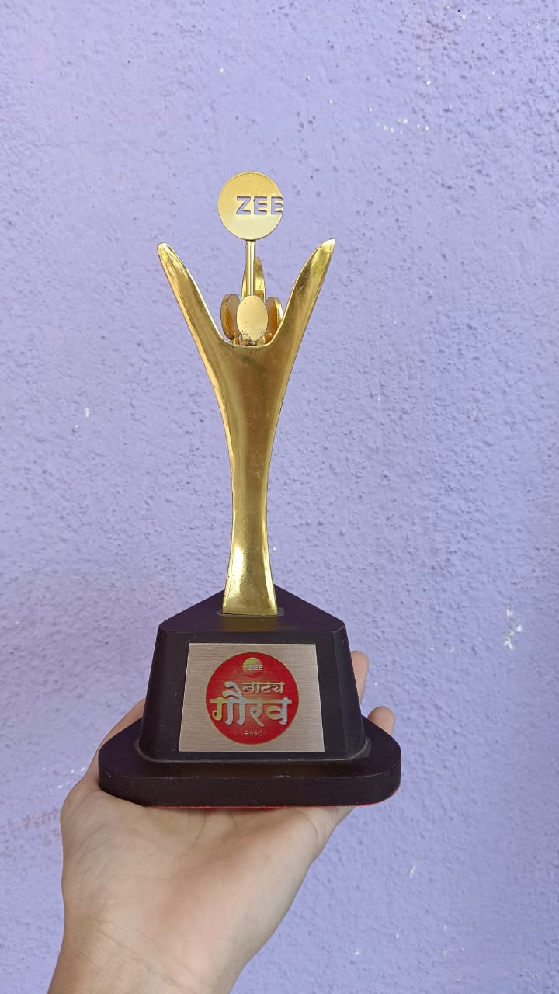
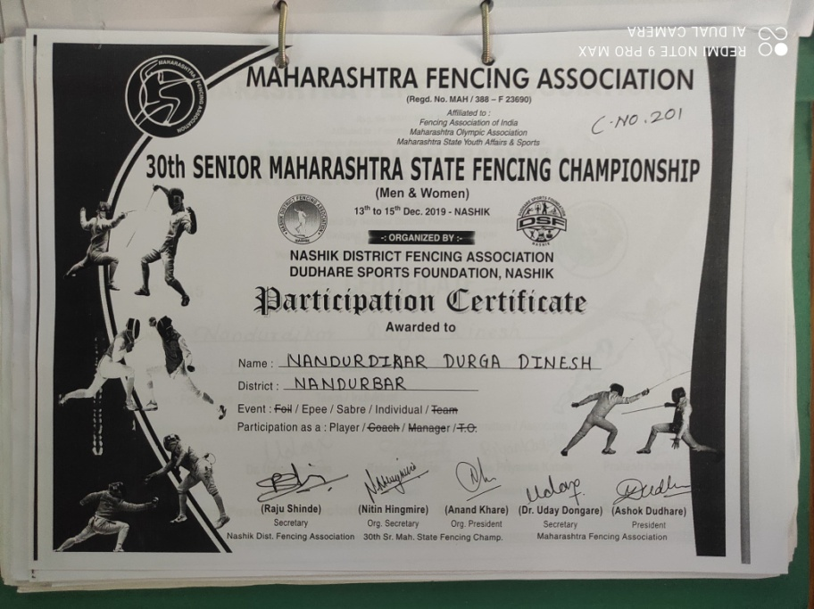
Student Achievements
Kaustubh Aware & Group - 1st Prize in Udaan-4 Webosoft Competition
Shraddha Patil - Maharashtra Rajya Natya Mahotsav
– Best Actress
Durga Nandurdikar - State Level Fencing Competition

Slide 40
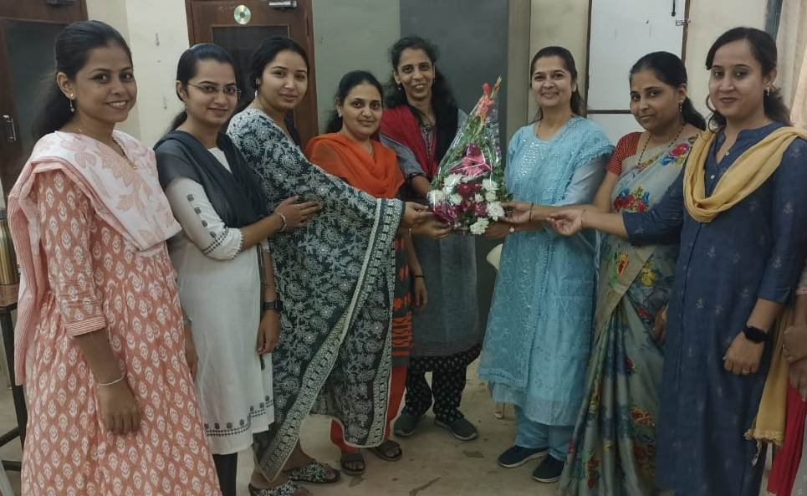
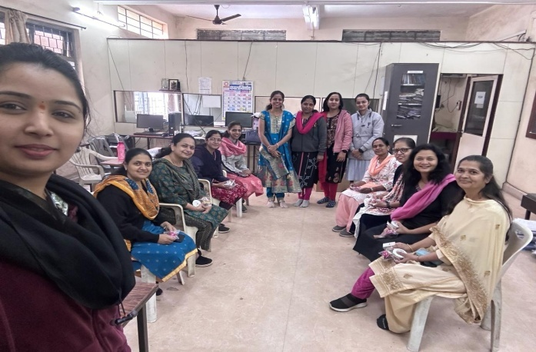




Good Practices
Department Staff Felicitating HOD on her Patent Achievement
Women's Day Celebration
Makar Sankranti Celebration
Computer Pujan on the Occasion of Dussehra

Slide 41
SWOC
SWOC
Strength
- Experienced & Qualified Staff
- No Dearth of students
-Lecture cum Demonstration
method
- Software Projects
Weaknesses
- Less number of publications
Opportunities
- Expansion of Collaborations
and Consultancy
- E-content development at
national level.
Challenges
- Constant updating technology

Slide 42
Future Plans
1) To enhance research and publications.
2) To Organize State/National level Software Project Competition
3) To start Certificate Course in Data Science

Slide 43


