Slide 1
WELCOME NAAC PEER TEAM
G. E. Society’s
B.Y.K. (Sinnar) College of Commerce, Nasik-05
Department of BUSINESS Economics
Dr. K. J. Shivade (Head of Department) and Faculty Members

Slide 2
Objectives of Department:
To expose the students to evolution, basic concepts and theories of economics
To enable the students to apply the theoretical tools of economics to real life situations
To expose the latest developments and new approaches in the field of economics to students
To enable the students to study the behavior of the economy as a whole
To enable the students to understand policy making process and various issues related to economic development

Slide 3
Workload Of Department (146 hrs):
Class | Subject | Grant in aid | Non Grant
F.Y. B.Com | 1) Business Economics (Micro) | 24 | 08
 | 2) Foundation Course in Restructuring | 24 | 08
S.Y. B.Com | 1) Business Economics (Macro) | 24 | 08
T.Y. B.Com | Indian & Global Economic Development (IGED)/ International Economics | 24 | 08
M. Com | Industrial Economics/ Industrial Economic Environment | 18 | 00
Total | Total Workload - 146 | 114 | 32

Slide 4
List of Permanent Faculties
Sr. No. | Name of the Teacher | Designation | Status | Qualification | Experience
1. | Dr. Kailas J. Shivade | Associate Professor | Permanent | M.A. (Eco) Ph.D. | 33
4. | Dr. H. P. Wangarwar | Associate Professor | Permanent | M. A. (Eco) B.Ed. SET Ph.D. LLB | 16
5. | Dr. Pankaj P. Bawane | Assistant Professor | Permanent | M.A. (Eco) NET, Ph.D. | 08

Slide 5
List of Non Grant & CHB Faculty:
Sr. No. | Name of the Teacher | Designation | Status | Qualification | Experience
1. | Prof. Bhavana Gangurde | Assistant Professor | Non Grant Full Time | M. A. (Eco) SET | 04
2. | Prof. Krishna. P. Sangle | Assistant Professor | Grant in Aid CHB | M.A. (Eco) B.Ed. SET | 07
3. | Ms. Elizabeth Oommen | Assitant Professor | Grant in Aid CHB | M.A. (Eco) SET | 01

Slide 6
List of Contributory Faculty (belongs to other Department)
Sr. No. | Name of the Teacher | Designation | Status | Qualification | Experience
1) | Prof. Dr. Suvarna Kadam | Professor | Grant in aid Full Time | M.A. SET, NET, Ph.D. | 25
2) | Dr. Mrs. Sangeeta S. More | Associate Professor | Grant in Aid Full Time | M.A. M. Phil Ph.D. | 27
3) | Dr. Yogini Dixit | Assistant Professor | Non Grant Full Time | M.A. Ph.D. | 10
4) | Mr. Rajendra Shahane | Assistant Professor | Grant in Aid CHB | M.A. Ph.D. | 09
5) | Mr. Manish Ugale | Assistant Professor | Grant in Aid CHB | M.Com. NET | 03
6) | Ms. Rani Zankar | Assistant Professor | Non Grant Full Time | B.Com | 03
9) | Mr. Santosh Boraste | Assistant Professor | Non Grant Full Time | M.Com. SET GDC&A, DTL | 08

Slide 7
List of Faculty members Transferred or retired:
Sr. No. | Name of Faculty | Designation | Year | Status
1. | Dr. Sanjay M. Chapalgaonkar | HOD, Banking & Finance | Sept. 2018 | Retired
2. | Dr. Sanjay N. Tupe | HOD, Banking & Finance | May 2023 | Retired
3. | Prof. S. V. Sindekar | Assistant Professor | Jan 2022 | Retired
4. | Dr. Vijaykumar Wawle | HOD, Business Economics | July 2021 | Transferred
5. | Dr. Ashlesha Kulkarni | Assistant Professor | Nov. 2019 | Transferred
6. | Dr. Bhagwat B. Gadekar | Associate Professor | Sept. 2023 | Transferred
7. | Dr. Subhash Bhosale | Assistant Professor | Sept. 2021 | Transferred

Slide 8
Faculty Research & Development
Seminars/ Conferences Attended
Sr. No. | Particulars | Number
1. | International | 03
2. | National | 11
3. | State | 09
4. | Local | 03
 | Total | 26

Slide 9
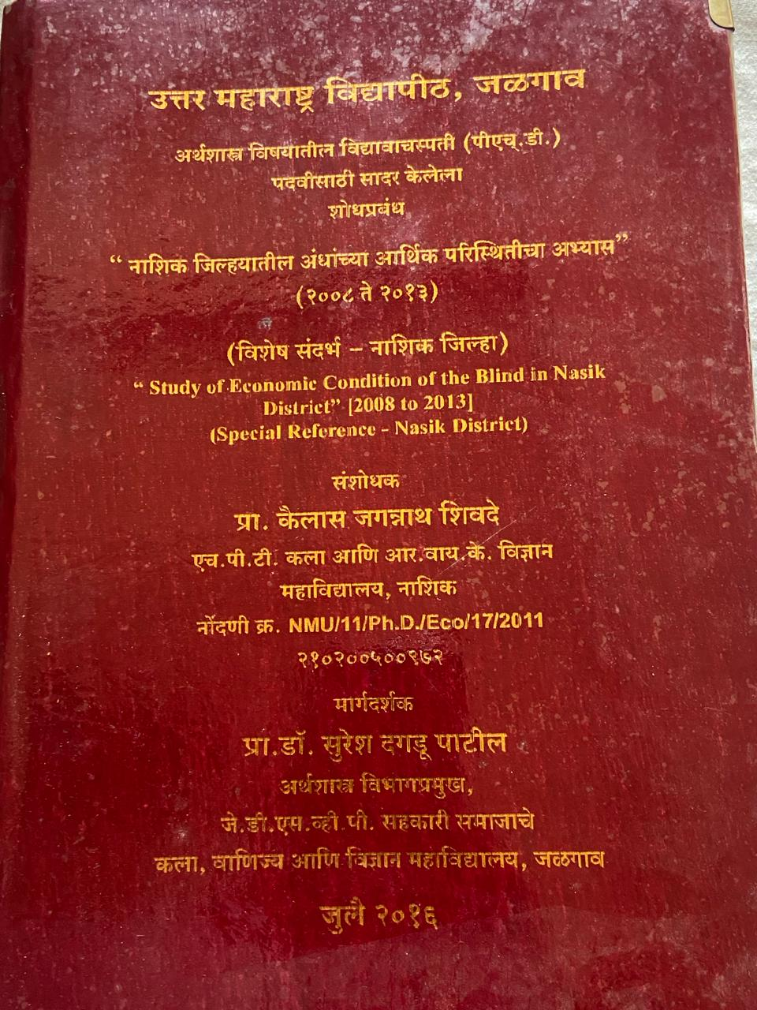
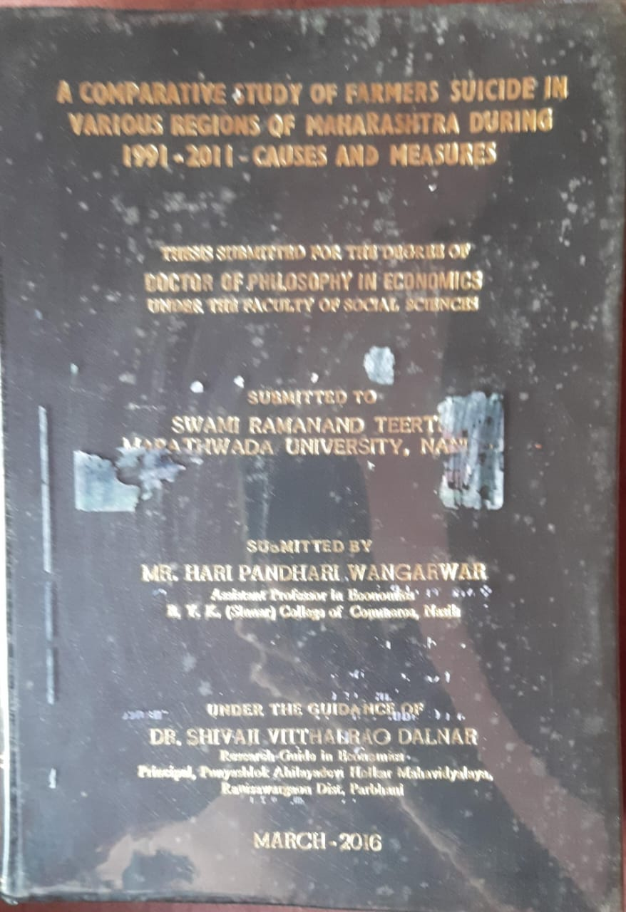
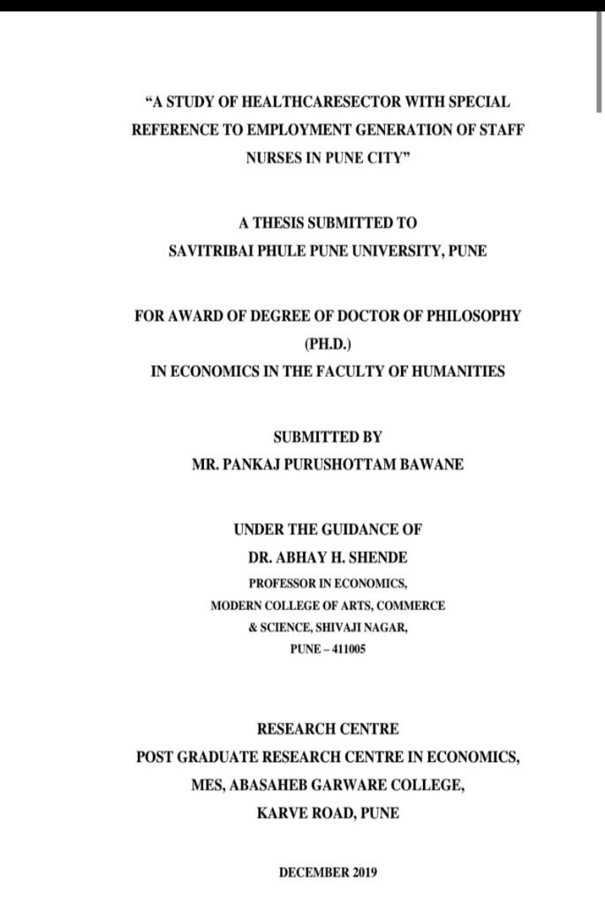
Faculty Research & Development
M.Phil. / Ph.D. Awarded Faculties
Sr. No. | Particulars | Number
1. | Ph.D. Awarded | 03
2. | Ph.D. ongoing | 03

Slide 10
Faculty Research & Development
Orientation Course/ Refresher Course/ Faculty Development Programme/ Short term Course completed
Sr. No. | Particulars | Number
1. | Orientation Course | 0
2. | Refresher Course | 2
3. | Faculty Development Programme | 5
4. | Short term Course | 3

Slide 11
Faculty Research & Development
Research paper presented in Seminars or Conferences/ Published in Journals or Proceedings/ Chapters Published in Edited Books/ Books Published
Sr. No. | Particulars | Number
1. | Research paper presented in Seminars or Conferences | 10
2. | Research Paper Published in Journals or Proceedings | 16
3. | Chapters Published in Edited Books | 03
4. | Books Published | 04

Slide 12
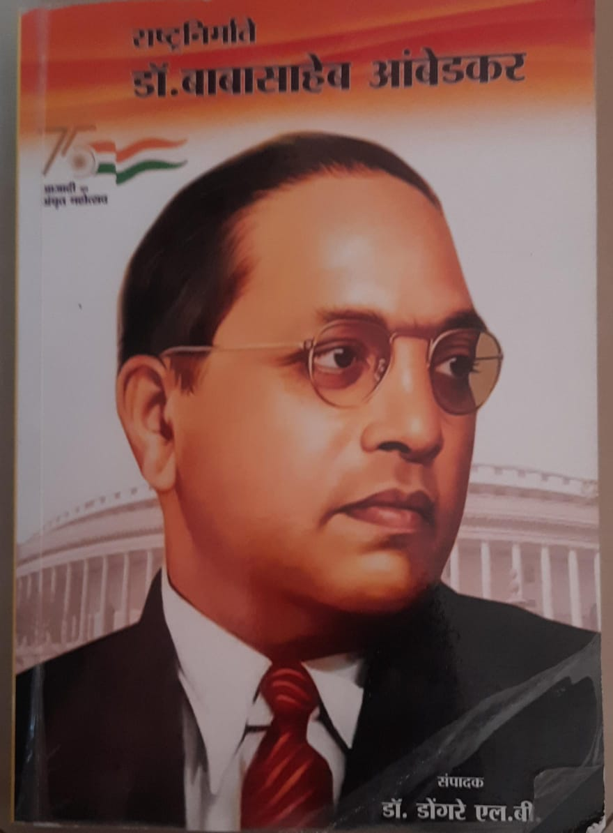
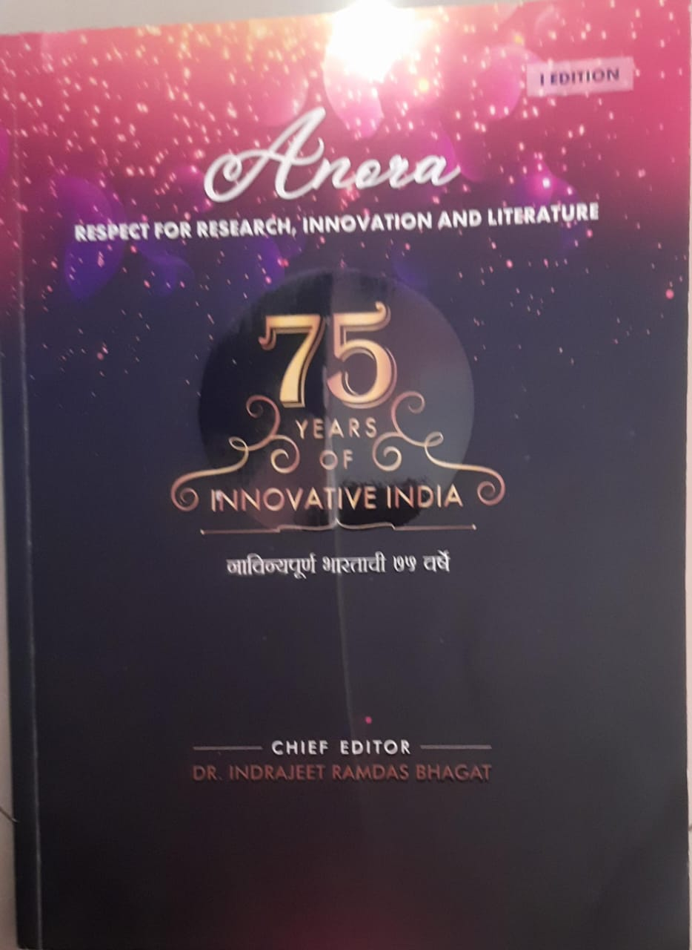
Faculty Research & Development
Chspters in Edited Book

Slide 13
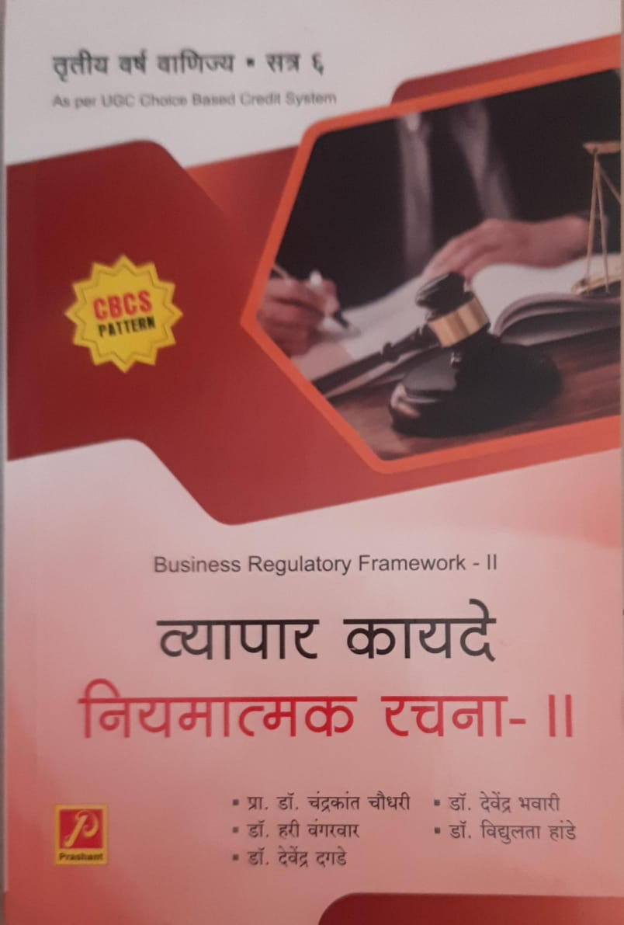
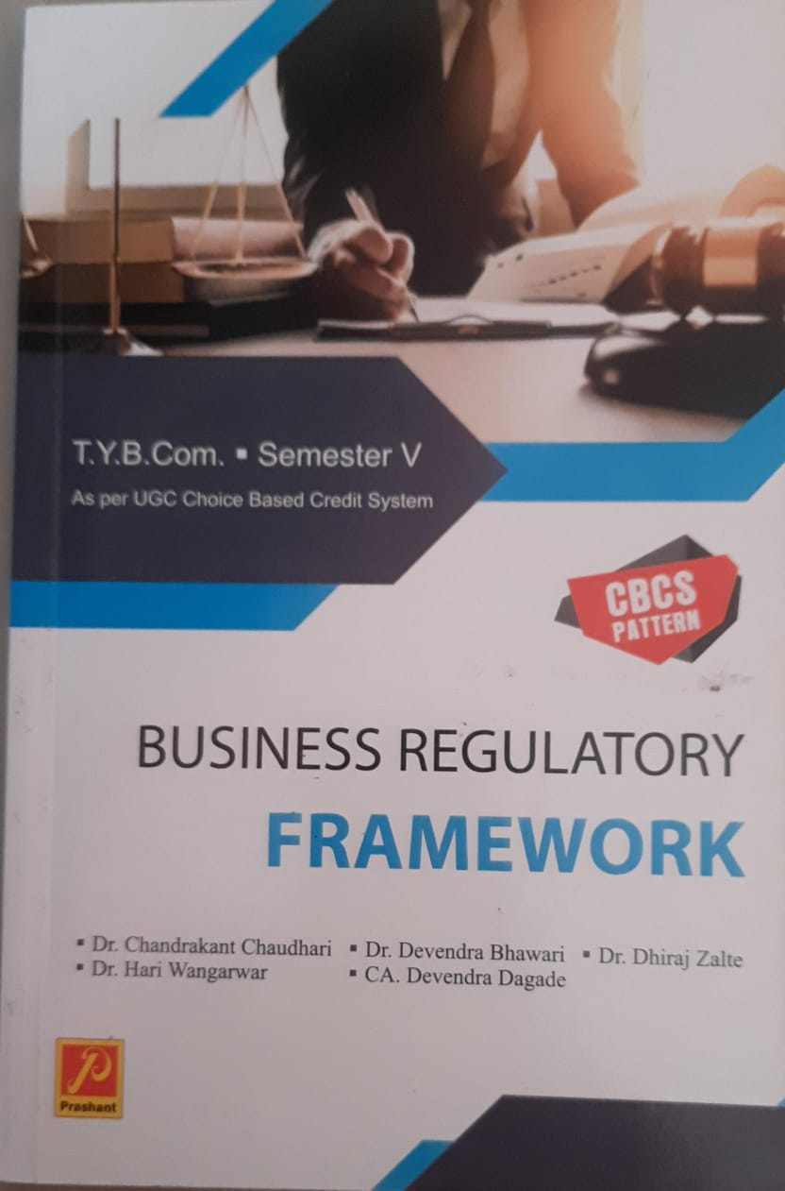
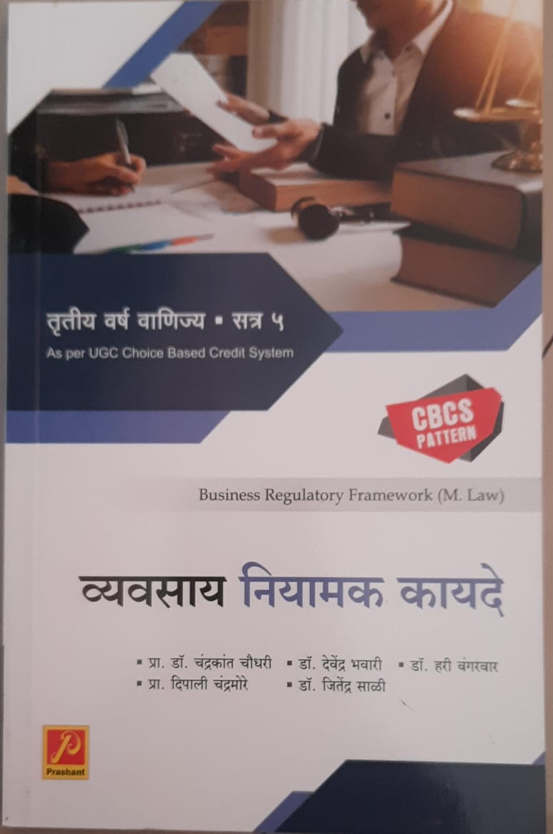
Faculty Research & Development
Books Published

Slide 14
Faculty Responsibilities & Awards
National Level | National Award for most efficient blind employee- Dr. K. J. Shivade
University Level | Chairman of paper setting for T.Y. B.Com. Indian & Global Economic Development Subject - Dr. H.P. Wangarwar
 | Research Guide (Ph.D.) Guide of SPPU, Pune – Dr.. H.P. Wangarwar
 | Student Development Officer (2021 to till date)- Dr. Pankaj Bawane
 | NSS Program Officer (2018 - 2023)- Dr. H. P. Wangarwar
G.E Society Level | Member of College Development Committee(CDC)- Dr. Pankaj Bawane
 | Member of Centenary Celebration Committee- Dr. H.P. Wangarwar

Slide 15
Membership of Organisations
Dr. K. J. Shivade | Life Member of the National Association for the Blind, Maharashtra Life member of the National Federation of the Blind, Maharashtra
Dr. H. P. Wangarwar | Life Member of the Marathi Arthshastra Parishad Life Member of the Sarvajanik Vachnalaya, Nasik
Dr. Pankaj P. Bawane | Life Member of the Indian Economic Association

Slide 16
Use of Teaching Methods
Classroom Lectures
Guest Lecture
Group Discussion
Presentation
Online Lectures
Video Lectures
Field Visit
Workshop

Slide 17
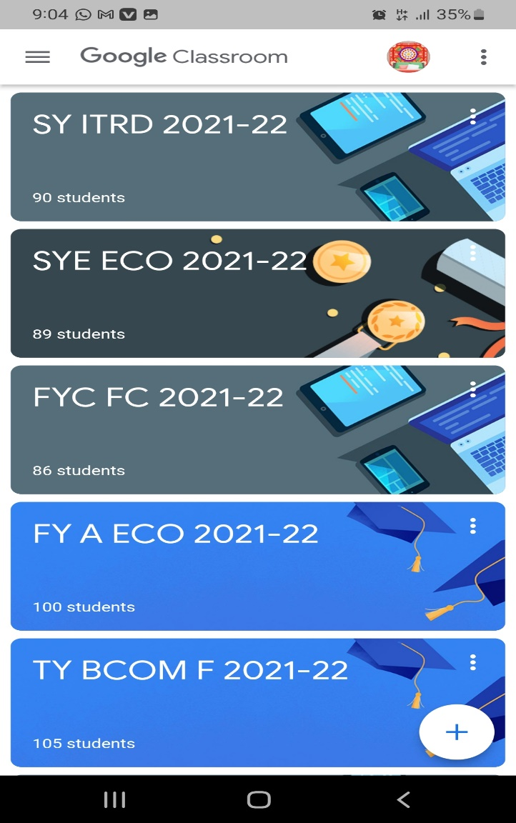
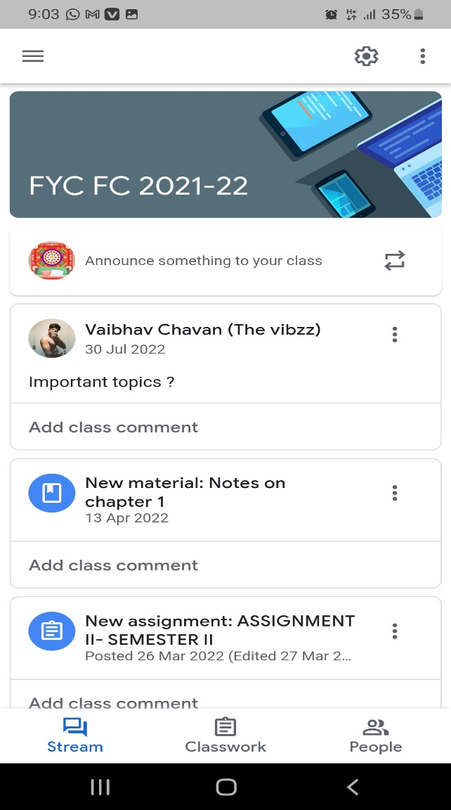
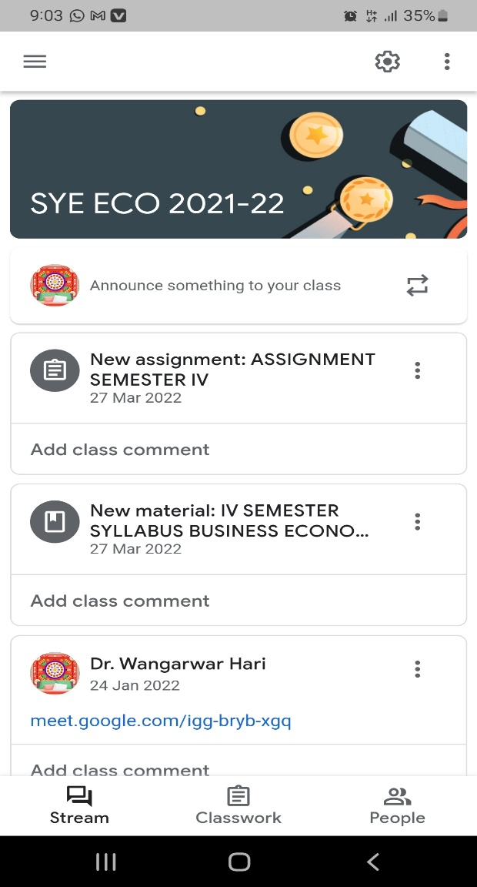
Use of online Mode during pandemic -Google Classroom, Google Meet

Slide 18
Use of online Mode- Video Lecture links
https://drive.google.com/file/d/1rf6nveQqP2b3eDYkIDei045JxQfa-85P/view?usp=drive_link
https://drive.google.com/file/d/1zZciMho08pxF96_6AsOfzOzGavbVCd9j/view?usp=drive_link
https://drive.google.com/file/d/1GPf2pw3uN60NAD_ywNe3CmMP23ty9myo/view?usp=drive_link
https://drive.google.com/file/d/1HTCVTuJ6o88qq3TorVGYFYyND5yqwq3Q/view?usp=drive_link
https://drive.google.com/file/d/1dsve52xIBBom8NdXe_xy-hq_7KNQYyhc/view?usp=drive_link

Slide 19
Evaluation System
Examination (Internal & University)
Assignment
Tutorial
Power Point Presentation
Case Study

Slide 20
Result Analysis (T.Y. B Com)
Academic Year | Students Appeared | Result (in Percent)
2022-23 | 894 | 96
2021-22 | 920 | 95.5
2020-21 | 850 | 98.7
2019-20 | 624 | 91.5
2018-19 | 730 | 96.4

Slide 21
M. Com Result Analysis (Research Methodology for Business)

Slide 22
M. Com Result Analysis (Industrial Economic Environment)

Slide 23
Departmental Activities
The department has organized many activities from 2018-19. Some recent activities are as follows.
The department had organized a Guest Lecture for the T.Y. B. Com Students on 8th January 2024 on the topic ‘Current status of economic Development in India.’ Prof. Vishwajeet Kadam (Assistant Professor, H.P.T. Arts & R.Y.K. Science College, Nasik) was the speaker. He focused on the “contribution of the rural economy in the development of India and Maharashtra and challenges of Indian economy.” Moreover, major issues of rural society had been discussed in the presentation.

Slide 24
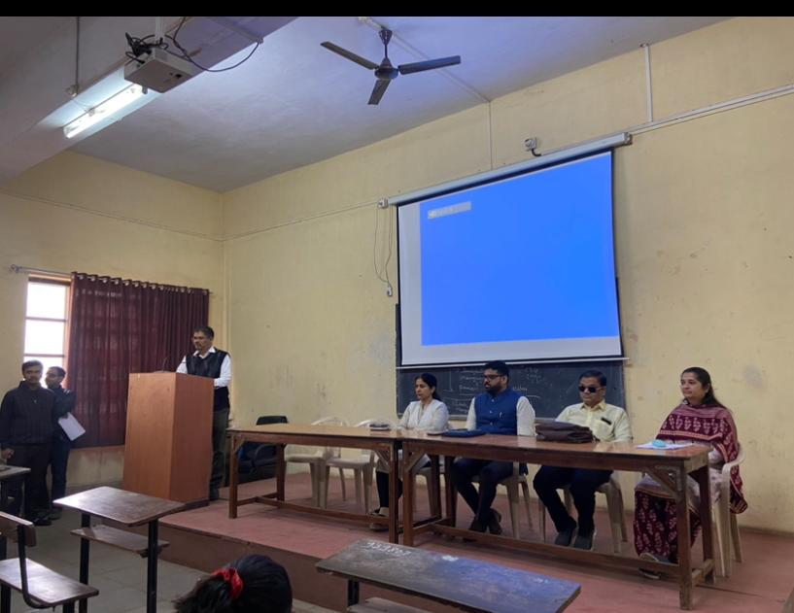
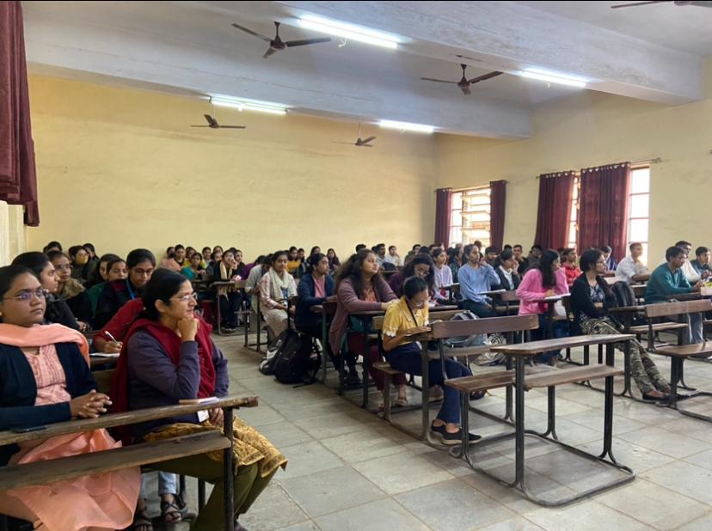
Guest lecture on Current status of economic development in India

Slide 25
The department has organized a field visit to the business expo at Thakkar dome, Nasik on 10th February 2024, organized by BNI, Nasik. students have collected information about the new business ideas introduced by many businessmen of Nasik. The business expo had stalls of building construction, fashion designing, bag manufacturing, fine arts, music instruments, paper bag manufacturing, etc. in the expo.

Slide 26
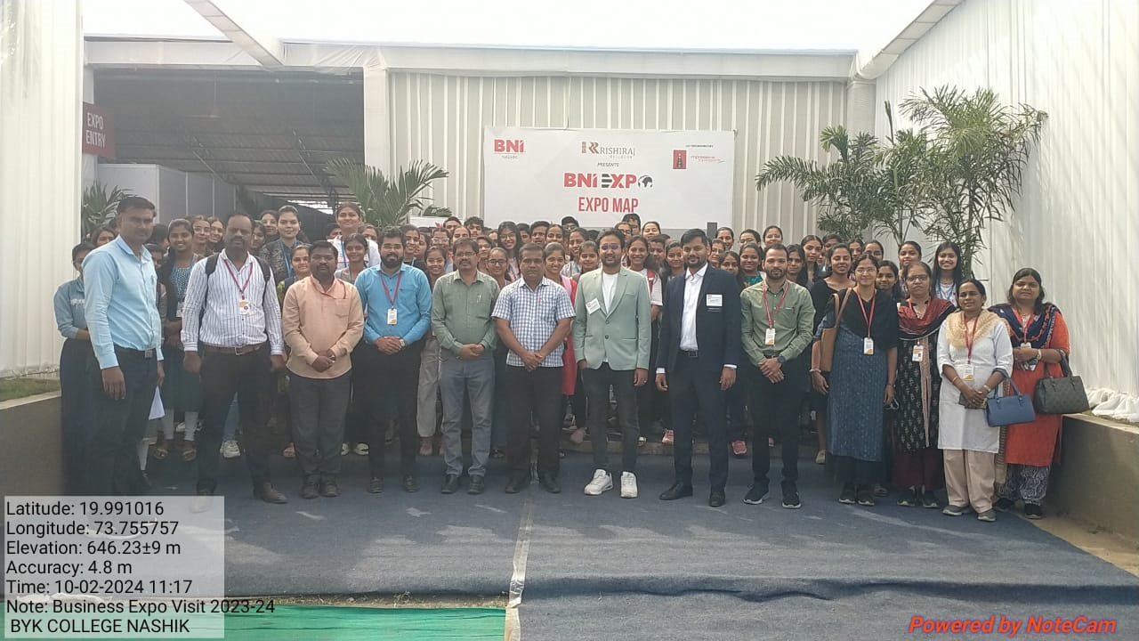
Field visit for Business Expo at Thakkar Dome

Slide 27
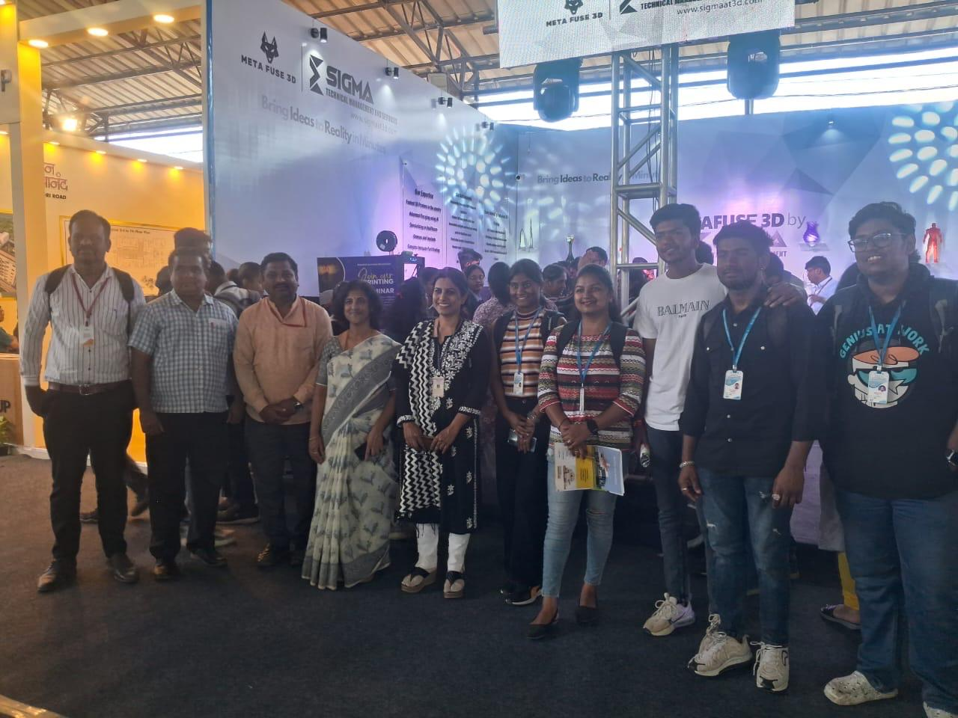
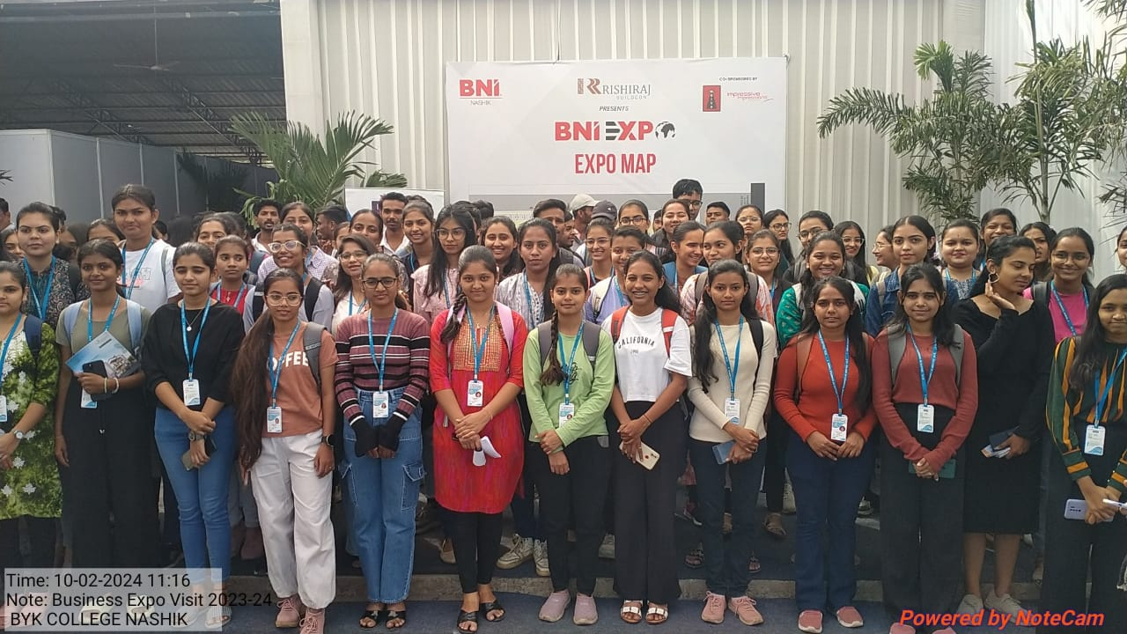
Field visit for Business Expo at Thakkar Dome

Slide 28
The department has organized a visit to Sahyadri Farmers Producers Company Ltd, Mohadi on 6th February 2024. students get knowledge about the availability of career opportunities in the export and processing of agricultural products.

Slide 29
Field visit is organized to T. B. Nikam’s Honey Bee Farm, Gangapur and get the knowledge about economics of honeybee farming dated on 13/01/2020.

Slide 30
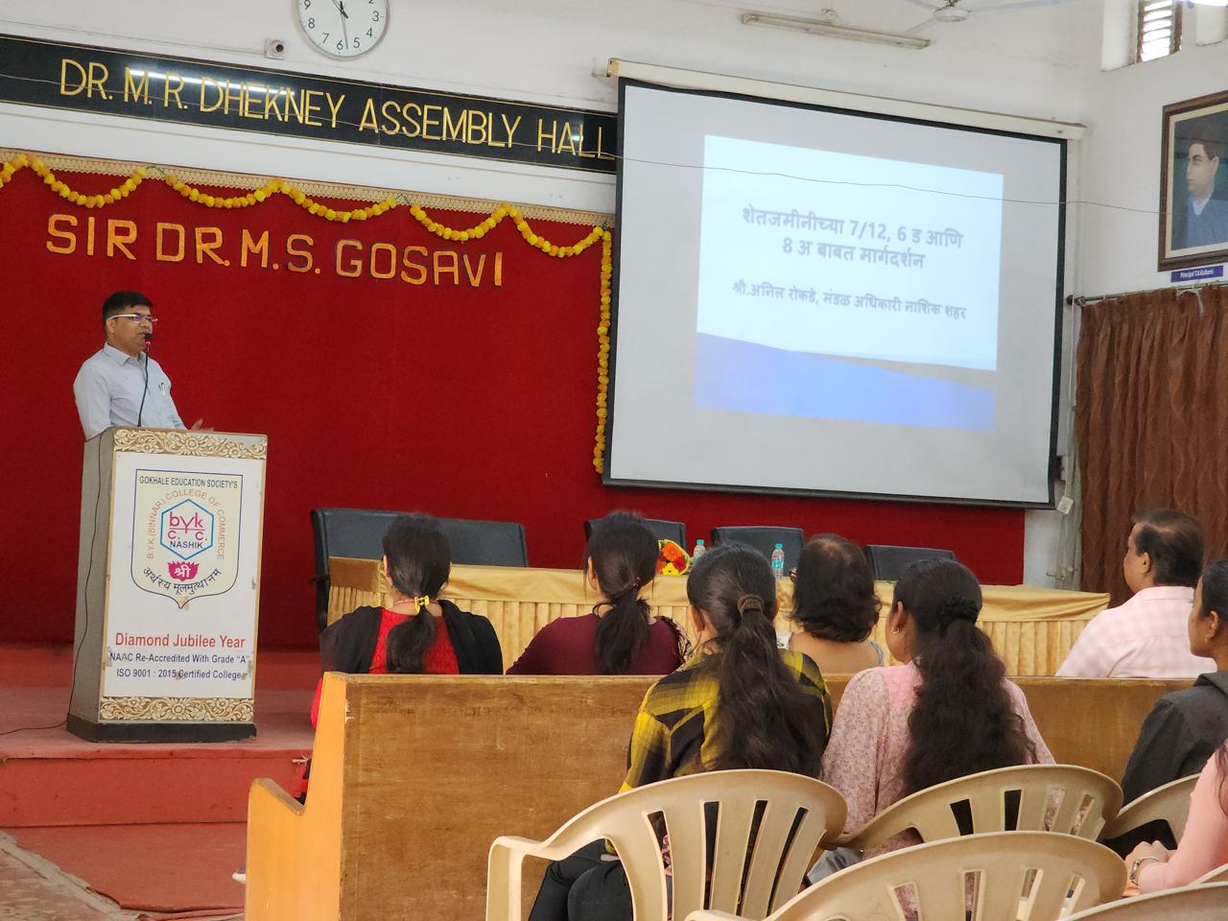
A guest lecture on “ Importance of Land Records in Agricultural Finance” was organized in which Mr. Anil Rokde, circle officer in Collector’s Office, Nasik was the speaker. He focused on different types of land records and the importance of maintaining them.

Slide 31
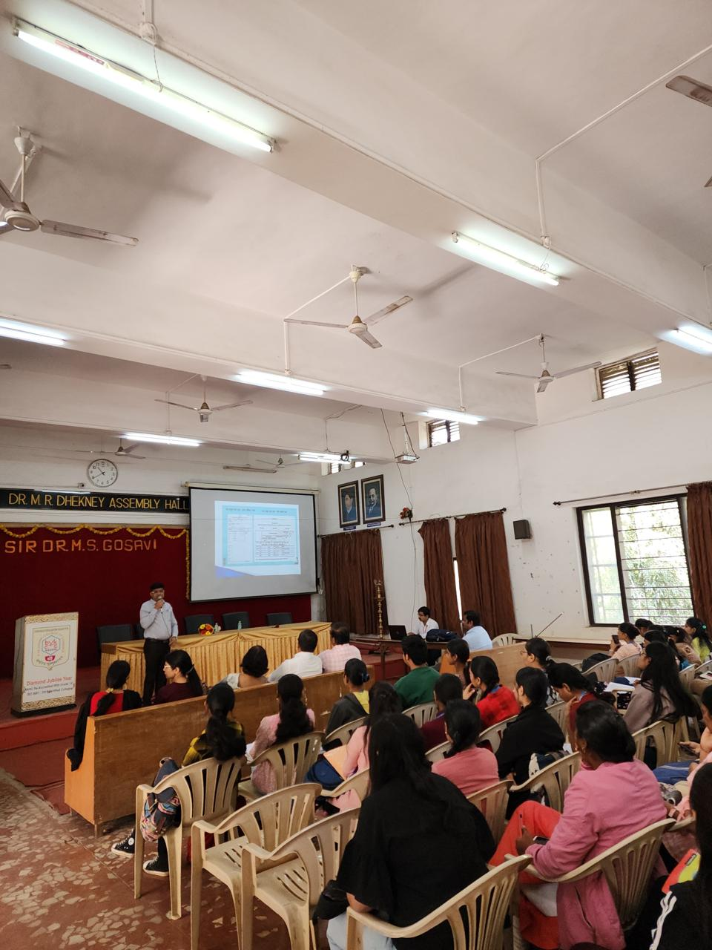
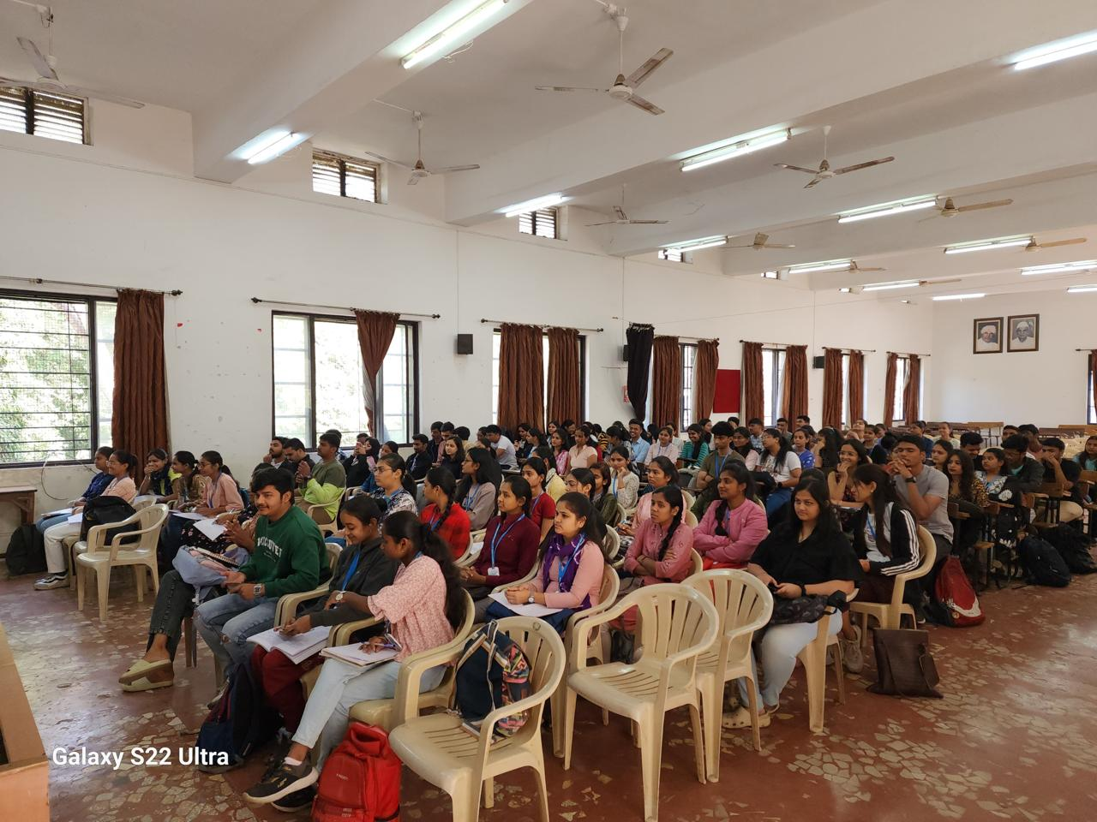
Guest Lecture on Importance of Land Records in Agricultural Finance

Slide 32
Students have visited to the Khatib Dairy, College Road, Nasik and Kokani Dairy, Dwarka Nasik to get the information about management and economics of dairy farming.

Slide 33
Students discussion with dairy farmers
Visit to vegetable sellers

Slide 34
Students participated in Food distribution Campaign of howfoundation 2021-22

Slide 35
Staff Achievement
Dr. K. J. Shivade (HOD, Department of Economics)
Motivational Speech has given at HAEWRC on 3rd December 2021 by Dr. K.J. Shivade as a chief Guest.
Motivational Speech has given on Akashwani and Radio Vishwas.
Flute Recital in Vandya Vande Matram before 15000 audience at Nasik.
Braille and Audio notes are prepare for blind students.
Braille updating digital dictionary has been prepared for visually challenged students
More than 500 Diagrams related to syllabus have been prepared, which are accessible to both sighted and visually challenged students.

Slide 36
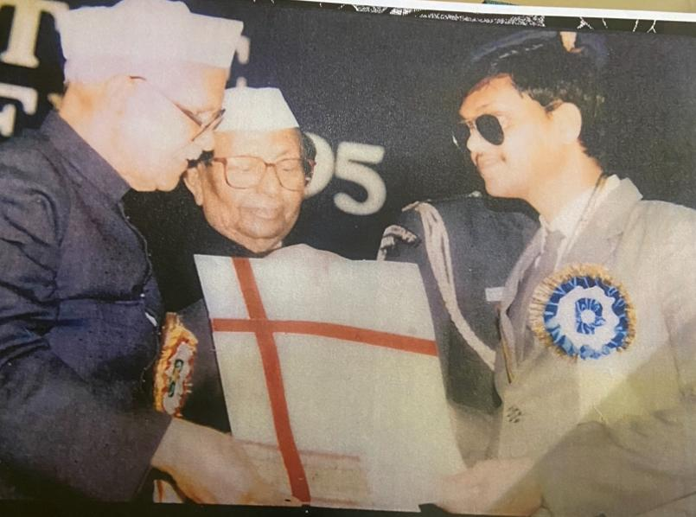
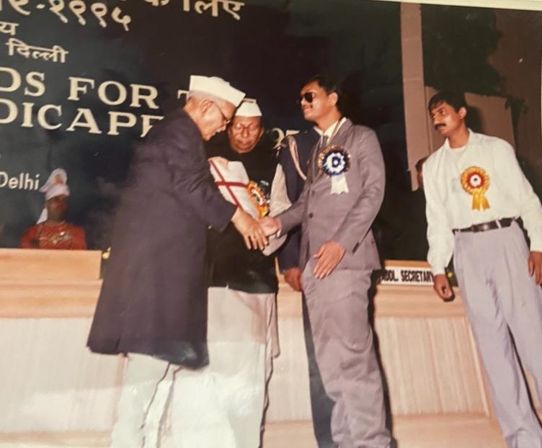
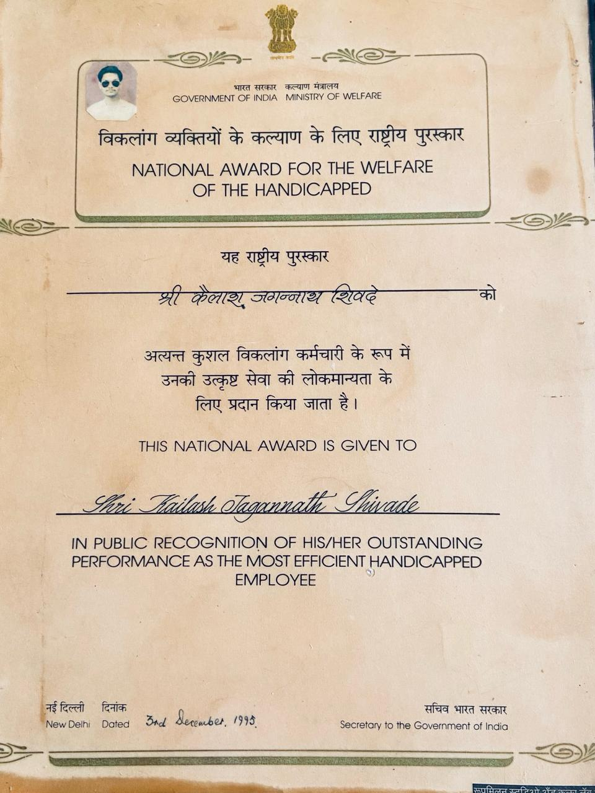
National Award For Most Efficient Blind Employee Award (1995)

Slide 37
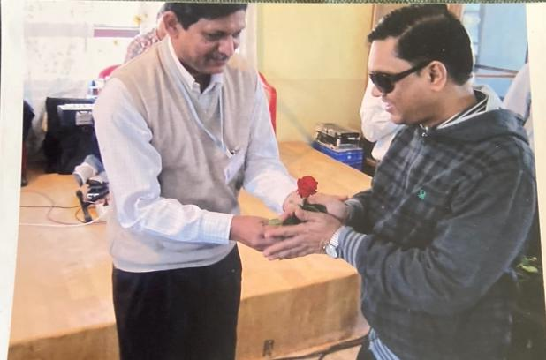
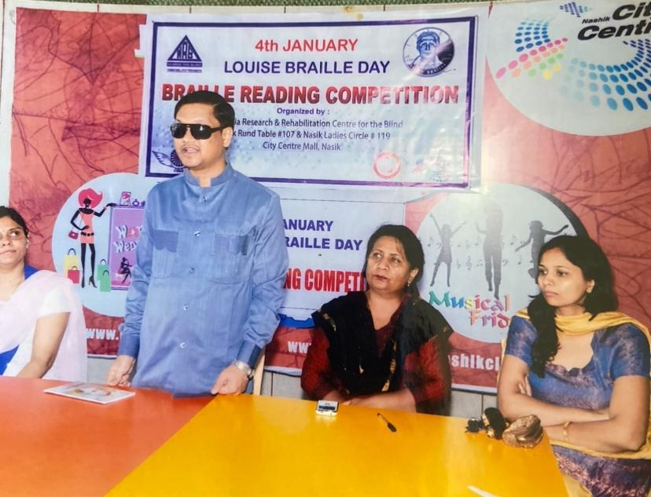
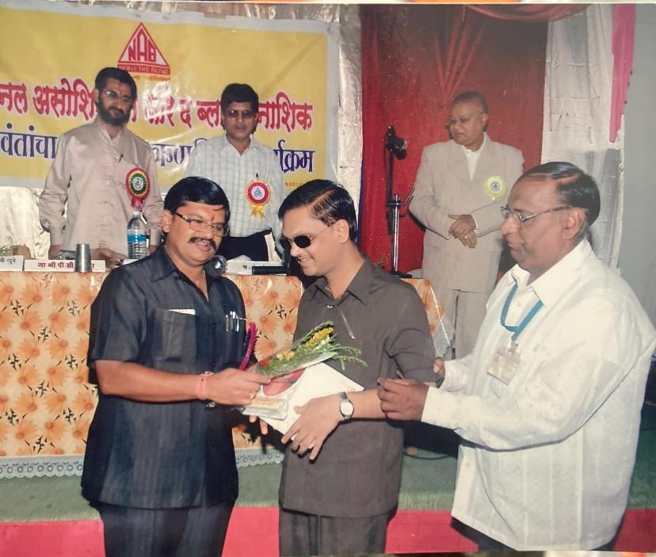
Music Competition – organised
Judge in women’s rotary club braille reading competition
Judge in music competition

Slide 38
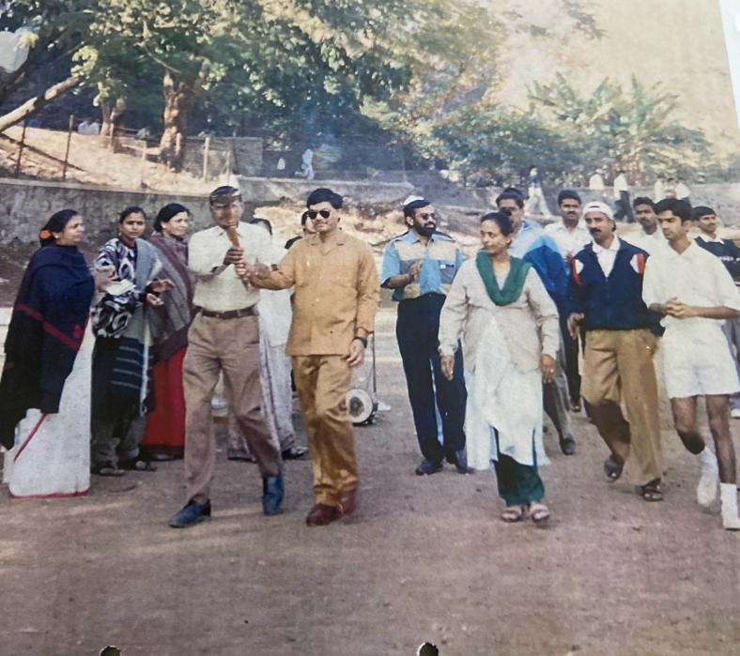
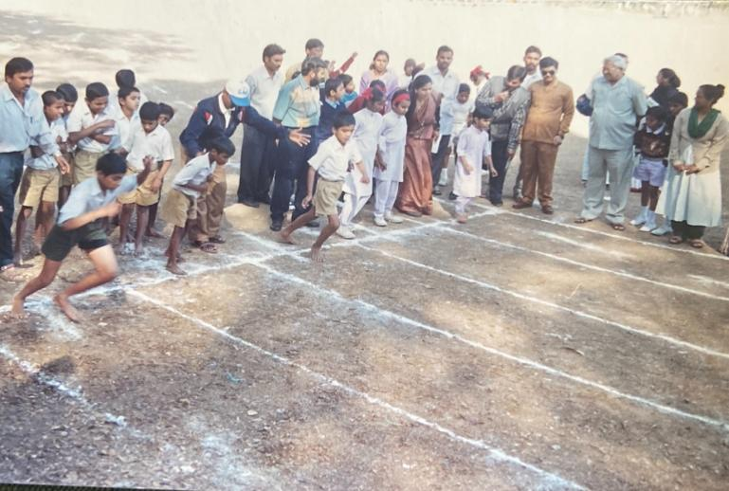
Inauguration of Divyang Sports Competition organised by Social Welfare Dept. Nasik

Slide 39
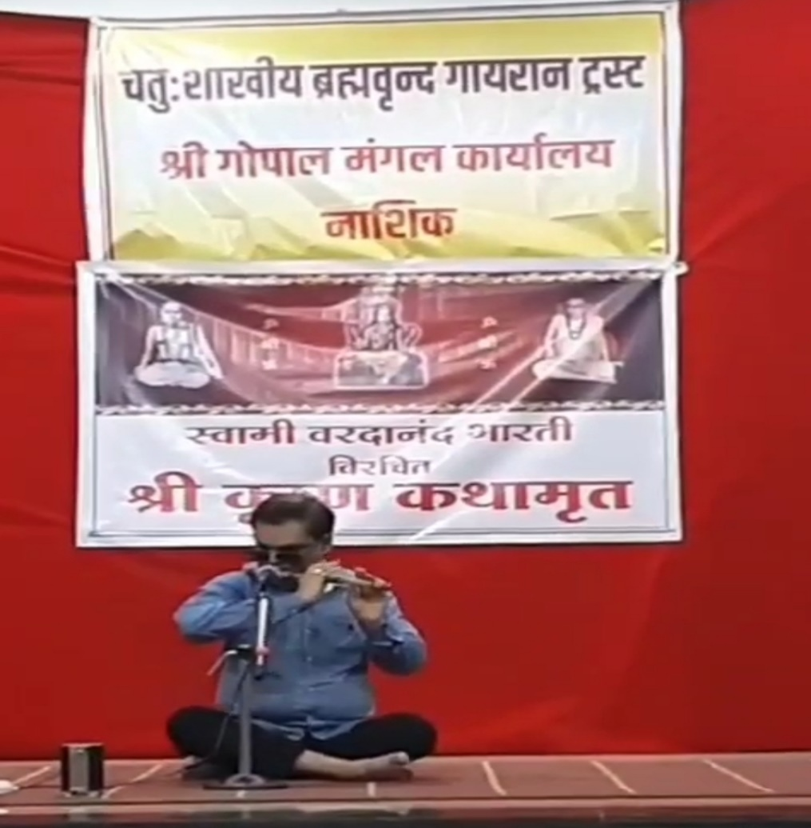
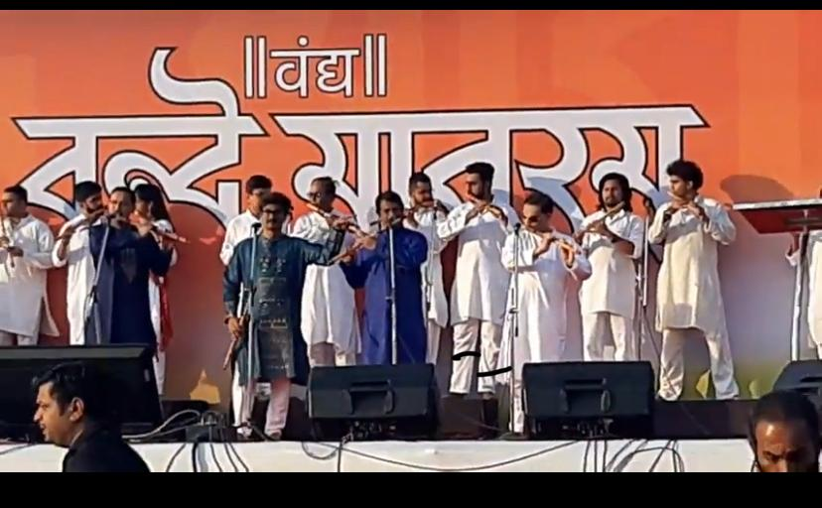
Performance at Vandya Vande Mataram
Government of Maharashtra (25/01/2020)
Performance at chaturshakhiya Brahmavrunda Gayran Trust
https://drive.google.com/file/d/1eOZ8B9BOhQ2YsfQ5nBEXXFTJb9pjdlu4/view?usp=drive_link
https://drive.google.com/file/d/1BWJwuNDSJwRDwxE9WedFnGVizA2HLKwx/view?usp=sharing

Slide 40
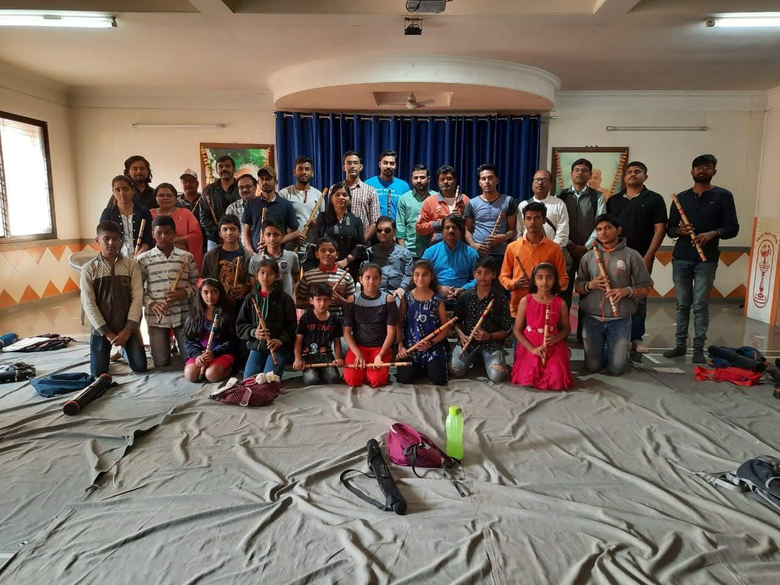
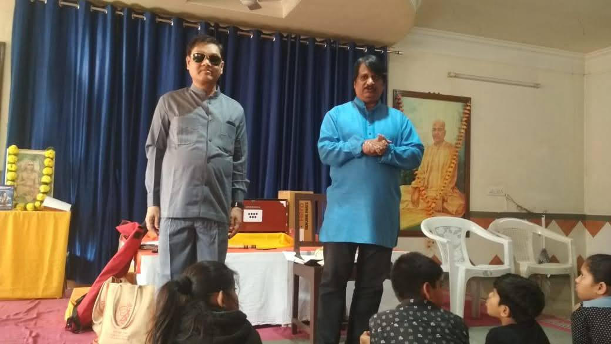
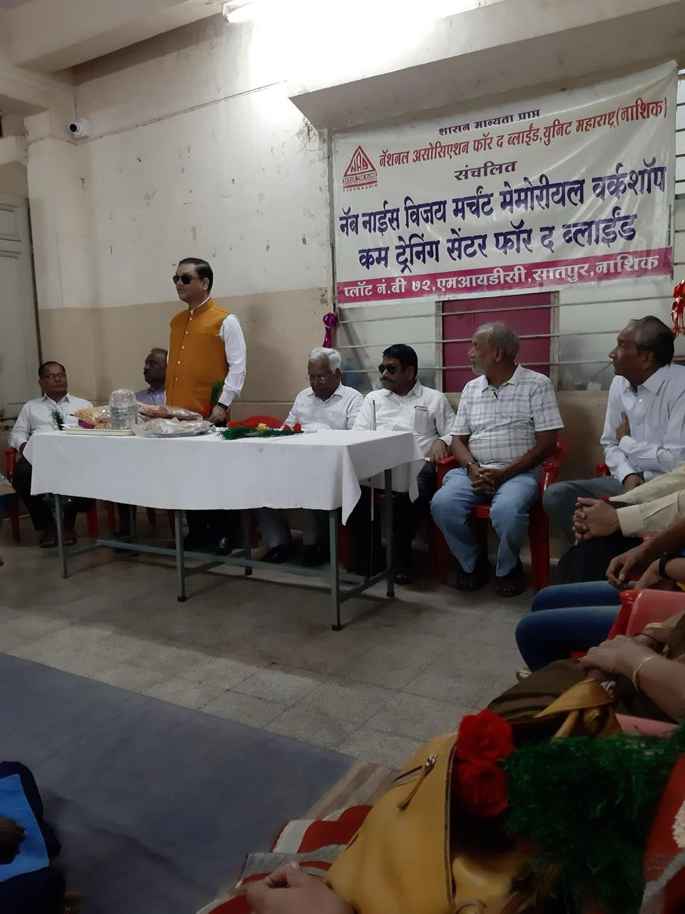
Guidance to the student regarding flute recital

Slide 41
Dr. H. P. Wangarwar
Guest Lecture delivered on NSS and Youth, Voters Awareness, Start-up India, Stand-up- India, Mudra Yojana, Budget.
Received Golden Award for Spit Free India Programme organised by Pledge for Life Organisation.

Slide 42
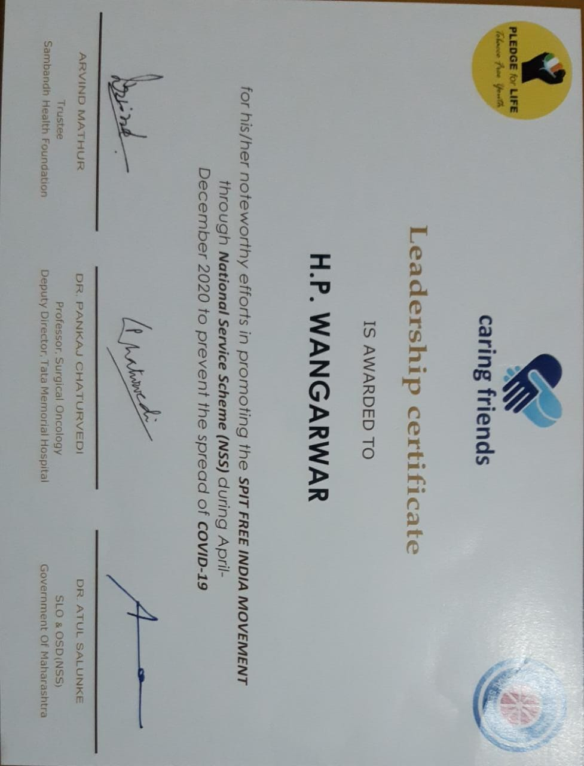
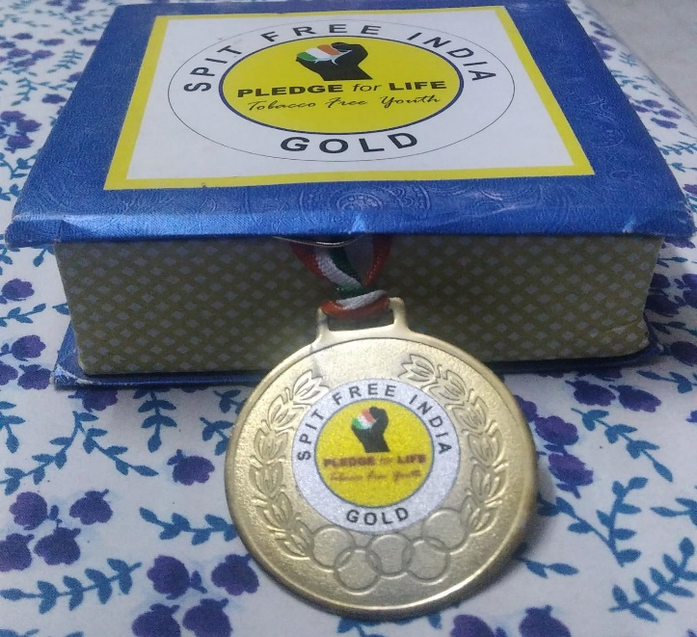

Slide 43
Delivered Lecture on Voters Awareness
Delivered Lecture on Entrepreneurship Development

Slide 44
SWOC Analysis
Strength | Weakness | Opportunity | Challenges
Most of the faculties are Ph.D. holders. | High weightage to the theoretical knowledge in evaluation. | To correlate subject knowledge with real life | High number of students
Highly experienced faculties | Less number of workshop organized | To update the domestic and international economic thoughts through media | Inadequate weightage in commerce faculty
e-book library (More than 9000 books) |  | To discuss on the economic issues through workshop
compulsory subject
practical oriented subject

Slide 45
Future Plan
To organize State or National level seminar
To organize workshop for T.Y. B.Com college students on current topic
To introduce certificate course in ‘Statistics for economics’
To encourage department-industry collaborative projects.
To establish financial literacy club.

Slide 46
Thank You

