Slide 1

Department of
Physical Education and Sports
GOKHALE EDUCATION SOCIETY’S
B.Y.K. (SINNAR) COLLEGE OF COMMERCE
PRIN. T. A. KULKARNI VIDYANAGAR, NASHIK 422005
Welcomes
NAAC Peer Committee Members

Slide 2
Department of
Physical Education and Sports
Staff of the Department
1. Dr. Sunil S. More
M.A., M. Ed. (Phy.Edu.), S.E.T., P.hD.
Maharashtra State Shiv Chhatrapati Awardee (Handball)
HOD, Director of Physical Education and Sports
Experience : 25 Years
2. Mr. Kunal Mahajan
M.A., M.P.Ed.
Cricket Player
Physical Education Teacher
Experience : 8 Years
Mr. Arun Pakale
Attendant
Experience : 33 Years

Slide 3
Vision
To encourage students to participate in competitive sports
To inculcate life skills through participation in sports
To develop sportsmen spirit among students.
To enhance psychological wellbeing through sports.
To co-ordinate sporting activities with educational curriculum.

Slide 4

Mission
The department of Physical Education aims at mass participation of students and staff in Sports and Games.
To develop aptitude towards participation in competitive sports.
To educate students about the overall benefits through participation in sports.

Slide 5
Objectives
      To develop motor abilities like strength, speed, endurance, co-ordination,
      flexibility, agility and balance, as they are important aspects for
      good performance in different games and sports.
To develop physical growth , personality characteristics and emotional stability through participation in sports.
The major objectives of the department is to improve Physical fitness (Health
Awareness), High performance in sports and Recreation.
To develop awareness towards health, hygiene and environment awareness through physical education.
To allow for the development of social skills through participation in sports.
To allow for the development of leadership skills through participation in sports.

Slide 6
Details of Indoor and Outdoor Sports Facilities Available
Sr.No. | Indoor | Sr.No. | Outdoor
01 | Badminton | 01 | Football
02 | Table Tennis | 02 | Cricket
03 | Chess | 03 | Volleyball
04 | Carrom | 04 | Basketball
05 | Yoga | 05 | Kabaddi
06 | Multigym | 06 | kho - kho
 |  | 07 | Handball
 |  | 08 | Baseball
 |  | 09 | Softball

Slide 7

Students Participation in Inter-Uni., Ashwamedha , and World University Championship
Sr. No. | Academic year | Inter College | Inter Zonal |  | Ashwamedha University championship | All India Inter Uni. | Khelo India Inter University | World University Games
1 | 2018-19 | 174 | 34 |  | 05 | 08 | 02 | 01
2 | 2019-20 | 181 | 39 |  | 07 | 09 | 02 | 02
3 | 2020-21 | No Sports activity held due to COVID – 19 Pandemic
4 | 2021-22 | 153 | 31 |  | 06 | 09 | 01
5 | 2022-23 | 111 | 37 |  | 04 | 11 | 03

Slide 8
Achievement
University/National/Inter-national
Sr. No. | Academic Year | Name of Student | Sports Event | Participation Level | Venue | Performance
1 | 2018-19 | Akhilesh Nagare | Chess | International Level | Delhi | Common Wealth Games Participation
2 |  | Dhanashri Rathi | Chess | International Level | Delhi | Common Wealth Games Participation
3 |  | Ranjit Sharma | Softball | International | Jakarta Indonesia | Asian games Participation
4 |  | Aditya Ashtekar | Basketball Khelo India Games | National | Pune | Participation
5 |  | Shiva Vagal | Body Building | International | Ecuador ,South America | Participation
6 |  | Praneet Diwan | Football | National All India Inter University | Mumbai | Participation
7 |  | Dakshata Lingayat | Shooting | National All India Inter University | Tiruvanthpuram | Participation
8 |  | Ameet Maid | Cricket | National All India Inter University | Bhuvaneshwar | Participation

Slide 9
Achievements
University/National/Inter-national
Sr. No. | Academic Year | Name of Student | Sports Event | Participation Level | Venue | Performance
1 | 2019 - 20 | Himanshu Gaikwad | Yoga | International Level | Nashik | Noble World Record
2 |  | Dhanashree rathi | Chess | International Level | Delhi | Western Asian championship, World Junior Chess Championship
3 |  | Priyanka Bhavsar | Gymnastics | National Level | Guwahati | National Championship
4 |  | Ajinkya Patharkar | Badminton | International Level | Indonesia | Asian Junior Championship
5 |  | Dakshata Lingayat | Shooting | University level | Faridabad | Won Gold Medal in State Level Championship

Slide 10
Achievements
National/International level
Sr. No. | Academic Year | Name of Student | Sports Event | Participation Level | Venue | Performance
1 | 2020-21 | Priyanka Bhavsar | Gymnastics | International Level | Patiala,Banglore | Selection Trials
2 |  | Ajinkya Patharkar | Badminton | International Level | Patiala,Banglore | Selection Trials
3 |  | Aditi Chandramore | Volleyball | National Level | Panhala | Selection Trials
4 |  | Tanisha Kavale | Volleyball | National Level | Panhala | Selection Trials
Academic Year 2020-21 :- Less Participation due to Covid

Slide 11
Achievements
Participation National Level
Sr. No. | Academic Year | Name of Student | Sports Event | Participation Level | Venue | Performance
1 | 2021-22 | Ajinkya Patharkar | Badminton | Inter-National Level | Banglore | Khelo India (Bronze)
2 |  | Dhanashree rathi | Chess | National Level | Jaipur | All India Inter-Uni.
3 |  | Adhirath Gade | Athletics (200m/400m) | National Level | Banglore | All India Inter-Uni.

Slide 12
Achievements
Inter-University level
Sr. No. | Academic Year | Name of Student | Sports Event | Participation Level | Venue | Performance
1 | 2022-23 | Mustansir Kanchwala | Cricket | Inter-University level | Rajasthan | Participation
2 |  | Dhanashree rathi | Chess | Inter-University Level | Bhopal | Won Individual and team Gold Medal
3 |  | Amit Kamble | Gymnastics | Inter-University Level | Punjab | Khelo India University Championship
4 |  | Shiya Lalwani | Cycling | International Level, National,Inter-University Level | Patiala | Khelo India University Championship
5 |  | Yogeshwari Jadhav | Handball | Inter-University level | Bundelkhand | Khelo India University Championship
6. |  | Karuna Thattekar | Judo | Inter-University level | Jalandar | Khelo India University Championship

Slide 13
Sir Dr. M.S. Gosavi
T-20 Cricket Invitational Tournament
Sr. No. | Year | Winners | Runners Up
1 | 2018-19 | BYK – X | Ahmednagar
2 | 2019-20 | BYK Regular | Pune
3 | 2020-21 | Not held due to COVID 19 Pandemic | ----
4 | 2021-22 | Not held due to COVID 19 Pandemic | ----
5 | 2022-23 | Not Held due to university exams | ----
6 | 2023-24 | BYK Regular BYK - X

Slide 14
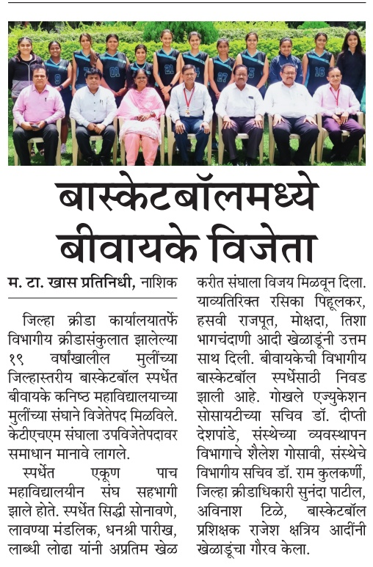
Achievements

Slide 15
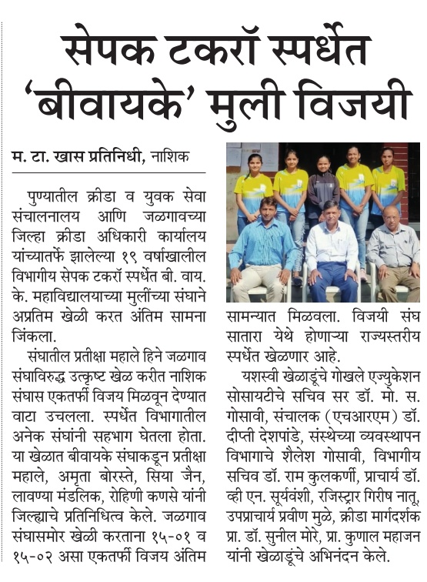
Achievements

Slide 16
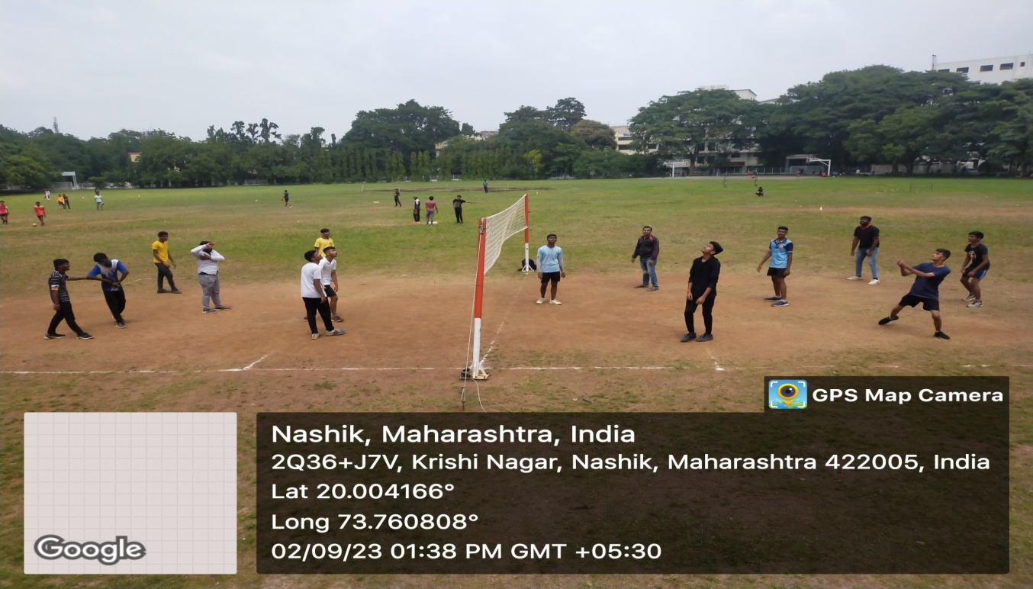
Outdoor Sports Volleyball Court

Slide 17
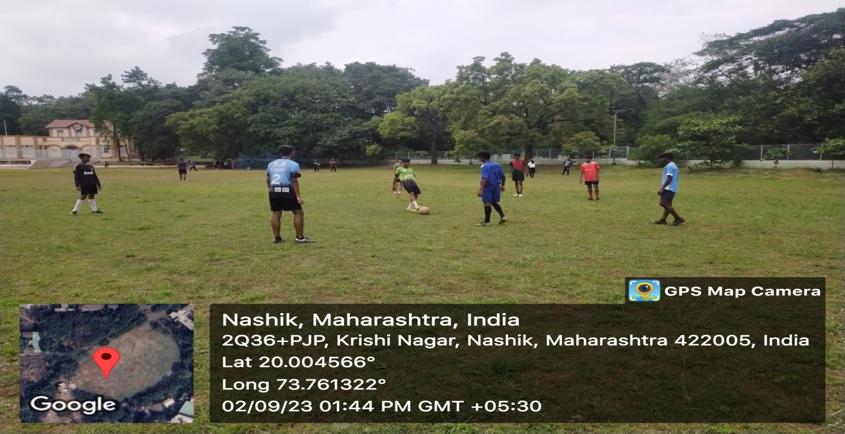
Outdoor Sports Football Play Field

Slide 18
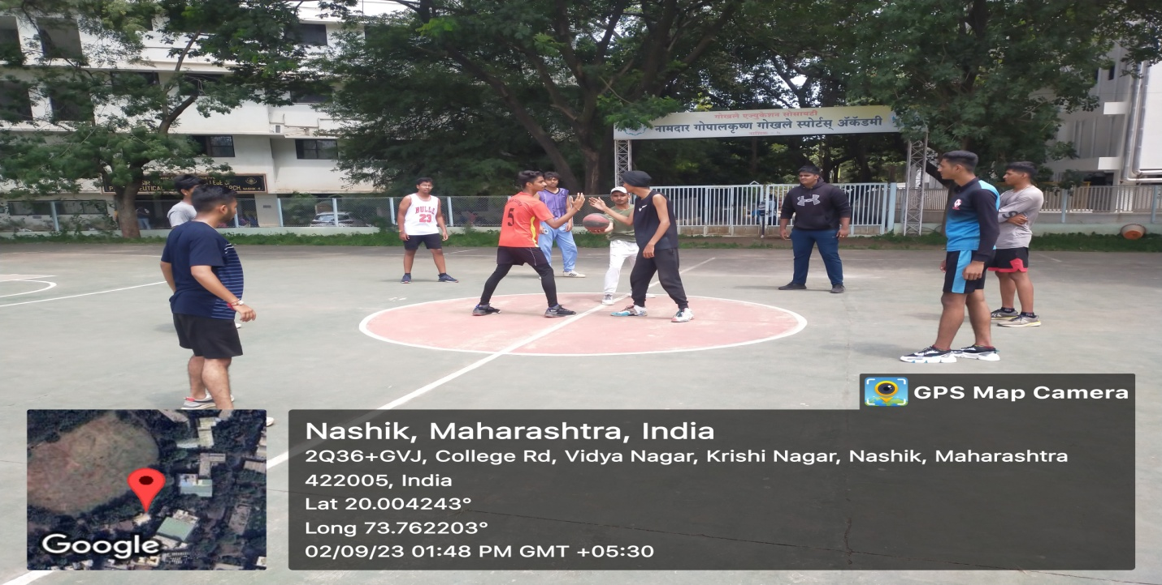
Outdoor Sports Basketball Court

Slide 19
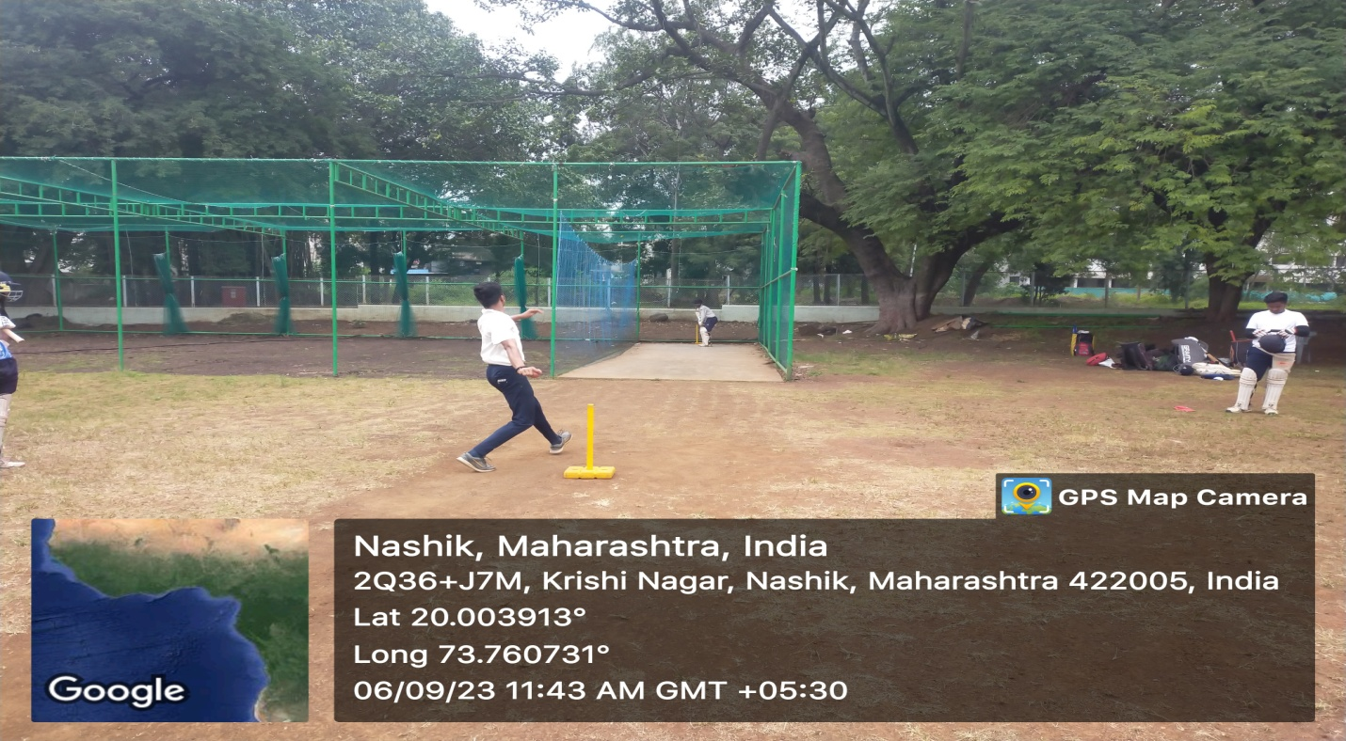
Outdoor Sports Cricket Nets

Slide 20
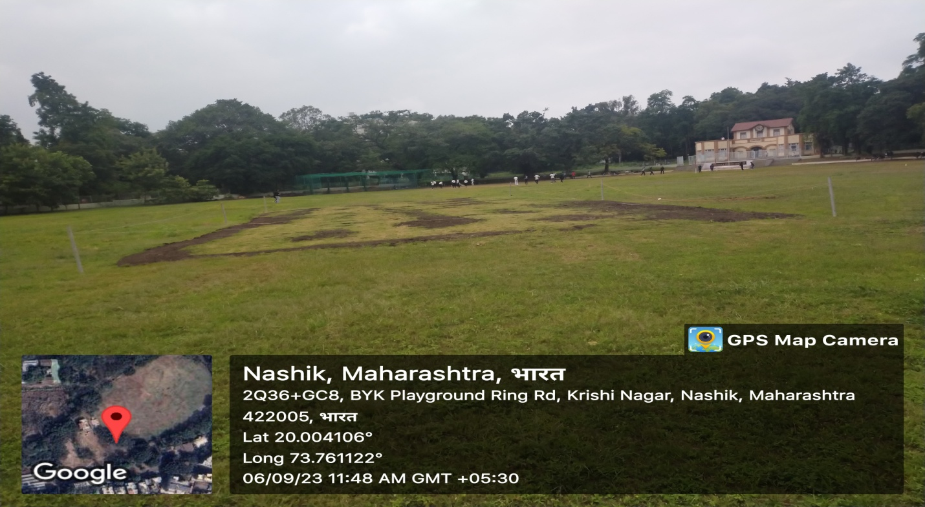
Turf Wicket for
Cricket

Slide 21
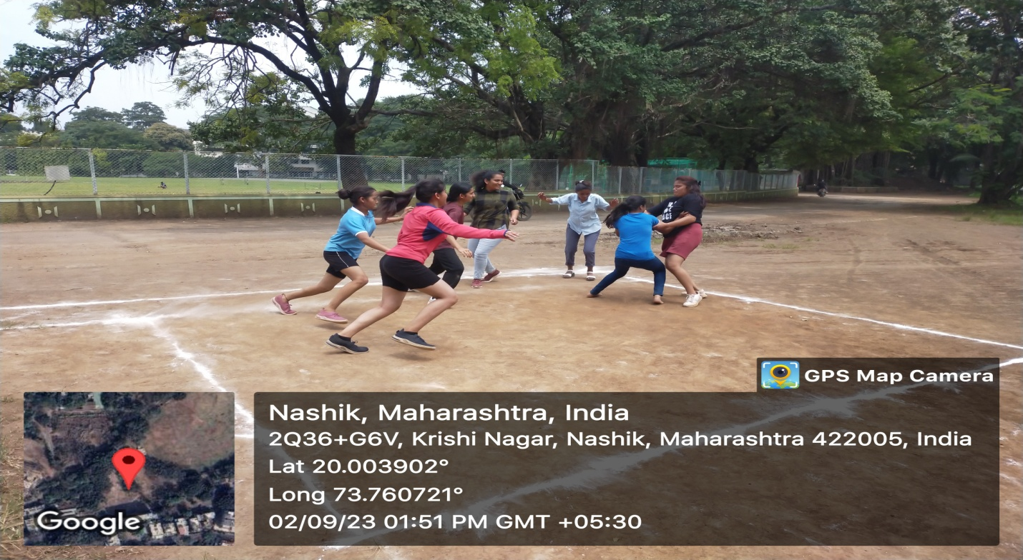
Outdoor Sports
Kabaddi Court

Slide 22
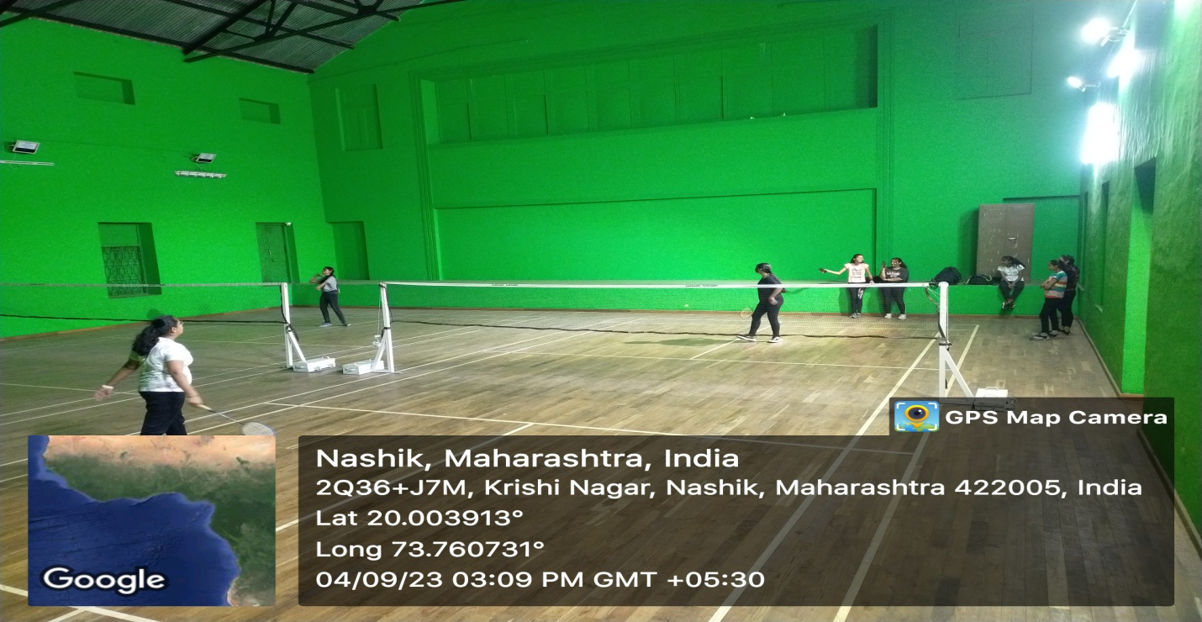
Indoor Sports Badminton

Slide 23
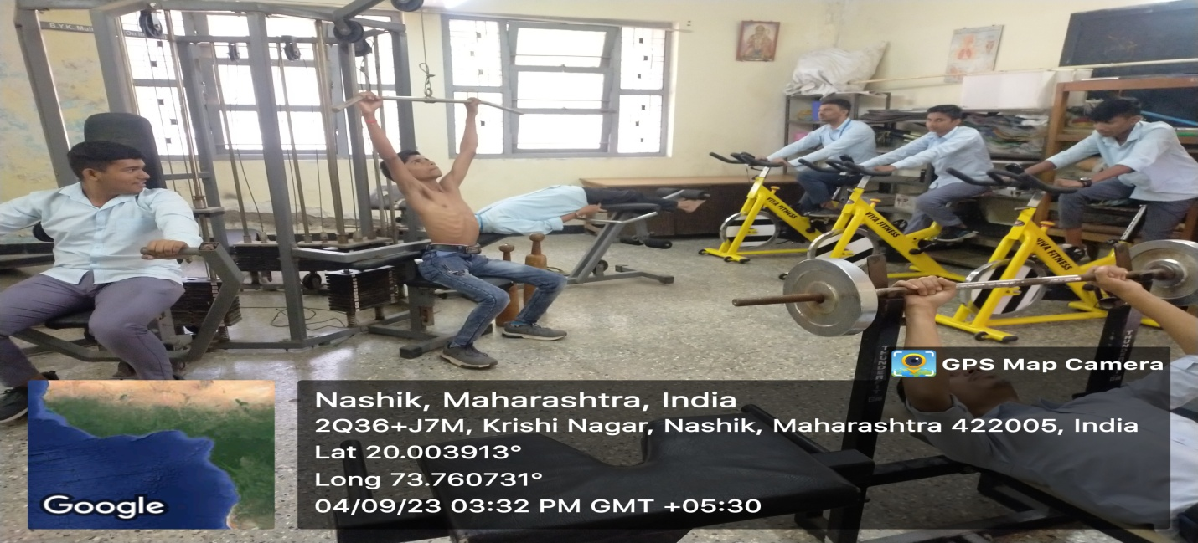
Indoor
Multi Gym

Slide 24
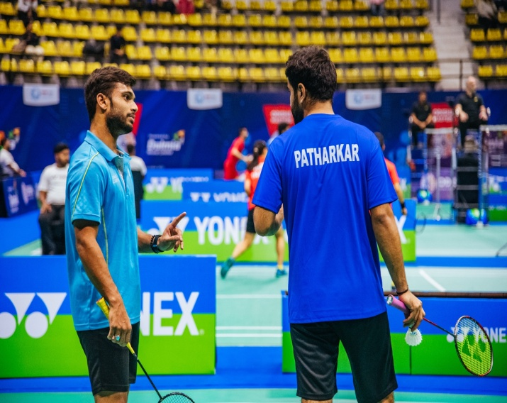
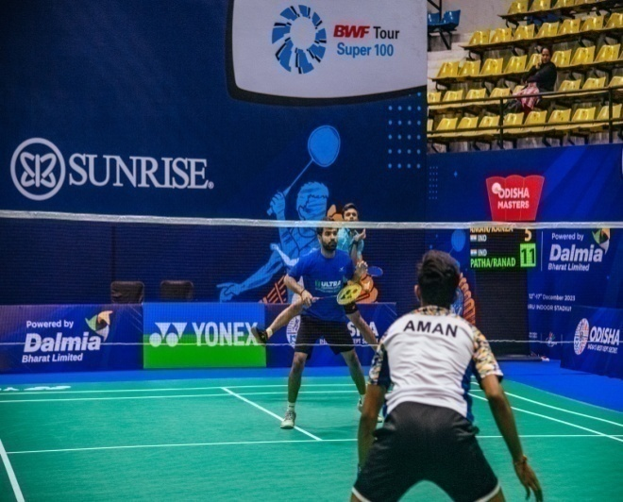
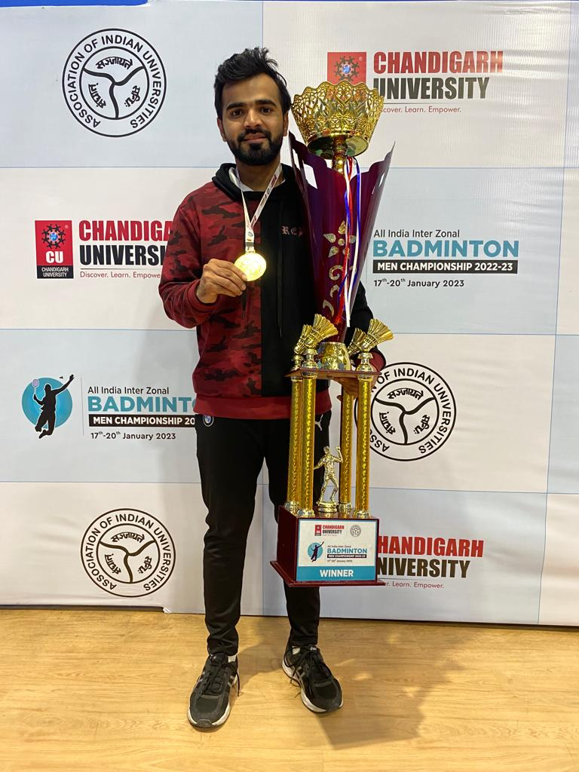
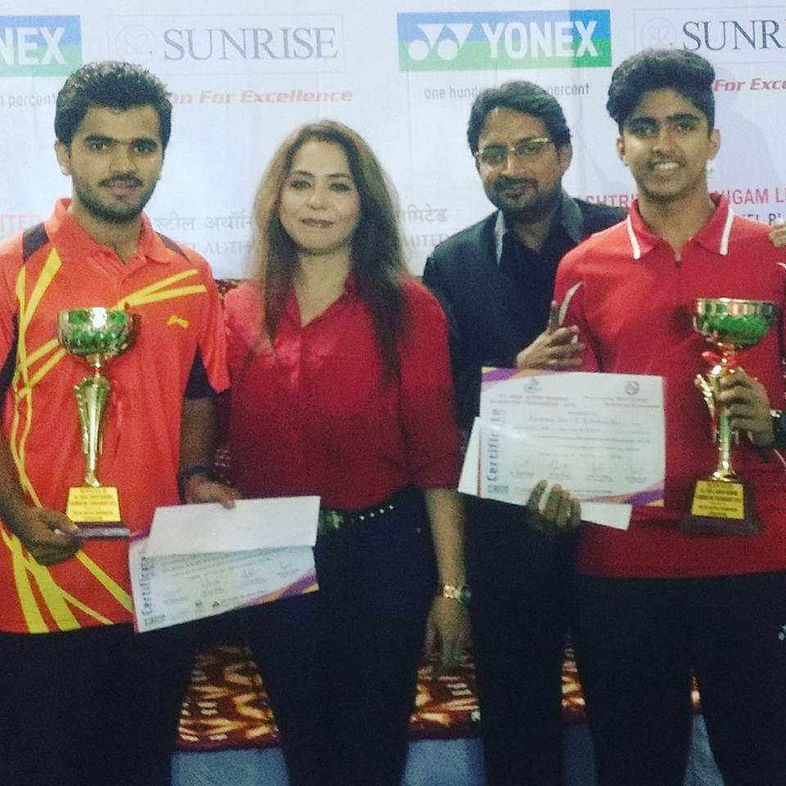
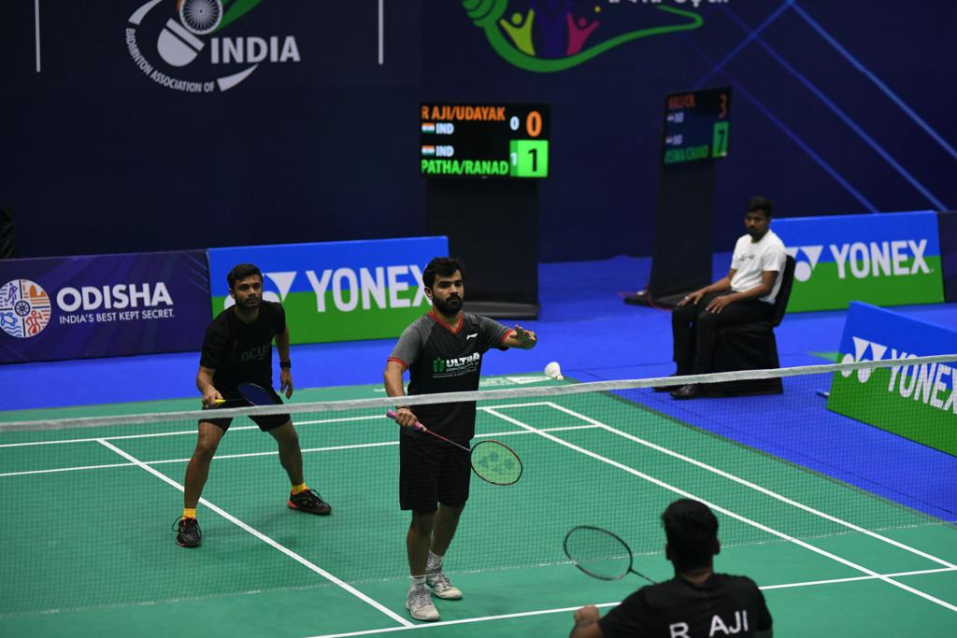
Badminton
Ajinkya Patharkar.

Slide 25
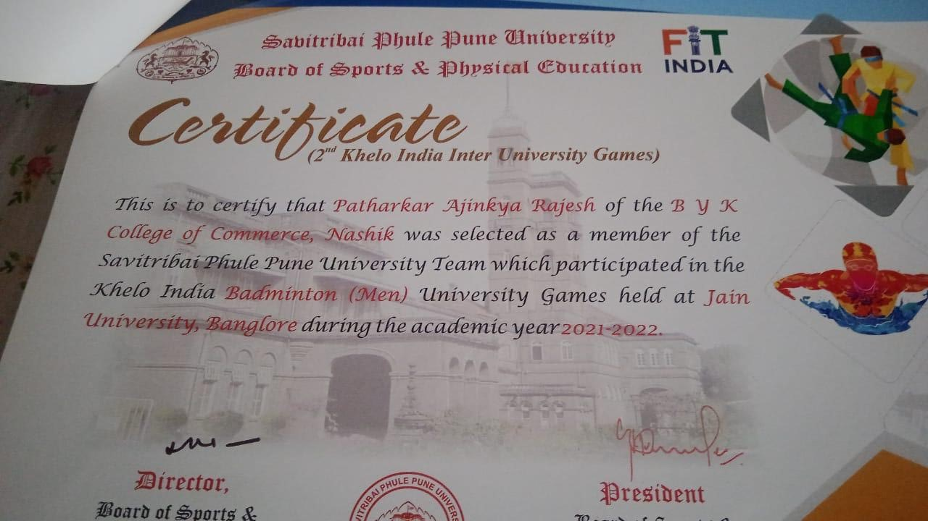
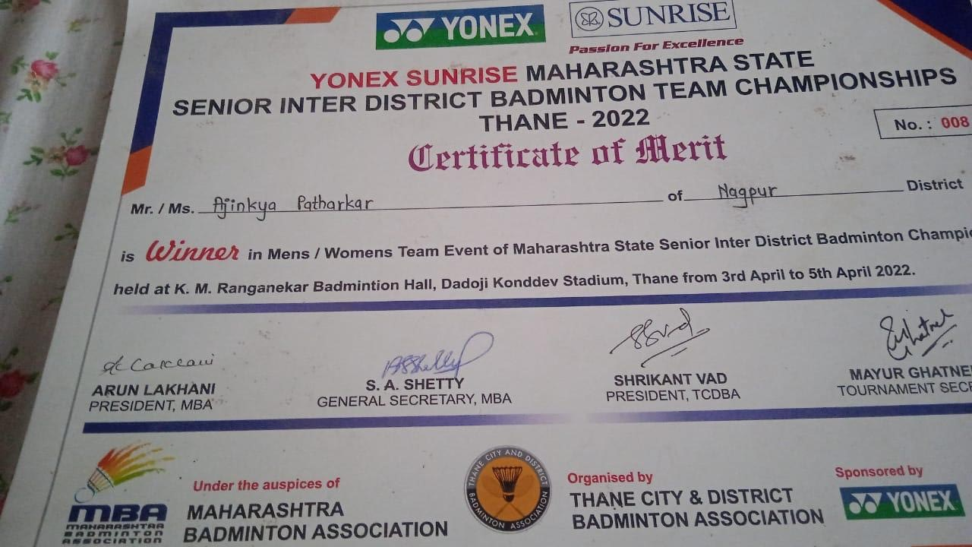
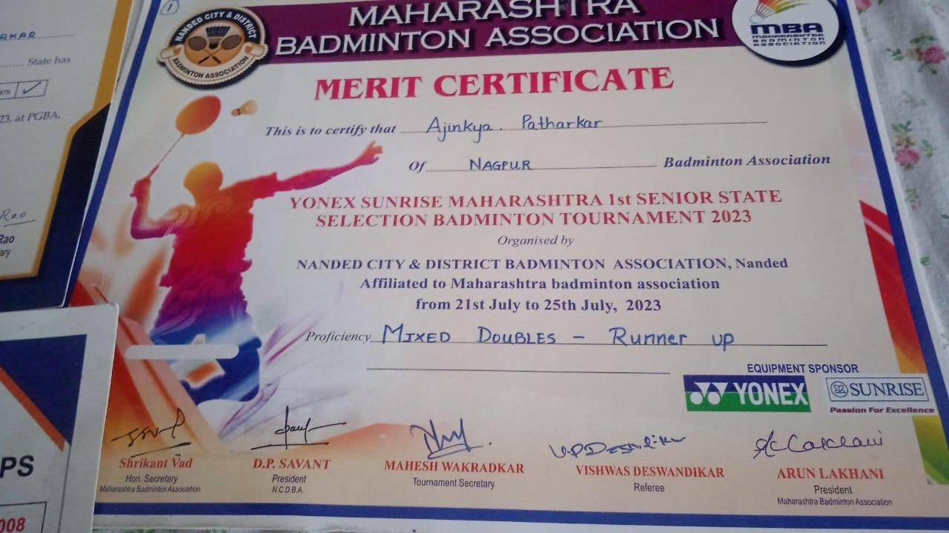
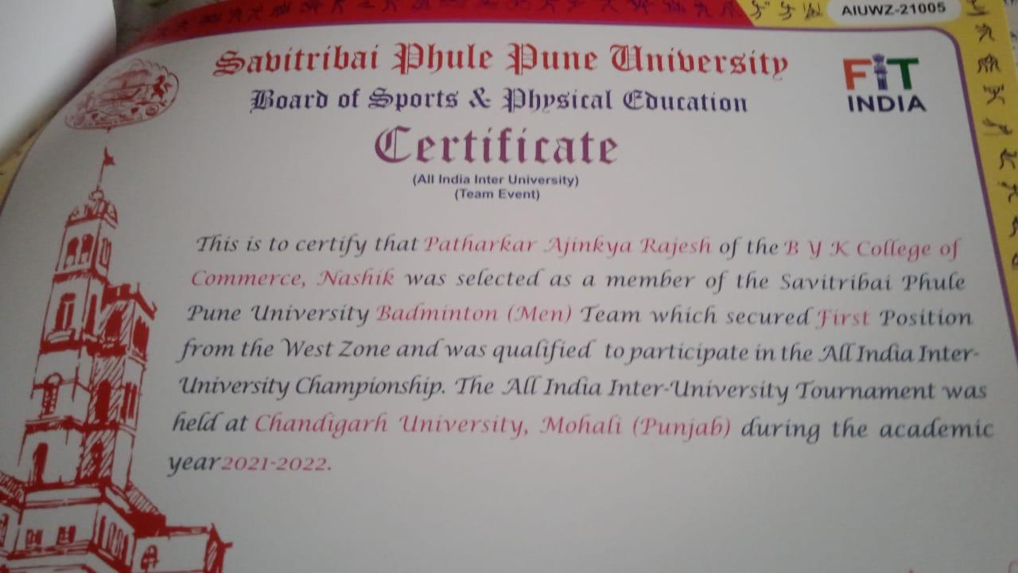
Certificates:
Ajinkya Patharkar

Slide 26
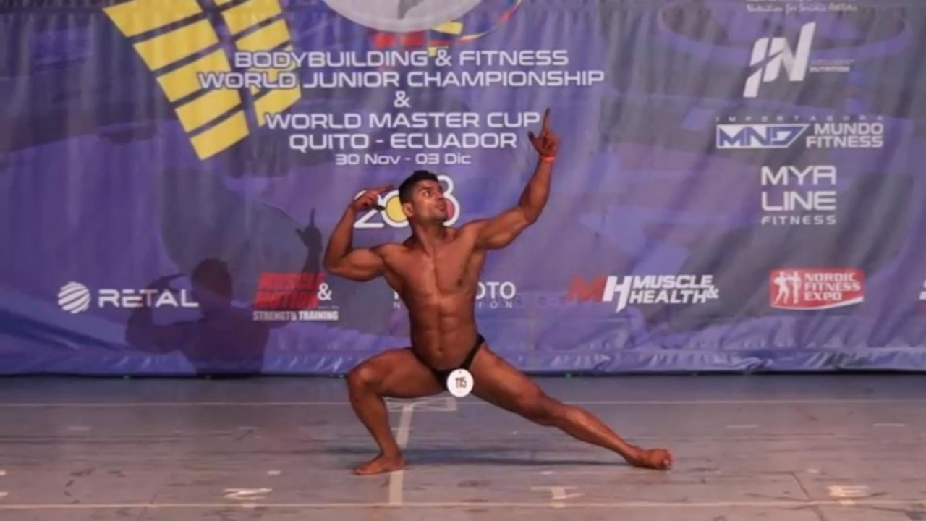
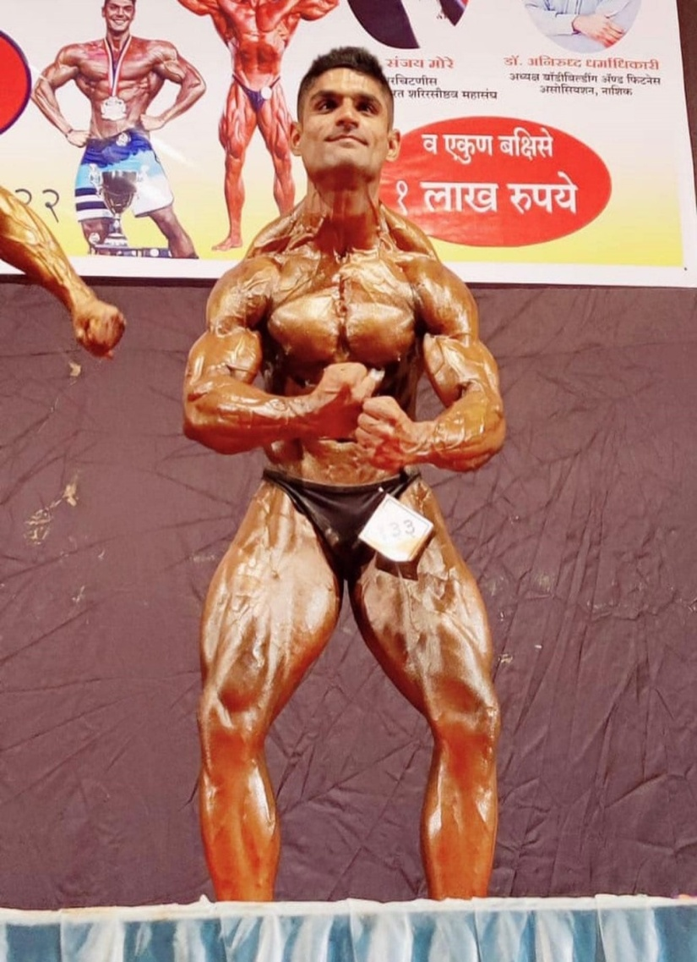
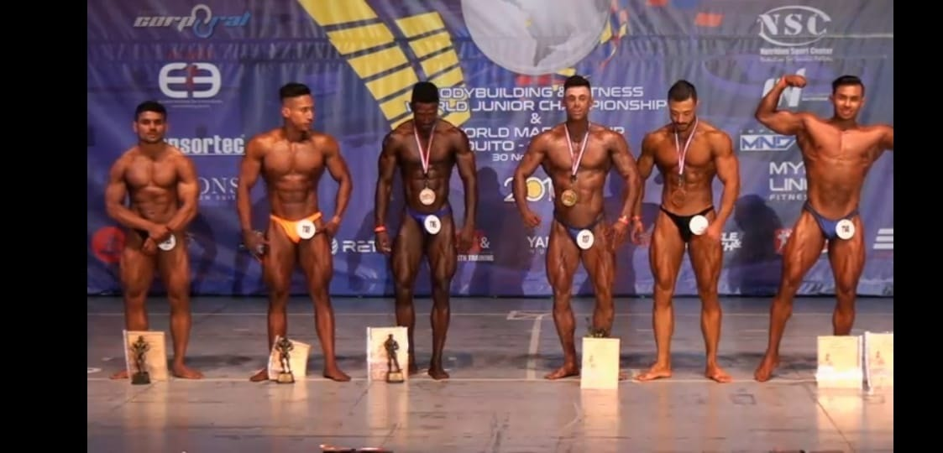
Body Building
Shiva Vagal

Slide 27
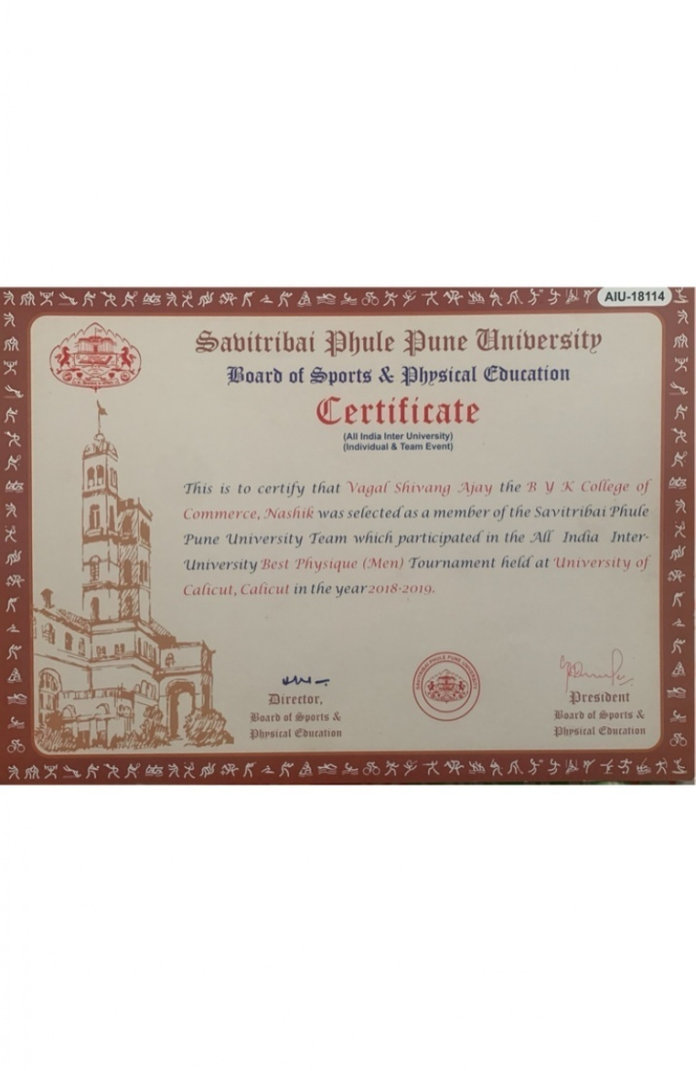

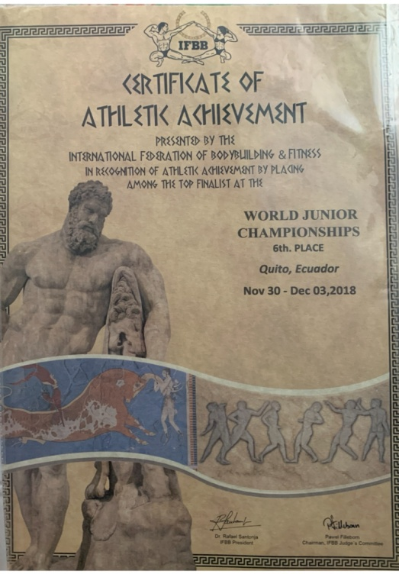
Certificates
Shiva Vagal

Slide 28
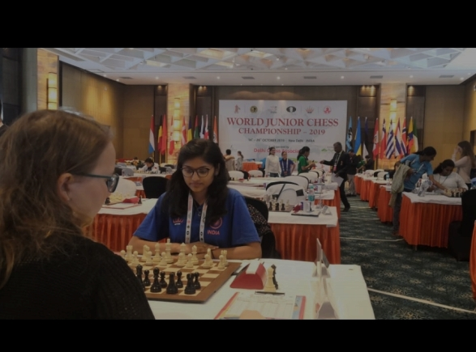
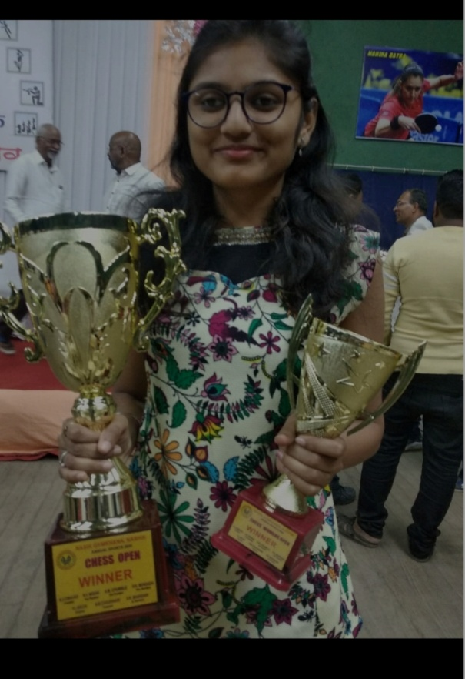
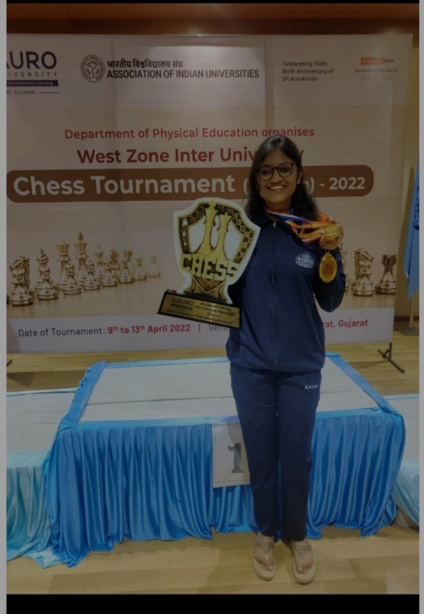
Chess
Dhanashree Rathi

Slide 29
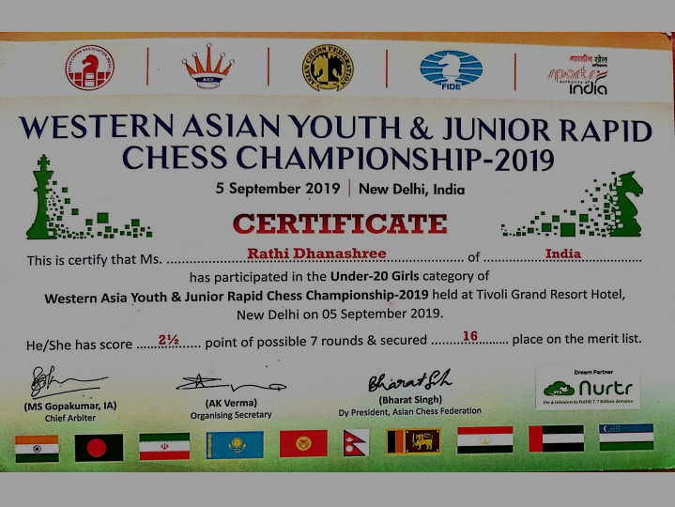
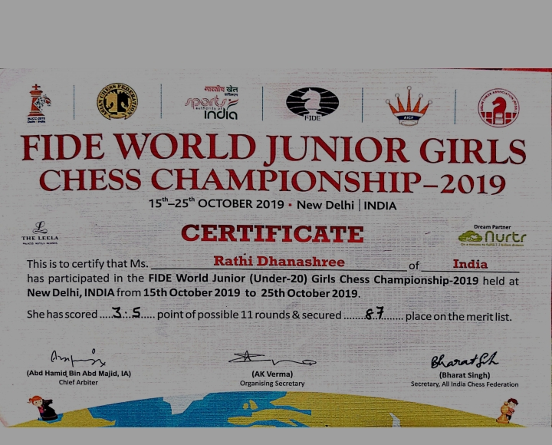
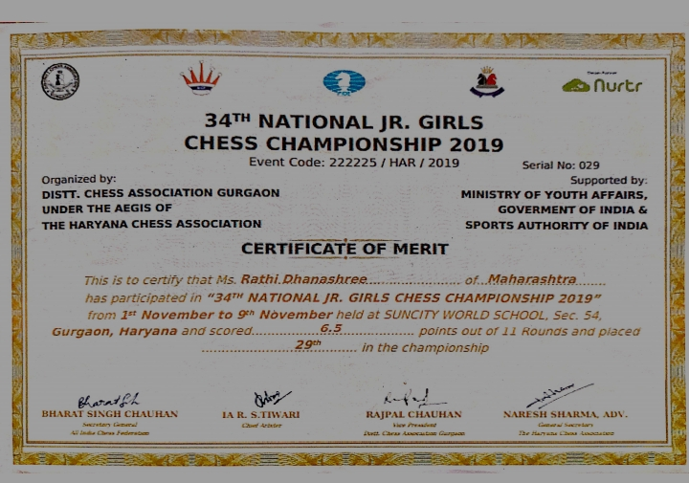
Certificates
Dhanashree Rathi

Slide 30
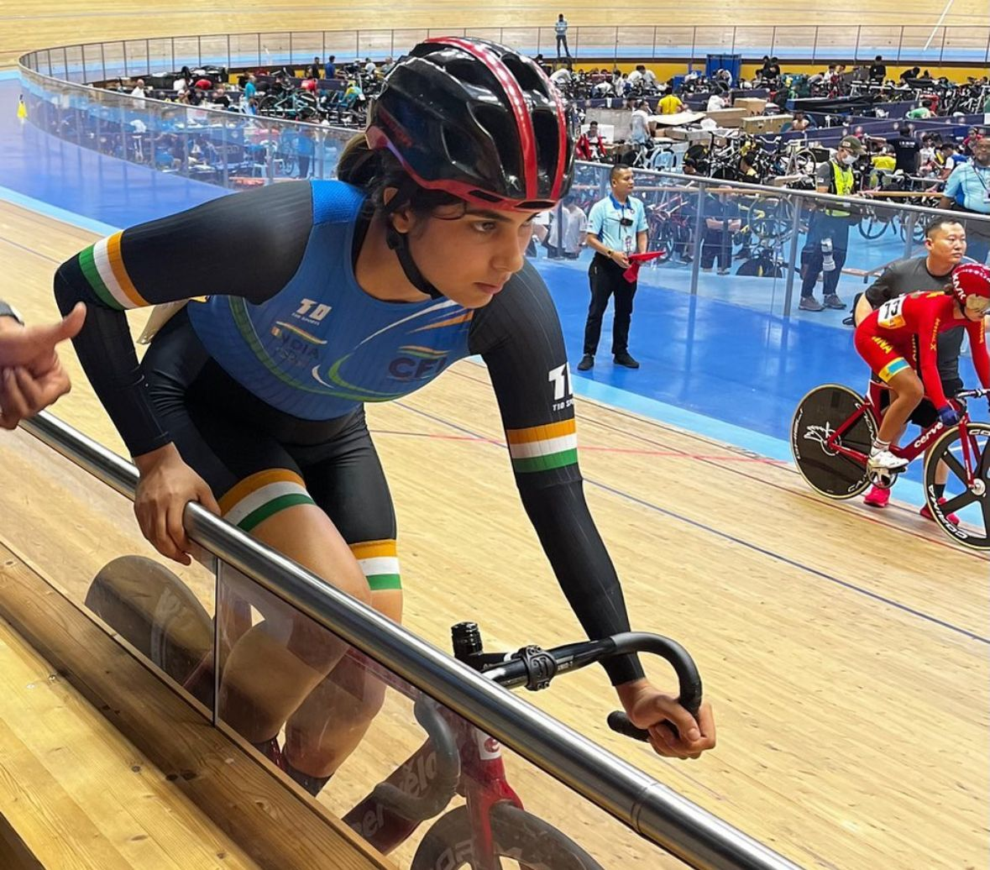
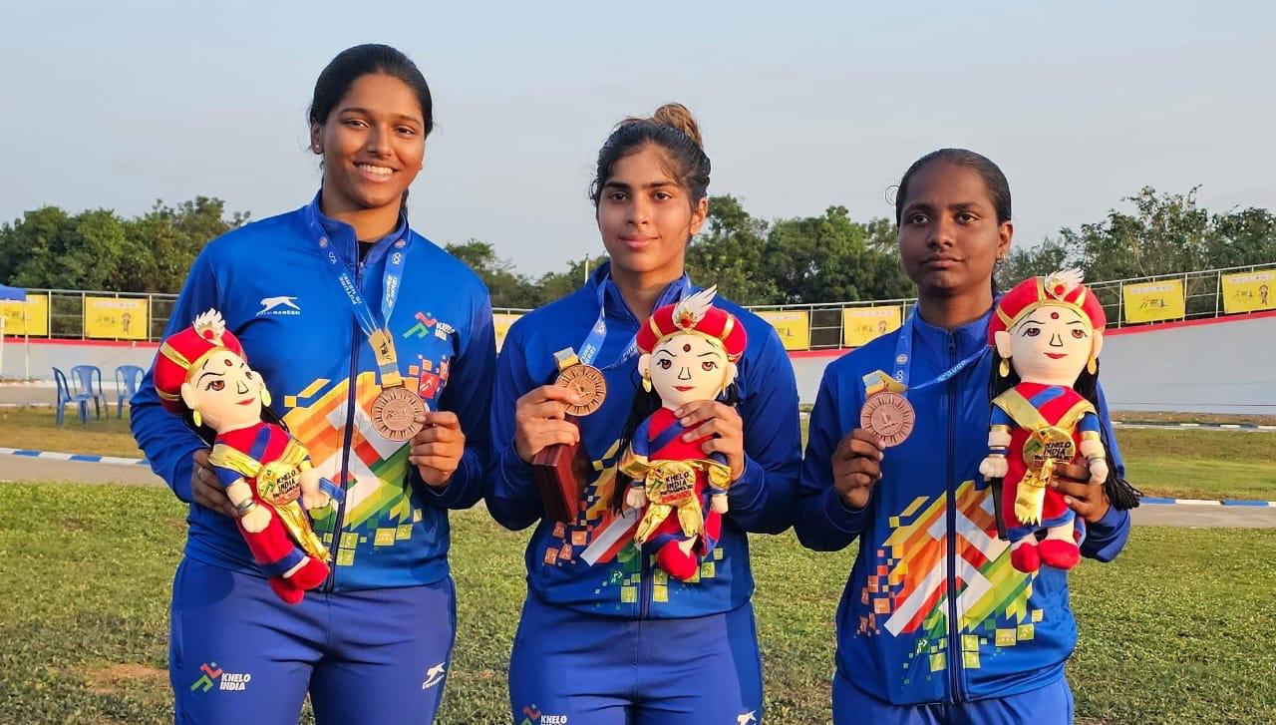
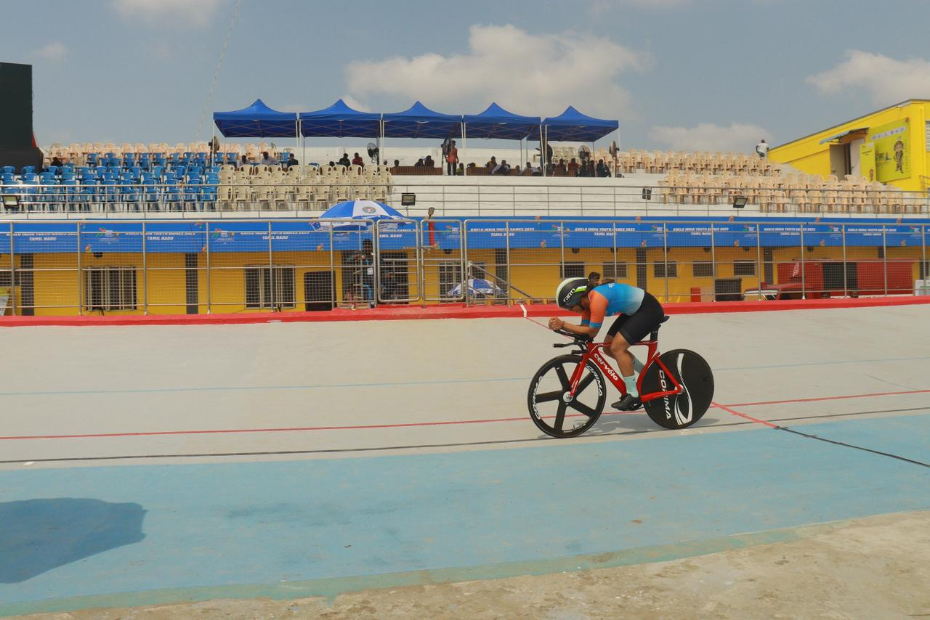
Cycling Sport :
Shiya Lalwani

Slide 31
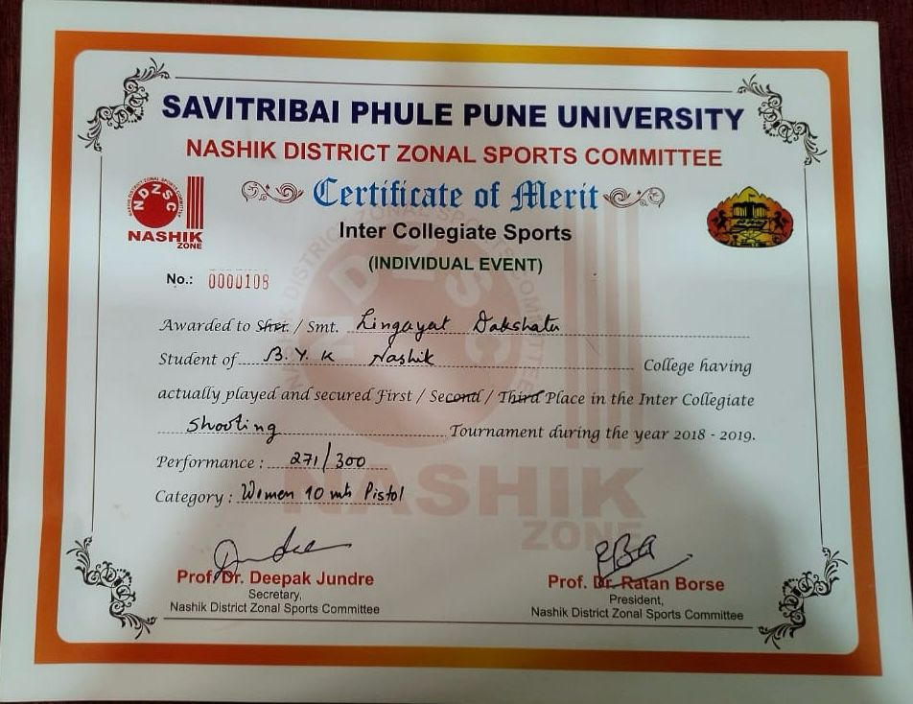
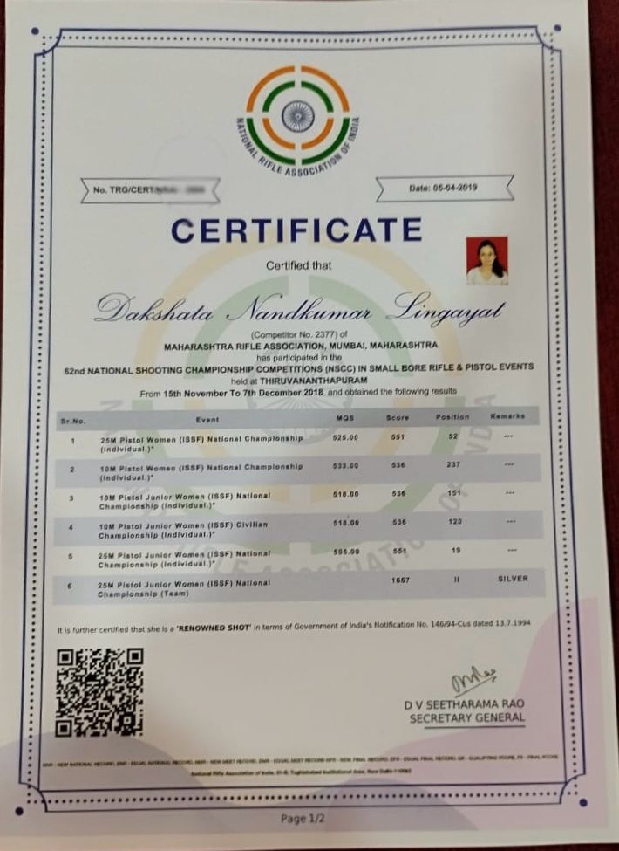
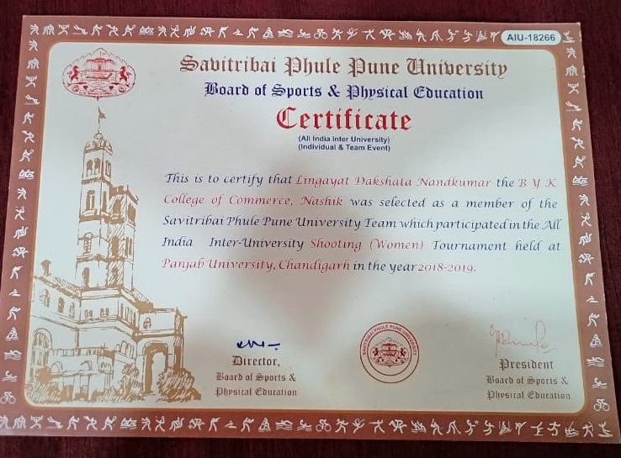
Certificates
Dakshata Lingayat

Slide 32


Thank You

