Slide 1
Gokhale Education Society’s B. Y. K. College of Commerce Nashik BBA, BBA(IB), BBA(CA) Programmes

Slide 2
Contents of the Presentation
About BBA, BBA(IB) and BBA(CA) Programme
Courses offered
Student intake
Workload of the Department
ADD- ON Courses
Evaluation & Teaching Method
Result Analysis
Best Practices
Sir. Dr. M.S. Gosavi Tecmomohatsav Management Fest Eureka
Beyond Academics activities
Students Achievements
Faculty Research and Development
Staff Achievements
Team Building
SWOC Analysis
Future Plans

Slide 3
Introduction of BBA, BBA(IB) & BBA(CA)
B.Y.K. (Sinnar) College of Commerce was established 1957
BBA and BFT Program started in the year 2004
BCA program was started in the year 2007
B.Y.K College of Commerce is a pioneer in starting BBA course (an undergraduate program) for Management students in Nashik

Slide 4
Objectives of Programmes
BBA
To develop precise understanding about business environment and organizations.
BBA (IB)
To provide aright understanding about the present scenario of and international trade and relationship of domestic trade with international trade.
BBA (CA)
To produce skill oriented human resource.
To develop leadership aptitude among the students in order to work independently and in organized groups.
To inculcate among the students the qualities of a dynamic manager, capable of taking various decisions and communicating effectively to different groups of people.
To understand and gain knowledge of various financial institutions and agencies.
To explain modalities, functions and activities related with various aspects of international trade.
To provide knowledge and understanding as to how business decisions are taken while conducting international trade transactions.
To give knowledge about institutional and regulatory framework governing international trade
To inculcate skills useful to analyze various international business situations.
To import practical skills among students.
To make industry ready resource.
To bring the spirit of entrepreneurship.

Slide 5
Staff List
Sr.No | Name | Qualification | Experience
1 | Dr. Mrs. Leena M. Bhat | P.h.D., M. Phil (Comp. Sci.) & M.Phil (IT) | 24
2 | Dr. Sushumna Kane | Ph. D, MBA (MKTG), LLB, MA(Eng) | 17
3 | Mrs. Suwarna Mulay | MCM, MCA | 17
4 | Mrs. Pradnya Bapat | MCM, MCA | 17
5 | Dr. Pooja Talreja | Ph.D, M. Phil, M.Com, MBA, Diploma in French Language | 14
6 | Mrs. Sharda Purkar | M.Sc. (Computer Science) | 13
7 | Ms. Yogita Deore | MCA | 10
8 | Ms. Sunita Deshmukh | M.Com, M.Phil, NET, Pursuing LLB | 8
9 | Mrs. Swati Nawal | M.Com, DTL Pursuing Ph.D | 6
10 | Ms. Prajakta Salunkhe | M.Sc. (Statistics), MBA(Finance) | 5
11 | Mrs. Rama Yadav | M.Com, DTL ,Pursuing: CS Final & LLB | 5
12 | Dr. Rashmi Bomble | M.Com, Ph.D. | 1
13 | Mrs. Trupti Katare | MCA | 1
14 | Ms. Madhura Karve | LLM, DCL | 1
15 | Ms. Ananya Chaudhary | BA, MA (English), | 8
16 | Ms. Ruchita Zankar | M.Sc. (Statistics), | 2
17 | Mr. Swapnil Pathak | M.Com, German | 3
18 | Mr.Sachin Aurange | M.Com, SET | 5

Slide 6
Workload BBA, BBA (CA), BBA (IB)
Subjects | Total Lectures
Commerce | 112
Business Administration with finance specialization | 40
Management : Marketing | 24
Accountancy | 40
Business Law | 04
Mathematics & Statistics | 16
Computer Applications | 134
Economics | 16
Foreign Language :German | 4
Total Lectures | 390

Slide 7
Courses Under BBA
BBA
BBA
BBA(CA)
BBA(IB)
Marketing
Finance
Marketing
Finance

Slide 8
Student Intake
BBA
FY BBA (2 Div) | SY BBA (2 Div) | TY BBA (2 Div)
160 | 160 | 160
BBA(IB)
FY BBA (IB) | SY BBA (IB) | TY BBA (IB)
80 | 80 | 80
BBA(CA)
FY BBA(CA) | SY BBA(CA) | TY BBA(CA)
80 | 80 | 80
For the Academic Year 2020-21, 2021-22 and 2022-23. The SPPU has sanctioned additional intake of 10% for all the programmes.

Slide 9
Students Strength(First Year)

Slide 10
Students Strength(Second Year)

Slide 11
Students Strength(Third Year)

Slide 12
ADD-On Courses
Personality and Soft Skills Development
Basic Managerial Skills
Democracy, Election and Governance
Certificate Course in Corporate Communication
Basic Course in Environmental Awareness
International Etiquettes and Mannerisms
Certificate Course in Artificial Intelligence
Scientific Survey, Societal Survey

Slide 13
University Approved Certificate Course in Corporate Communication BBA & BBA(IB) Certificate Course in Artificial Intelligence BBA(CA)

Slide 14
Certificate Course in Personality Development & Communication Skills ( PDCS )
For the Holistic development of the students and to make the students competent for career, P.D.C.S sessions are conducted for all the students of BBA, BBA (IB) and BBA (CA).
Every academic year altogether 8 sessions are conducted for the students of FY, SY and TY.

Slide 15
Certificate Course in Personality Development & Communication Skills ( PDCS )BBA, BBA(IB), BBA (CA)
SWOC Analysis
Goal Setting
Communication Skills
Presentation Skills
Body Language
Resume Writing
Group Discussion
Interview Skills
Report Writing
Project Writing
Public Speaking
Stress Management
EQ and IQ
Creative Thinking
Assertiveness
Digital Competencies for New Age
Writing good Research Paper
New Career Opportunities
Mock Interview
Mind Management
Employability Quotient
How to do Internship
Developing Career Profile
Developing Positive Attitude

Slide 16
Result Analysis

Slide 17
Result Analysis

Slide 18
Result Analysis–TYBBA (Marketing)
TYBBA(Marketing)
Year | Result in Percentage
2018-19 | 98%
2019-20 | 88%
2020-21 | 99%
2021-22 | 90%
2022-23 | 86%

Slide 19
TYBBA(Finance)
Year | Result in Percentage
2018-19 | 98%
2019-20 | 89%
2020-21 | 98%
2021-22 | 97%
2022-23 | 92%

Slide 20
Toppers List BBA, BBA (IB),BBA(CA)
Year | Name of the Student | Class | %
2022-23 | Gadekar Sakshi Sanjay | TYBBA (CA) | 82.28
2022-23 | Ms. Wadhwani Sanskruti | TYBBA(IB) | 85.4%
2022-23 | Ms. A B N Sai Deepika | TYBBA | 85.88
2021-22 | Ms.Bansode Samiksha Mukund | TYBBA (CA) | 88.3%
2021-22 | Ms. Agashe Taniya | TYBBA(IB) | 88.28%
2021-22 | Ms. Patkari Shafaque | TYBBA | 92.2%
2020-21 | Chandak Amita Purushottam | TYBBA (CA) | 86.58%
2020-21 | Ms. Machawe Purva | TYBBA(IB) | 84.4%
2020-21 | Ms. Bagga Aanchal Kaur | TYBBA | 84.87%
2019-20 | Walzade Purva Anant | TYBBA (CA) | 81.79%
2019-20 | Mr. Kulkarni Jayesh | TYBBA(IB) | 73%
2019-20 | Ms. Bhojwani Taruna | TYBBA | 75.7%
2018-19 | Picha Mayuri Mahavir | TYBBA (CA) | 79.83%
2018-19 | Ms. Merchant Fatema | TYBBA(IB) | 74.62%
2018-19 | Ms. Agrawal Ananya | TYBBA | 79.54%

Slide 21
Teaching & Evaluation
Evaluation Methods
Teaching Methodology
Classroom Teaching
Industrial Visits
Guest Lectures
Presentation of Students (Individual & Group)
Group Discussion
Case Study
Open Book Test
Oral Exam
Mock Viva
Remedial Teaching
Internal Exam
Assignments
Tutorials
Project
Internship
Viva voce
Online MCQ test
Class Test

Slide 22
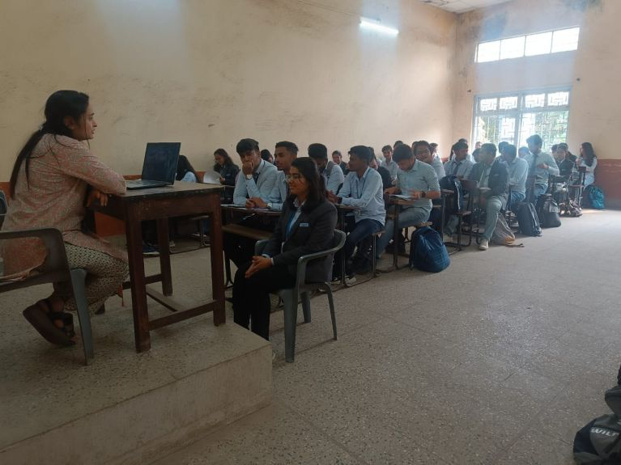
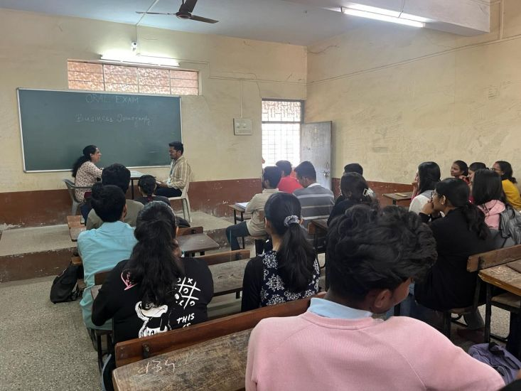
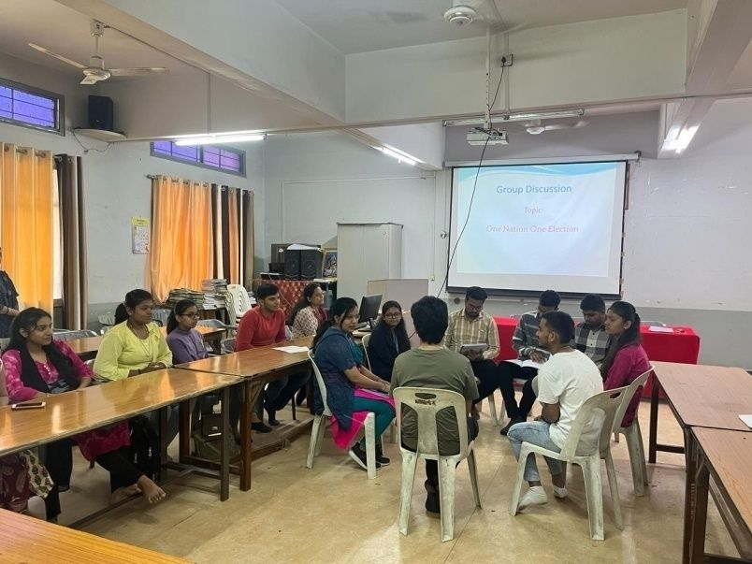
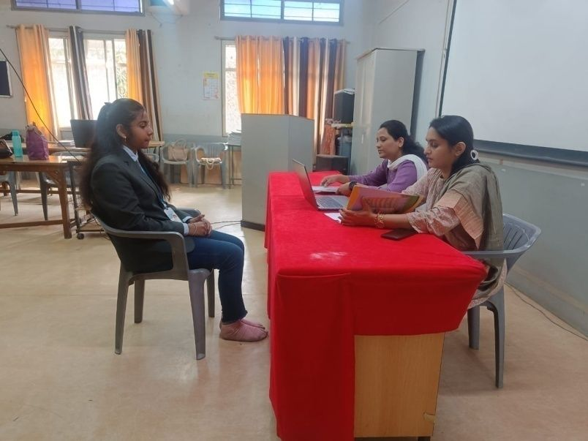
Oral Exam : Commercial Geography FYBBA(IB)
Oral Exam Business Demography FYBBA
Group Discussion BBA, BBA(IB) & BBA(CA) Students
Mock Viva TYBBA & TYBBA(IB)

Slide 23
Case Study
Cases in Finance:
TYBBA Finance
Cases in Marketing:
TYBBA Marketing

Slide 24
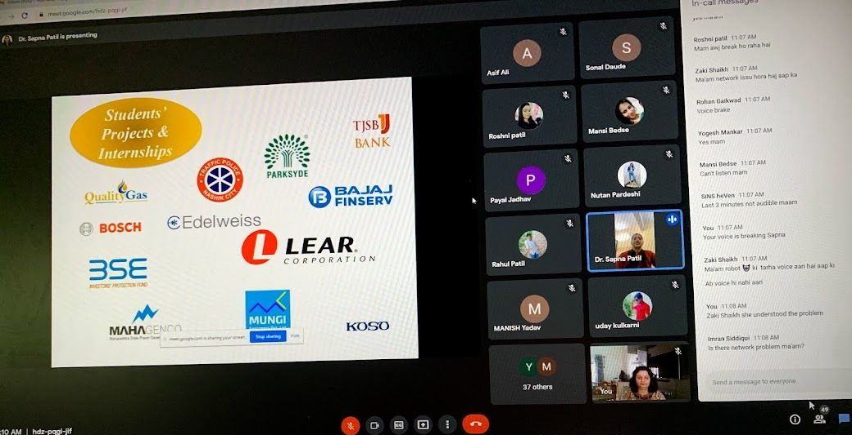
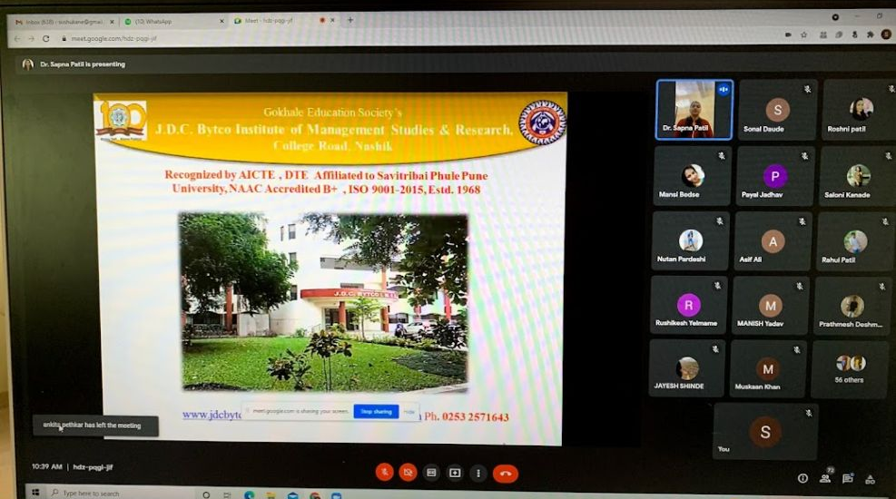
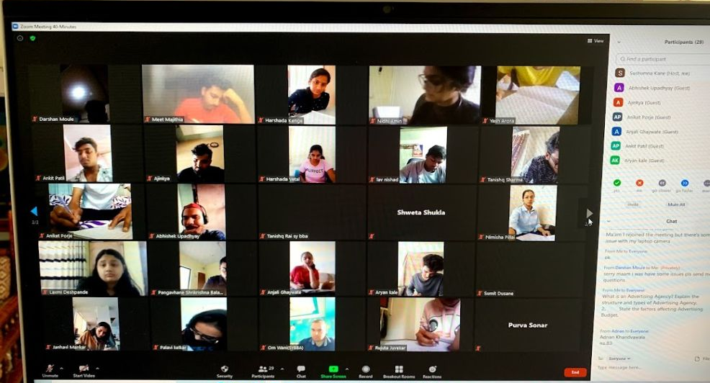
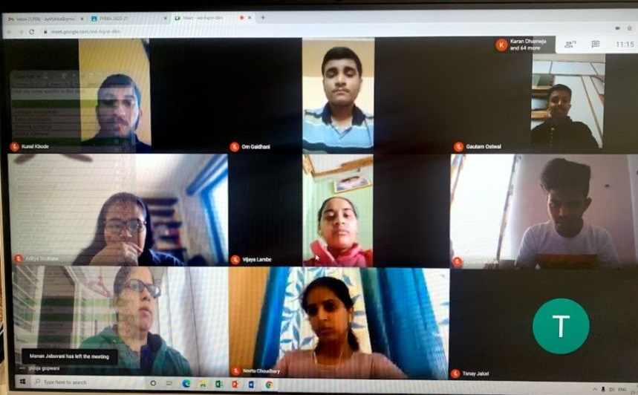
Blended Teaching and Learning
Online Pre Internship presentation of TYBBA(IB) students
Online lecture by Dr Sapna Mathure from JDC Bytco
regarding Career Guidance
Online Class test of TYBBA Marketing students
Online lecture of TYBBA finance students

Slide 25
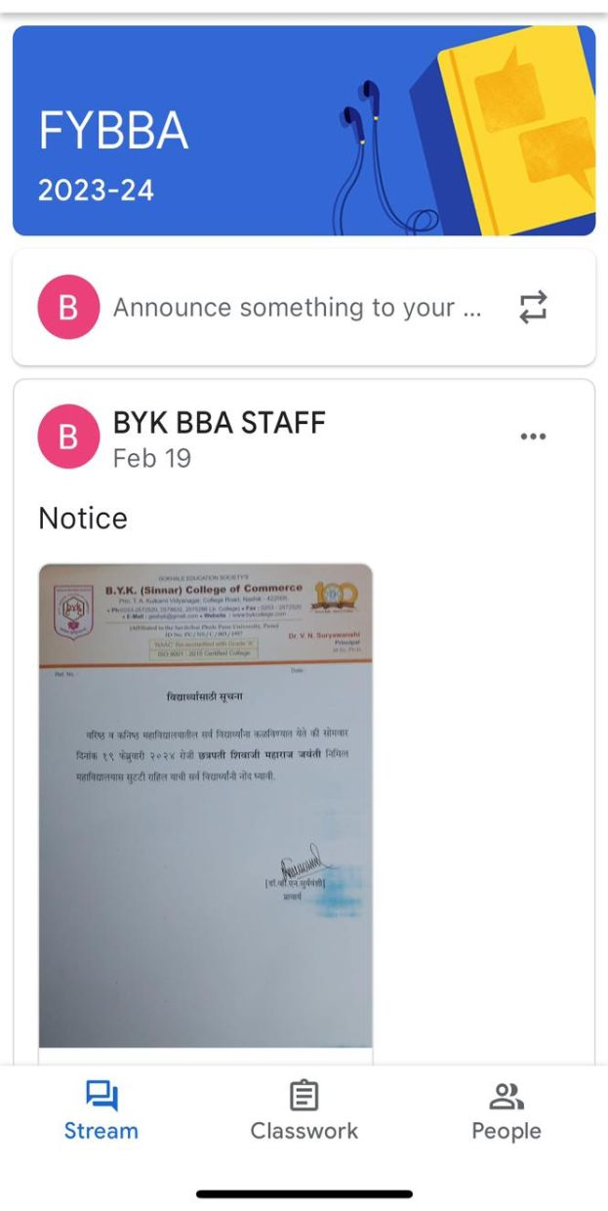
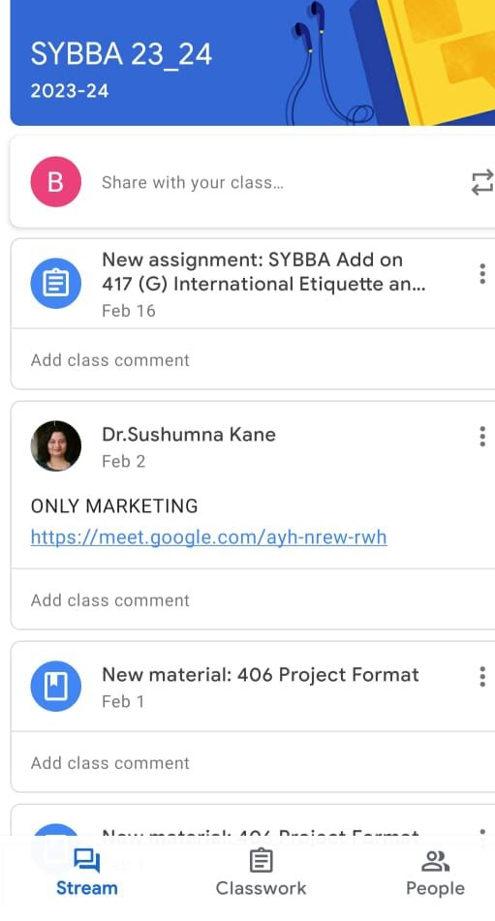
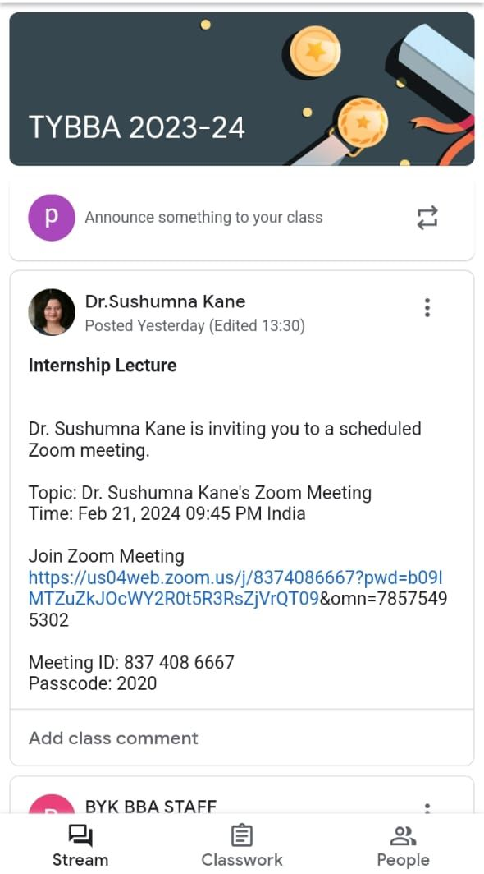
Google Classrooms Created for Blended Teaching BBA

Slide 26
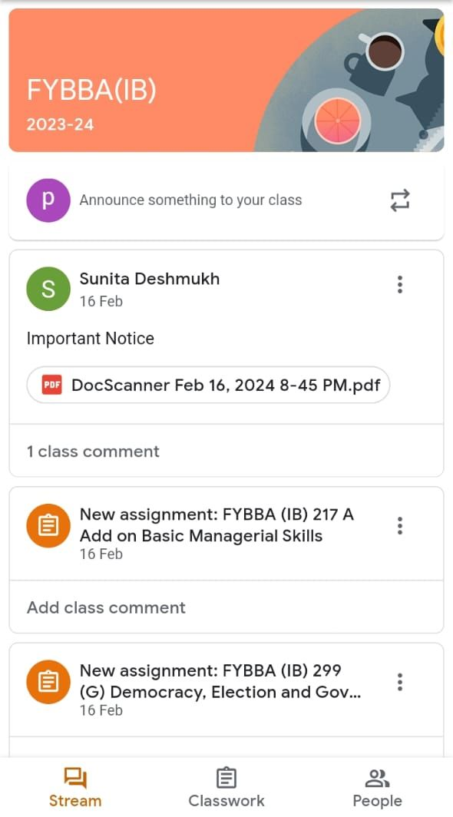
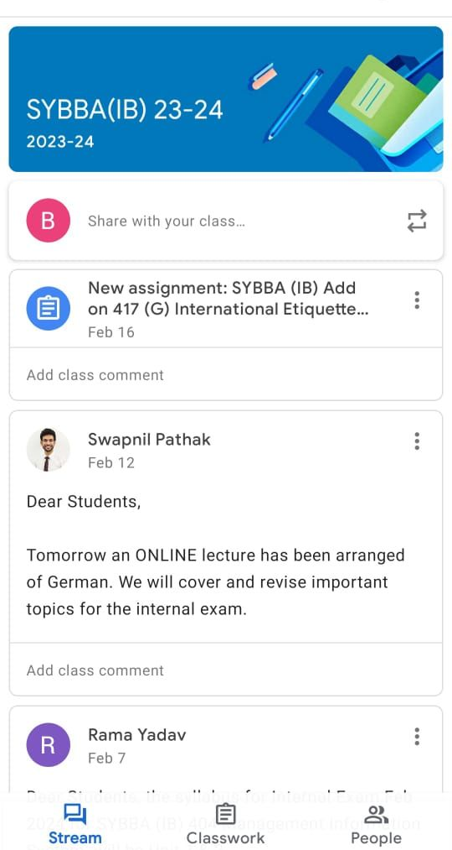
Google Classrooms Created for Blended Teaching BBA(IB)

Slide 27
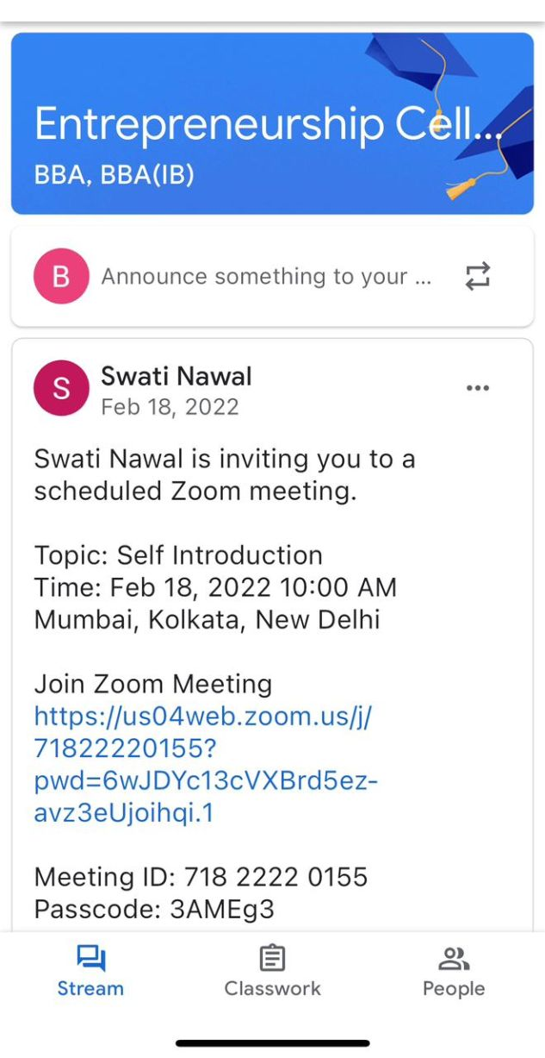
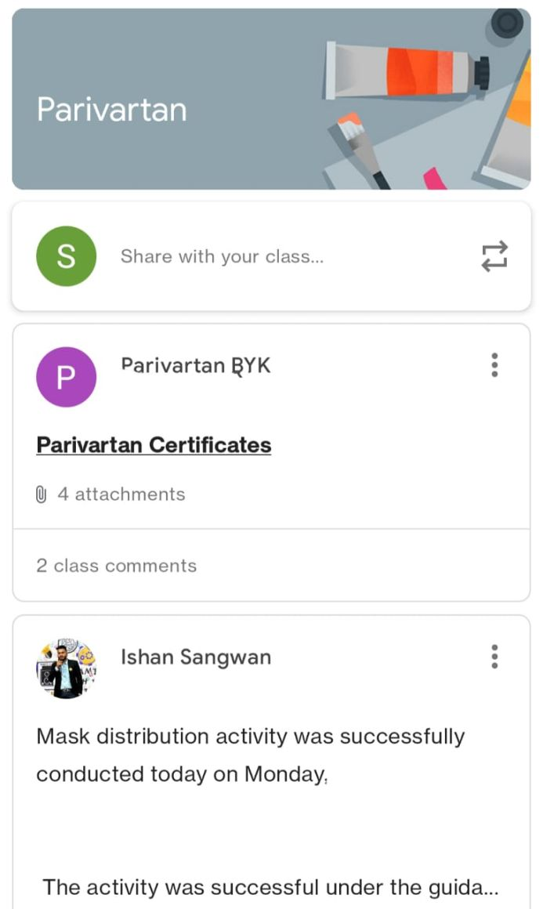
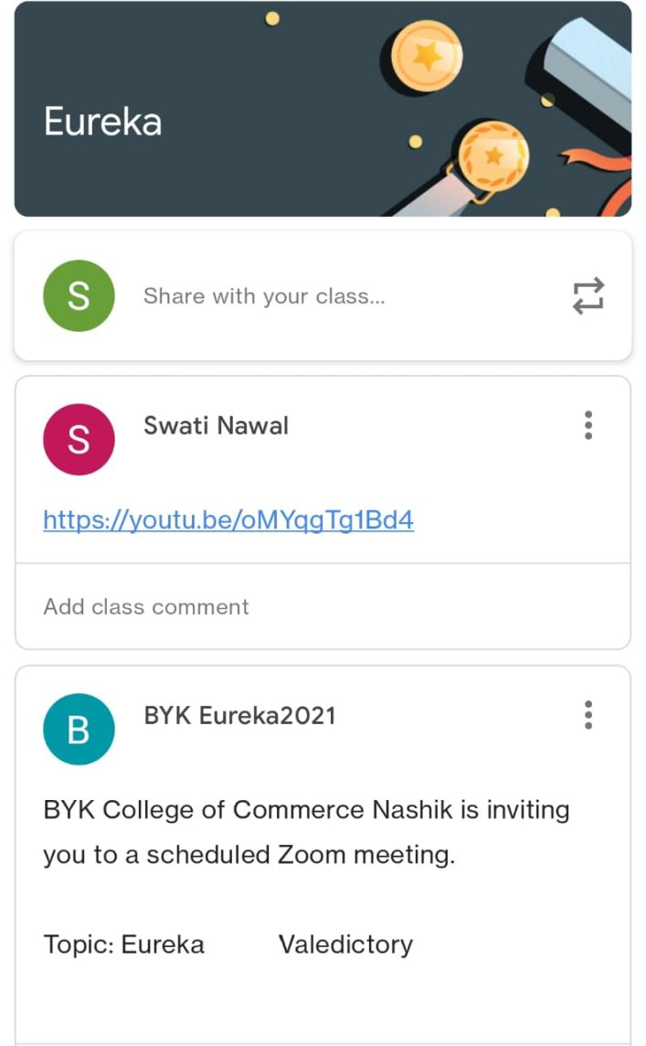
Google Classrooms Created for Extra Academic/ Curricular Activities

Slide 28
Guest Lectures
Year | Name of the Speaker | Topic
2018-19 | Mrs. Sneha Ratnaparkhi | Time Management
2018-19 | Mrs. Geetanjali Gite | Coping with Stress
2018-19 | Dr. K. R. Shimpi | Presentation Skills
2019-20 | Dr. Kanchan Nikam | Business Ethics
2020-21 | Mr. Shishir Sindekar | Basics of Economics
2020-21 | Dr. Ashlesha Kulkarni | Basics of Economics
2020-21 | Dr. Suneeta Pimple | Long term Finance
2020-21 | Mr. Amit Jadhav | Analysis of Financial Statement
2021-22 | Dr. Yogini Dixit | Basics of Economics
2021-22 | Dr. Sonali Chindhade | Advertising and Sales Promotion
2021-22 | Dr. Suneeta Pimple | Cases in Finance
2022-23 | Mr. Nandkishor Shimpi | Right Attitude for Successful Life

Slide 29
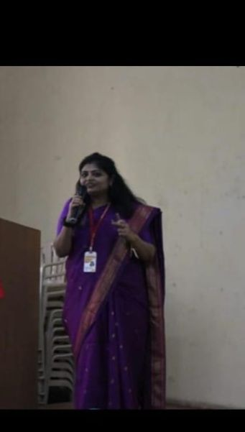
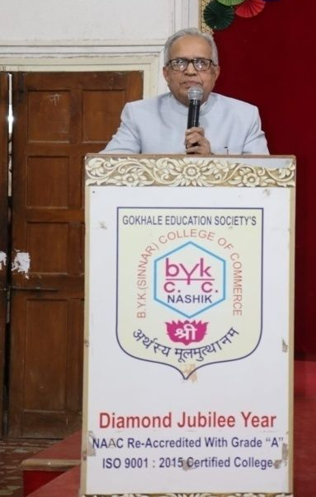
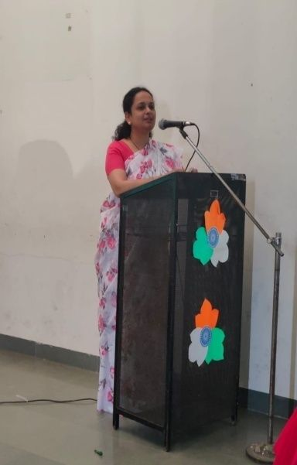
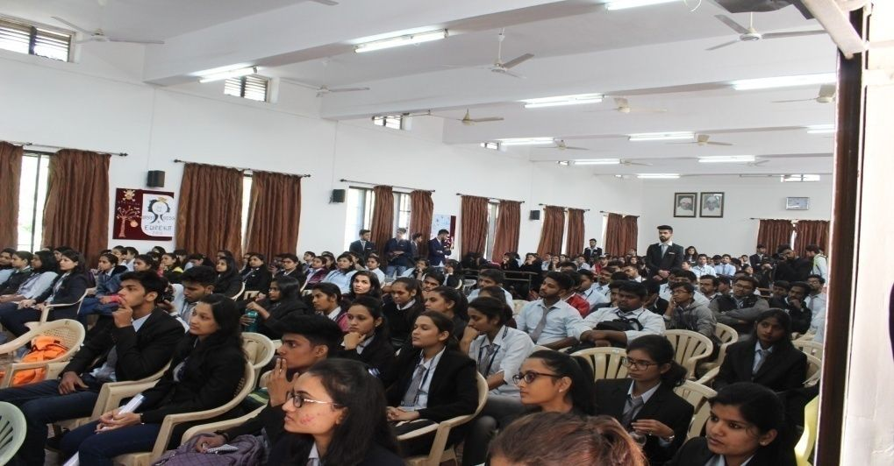
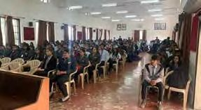
Speakers for Guest Lectures
Dr.Kanchan Nikam
Dr.K.R Shimpi
Dr.Sonali Chindhade
Dr.Yogini Dixit
Students of BBA, BBA(IB) & BBA(CA) attending Guest Lectures

Slide 30
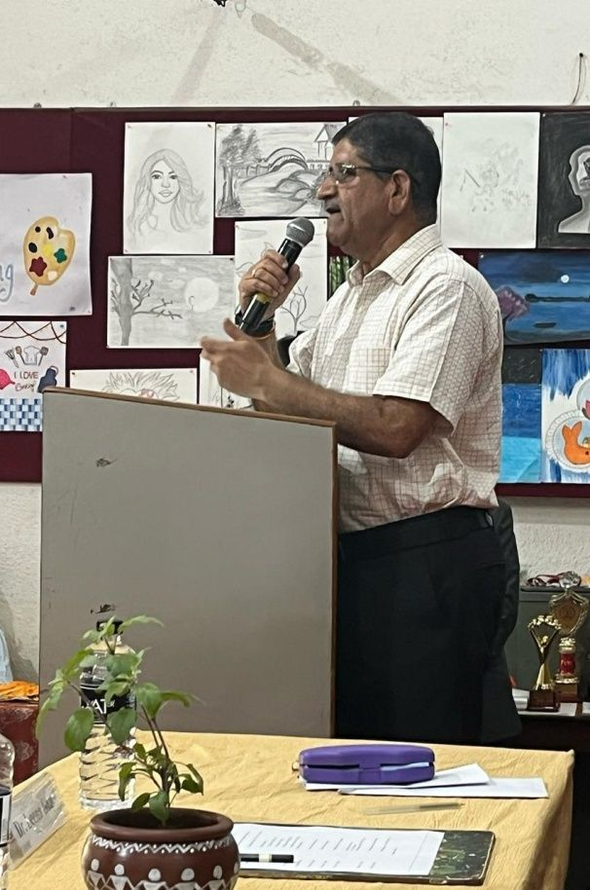
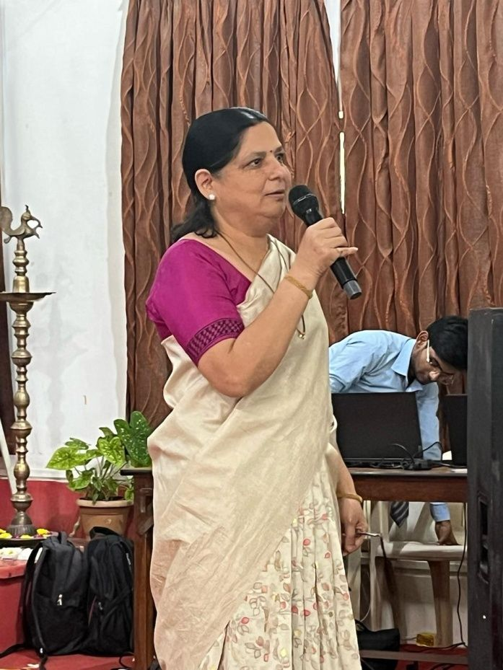
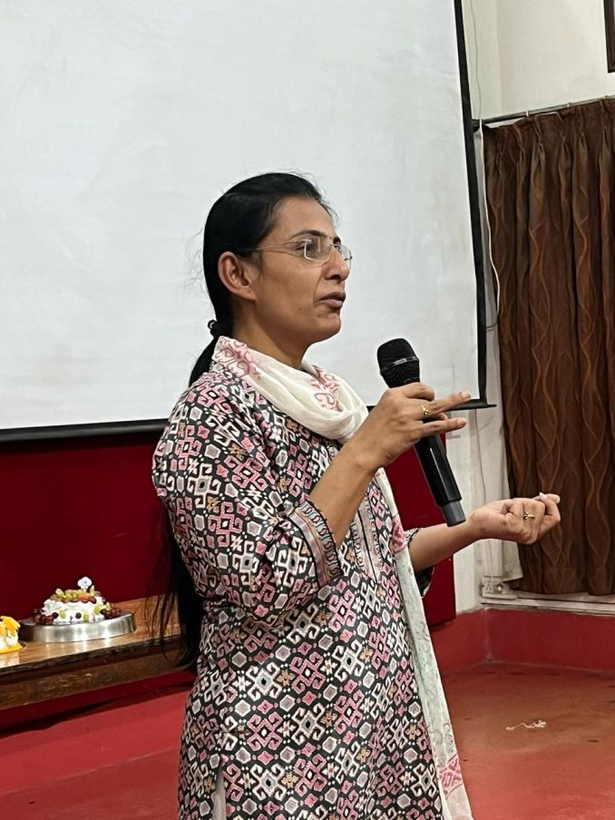
Dr. V.B. Gaikwad, Dean – BCUD, SPPU addressed the students
on “ Opportunities for Career Development
Dr. Sunita Pimpale addressing
TYBBA students regarding
Specialization subjects
Dr. Vibhawari Pawar from CMCS College addressing students
on “ Opportunities for BBA, BBA(IB) and BCA students”

Slide 31
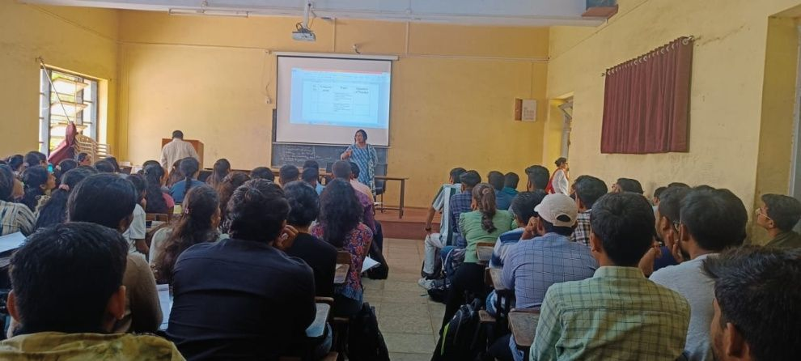
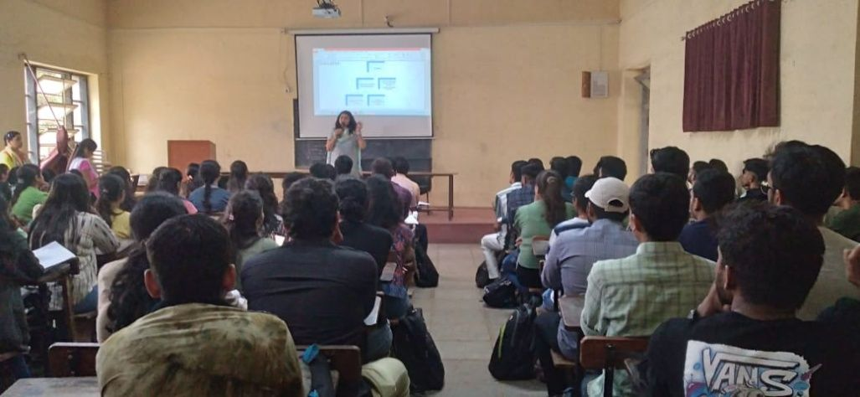
Best Practices BBA, BBA(IB) & BBA(CA)
Internship Meeting of TYBBA Finance Students
Internship Meeting of TYBBA Marketing Students
Internship Meeting of TYBBA(IB) Students

Slide 32
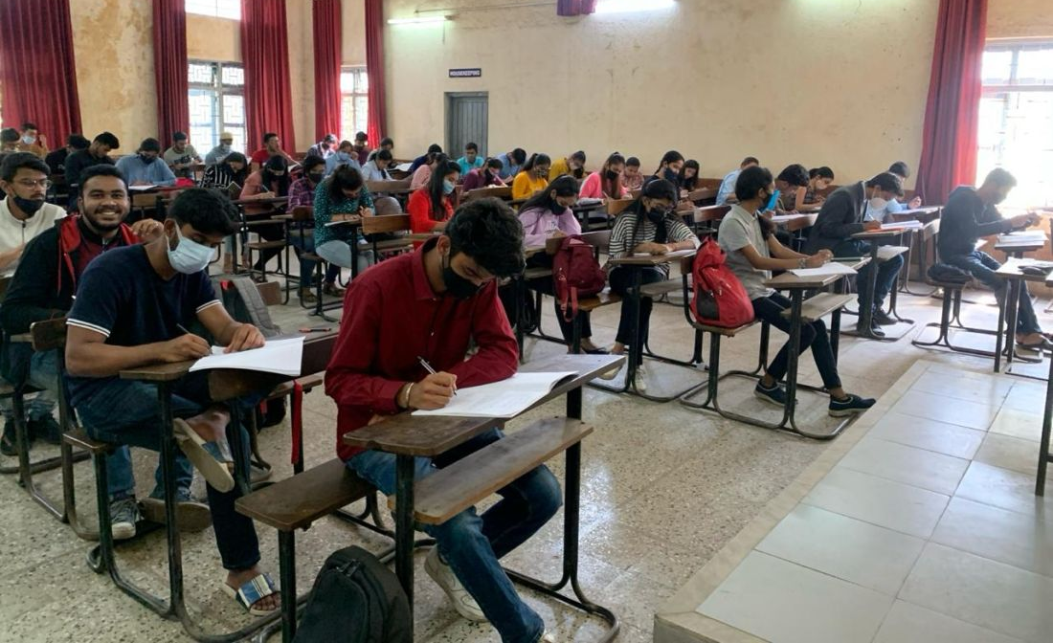
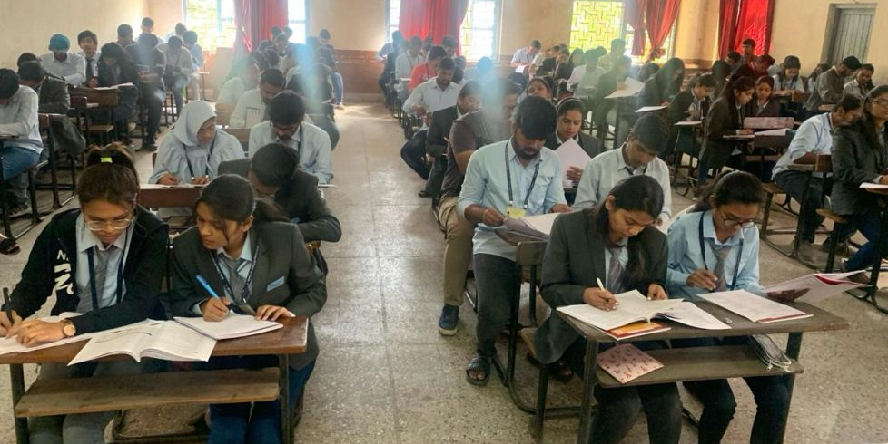
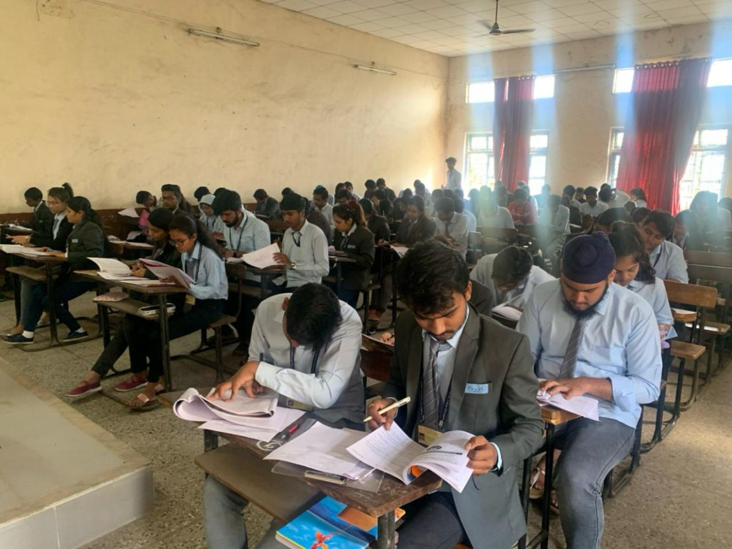
Open Book Test of Students
TYBBA
FYBBA
FYBBA (IB)

Slide 33
Remedial Teaching
Remedial lectures are conducted to assist students in order to achieve expected competencies in subjects where they are less confident or require more understanding or practice.
Students are identified and remedial lectures are conducted for a period of two months in every semester. These students are identified by concerned subject teachers during their regular classroom teaching and overall observation and participation of students in classroom.
Basis of selecting students:
Oral Exam conducted by subject teacher
Involvement of student in classroom
Class test performance
Overall observation of teacher

Slide 34
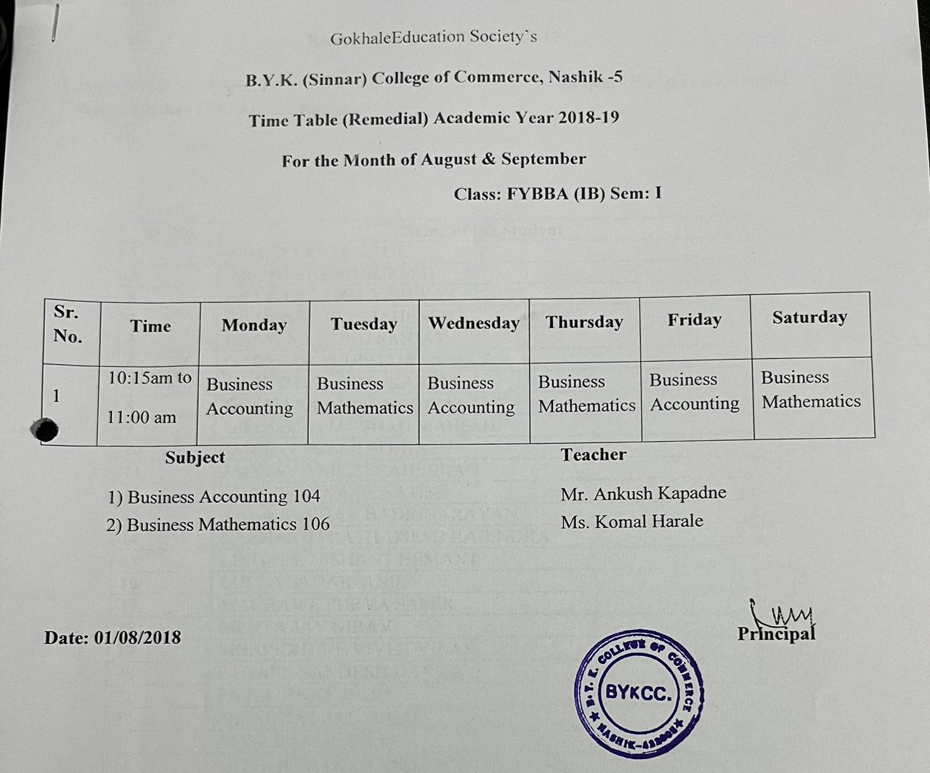

Slide 35
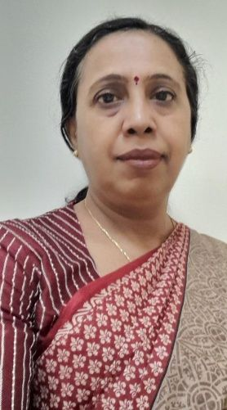
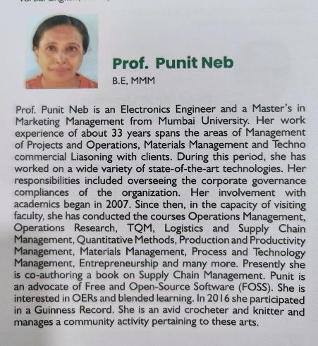
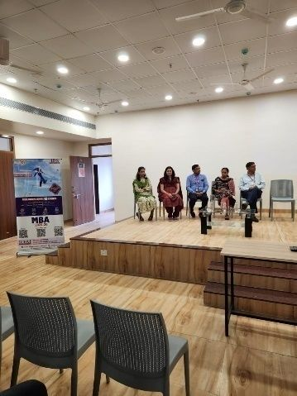
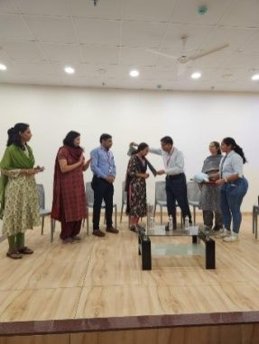
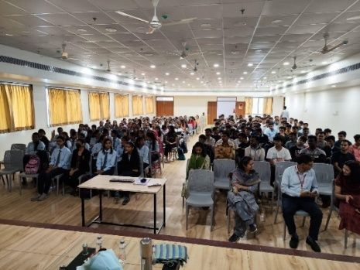
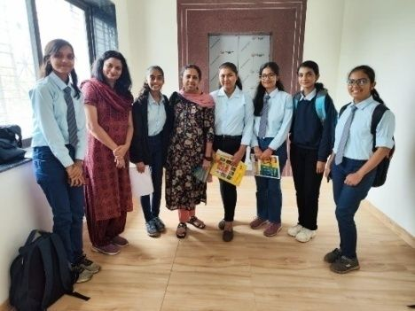
Student Development Program
Prof. Punit Neb addressing the students on Goal Setting

Slide 36
Process of Industrial Visit
Entire class is divided into different groups consisting of 20 students in each group.
Students identify the industries as per their specializations.
An official letter from the college is given to the students for seeking permission for industrial visit in a particular industry.
It is mandatory for the students to give presentations before visiting any industry.
They are also required to submit a copy of their presentation.
The students are accompanied by Faculty during group industrial visits.
The rules for the industrial visit are duly communicated to the students and made sure that they abide by the rules.

Slide 37
Industrial Visit : 2018-19

Slide 38
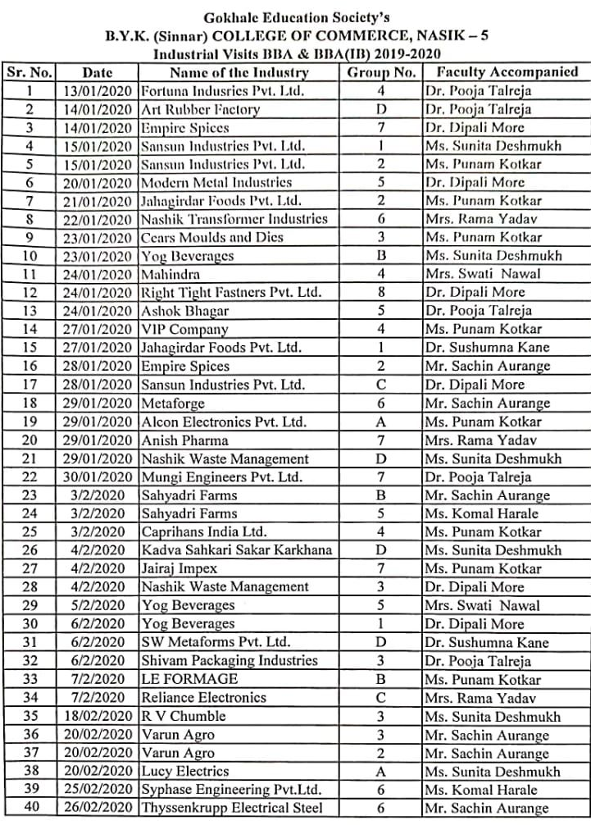
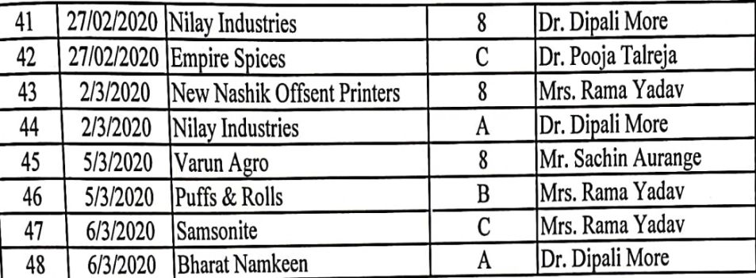
Industrial Visit : 2019-20

Slide 39
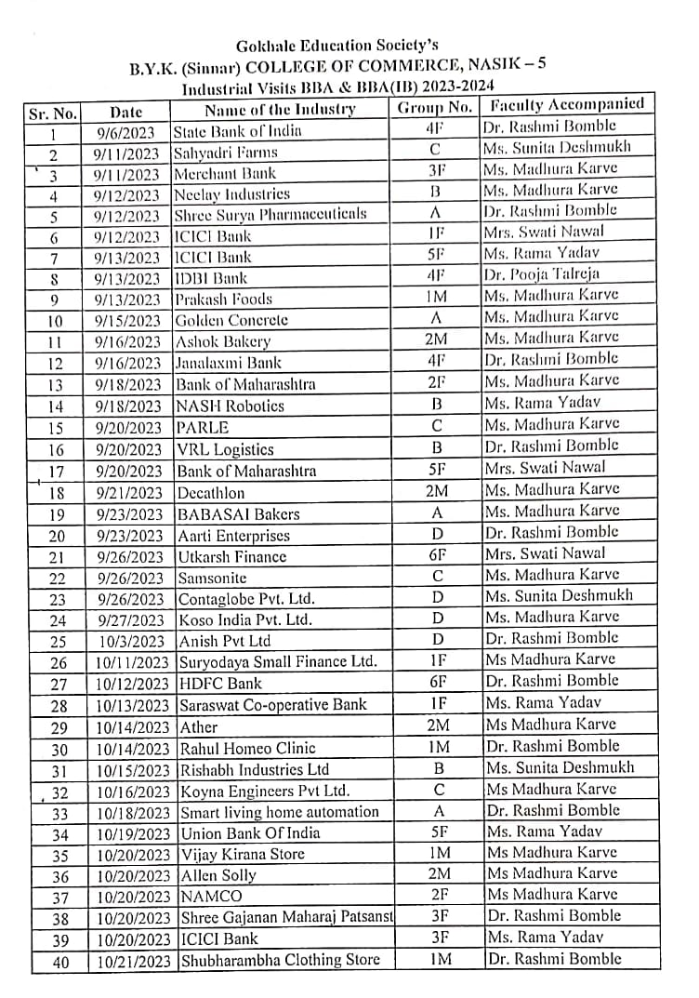
Industrial Visit : 2023-24

Slide 40
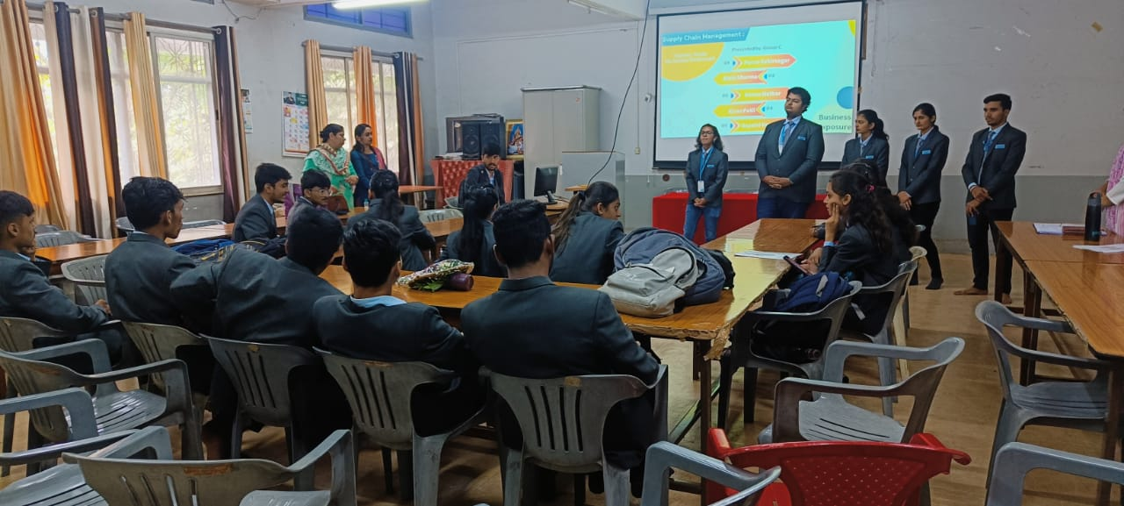
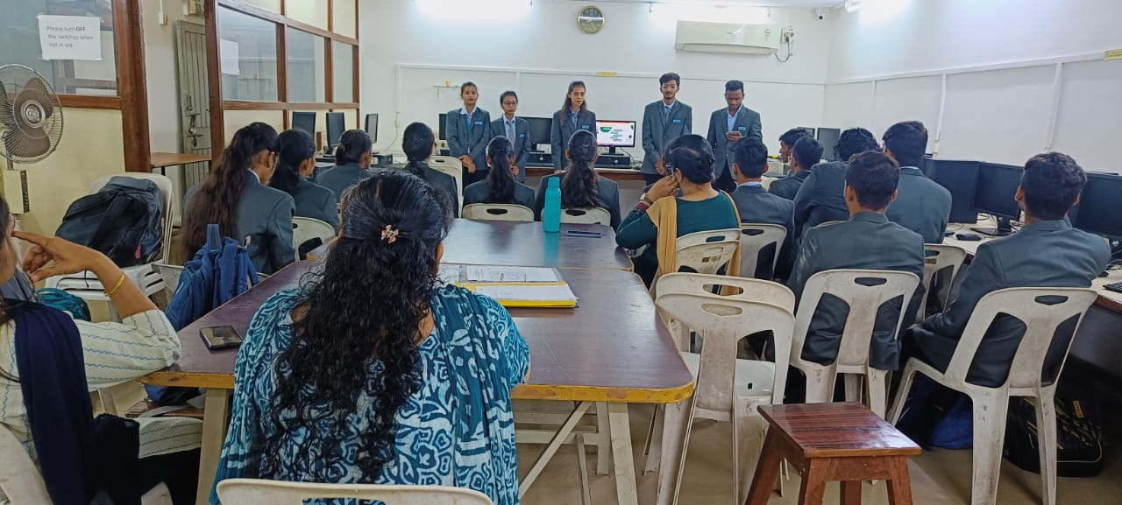
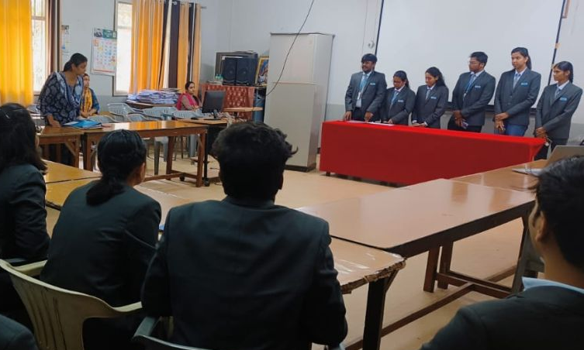
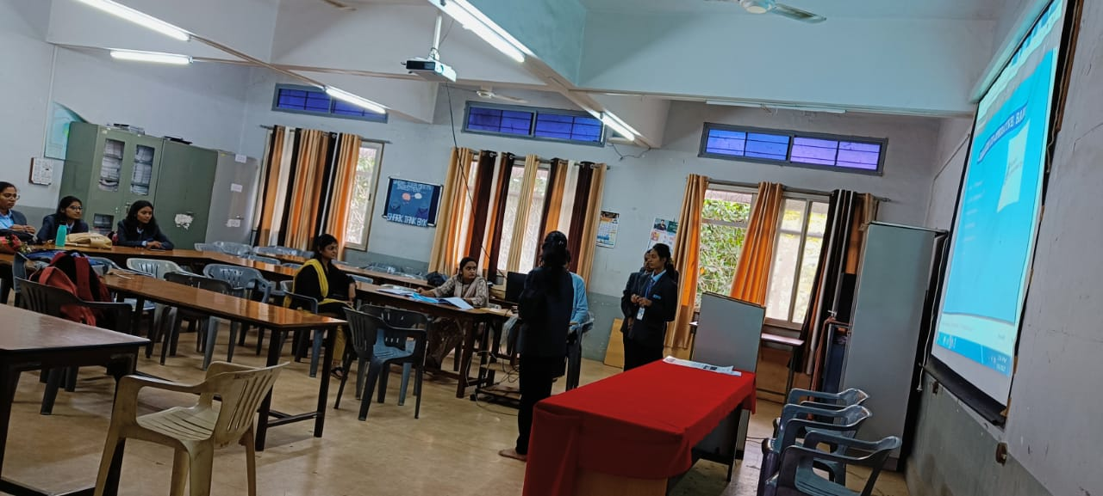
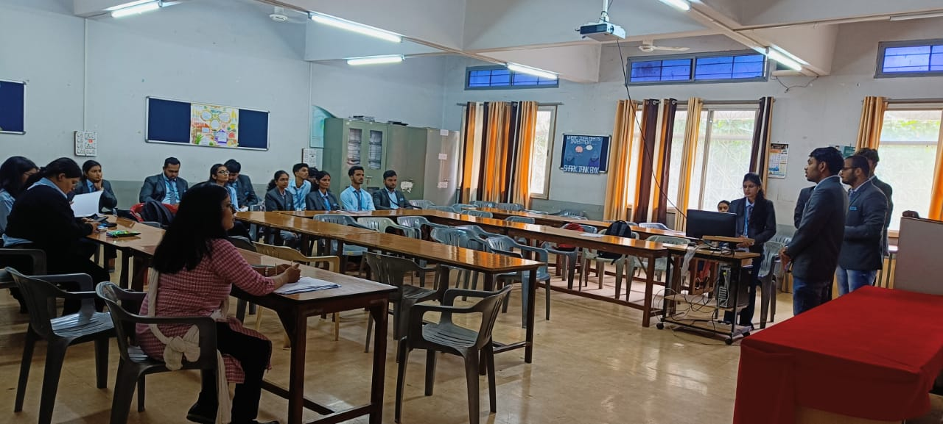
Industrial Visits
Students Group Presentation for Business Exposure
SYBBA (Finance)
SYBBA (Marketing)
SYBBA(IB)
SYBBA (Finance)
SYBBA(IB)

Slide 41
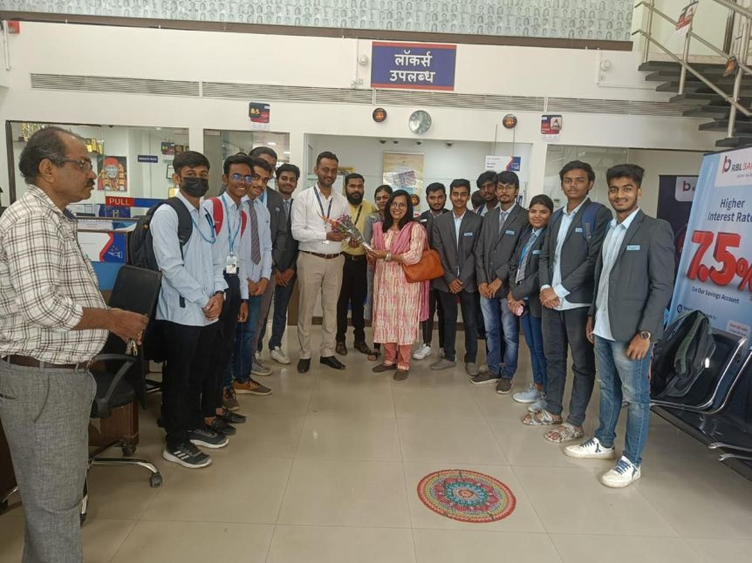
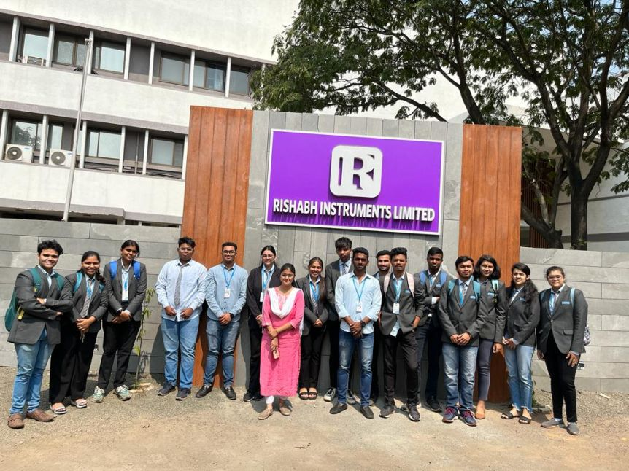
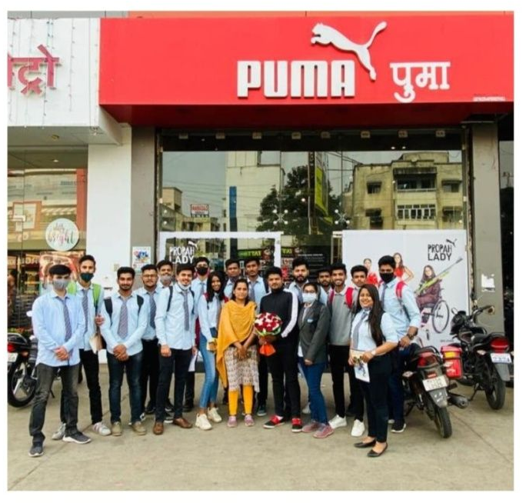
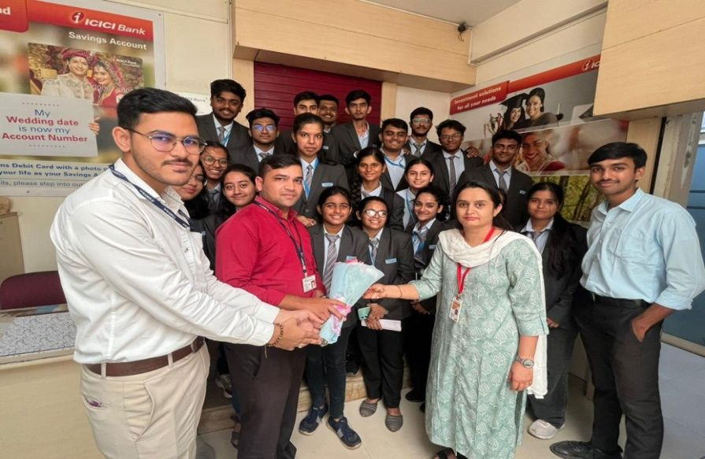
Industrial Visit
Visit to RBL Bank TYBBA Finance
Visit to Rishabh Instruments Limited TYBBA (IB)
Visit to PUMA Retail Outlet TYBBA Marketing
Visit to ICICI Bank TYBBA Finance

Slide 42
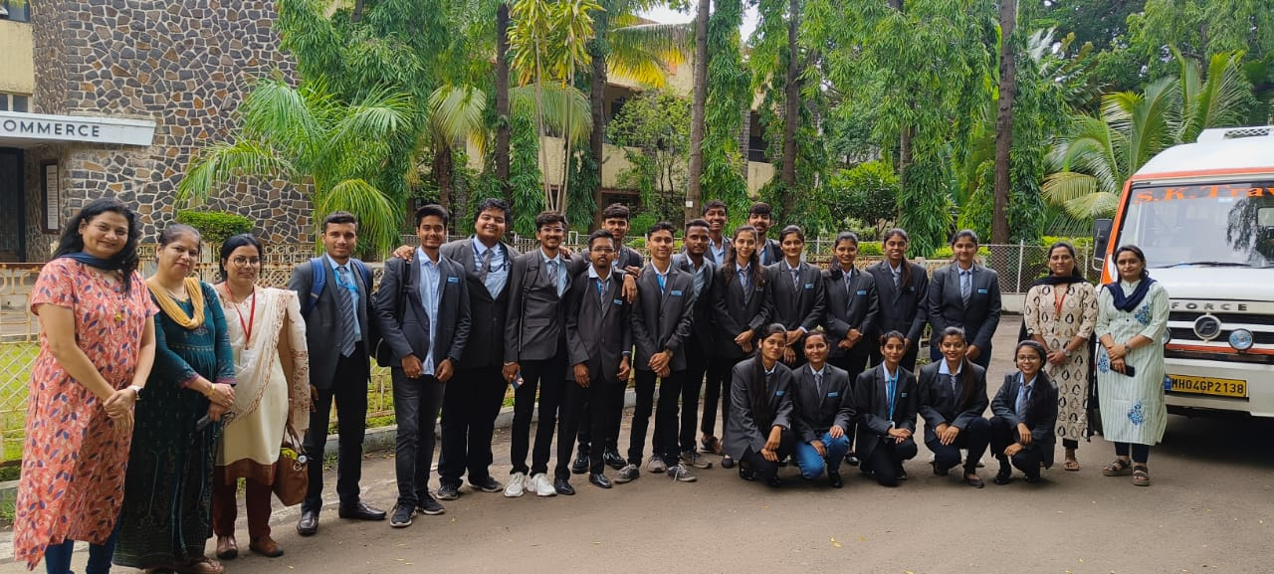
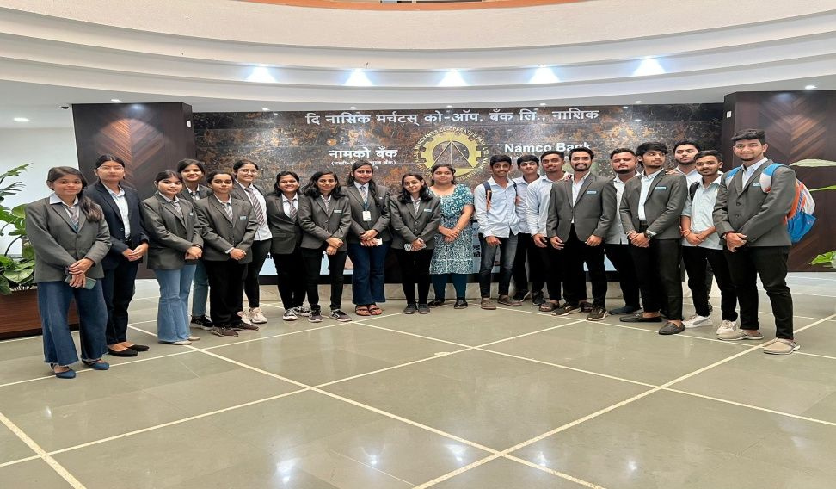
Industrial Visits
Visit to Decathlon TYBBA Marketing
Visit to NAMCO Bank TYBBA Finance
Visit to IDBI Bank TYBBA Finance
Visit to Shayadri Farm : TYBBA(IB)

Slide 43
Individual Presentation of Students : Project
Project Presentation of TYBBA(Finance Student)
Project Presentation of TYBBA(Finance Student)
Project Presentation of TYBBA (Marketing Student)

Slide 44
Events conducted for the
Students of BBA, BBA(IB), BBA(CA)

Slide 45
Guru Purnima & Teacher’s Day Celebration
Prin.Dr.V.N Suryavanshi with performers of Guru Purnima Celebration
on 3rd July 2023
Prin.Dr.V.N. Suryavanshi addressing First year students
Prin.Dr.Ram Kulkarni with performers of Teacher’s Day Celebration
on 13th July 2022
BBA(CA) student welcoming Prin.Dr.V.N. Suryavanshi 2023

Slide 46
Sir Dr. M. S. Gosavi Technomohotsav Management Fest EUREKA
Inaugural of Eureka
Fitness Freak
B.Y.K Shark Tank
Master Chef Eureka
Nachbaliye
Students Attending EUREKA

Slide 47
Sir Dr. M. S. Gosavi Management Fest EUREKA
Winners of Mr. & Miss Eureka
Participants of Fitness Freak
Participants of Role Play
Dr. V.B. Gaikwad, Dean – BCUD, SPPU

Slide 48
Few Posters made by our students for various competitions

Slide 49
Parents participating in Online Eureka
Students participating in B.Y.K Shark Tank
Student performing with Parent
Student Performing during Online Eureka

Slide 50
Sir Dr. M. S. Gosavi Technomohotsav
Web Designing Competition
Black Coding Competition
Scribble Competition
Intercollegiate Software Development
Competition
Scratch Competition

Slide 51
Eureka Alumni Meet -2K23

Slide 52
THE ASCENT
Digital Magazine

Slide 53
Free Medical Checkup for Students of
BBA,BBA(IB) & BBA(CA)

Slide 54
Beyond Academics

Slide 55
Parivartan Club
Visit to NAB Sankul : National Association for Blind
30th October 2021
August 2021

Slide 56
Tree Plantation near Someshwar

Slide 57
Visit to Old Age Home : Late Anuradha V . Dharmadhikari Old Age Home
Birthday Celebration @ Dayasagar Social Trust
Vridharshram

Slide 58
Visit to Orphanage near Trimbakeshwar September 2018
1200 litres of Mineral Water was sent to the Flood
affected people at “Sangli“ in collaboration with Alumni by the students on 14th August 2019

Slide 59
Visit to Z.P. SCHOOL, JAMBHULWADI
Date: 18th January 2023

Slide 60
Distribution of Clothes in Kalmusthe Village
Date: 23rd February 2022

Slide 61
More than 7000 Mask Distribution and Sanitizers were distributed by the students of BBA, BBA(IB) & BBA(CA) along with Alumni in the year July 2021

Slide 62
Food Distribution by TYBBA Students

Slide 63
Entrepreneurship Cell
Aims & Objectives
Inculcating the spirit of 'Entrepreneurship' in students.
To make students Industry-Fit
To prepare students as per the fast changing Industrial Scenario.
To apprise students to face Global Competition.
Activities
Goal Setting
Business Plan : Presentations by students
Meet the Entrepreneur
Exhibitions
Corporate Lecture Series
Fiesta

Slide 64
Business Plan Presentations by Students of Entrepreneurship Cell

Slide 65
Meet the Entrepreneur & Corporate Lecture Series
Dr. K.R. Shimpi
Mr. Piyush Somani
Mr. Somnath Rathi
Mrs. Nilu Somani

Slide 66
Exhibitions
Aditi Dharmadkahari -TYBBA(CA) Product Organic Incense Sticks
Daksh - TYBBA(CA)
Product/ Service: Dry-cleaning
Viren Jamdar - SYBBA: Product TOFU
Dipesh Panjwani - TYBBA
Product: Chocolates
Mayur Mundada - TYBBA Product: Cereals
Aditya Dargode SYBBA
Product: Agri Resort

Slide 67
Fiesta
Dr. Hemant Kochargaonkar with the Participants of Fiesta

Slide 68
Students Achievement: Sports
Sandesh Mokal from F.Y. BBA
secured 1st position in cycle race
Sanchi Shrinivas GangurdeClass TYBBA ,SNBP Hockey Tournament 2nd Position
Ajinkya Patharkar student of
TYBBA 2021-22 batch

Slide 69
Shiya Lalwani International Cyclist from FYBBA

Slide 70
Anushka Ghaywate FYBBA(IB)
Recognized as INDIA'S YOUNGEST BADMINTON CERTIFIED COACH 2022
Having learned and earned her qualification from Badminton world Federation and
INTERNATIONAL OLYMPIC COMMITTEE. She has been selected for the
INTERNATIONAL INDO-NEPAL series organized by the
YOUTH GAMES COUNCIL OF INDIA and will represent INDIA on 8th of February 2023.

Slide 71
Student Achievements BBA(CA)
Kautubh Aware of TYBBA (CA) won 1st Prize in Webosoft Competition
at Ashoka College, Nashik
Durga Nandurdikar participated in
State Level Fencing Competition
Sonal Patil, TYBBA Batch 2022-23
got selected in IIM, Kolkata

Slide 72
Placement of Students Year2022-23
 | PLACEMENT OF STUDENTS YEAR 2022-23
Sr. No. | Name of the Student | Organisation
1 | Satyajeet S. Jadhav | Buzzworks
2 | Shafaque I. Patkari | St. Xavier's Technical Institution
3 | Rahul D. Patil | Navneet
4 | Sakshi A. Varade | Modern Space Interiors
5 | Raj Chhajed | Neelay Industries
6 | Desmond Abraham | Gallop Shiping Co.LLC
7 | Gokul V. Patole | Tahasil Karyalaya
8 | Shreekrishna Gavane | D.Y. Patil Vidyapith
9 | Aditya Gadekar | Coforge Ltd.
10 | Harsh Hirani | Kings Research
11 | Om Wani | Om Pooja Electronics
12 | Devesh Despande | Kogta Financial
13 | Ninad Nikam | HDFC Life
14 | Shweta Kamble | Mahatma Gandhi VidyamandirHead Office
15 | Rahul Satpute | Atharva Institute of Management
16 | Devanshi Ved | Revolut
17 | Rishab Soni | BFSI
18 | Latesh | Subway
19 | Naman singh | Bellweather
20 | Uneeb Shaikh | University of South wales
21 | VRAJ PATEL | Expert Slot Booking
22 | Fardeen Atik Khan | Superb Technologies
23 | Monish pradip kankariya | Navkar Trading Company
24 | Kunal Warghade | University of Sarthclydde Glasgow
25 | Adi jategaonkar | Zed Certification
26 | Rohan Ghare | Kafehr
27 | Ishan Sangwan | Grow More Degital Marketing & Consultancy
28 | Mansi Pagare | University of Greenwich
29 | Chaitanya Jadhav | The Times Of India Group
30 | Shubham Unawane | Rialtes
31 | Ruchita Tidke | Atlas ISME
32 | Mansi Kshatriya | Imarticus Learning
33 | Daivik Vasant | Sonal Polymers

Slide 73
https://docs.google.com/forms/d/e/1FAIpQLSepXPqwlVY6SY5DTpMRDPWrxcgPNdGEWry83wSemryoBuZiOw/viewform?usp=sf_link

Slide 75
Faculty Research & Development
Attended Inter- National Level Seminar | 11
Attended National Level Seminar | 30
Attended State Level Seminar | 26
Research Paper Presented / Published | 67
Number of Chapters Published in edited books | 2
MBA | 4
Ph.D. Holders | 3
M.Phil. | 1
Net/Set Qualified | 1
Mooc | 38
Guest Lectures | 7

Slide 76
Staff Achievement
Dr. Sushumna Kane : Guest Lecture
on Presentation Skills on 10/10/2023
Dr. Sushumna Kane : Guest Lecture on Entrepreneurship in HPT Arts and RYK Science College

Slide 77
Team Building
Enjoying Misal
Computer Pujan on the Occasion of Dussehra

Slide 78
SWOC Analysis
Strengths
Dynamic Students
Weakness
Less representation of students in other State level Competitions.
Challenges
Fast changing Industrial Scenario
Opportunities
Smooth Journey from Campus to Corporate
Strong B.Y.K Brand
Excellent & Hardworking Faculty
360 Degree Student Development – NEP 2020 Vision
Strong Alumni
Entrepreneurial Prospects for Students
Adaptability to face the Competitive World
Global Competition
Making Students Industry-Fit.
No Industry Visits outside Nashik City

Slide 79
Future Plans
To conduct National & State Level Student Seminar
To sign MOU with MNC’s for Student’s Internship
To start Certificate Course in Advance Research Methodology

