Slide 1
6.3.1 The institution has performance appraisal system, effective welfare measures for teaching and nonteaching staff and avenues for career development/progression
Welfare measures for teaching staff
Employees Provident Fund as per PF rules
Increment of 5000/ for Non Grant teachers after they are awarded with Ph.D. degree
Medical reimbursement facility to all the teaching staff
Maternity Leave to as per the service rules of the institution and the government
Faculty members are eligible for Earned Leave, Advances salary for CHB teachers, Non Grant teachers and administrative staff is available
Gratuity for the employees of the institution
Credit Cooperative Society
Free health check-up camps
Motivational Awards
Staff Academy
Staff Training Academy at GE Society level
Welfare measures for non-teaching members
Employees Provident Fund as per PF rules
Maternity Leave for women
Medical reimbursement facility is provided to all the non teaching staff
Free health check-up camps
Free uniforms for class IV employees
Credit Co-operative Society
Motivational Awards

Slide 2
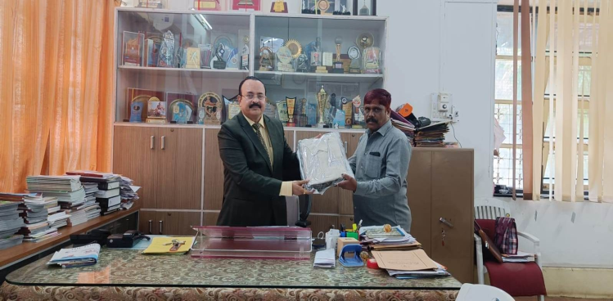
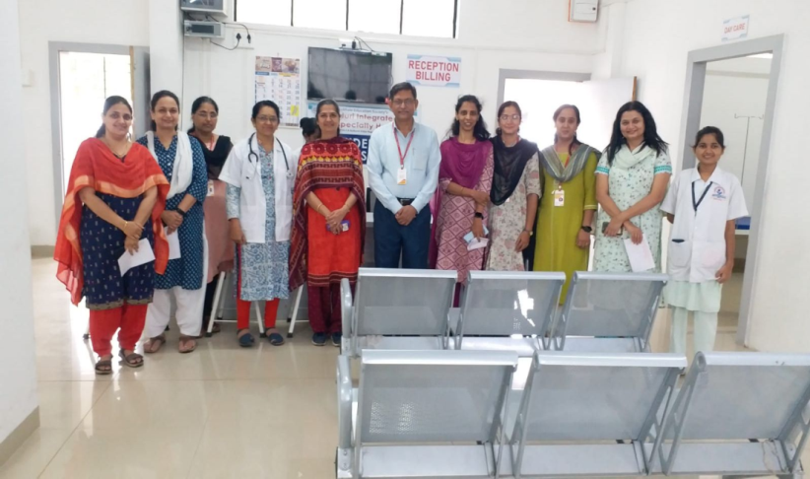
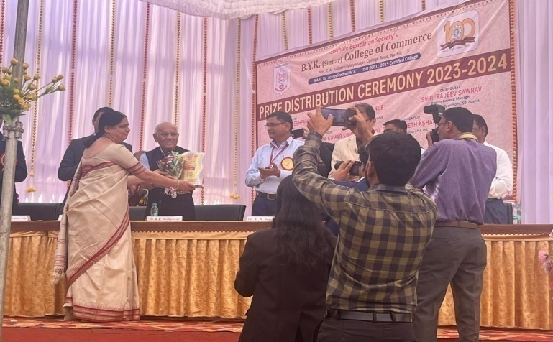
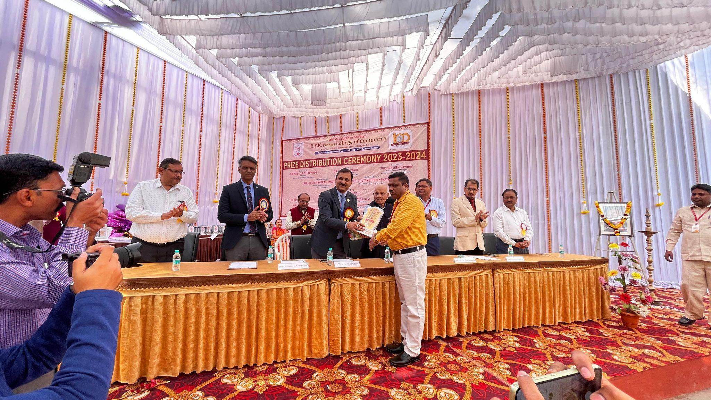
6.3 Faculty Empowerment Strategies
Uniform Distribution
Free Medical Check up of Staff
Motivational Awards: Best Teacher (2022-23)
Motivational Awards: Best Employee (2022-23)

